Slide 2
Biodegradation and Bioremediation University Of Sargodha

Slide 3
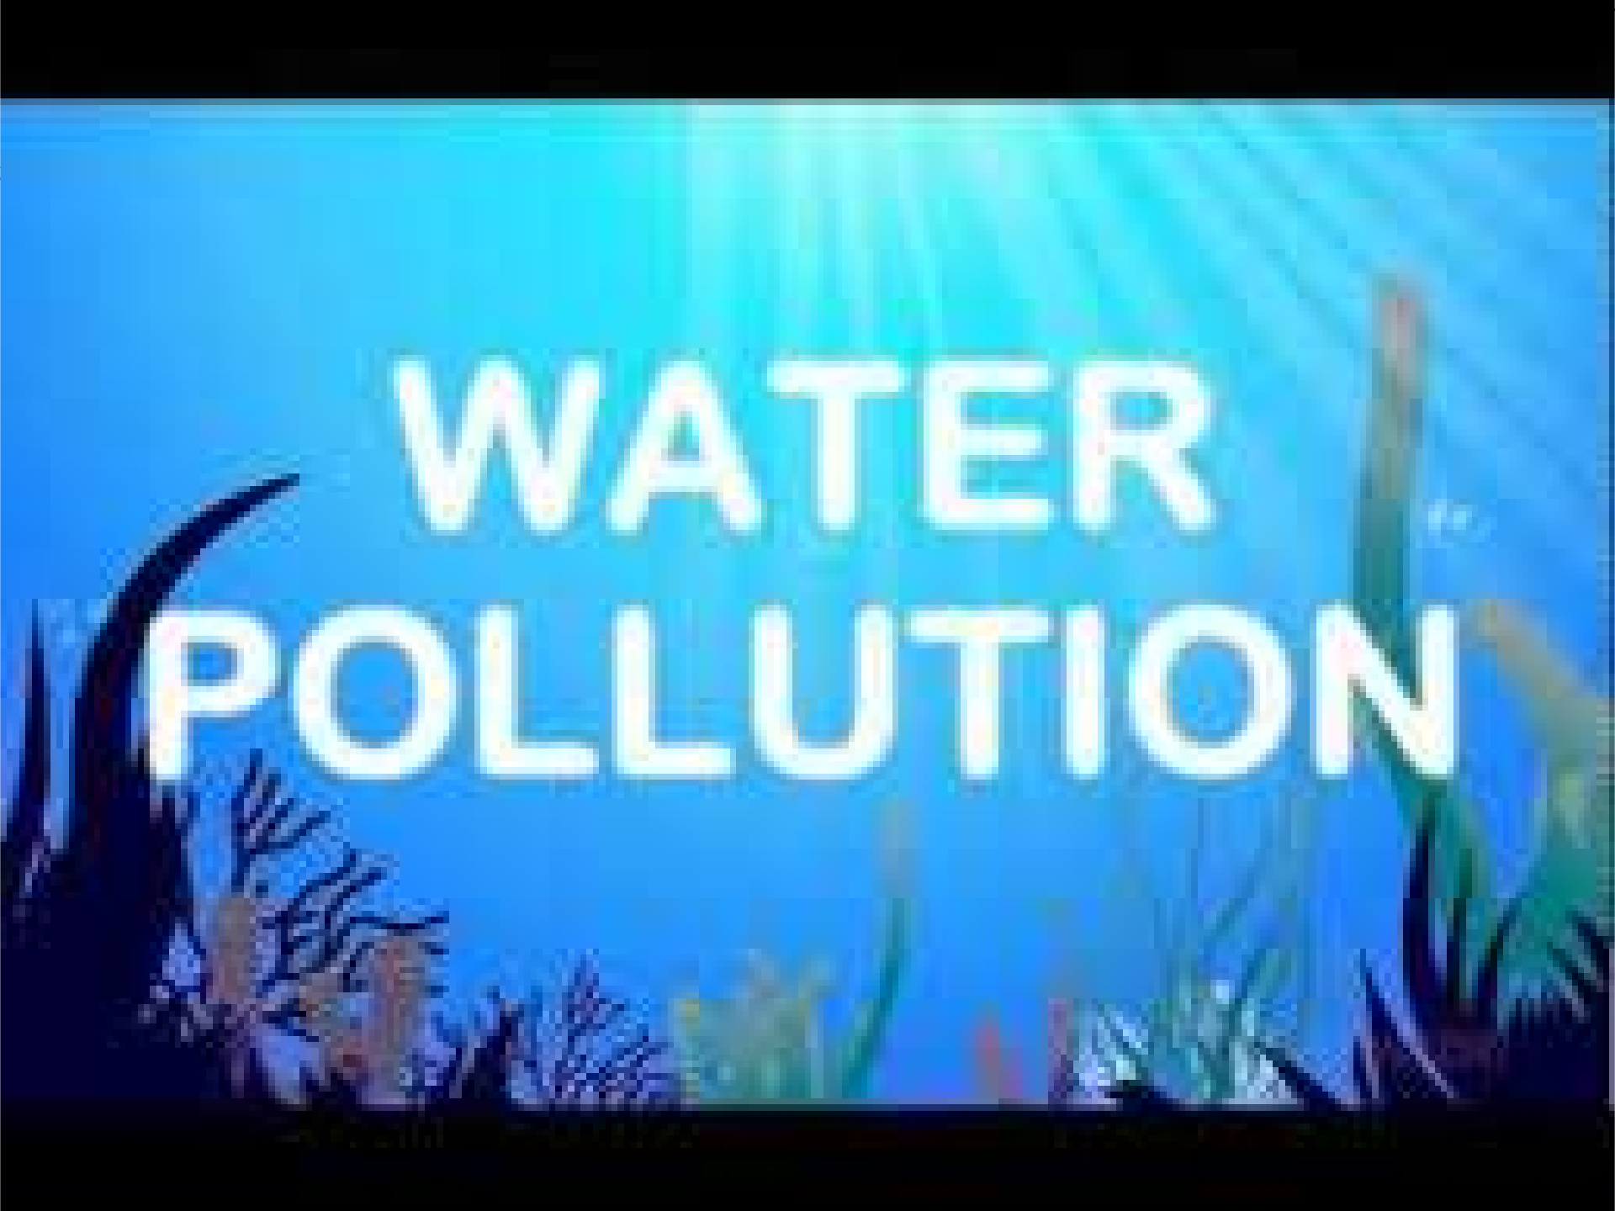

Slide 4
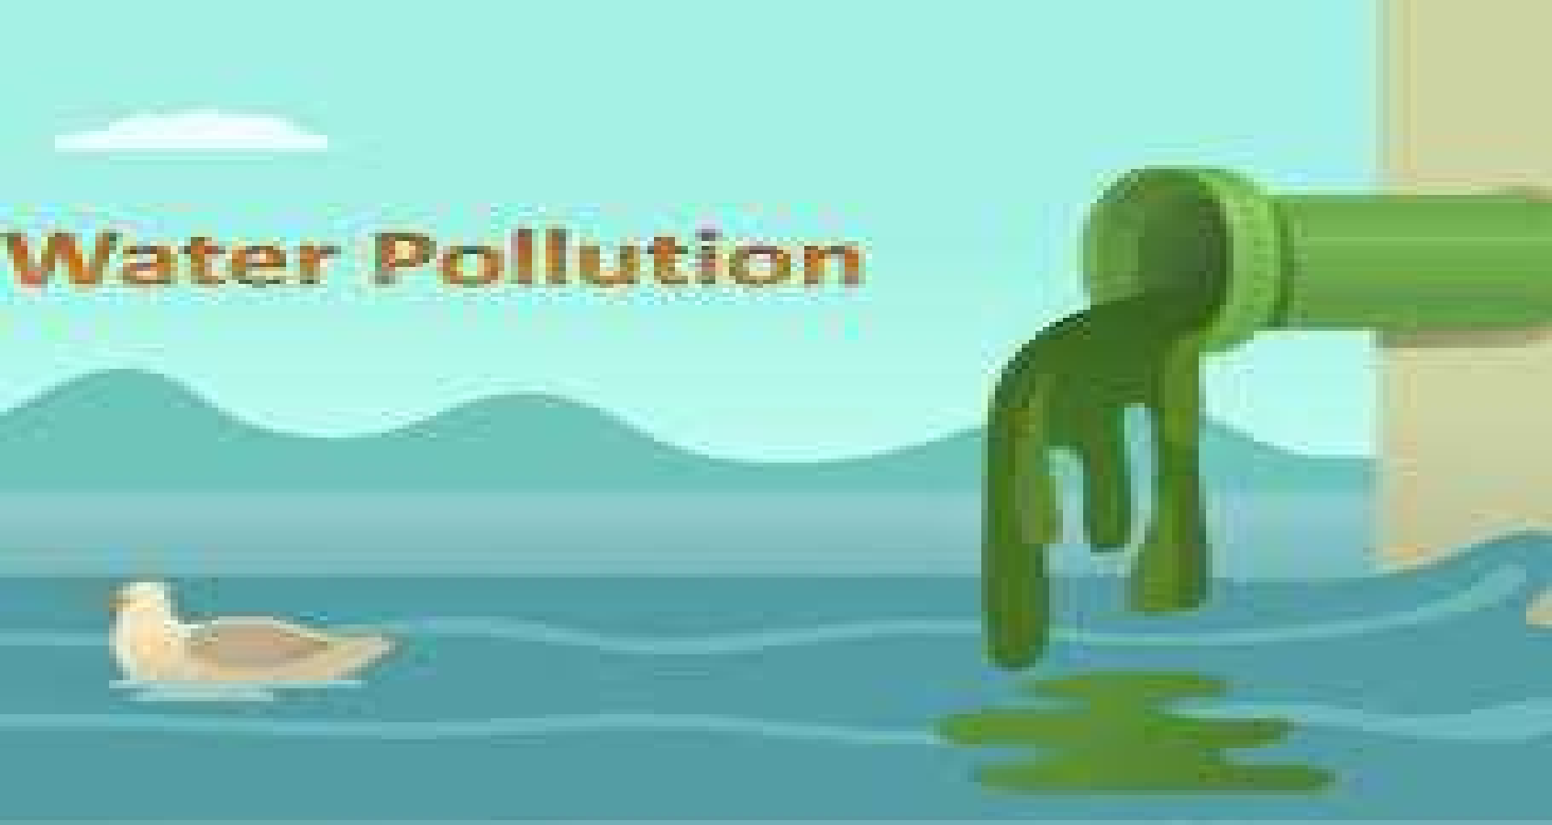

Slide 5
Contents
Introduction
Definition of water pollution
Causes of water pollution
Effects of water pollution
Measures of control
Reference

Slide 6
INTRODUCTION
Water is a precious resource and without it life is not
possible on earth.
Water is getting polluted day by day due to excessive and careless use so the percent of available drinking water is reducing.
There are many ways which causes water pollution and the effects of it are very harmful for all living and non living objects.

Slide 7
Water Pollution
Water pollution can be defined as presence of solid, liquid or gaseous contaminants in such concentration that may alter the quality of water.
Water pollution is defined as the addition to water of an excess material or heat that is harmful to the living organism or which impairs the beneficial use of water.

Slide 8
Causes of Water Pollution
The principal sources of water pollution resulting from exploration and production operations are:
Domestic waste
Sewage System
Solid Waste
Industrial Waste
Acid Rain
Oil Industry
Aquatic Plants

Slide 9
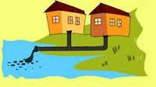
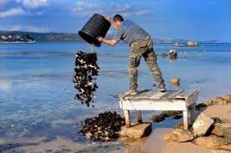
Causes of water pollution
1. Domestic waste
Dumping of household waste into water.

Slide 10
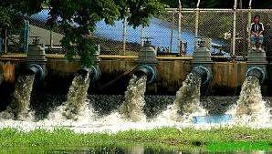
Causes of water pollution
2. Sewage waste

Slide 11
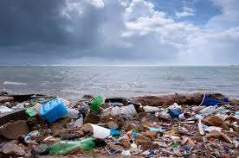
Causes of water pollution
Solid waste
Solid waste causes blockage in flow of water.
It causes water as well as air pollution.
Polythene is the main solid waste.

Slide 12
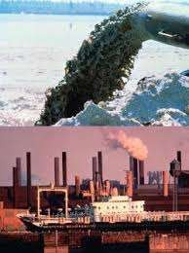
Causes of water pollution
4. Industrial waste
Industrial waste containing paper waste, rubber, metallic, aluminium waste etc. is drawn directly into water which pollutes water.

Slide 13
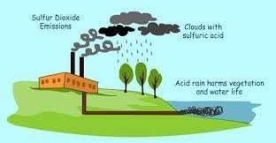
Causes of water pollution
5. ACID RAIN

Slide 14
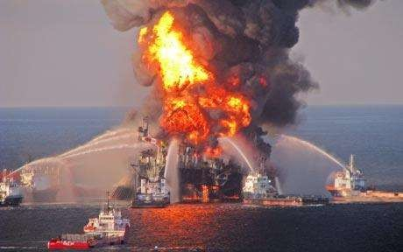
Causes of water pollution
6. Oil Industry

Slide 15
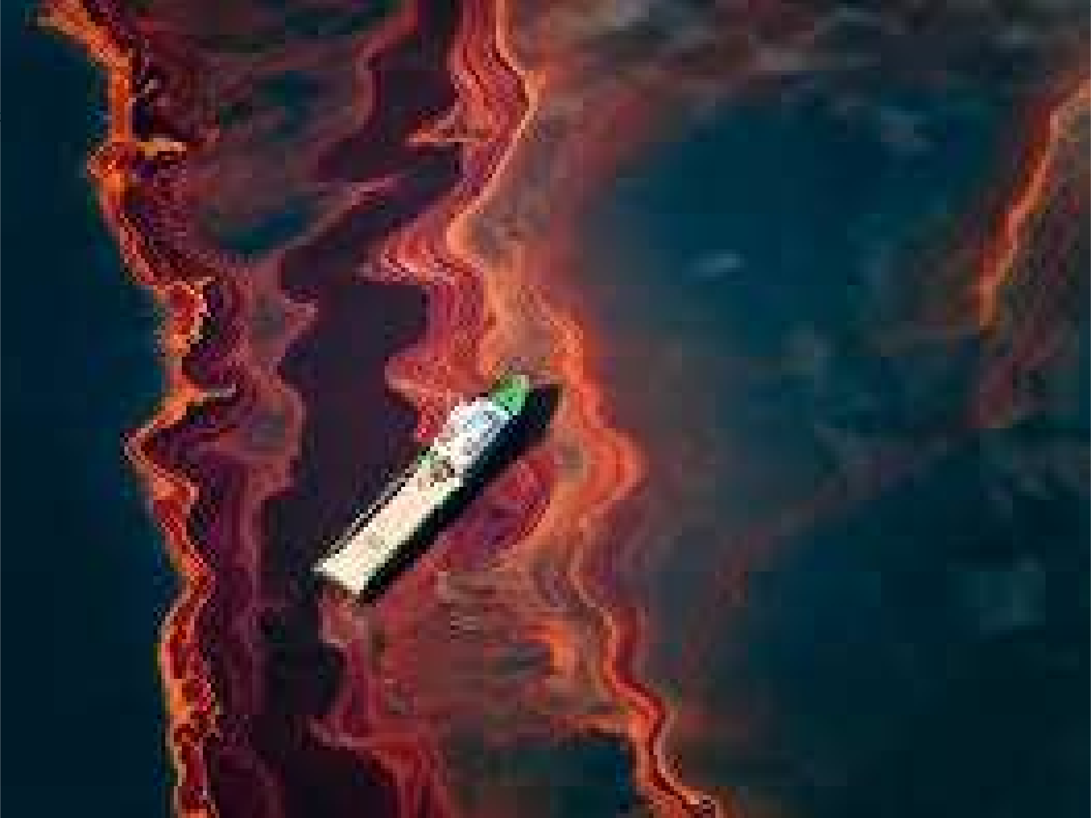

Slide 16
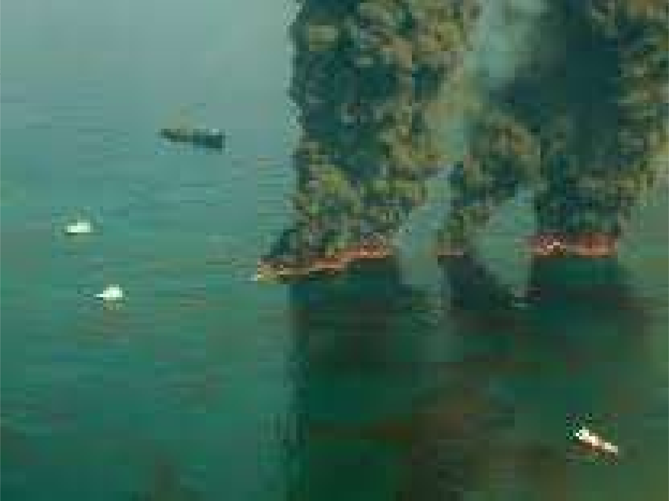

Slide 17
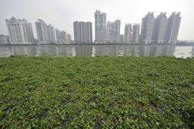
Causes of water pollution
5. Aquatic Plants
Water hyacinth, an aquatic plant causes pollution in water.
It is long leaved plant which grows faster in water bodies and absorbs all essential nutrients from water which is fetal for marine organisms.
It is also known as ‘Terror of Bengal’ due to its abundance.

Slide 18
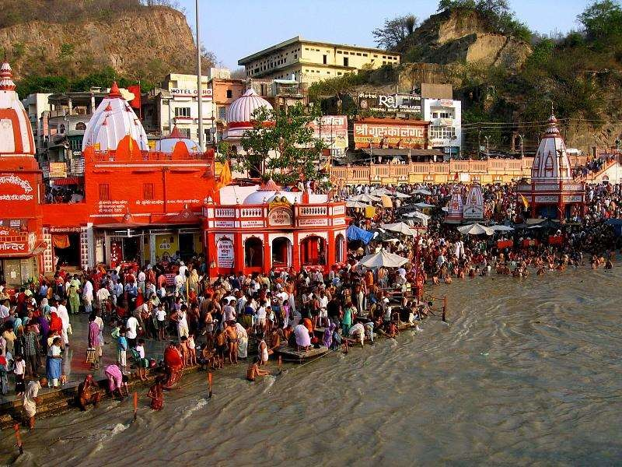
Causes of Water Pollution 6.Religious means

Slide 19
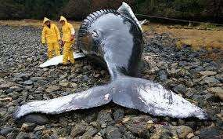
Effects of Water Pollution
1. Death of aquatic organisms

Slide 20
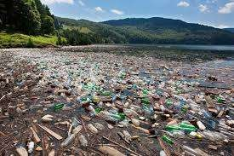
Effects of Water Pollution
2. Rivers are changed into dustbin

Slide 21
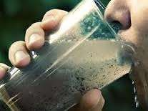
Effects of Water Pollution
3. Shortage of drinking water

Slide 23
Control measures
1. Stabilisation of ecosystem
Reduction of waste at source
Burying of organic waste
Fish management
Proper use of water

Slide 24
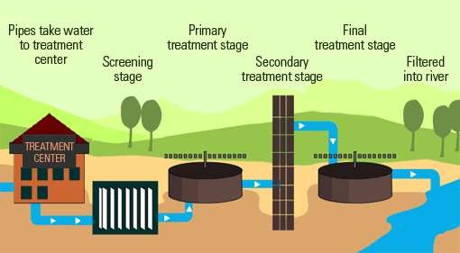
2.Sewage Treatment Plant

Slide 25
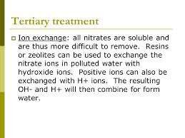
3.Ion Exchange Method

Slide 26
Reference
Environmental Chemistry, Dr. Parveen Bhairo, Pradeep’s Publications.
https://en.wikipedia.org/wiki/Water_pollution
Environmental Chemistry, Samir K. Banerji, PHI Learning Pvt. Ltd.

Slide 27
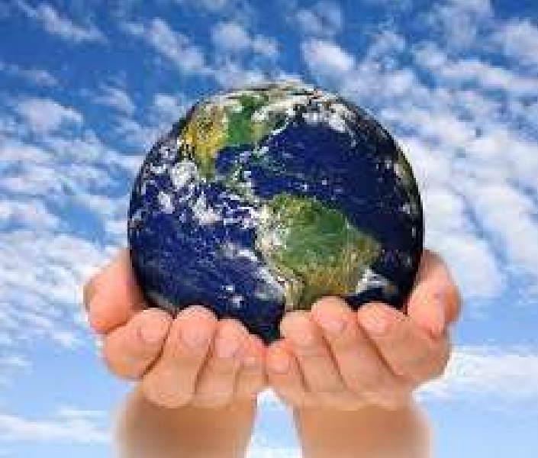
THANKS

