Slide 1
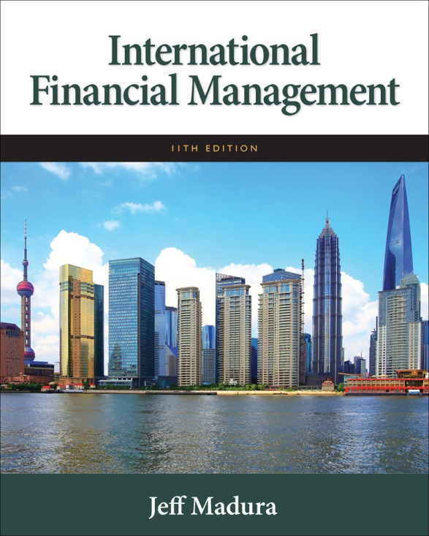

Slide 2
11
Managing Transaction Exposure
Chapter Objectives
Compare the techniques commonly used to hedge payables
Compare the techniques commonly used to hedge receivables
Describe limitations of hedging
Suggest other methods of reducing exchange rate risk when hedging techniques are not available
2

Slide 3
Policies for Hedging Transaction Exposure
Hedging Most of the Exposure
Hedging most of the transaction exposure allows MNCs to more accurately forecast future cash flows (in their home currency) so that they can make better decisions regarding the amount of financing they will need.
Selective Hedging
MNC must identify its degree of transaction exposure.
MNC must consider the various techniques to hedge the exposure so that it can decide which hedging technique is optimal and whether to hedge its transaction exposure.

Slide 4
Hedging Exposure to Payables
An MNC may decide to hedge part or all of its known payables transactions using:
Futures hedge
Forward hedge
Money market hedge
Currency option hedge

Slide 5
Forward or Futures Hedge on Payables
Allows an MNC to lock in a specific exchange rate at which it can purchase a currency and hedge payables. A forward contract is negotiated between the firm and a financial institution. The contract will specify the:
currency that the firm will pay
currency that the firm will receive
amount of currency to be received by the firm
rate at which the MNC will exchange currencies (called the forward rate)
future date at which the exchange of currencies will occur

Slide 6
Money Market Hedge on Payables
Involves taking a money market position to cover a future payables position.
If a firm prefers to hedge payables without using its cash balances, then it must
Borrow funds in the home currency and
Invest in a short-term instrument in the foreign currency

Slide 7
Call Option Hedge on Payables
A currency call option provides the right to buy a specified amount of a particular currency at a specified strike price or exercise price within a given period of time.
The currency call option does not obligate its owner to buy the currency at that price. The MNC has the flexibility to let the option expire and obtain the currency at the existing spot rate when payables are due.

Slide 8
Cost of Call Options
Based on contingency graph (Exhibit 11.1)
Advantage: provides an effective hedge
Disadvantage: premium must be paid
Based on currency forecast (Exhibit 11.2)
MNC can incorporate forecasts of the spot rate to more accurately estimate the cost of hedging with call options.
Consideration of Alternative Call Options
Several different types of call options may be available, with different exercise prices and premiums for a given currency and expiration date.
Whatever call option is perceived to be most desirable for hedging a particular payables position would be analyzed, so that it could then be compared to the other hedging techniques.

Slide 9
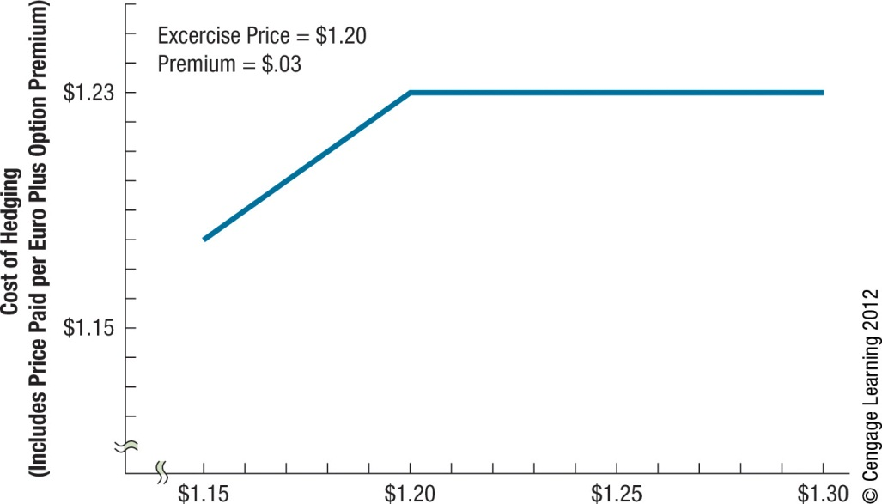
Exhibit 11.1 Contingency Graph for Hedging Payables With Call Options
9

Slide 10
Exhibit 11.2 Use of Currency Call Options for Hedging Euro Payables (Exercise Price = $1.20, Premium = $.03)
10

Slide 11
Comparison of Techniques to Hedge Payables
The cost of the forward hedge or money market hedge can be determined with certainty
The currency call option hedge has different outcomes depending on the future spot rate at the time payables are due.

Slide 12
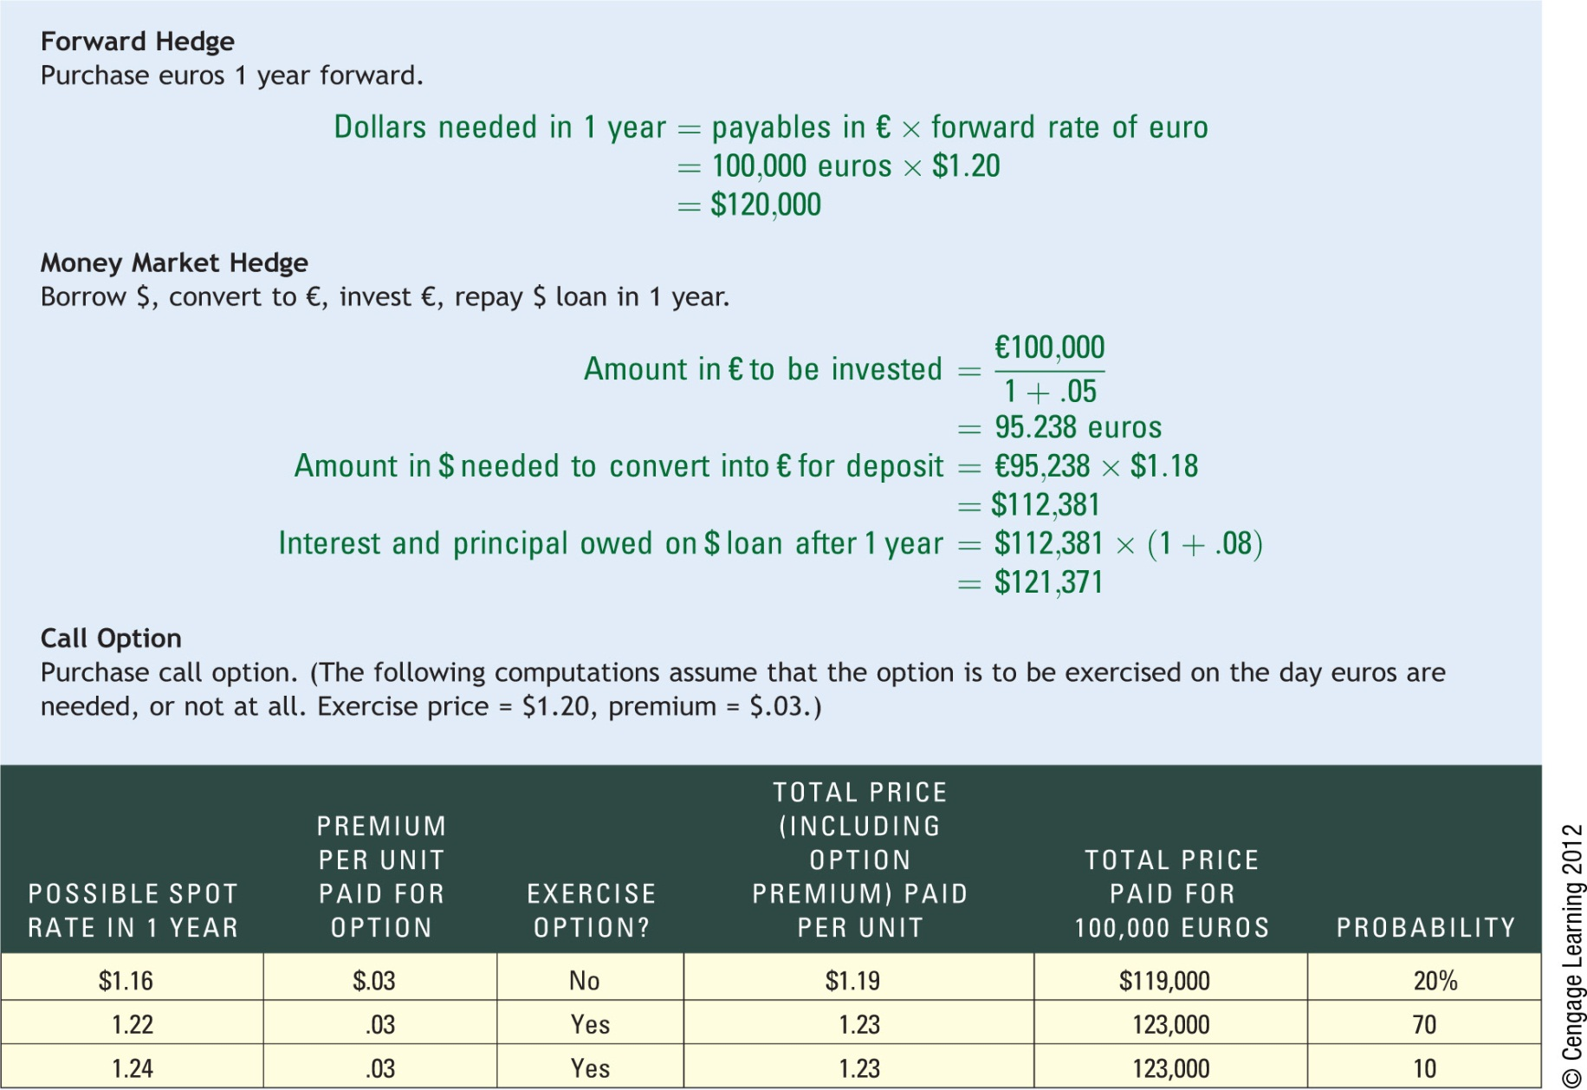
Exhibit 11.3 Comparison of Hedging Alternatives for Coleman Co.
12

Slide 13
Optimal Technique for Hedging Payables
Select optimal hedging technique by:
Consider whether futures or forwards are preferred.
Consider desirability of money market hedge versus futures/forwards based on cost.
Assess the feasibility of a currency call option based on estimated cash outflows.
Choose optimal hedge versus no hedge for payables
Even when an MNC knows what its future payables will be, it may decide not to hedge in some cases.
Evaluate the hedge decision by estimating the real cost of hedging versus the cost if not hedged.

Slide 14
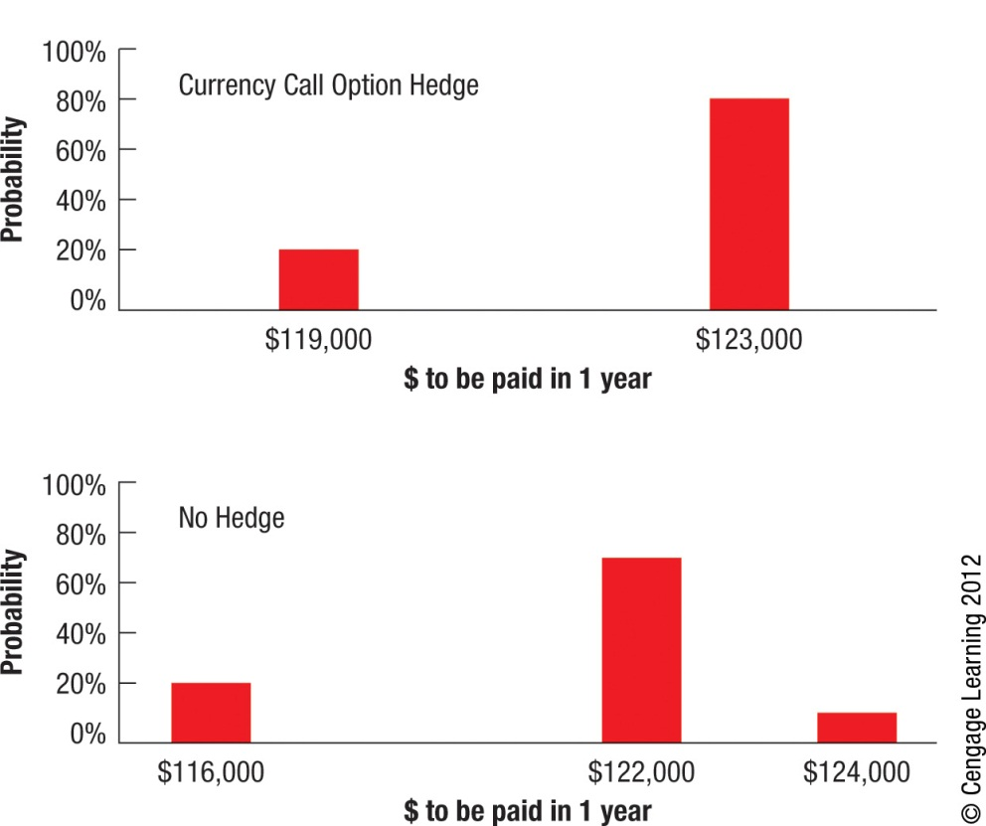
Exhibit 11.4 Graphic Comparison of Techniques to Hedge Payables
14

Slide 15
Hedging Exposure to Receivables
Forward or futures hedge allows the MNC to lock in the exchange rate at which it can sell a specific currency.
Money market hedge involves borrowing the currency that will be received and using the receivables to pay off the loan.
Put option hedge on receivables provides the right to sell a specified amount of a particular currency at a specified strike price by a specified expiration date.

Slide 16
Cost of Put Options
Based on Contingency Graph (Exhibit 11.5)
Advantage: provides an effective hedge
Disadvantage: premium must be paid
Based on Currency Forecasts (Exhibit 11.6)
MNC can use currency forecasts to more accurately estimate the dollar cash inflows to be received when hedging with put options.

Slide 17
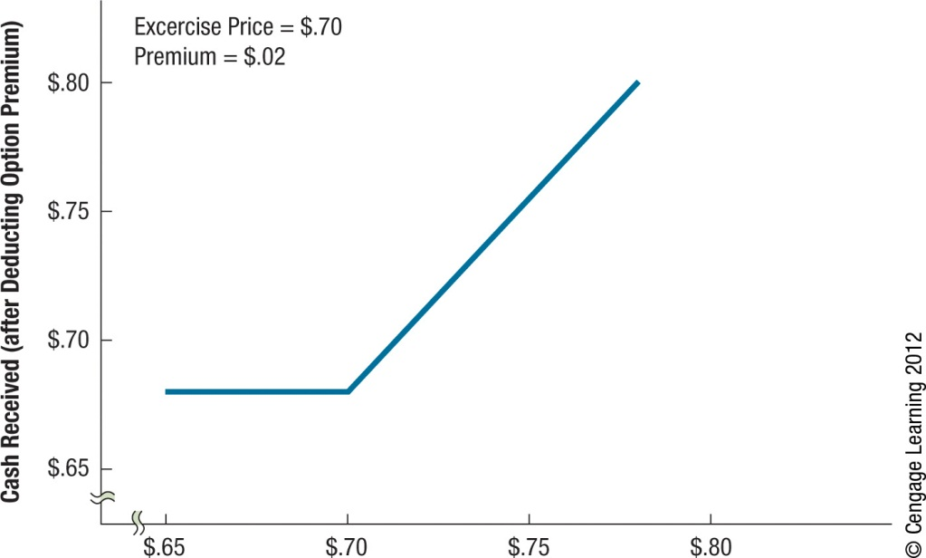
Exhibit 11.5 Contingency Graph for Hedging Receivables with Put Options
17

Slide 18
Exhibit 11.6 Use of Currency Put Options for Hedging Swiss Franc Receivables (Exercise Price = $.72; Premium = $.02)
18

Slide 19
Comparison of Techniques for Hedging Receivables
Optimal Technique for Hedging Receivables:
Consider whether futures or forwards are preferred.
Consider desirability of money market hedge versus futures/forwards based on cost.
Assess the feasibility of a currency put option based on estimated cash outflows.
Choose optimal hedge versus no hedge for receivables
Evaluate the hedge decision by estimating the real cost of hedging receivables versus the cost of receivables if not hedged.

Slide 20
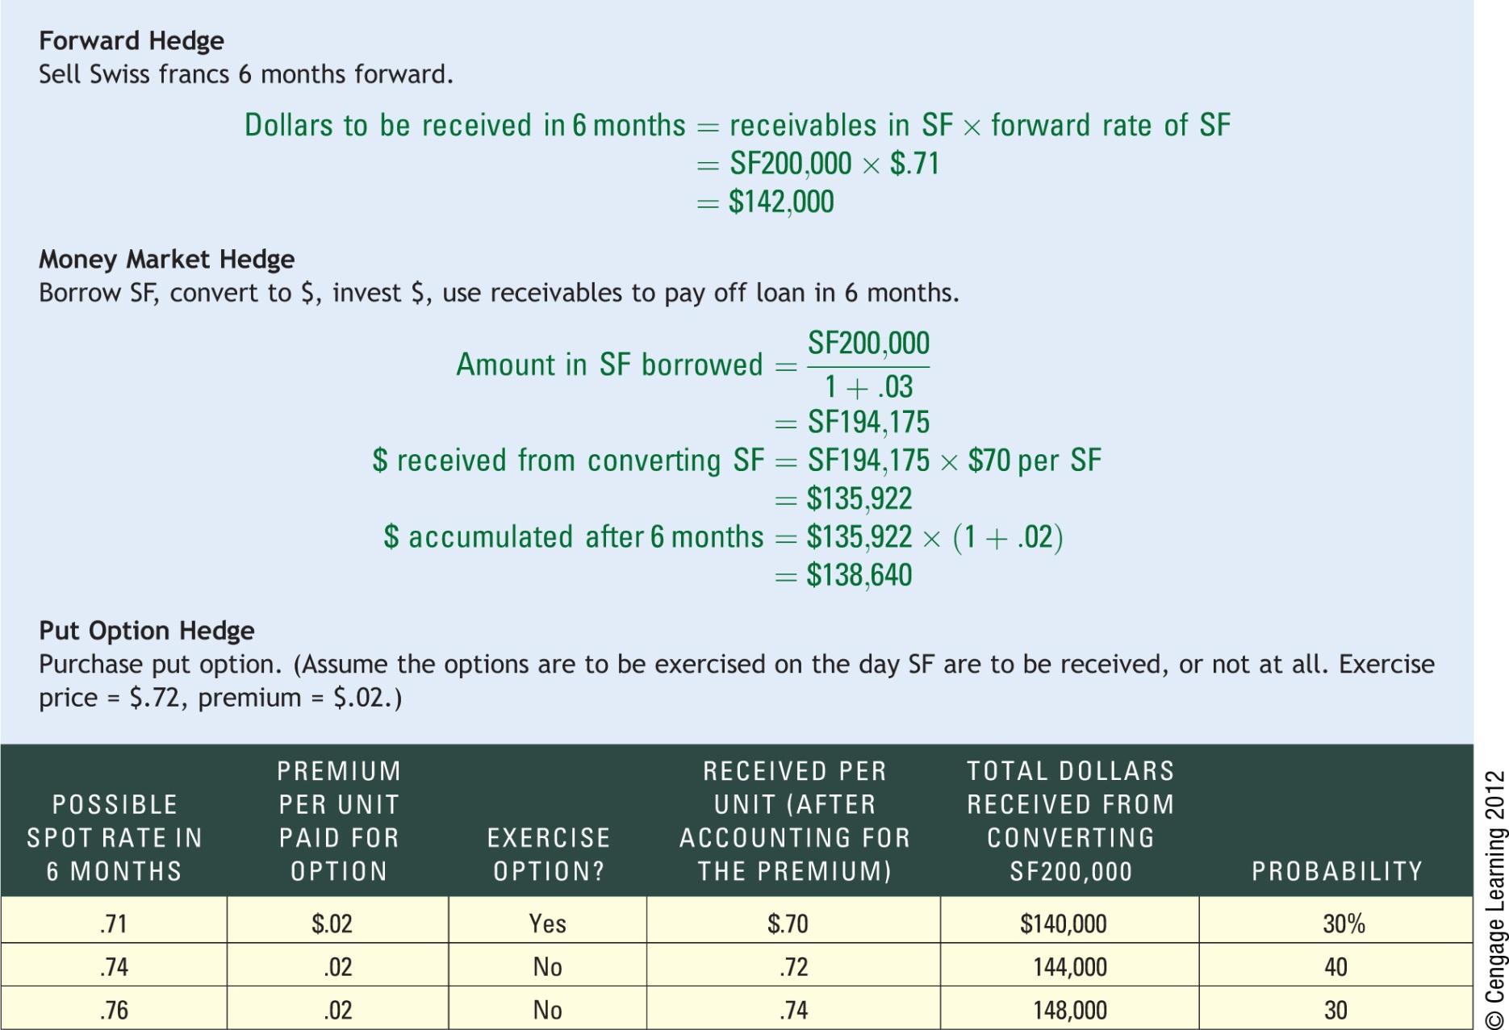
Exhibit 11.7 Comparison of Hedging Alternatives for Viner Co.
20

Slide 21
Exhibit 11.8 Graph Comparison of Techniques to Hedge Receivables
21

Slide 22
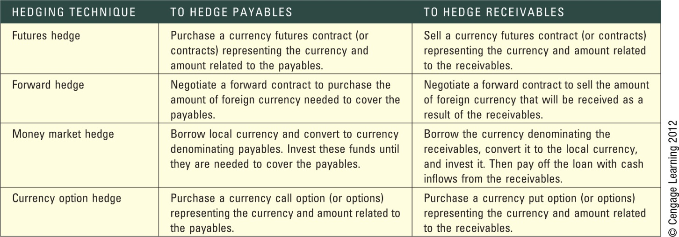
Exhibit 11.9 Review of Techniques for Hedging Transaction Exposure
22

Slide 23
Limitations of Hedging
Limitation of Hedging an Uncertain Payment
Some international transactions involve an uncertain amount of foreign currency, leading to overhedging.
Limitation of Repeated Short-Term Hedging
The continual short-term hedging of repeated transactions may have limited effectiveness.
Long-term Hedging as a Solution
Some banks offer forward contracts for up to 5 years or 10 years on some commonly traded currencies.

Slide 24
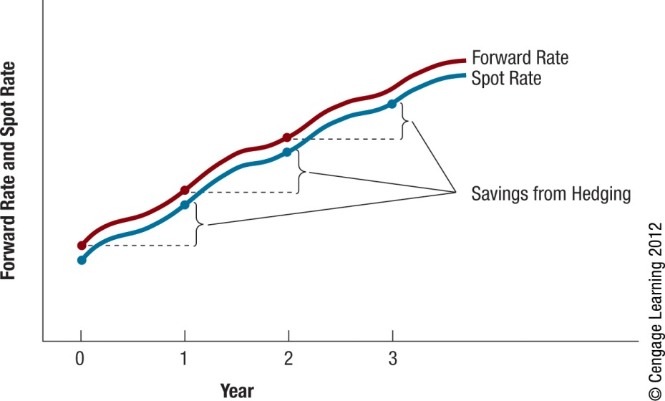
Exhibit 11.10 Illustration of Repeated Hedging of Foreign Payables When the Foreign Currency Is Appreciating
24

Slide 25
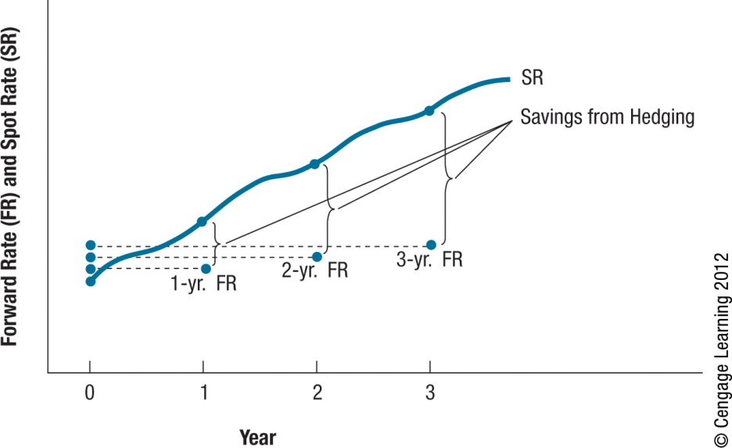
Exhibit 11.11 Long-Term Hedging of Payables When the Foreign Currency Is Appreciating
25

Slide 26
Alternative Hedging Techniques
Leading and Lagging: adjusting the timing of a payment or disbursement to reflect expectations about future currency movements.
Cross-Hedging: hedging by using a currency that serves as a proxy for the currency in which the MNC is exposed.
Currency Diversification: reduce exposure by diversifying business among numerous countries.

Slide 27
SUMMARY
An MNC may choose to hedge most of its transaction exposure or to selectively hedge. Some MNCs hedge most of their transaction exposure so that they can more accurately predict their future cash inflows or outflows and make better decisions regarding the amount of financing they will need. Many MNCs use selective hedging, in which they consider each type of transaction separately.
To hedge payables, a futures or forward contract on the foreign currency can be purchased. Alternatively, a money market hedge strategy can be used; in this case, the MNC borrows its home currency and converts the proceeds into the foreign currency that will be needed in the future. Finally, call options on the foreign currency can be purchased.

Slide 28
SUMMARY (Cont.)
To hedge receivables, a futures or forward contract on the foreign currency can be sold. Alternatively, a money market hedge strategy can be used. In this case, the MNC borrows the foreign currency to be received and converts the funds into its home currency; the loan is to be repaid by the receivables. Finally, put options on the foreign currency can be purchased.
When hedging techniques are not available, there are still some methods of reducing transaction exposure, such as leading and lagging, cross-hedging, and currency diversification.

Slide 29
SUMMARY (Cont.)
The currency options hedge has an advantage over the other hedging techniques in that the options do not have to be exercised if the MNC would be better off unhedged. A premium must be paid to purchase the currency options, however, so there is a cost for the flexibility they provide. One limitation of hedging is that if the actual payment on a transaction is less than the expected payment, the MNC overhedged and is partially exposed to exchange rate movements.

Slide 30
SUMMARY (Cont.)
Alternatively, if an MNC hedges only the minimum possible payment in the transaction, it will be partially exposed to exchange rate movements if the transaction involves a payment that exceeds the minimum. Another limitation of hedging is that a short-term hedge is only effective for the period in which it was applied. One potential solution to this limitation is for an MNC to use long-term hedging rather than repeated short-term hedging. This choice is more effective if the MNC can be sure that its transaction exposure will persist into the distant future.

