Slide 1
ENTO-306
Agricultural pests and their management
Identification of important agricultural pests
Their mode of damages
Control measures
By: Dr. Muhammad Zeeshan Majeed

Slide 2
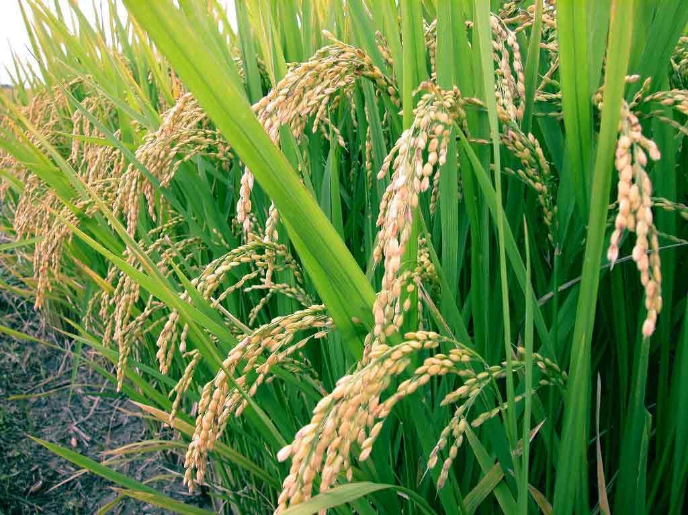
Major Insect Pests of Rice Crop in Pakistan
Notes:
Oryza sativa
Largest staple food of the globe. Mostly consumed in Asian countries (90% of the world). Pakistan most important staple crop, 11th largest producer in world and 10th in Asia
Pakistan cultivation 2.85 (3) M ha. / India 43 M ha
Production in Pakistan 7.4 Mt (2017-18) / 6.2 Mt in 2013-14. (China 143Mt: India 99 Mt).
2.7 % agriculture value-added and 0.6% of GDP.
There are 3 kinds of rice varieties in Pakistan which are produced for local consumption and export_Basmati, IRRI (International Rice Res. Inst. Los Banos, Phillipines) (medium long grain) , Cold tolerant (short and bold grained rice)
These are Basmati (aromatic), IRRI variety and bold grain (cold tolerant varieties).
IR-varieties are developed by NIAB.
Most widely grown varieties are Basmati-long grained rice (vasmati_sansaqreet word_Vas means Fragrance and Mati means soil).
According to IRRI reports, there are over 100 species of insect pests to rice around the world but only about 20 species can cause economic damage.

Slide 3
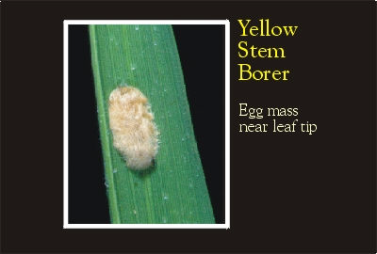
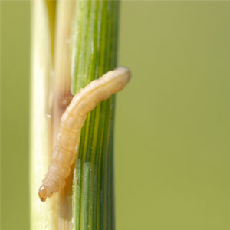
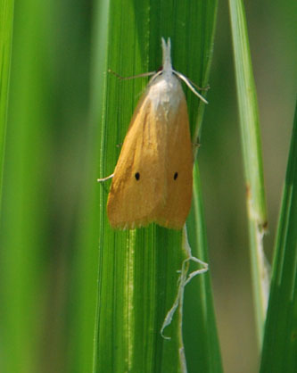
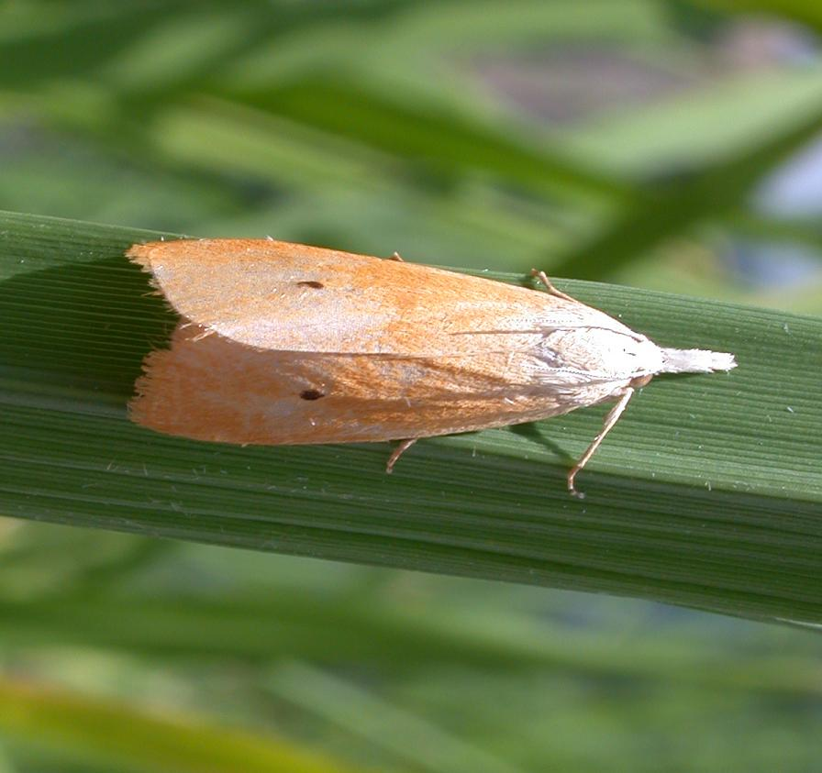
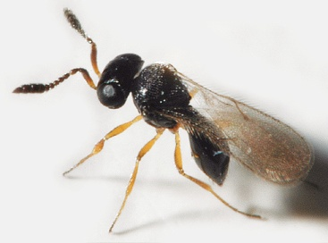
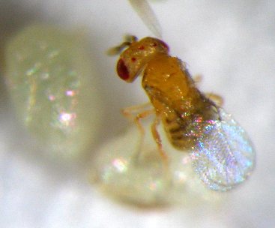
ENTO-306 Agricultural pests and their management 4(3-1)
Insect pests of Rice Yellow stem borer (Scirpophaga incertulus: Pyralidae)
Telenomus sp. (Scelionidae, Hymenoptera)
Trichogramma chilonis
Notes:
Yellowish straw color adults with black spots on forewings. Larvae; (about 20mm long) Pale yellow or yellowish white with head-capsule orange-yellow or brown in color. Eggs laid in clusters of 60-80s. Female moths are bigger than male ones and has anal tuft of brownish orange hairs at caudal end of abdomen.
Could cause 40-90% of crop loss. Growing shoots dries up (dead-heart). Upon attack at flowering stage, whitish ears stands erect in field with no grain formation particularly in August-September.
Pest active _ April to October
Inactive November to March (Hibernation as full grown larva in rice crop stubbles, pupation occurs in March and moth emergence in early April)
Egg-laying under leaf-blades in 2-3 clusters of about 60-80 pearly white eggs, total 120 to 150 eggs per female and covered by brown hairs.
Young larvae bore into stem downwardly from growing point of plant. Larvae stages 6 and takes 2-3 weeks to mature. Total lifespan of pest is 1-1.5month. 5-6 generations per annum
Management
Removal of crop stubbles after harvestiong of crop. Ploughing following by heavy irrigation.
Mechanical removal and destruction of egg masses at nursery stage before transplanting.
ETL = 5% deadhearts
Egg parasitoids
Chlorpyrifphos, deltamethrin, bifenthrin lambd-cyhalothrin etc.

Slide 4
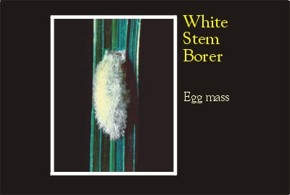
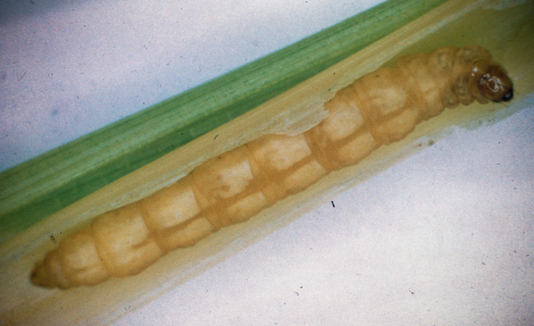
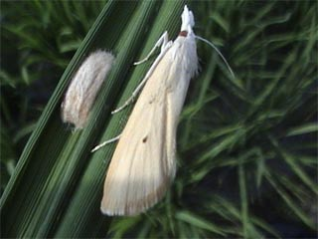
ENTO-306 Agricultural pests and their management 4(3-1)
Insect pests of Rice White stem borer (Scirpophaga innotata: Pyralidae)
Notes:
Selender whitish adult with black spot on each fore wing. Female with orange anal tuft. Larvae; (20-25mm long) Pale or yellowish white.
Damage same as yellow Stem Borer.
Similar as Yellow stem Borer
Pest active _ April to October
Inactive November to March (Hibernation as full grown larva in rice crop stubbles, pupation occurs in March and moth emergence in early April)
Egg-laying under leaf-blades in 2-3 clusters of about 60-80 pearly white eggs, total 120 to 150 peggs per female and covered by brown hairs.
Young larvae bore into stem downwardly from growing point of plant. Larvae stages 6 and takes 2-3 weeks to mature. Total lifespan of pest is 1-1.5month. 5-6 generations per annum
Management
Removal of crop stubbles after harvestiong of crop. Ploughing following by heavy irrigation.
Mechanical removal and destruction of egg masses at nursery stage before transplanting.
ETL = 5% deadhear
Egg parasitoids
Chlorpyrifphos, deltamethrin, bifenthrin lambd-cyhalothrin etc.

Slide 5
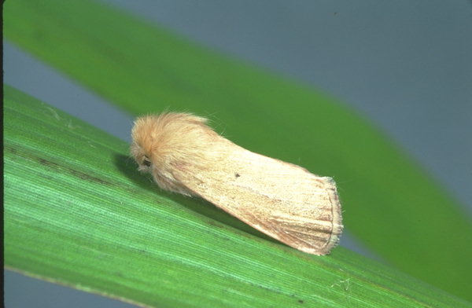
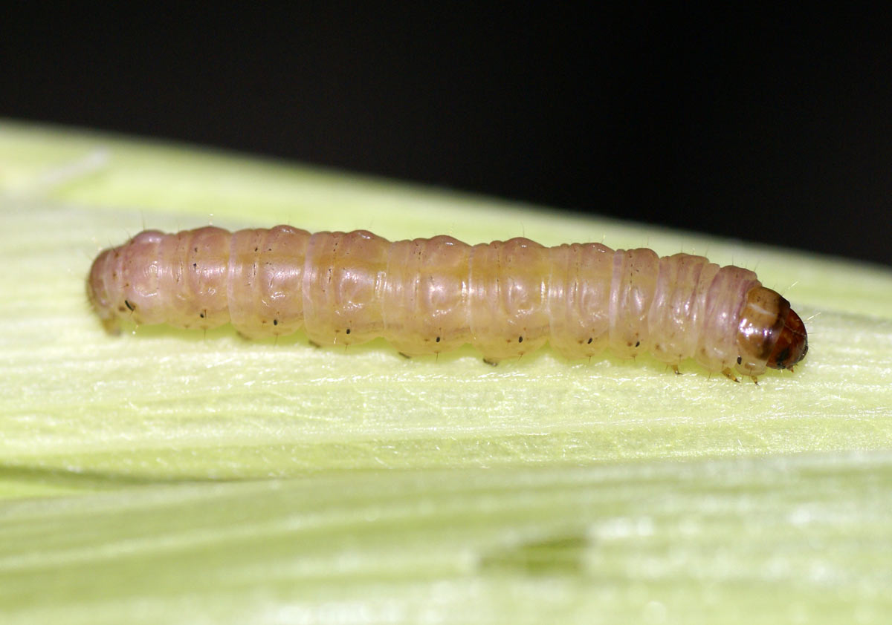
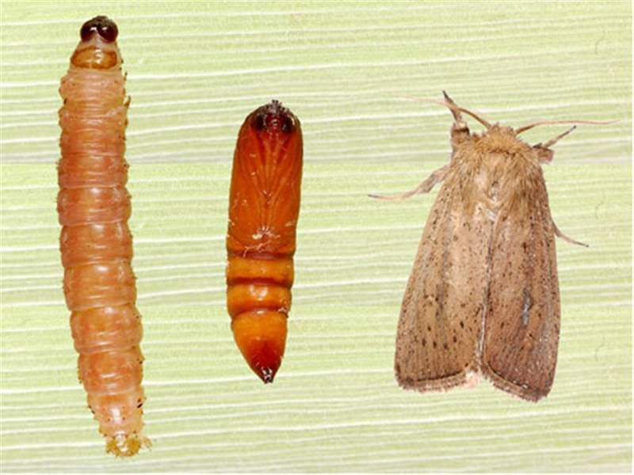
ENTO-306 Agricultural pests and their management 4(3-1)
Insect pests of Rice Pink gramminous borer (Sesamia inferens: Noctuidae)
Notes:
Adult: Pale brown or straw-colored with reddish brown dots on forewings, hind wings whitish., larva: 25mm Pinkish brown in color, 4-6 generations per y.
Larvae feed on leaf sheaths and later on bores in to central core of plant to produce dead-heart (easily pulled out) also feeds on rice grains in ears as well.
Total life-cycle 6 to 7 weeks with 4-6 generations per year.
Damage is more intense in pre-moonsoon (dry) season and it produces dead-hearts. Late attack results into few grain formation.
Polyphagous may be found on sugarcane, rice, wheat, maize and sorghum etc. But damage is more significant on rice and maize.
Conntrol/management same as yellow or white stem borer of rice.

Slide 6
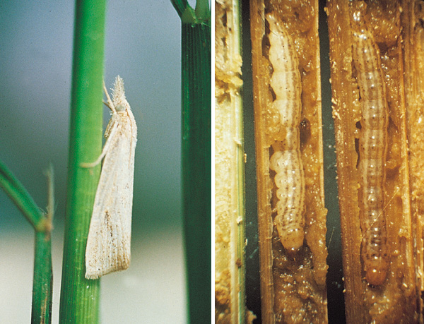
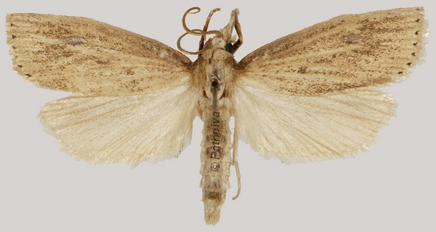
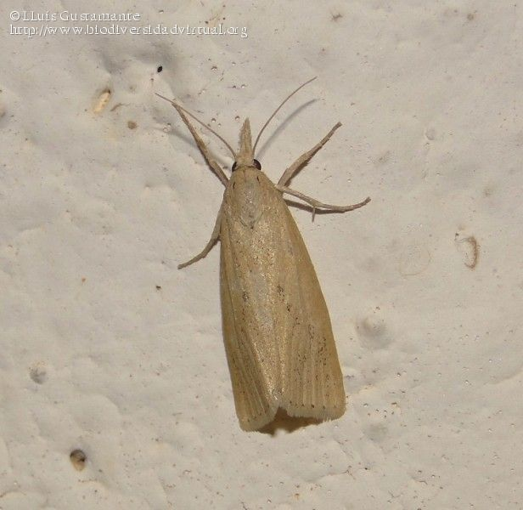
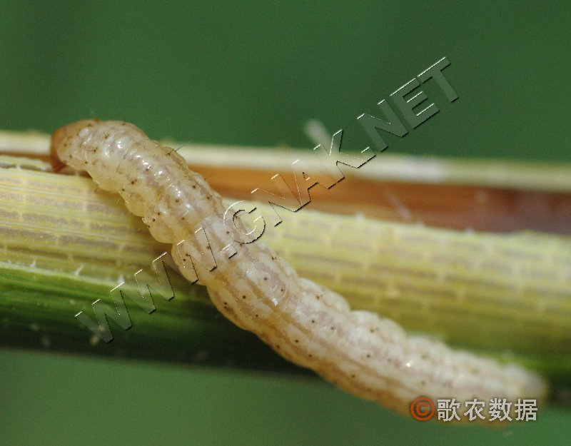
ENTO-306 Agricultural pests and their management 4(3-1)
Insect pests of Rice Stripped Stem Borer (Chilo suppressalis: Noctuidae)
Notes:
Adult: straw-colored, Larva: (25mm long) Greenish brown with 5 longit. Stripes on dorsal side and yellowish brown head capsule.
Cluster egg-laying (50-70 eggs)
Active period: April-Oct., Maxi. Activity; Sept. Oct., 1-4 generations per y.; Maxi. Damage: 3rd and 4th generations.

Slide 7
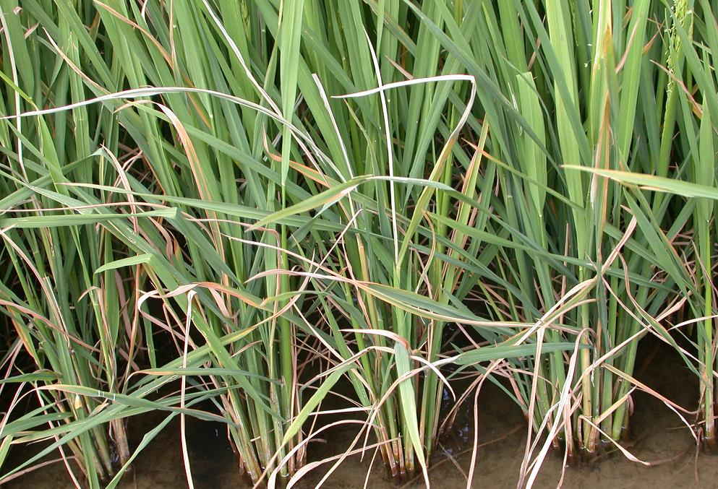
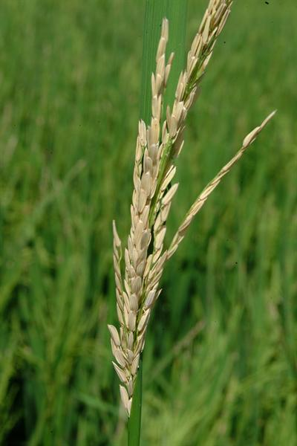
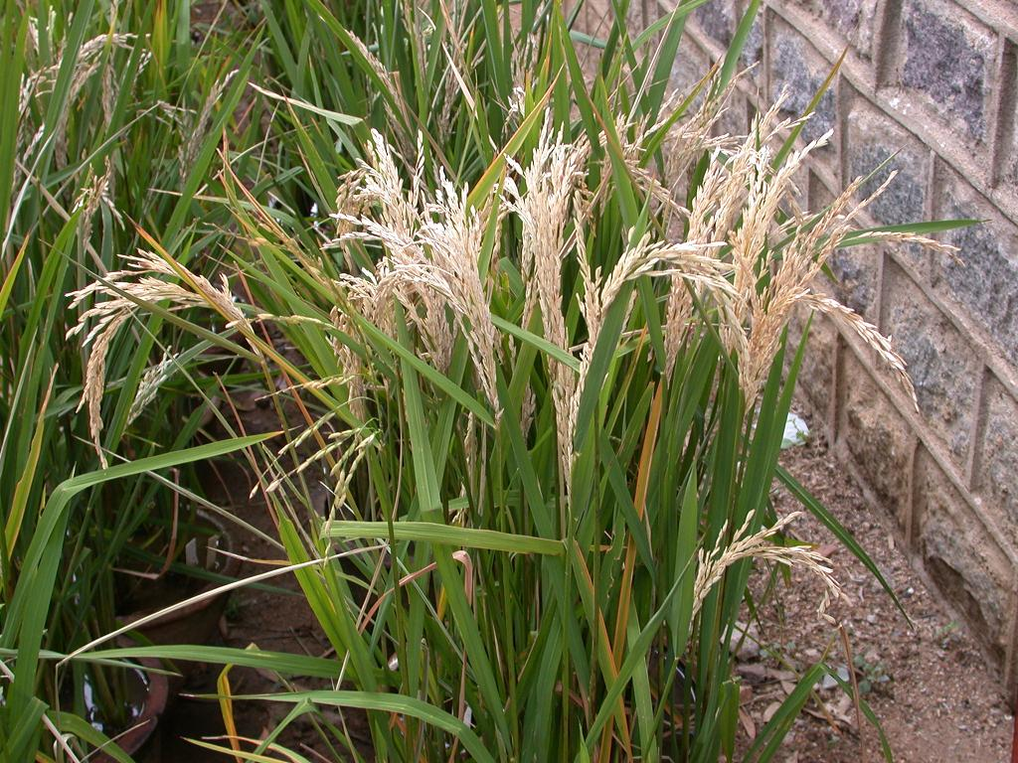
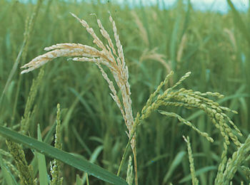
ENTO-306 Agricultural pests and their management 4(3-1)
Insect pests of Rice Damage of Stem Borers
Dead-heart formation
Milky or White-ear formation
Notes:
Cultural Control: Nursery after 20th May, Transplaning essentially in August Light traps, clean-cultivation, stubbles removal, picking and destroying egg-masses and dead-hearts
Egg parasitoids : Telenomus and Trichogramm sp.
Chemical control: Carbamate insecticides such as Carbofuran, Carbosulfan, Monomehypo
OPs such as Chlorpyriphos, Diazinon, Methamidophos, Profenophos

