Slide 1
Input Devices

Slide 2
Input
Input is any data or instructions entered into the computer in the form of signals
The input into the computer can be entered:
Through keyboard
By selecting commands on the screen and then clicking with mouse
By pressing finger on touch screen
By speaking into a microphone
By sending image through digital camera
By scanning data printed on paper through scanner

Slide 3
Input Devices
The devices that are used to enter data and instructions or commands into the computer
Eyes and ears of computer
Commonly used input devices are:
Keyboard
Mouse
Joystick
Light Pen
Digital Scanner
Floppy drives, hard disks and CD drives are used for both input and output devices

Slide 4
Keyboard
Most commonly used input device
Contain keys for each alphabetic characters, digits and special characters
Used to feed data and instructions into a computer by pressing related keys on the keyboard

Slide 5
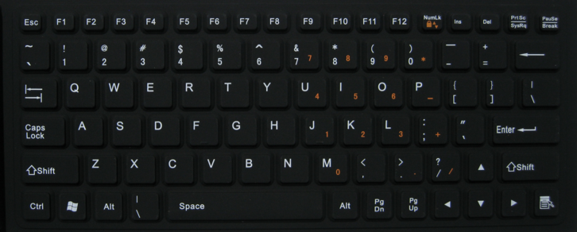
Keyboard
http://menotek.com/101899.html

Slide 6
Keyboard
http://computerhws.blogspot.com/2011/08/parts-of-computer-keyboard.html

Slide 7
Types of Keyboard
QWERTY
Enhanced Keyboard
Cordless Keyboard
Portable keyboard
Ergonomic keyboard
Gaming keyboard
Virtual keyboard

Slide 8
Pointing Devices
A pointer represents a small symbol on the screen
Appears on the screen in Graphical User Interface
For example, an arrow appears on the screen in Windows environment
A pointing device is an input device that is used to control a pointer on the screen
Used to select item on the screen, to select commands from the command menu, to draw graphs etc
Mouse, Joystick, Trackball etc are examples of pointing devices

Slide 9
Mouse
Pointing input device
Used to input instruction with a pointer on the screen
Moved on the flat surface to control the movement of the cursor or pointer on the screen
Has two or three buttons on the top of its body
Used to select any option from the group of options by pointing the mouse pointer on it and then clicking one of the mouse buttons

Slide 10
Mouse
http://microsoft.com

Slide 11
Types of Mouse
Mechanical Mouse
Optical Mouse
Cordless Mouse
Air Mouse

Slide 12
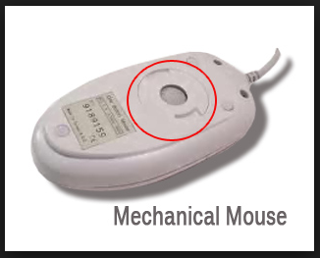
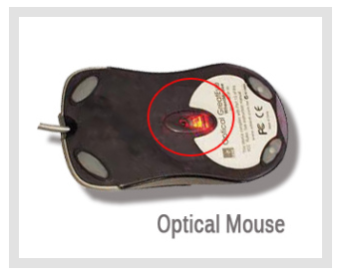
Types of Mouse
https://techexplainer.wordpress.com/2012/03/23/different-types-of-computer-mice/

Slide 13
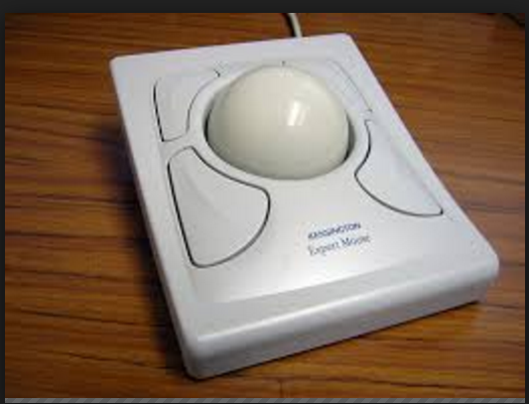
Trackball
Pointing input device
Like a mouse but it is a stationary pointing device with a ball on its top
https://en.wikipedia.org/wiki/Trackball

Slide 14
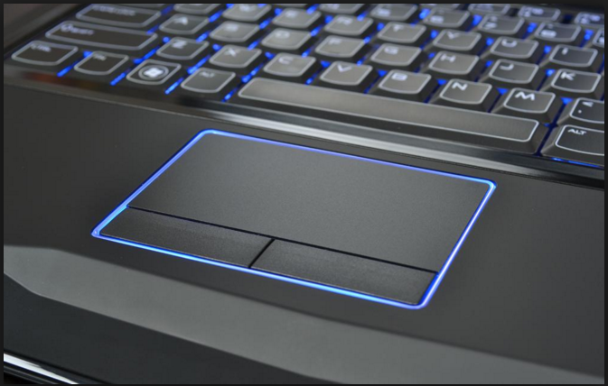
Touchpad
Also known as track pad
Small, flat, rectangular, stationary pointing device
Sensitive surface of 1.5 or 2 inches
Mostly used in laptops
http://news.softpedia.com/news/how-to-toggle-or-disable-laptop-touchpad-in-windows-487428.shtml

Slide 15
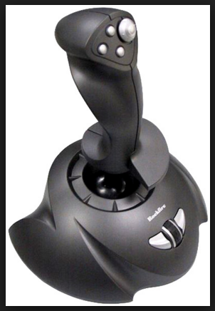
Joystick
Pointing input device
Small box with a moving handheld stick and buttons
Stick is used to control the movement of the pointer on the screen
Button is pressed to activate certain events
http://onlinemca.com/mca_course/kurukshetra_university/semester5/computergraphics/joy_stick.php

Slide 16
Light Pen
Another input pointing device
Detect the presence of light
Handheld pen shaped device with a photocell mounted at its front end
Used by engineers, graphic designers etc
Used in PDA’s and other hand held computers

Slide 17
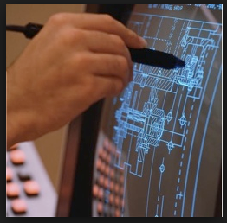
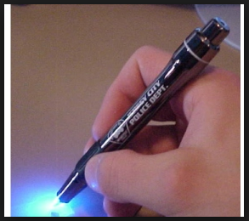
Light Pen
http://www.igcseict.info/theory/2/point/
http://www.bluetrackpromo.com/diamondlightpens.html

Slide 18
Electronic Pen
Also called stylus
Ballpoint like pen
To write texts and draw lines with the help of its pressure
Used in graphics application

Slide 19
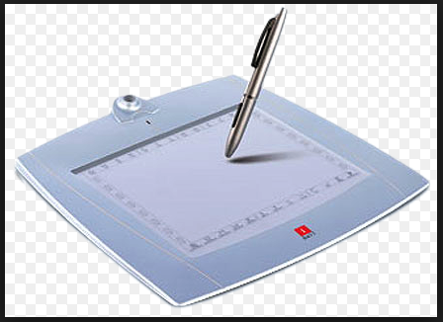
Electronic Pen
http://www.yankodesign.com/2011/10/25/meter-pen/
http:/techkidz.biz/products.html/

Slide 20
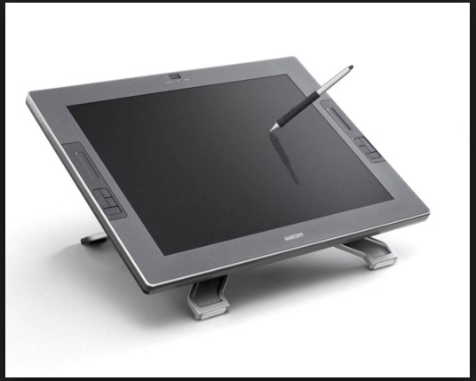
Digitizer
Flat, rectangular, electronic plastic board
Mainly used for drawing purposes in computer aided design applications
Makes easy to enter free-hand drawing in the computer
http://shaniqueeportfolio.weebly.com/digitizing-tablet.html

Slide 21
Microphone
Input device used to enter the sound signals of user into the computer
Record the voice of the user in computer
Sound card translates the sound signals into digital signals for processing by computer
Also translates the sound digital signals back into the analog signals

Slide 22
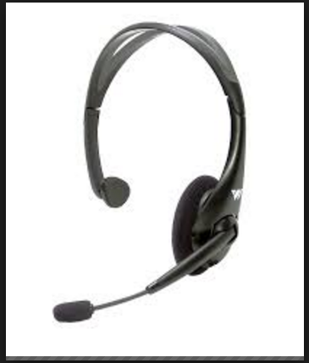
Microphone
http://www.crowriveraudio.com/mics/index.htm

Slide 23
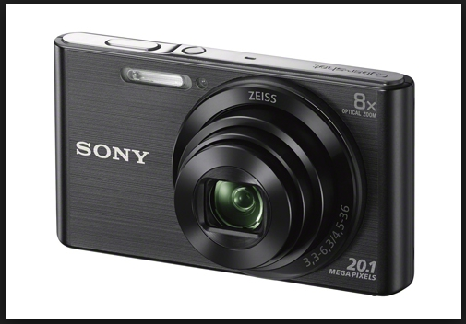
Digital Camera
Input device used to take pictures and to store directly into the computer in digital form
http://www.sony-asia.com/local/product/dsc-w830

Slide 24
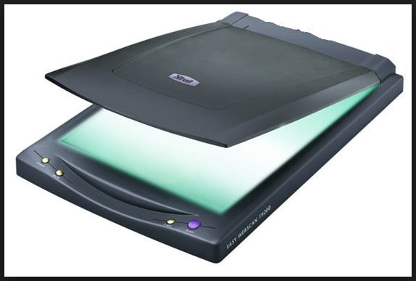
Digital Scanner
Light sensing input device
Read images and text printed on paper and then translates into electronic form that can be processed and stored by the computer
Also called image scanner
http://www.freefaxonline.org/how-to-scan-documents-without-scanner/

Slide 25
Optical Reader
Device that uses a light source to read characters, marks printed on the paper etc
Converts them into the digital form that can be stored and processed in computer
Two main types of optical reader:
Bar Code Readers
Optical Character Recognition

Slide 26
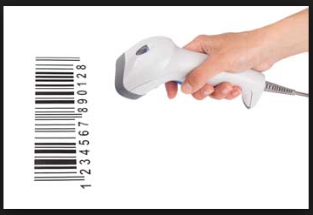
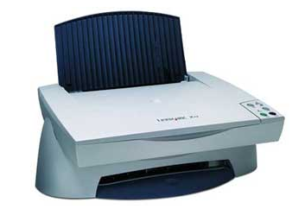
Optical Reader
http://www.tutorialspoint.com/computer_fundamentals/computer_input_devices.htm

Slide 27
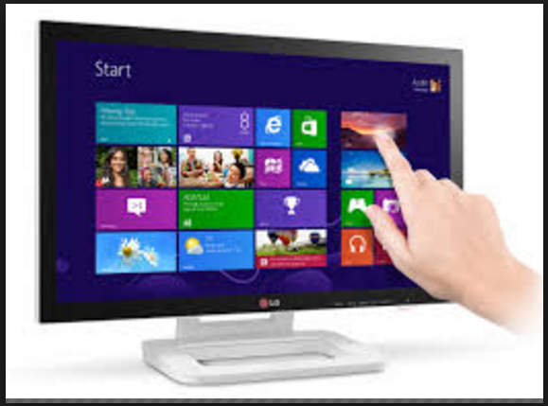
Touch Screen
Sensitive display screen
Touch the different areas of screen with the finger tip just as you click different areas with the help of mouse
http://www.slashgear.com/lg-et83-touchscreen-monitor-wants-your-windows-8-fingers-31254980/

Slide 28
References
Introduction to Information Technology by Riaz Shahid, CM Aslam and Safia Iftikhar
The Concepts of Information Technology by Imran Saeed, Ahsan Raza, Tariq Mehmood and Zafar Hussain

