Slide 1
Communication skills
Speaking
Writing
listening
Reading

Slide 2
about people/you/me
10% of what they read
20% of what they hear
30% of what they see
40% of what they hear and see

Slide 3
Oral Communication/speaking
How it takes place
Face-to-face, via telephone, voicemail, videoconferencing
What provides
Discussion, clarification, understanding, immediate feedback
Elements affecting communication
Body language
Cultural differences
When to use
Early , especially face-to-face
Provide timely communications
Notes:
Verbal Communication
Verbal communication can take place face-to-face, via telephone, voicemail, or videoconferencing.
Verbal communication provides a forum for discussion, clarification, understanding, and immediate feedback.
Body language (in face-to-face communications) and tone (inflection and emotion of the voice) are important elements that enrich verbal communication.
Body language can be used not only by the person talking, but also by the listener, as a way of providing feedback to the person talking.
Positive body language can include direct eye contact, a smile, hand gestures, leaning forward, and nodding acknowledgment or agreement.
Negative body language can be a frown, crossed arms, slouching, fidgeting, gazing or looking away, doodling, or yawning.
When communicating with individuals from other cultures or countries, you need to be aware of their customs regarding greetings, gestures, eye contact, and proper protocol.
When communicating verbally, a person must be careful not to use remarks, words, or phrases that can be construed to be sexist, racist, prejudicial, or offensive.
A high degree of face-to-face communication is especially important early in a project to foster team building, develop good working relationships, and establish mutual expectations.
Project team members need to be proactive in initiating timely communication with other team members and the project manager to get and give information.
Verbal communication should be straightforward and unambiguous.
The timing of verbal communication is very important.

Slide 4
Presentations
Prepare
Deliver
What is the purpose?
Know the audience
Make outline
Use clear language
Prepare notes and materials
Practice, practice, practice
Copy handouts
Request audiovisuals
Visit intended room
Expect nervousness
Remove distractions
Memorize opening lines
Present accordingly
Summarize points
Memorize closing lines
Interact with audience
Notes:
Presentations
Often the project manager or members of the project team are called on to give a formal presentation. The audience may be representatives of the customer’s organization, the project organization’s upper management, or the project team itself.
There are many steps that go into preparing for a presentation.
Determine the purpose of the presentation. Is it to inform or to persuade?
Know the audience. What is their level of knowledge or familiarity with the subject?
Make an outline of the presentation.
Use clear language that the audience will understand.
Prepare notes or a final outline that you can refer to during your presentation.
Prepare visual aids and test them.
Make sure the visual aids are readable from the most distant seat in the room where the presentation will be given. They should be simple and not too busy.
Practice, practice, practice.
Make copies of handout materials.
Request the audiovisual equipment well in advance.
Go into the meeting room when it is not in use and get a feel for your surroundings.
This slide also lists some tips for delivering presentations
Expect a bit of nervousness; all speakers experience it.
Turn off your cell phone and other distractions and ask the audience to do the same.
Memorize the first two or three sentences of your presentation.
Use the 3-T approach in your presentation:
Tell them what you are going to tell them (your outline)
Tell them (the body of your presentation)
Tell them what you told them (your summary)
Be professional
Talk to the audience, not at it.
Speak clearly and confidently.
Use appropriate gestures to help make a point.
Do not read the slides. Elaborate on the ideas illustrated on the slides.
Do not stand in front of your visual aids.
Build interest in your presentation.
Keep to the key points in your outline and explain to the audience why they are important.
Sum up your points on a particular item before moving on to the next item on your outline.
Know your closing lines.
Allow time for interaction with the audience, if appropriate.
When responding to questions, be sincere, candid, and confident.

Slide 5
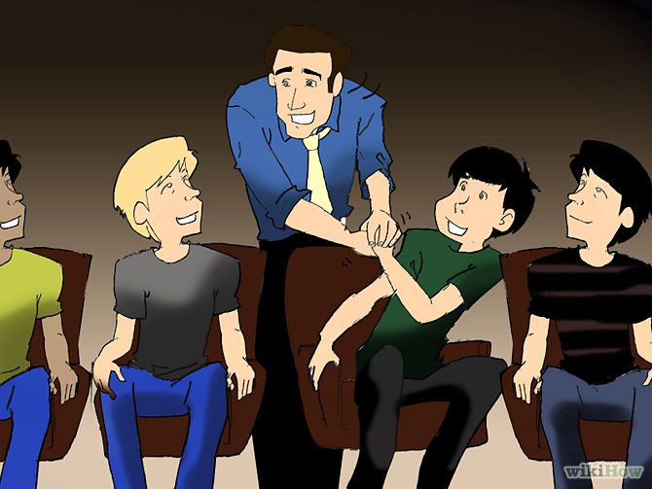
Preparatory Steps
1
Know your audience and understand its perspective. Whether your goal is persuasion, or simply to inform,
you need to understand your audience its level of expertise and how your message will resonate.

Slide 6
2- Research thoroughly.
You absolutely must be an expert on the subject. Okay, you don’t have to be the world’s
leading authority, but you have to know the critical facts as well as much of the little-known information.

Slide 7
3
Document your sources. Where you get your information is as important as the information itself. Without solid, peer-reviewed data, you’re just a person with an opinion. The audience, in this exercise, is expecting facts and projections. Your personal opinion may very well be important but it must not be the only thing you present. you do want to be able to give citations when asked.

Slide 8
Write your speech.

Slide 9
Prepare slides

Slide 10
Rehearse alone

Slide 11
Do a dress rehearsal. Enlist some people that you trust to give honest opinions.

Slide 12
Tweak the presentation. Take what you learned in the dress rehearsal and make modifications. Try to put yourself in the audience when you do this. What will they hear when the slides are on the screen?

Slide 13
Think about possible questions

Slide 14
Delivery of speech
Self confidence
Positive attitude towards audience and topic
Start should be good and within low pitch
Pleasant language and voice
Consider pitch to keep audience alert
Consider loudness
Words should be clear and distinct
Consider nonverbal communication

Slide 15
Run with audience and ask questions
Be alert to feedback and react accordingly
Eye to eye contact
Use visual aids and humour( if needed)
Respect your audience
Pay thanks.

