Slide 1
Communication Skills

Slide 2
What is Communication?
Communication is the process by which messages are transferred from a source to receiver.
The exchange of thoughts, ideas, messages, or information, as by speech, signals, writing, or behavior

Slide 3
Communication Process
The communication process is composed of several stages, like Source, Message, Channel , Receiver and Feedback.

Slide 4
Why Communication?
Information sharing
Feedback
Influence
Problem solving
Decision making
Facilitate Change
Group Building

Slide 5
What are Communication Skills
Communication skills are basically tools that we use to remove barriers to make communication more effective
Communication skills include:
Speaking Skills, Listening Skills and Writing Skills

Slide 6
People generally remember
10 % of what they read
20 % of what they hear
30 % of what they see
50 % of what they hear and see
70 % of what they say and write
90 % of what they say and do some thing

Slide 7
Effective Speaking
Speaking is the productive skill in the oral mode. It may includes speaking in the form of lecture, interviewing, etc.

Slide 8
For effective speaking consider:
Confidence
Purpose
Audience
Speed
Clarity
Pronunciation
Fluency
Expression

Slide 9
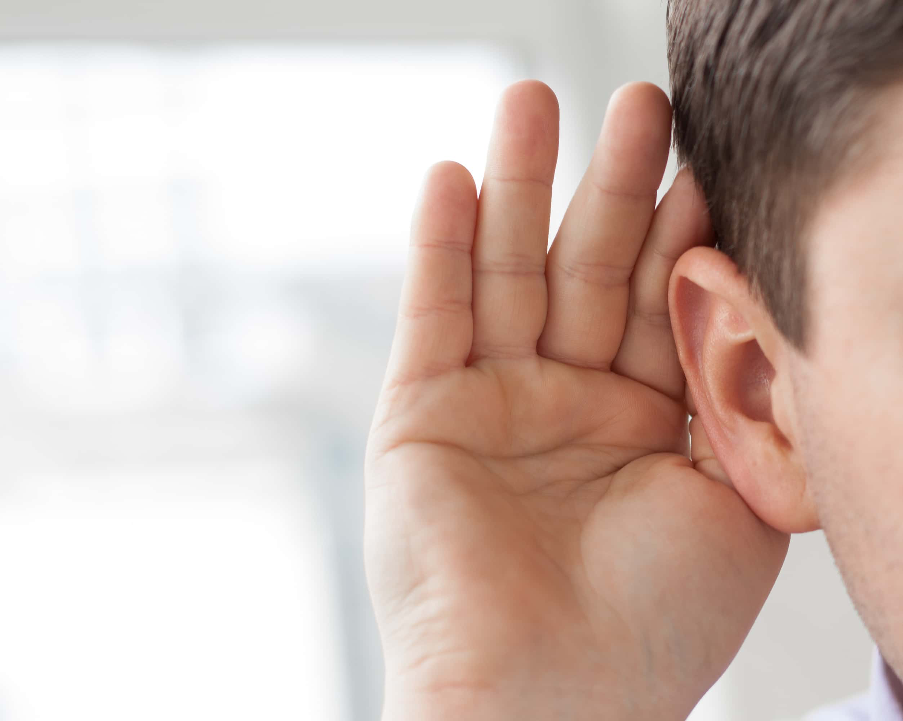
Effective listening skills
Listening is process of receiving, understanding, remembering, evaluating and providing feed back of information.
Effective Listening ensure:
Productivity, improved relations,
Avoid conflicts, improves understanding

Slide 10
Tips for effective listening
Silence
Pay Attention
Listen carefully
Do not interrupt
Don’t be defensive
Proper use of emotions
Keep in mind information
Respect the speaker
Maintain proper Body language

Slide 11
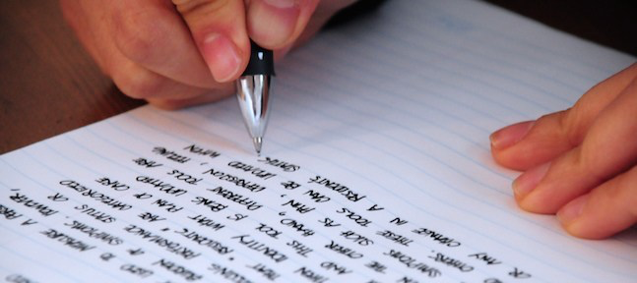
Why Written Communication?
A basic understanding of writing and a commitment to writing well in all situations is needed as a professional
Creates a permanent record
Easily distributed
Allows you to store information for future
Reference
All recipients receive the same information
Everyone has the basic skills necessary to write well

Slide 12
Remember while Writing:
The purpose
Be clear about your point of view
Create logical flow
Avoid grammatical errors
Make message brief

Slide 13
Writing Process
Planning
Outline
Writing
Proof reading
Presenting

Slide 14
Tips for Effective Writing
Completeness
Correctness
Credibility
Clarity
Conciseness
Consideration

