Slide 1
Legumes

Slide 2
Forage Legumes
The need for forage crops arose with the domestication of animals.
Initially wild grasses probably were used, but other sources were then sought.
These gradually became more numerous and more varied.
Today the extensive cultivation of grasses and legumes as forage crops is principally the product of European and American civilizations.
In addition to various cereal grasses and food legumes, many other species have been grown entirely as forage crops with little or no value as human food.
Included are such grasses as Timothy, Phleum pratense, Orchard Grass, Dactylis glomerata, Redtop, Agrostis alba, Brom Grass, Bromus inermis, Johnson Grass, Sorghum halepense, Tunis Grass, Sorghum virgatum, and Sudan Grass, Sorghum vulgare var. sudanense.

Slide 3
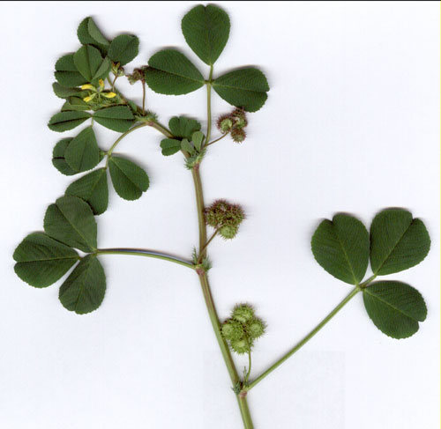
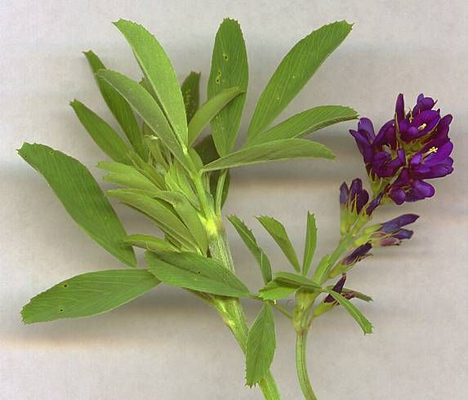
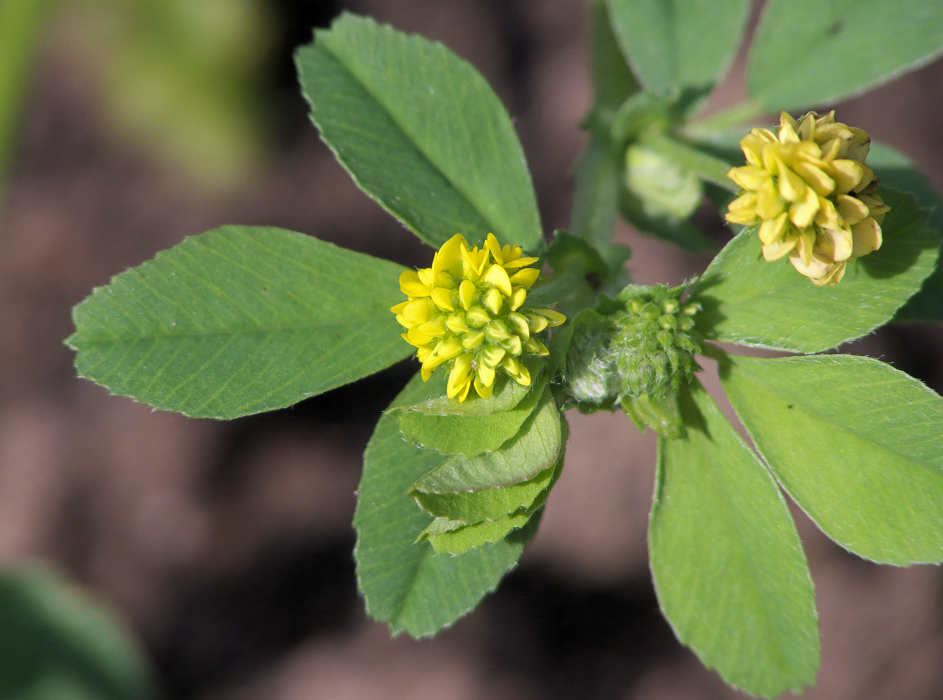
Alfalfa, Medicago sativa, native to Southwestern Asia, may have been the first cultivated forage plant.
Alfalfa is useful for pasture, hay and silage and for improving the soil.
Other species of Medicago include Bur Clover, M. hispida and Medic, M. lupulina.
Medicago hispida
Medicago lupulina

Slide 4
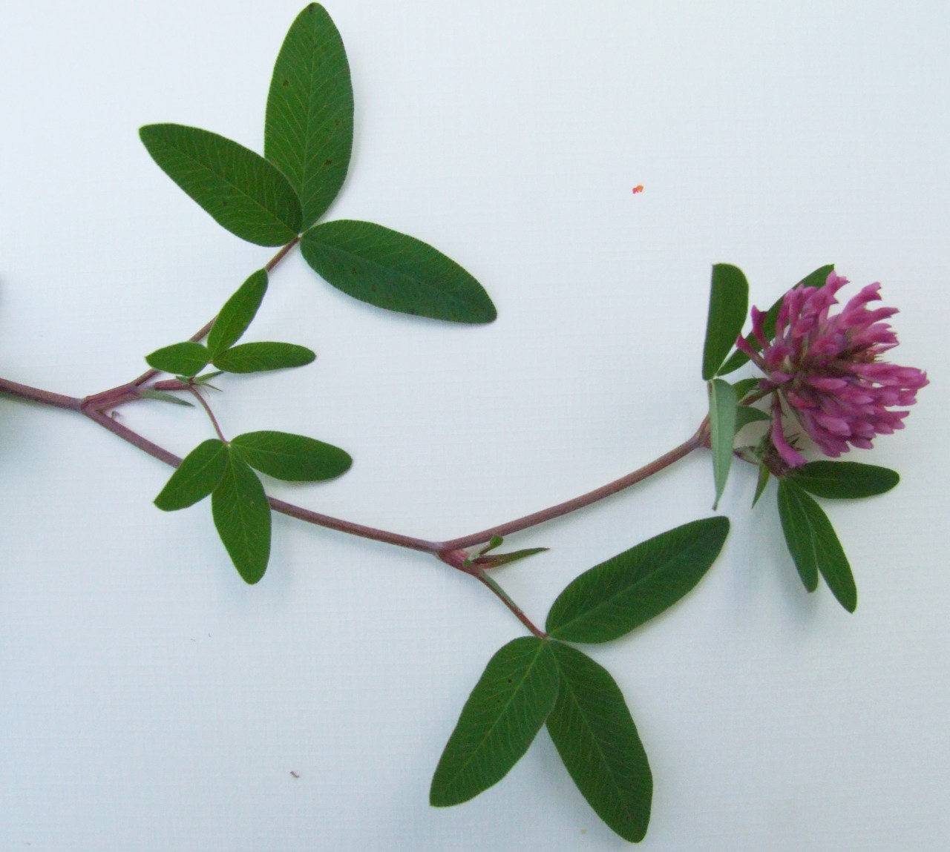
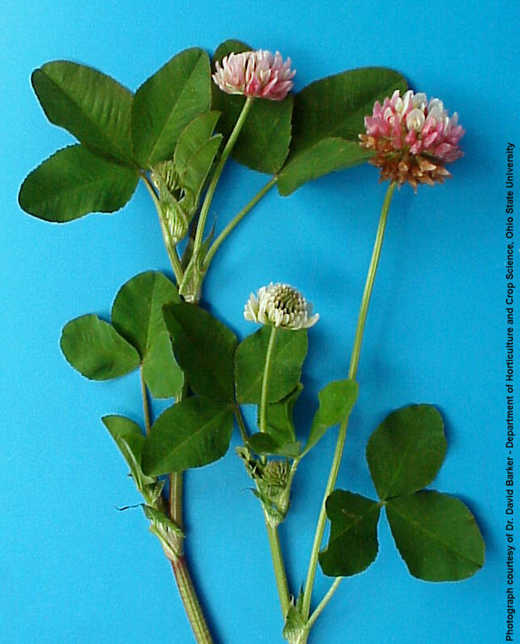
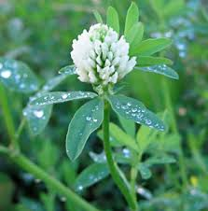
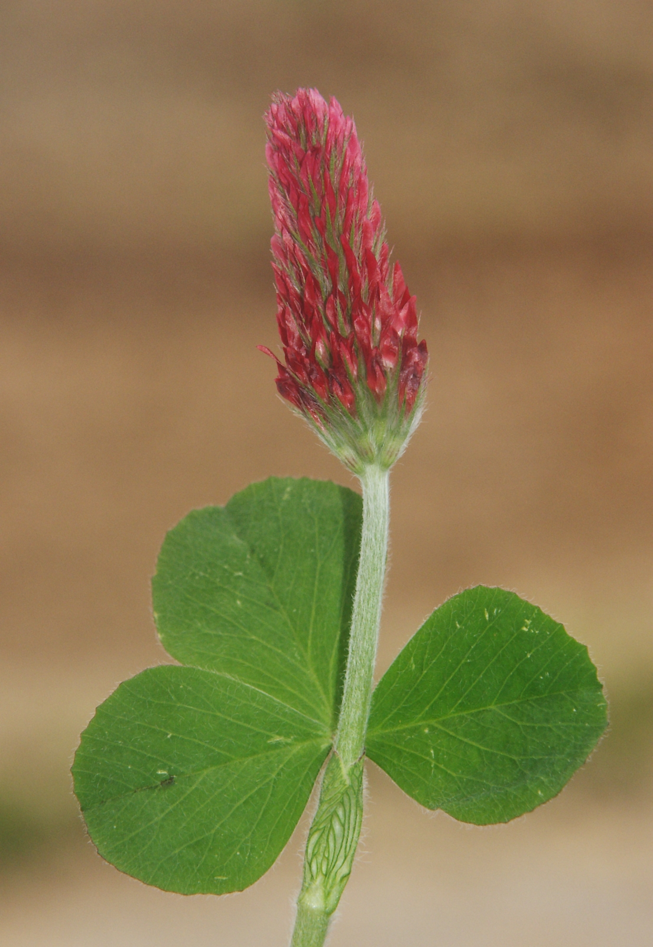
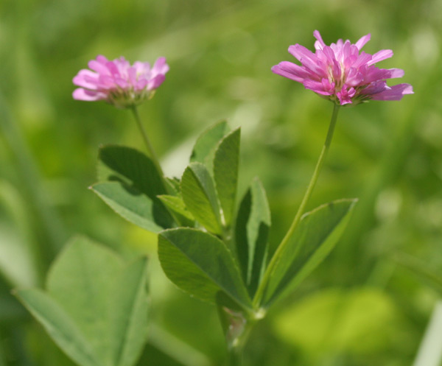
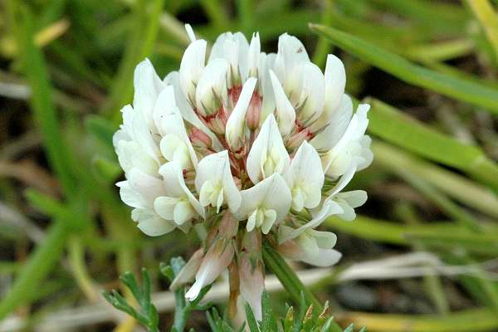
Clover, Trifolium spp., is grown particularly in the Northeastern and North Central united States.
Important species are Red Clover, Trifolium pratense, Alsike Clover, T. hybridum, Ladino or White Clover, T. repens, and Crimson Clover, T. incarnatum.
Trifolium pratense
Trifolium repens
Trifolium alexandrinum
Trifolium hybridum
Trifolium incarrnatum
Trifolium resupinatum

Slide 5
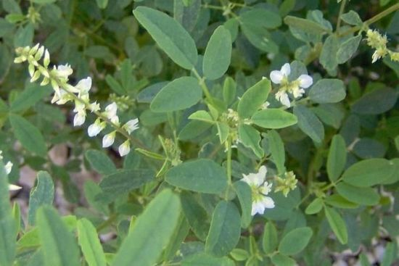
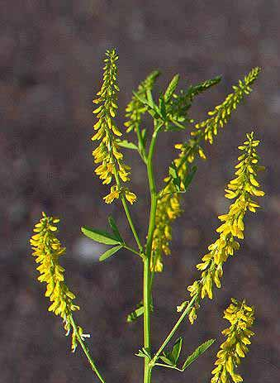
Sweet Clover
Sweet clovers, Melilotus spp., have become important forage crops since the beginning of the 20th Century.
Most production is centered in the Corn Belt of the United States.
Both White Sweet Clover, Melilotus alba, and Yellow Sweet Clover, M. officinalis, are grown.

Slide 6
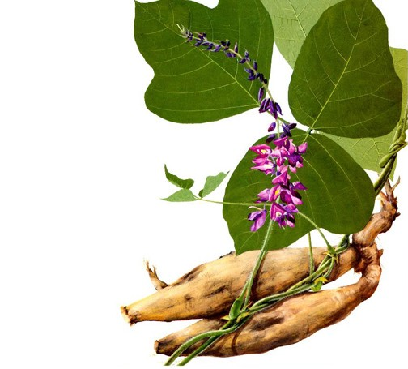
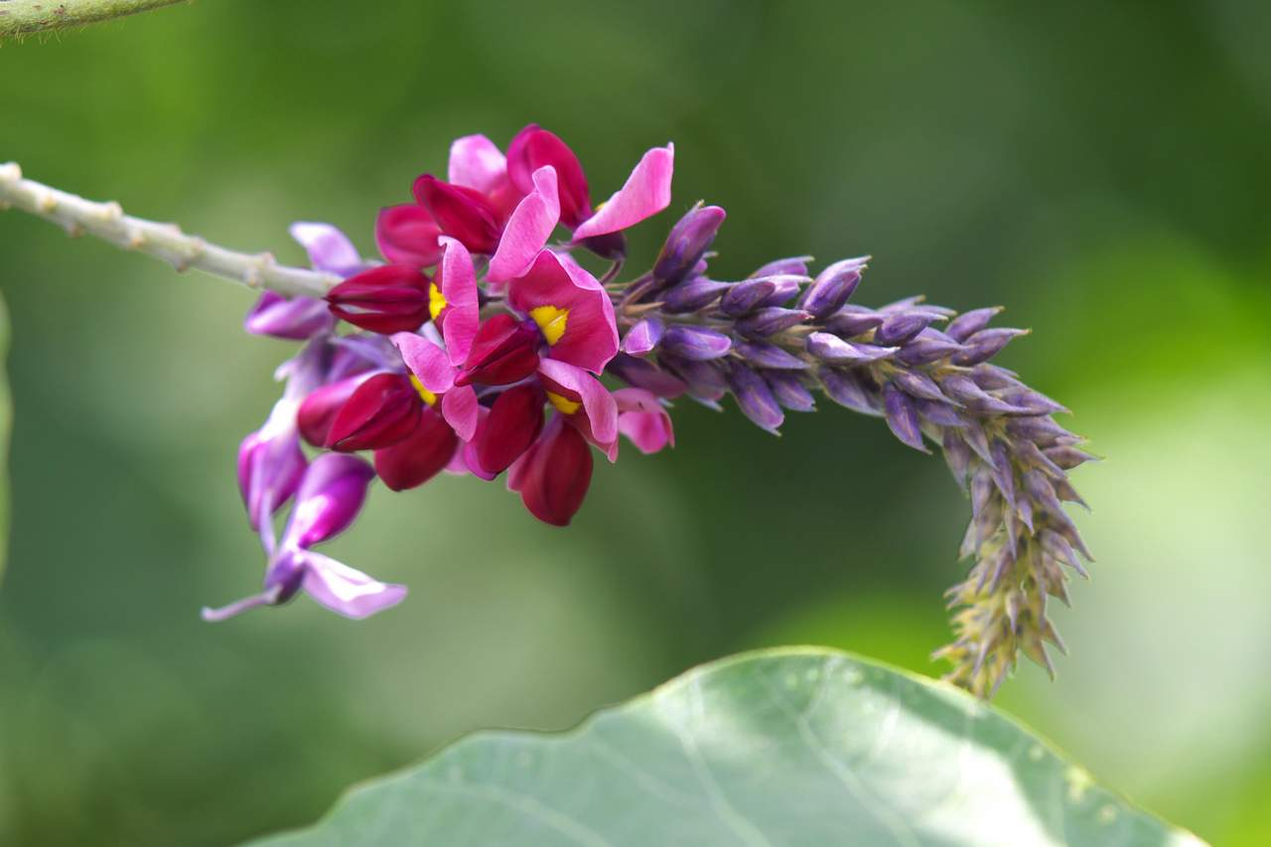
Kudzu Bean, Pueraria lobata, is a drought-tolerant perennial legume indigenous to Japan and Eastern Asia.
It was introduced into the Southeastern United States in the middle 20th Century.
The pods can be used and a valuable starch is obtained form the large roots.

Slide 7
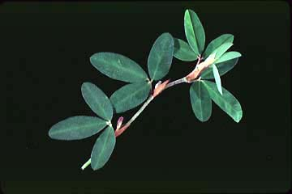
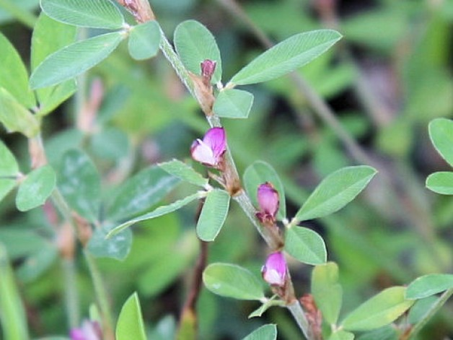
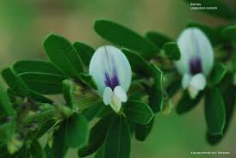
Lespedas: Three species of Lespedeza of some importance in the Southeastern United States are the annual Common Lespedeza, Lespedeza striata, a Korean species, L. stipulacea and a perennial from China, L. cuneata.
Lespedeza stipulacea
Lespedeza striata
Lespedeza cuneata

Slide 8
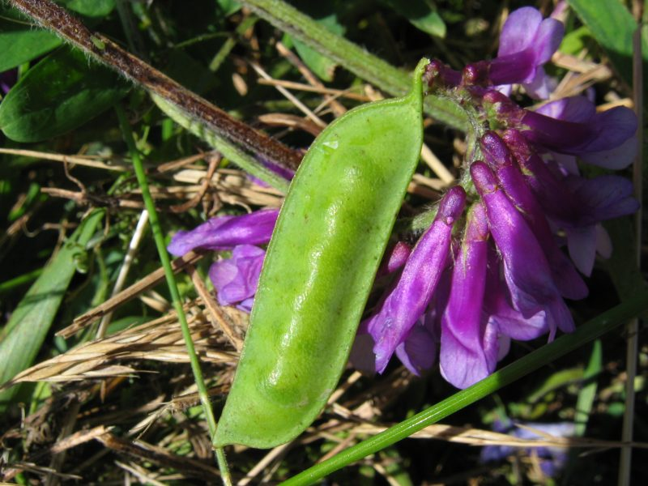
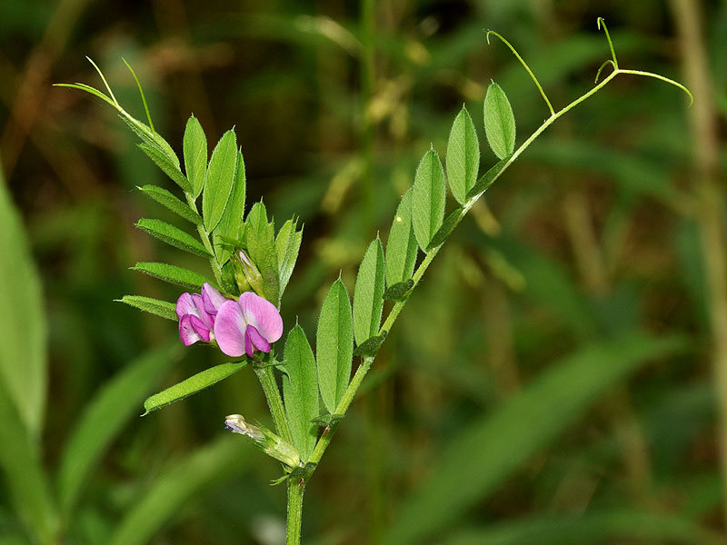
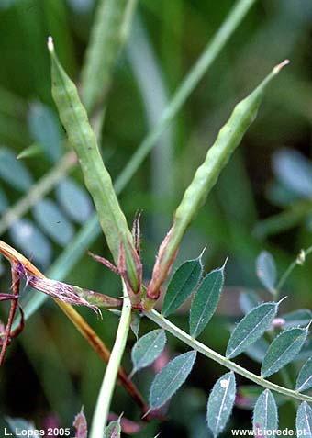
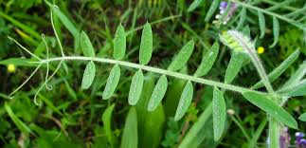
Vetches: There are a number of Vicia spp, both native and introduced, that are used for forage, especially in the coastal areas of the United States.
Two species of importance are Common Vetch, Vicia sativa, and Hairy Vetch, V. villosa.
Vicia sativa
Vicia villosa

