Slide 1
Wheat Grain Structure & Composition
1

Slide 2
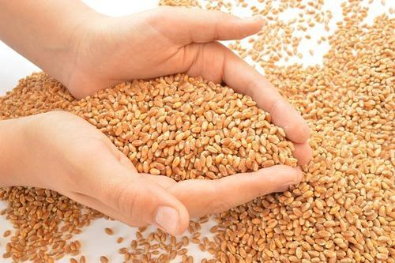
Wheat
Wheat is prominent among the cereals
Unique dough-forming properties
The gluten protein-viscoelastic properties
Major types:
Common wheat (Triticum aestivum) Breads (leavened and unleavened), noodles, breakfast cereals, (processed porridge), cakes, cookies, chapatis, snack foods, bulgur, animal feed, industrial uses
Durum wheat (Triticum turgidum subsp. Durum) Pasta (e.g., spaghetti, macaroni)
2

Slide 3
Conti…
In the world about
65% of wheat grain is used directly as a human food,
21% as a feed for animals,
8% as a seed,
6% wheat grains goes for other industrial purposes.

Slide 4
Conti…
In Pakistan about 70% of the total wheat produced is consumed for the production of unleavened flat bread locally known as "chapatti" and its culinary variations like "tandoori roti", "naans", "prathas" and "poories".
30% of the rest wheat is used for production of other bakery products such as breads, cookies, cakes and pastries etc

Slide 5
5

Slide 6
PARTS OF A WHEAT GRAIN
1- Bran
14.5% of whole grain
It contain five layers
Epidermis
Epicarp Pericarp
Endocarp
Episperm or testa
Aleurone cells
6

Slide 7
Pericarp
Immature pericarp helps in the transport of nutrients to other parts of grain
Mature pericarp gives protection to endosperm
High in fiber
Low in proteins
Low in lipids except rice grain pericarp
Devoid of starch except sorghum
7

Slide 8
Episperm or testa
Contain colouring matter that distinguishes the berry as being of red or white
Aleurone layer
Help in synthesis and transport of nutrients
Devoid of starch
High in protein
High content of vitamin B
Low in fiber
8

Slide 9
Caryopsis
Caryopsis is the technical name of grain or kernel
Two types of caryopsis
1. Covered caryopsis
Hull or husk remained attached even after harvesting examples are rice, barley

Slide 10
2. Naked caryopsis
Hull or husk is removed during harvesting examples are wheat, maize
Covered caryopsis has
Higher Ash
Higher Fiber
Higher minerals content

Slide 11
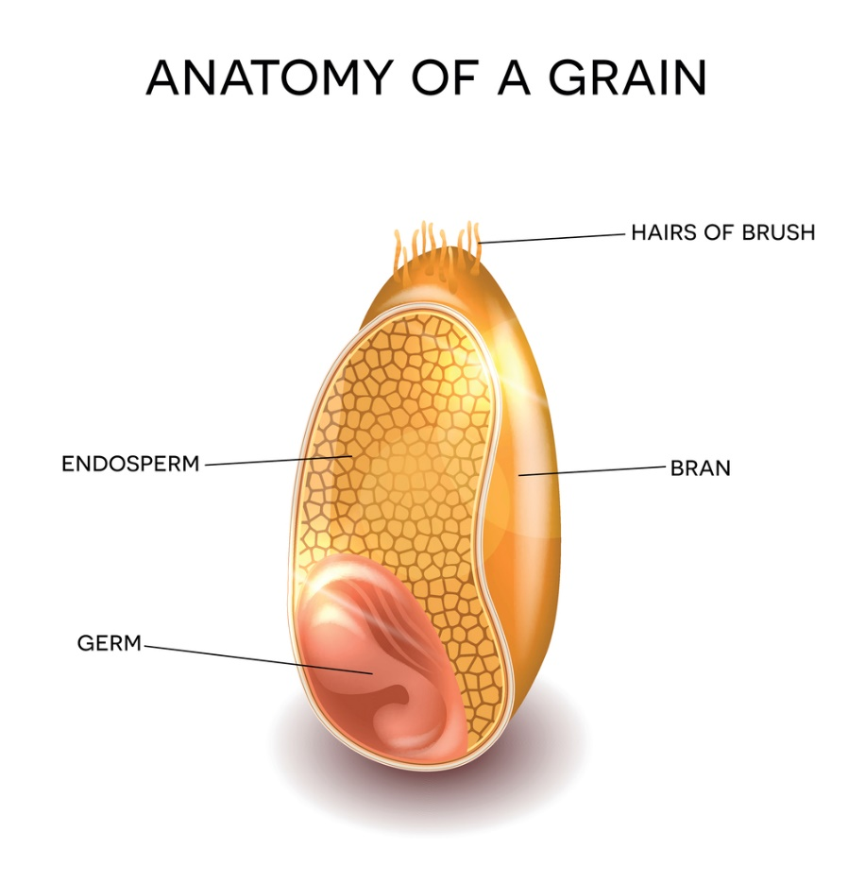
2- Endosperm
83% of whole grain
High in starch
Low in fiber
Low in ash
Low in lipids except oat
Low in proteins
11

Slide 12
3- Germ
2-3% of whole grain
Reproductive part
Devoid of starch
low in proteins
High in lipids (Linoleic acid, palmtic acid, oleic acid, linolenic acid)
Low in ash
High in fat soluble vitamin (Vitamin E) except vitamin B
12

Slide 13
Composition of Wheat Grain
1- Moisture
At harvesting 12-18%
Increases in rainy season
Decreases in dry season
Vital role in wheat quality
MC should not increase during the storage period, increase in moisture will result in mold growth
13

Slide 14
Moisture
Moisture content of wheat should not increase more than 15% during storage, increase in moisture will decrees the life of the grain
Moisture content | Storage life in
8-10 % | 4 years
11-13 % | 2 years
14-16 % | 1 year
17-19 % | 6 months

Slide 15
2-Proteins
Varies from 8-16%
Variation is due to
Rainfall
Climate
R.H
Fertilizers
Irrigations
Variety
15

Slide 16
Classification of Wheat Proteins
Classification on the basis of solubility
Albumin (Water soluble)
Globulin (Salt soluble)
Gliadin or Prolamines (Alcohol soluble)
Glutenin (Acid soluble)

Slide 17
Classification on the basis of storage
Storage proteins
(Gliadin & Glutenin)
Non Storage proteins
(Albumin & Globulin)
Albumin 10%
Globulin 10%
Gliadin 40%
Glutenin 40%

Slide 18
Wheat Gluten
Gluten protein does not exit as such in wheat flour, rather gluten is developed during the kneading
Wheat gluten is combination of gliadin and glutenin
Wheat gluten makes 80% of the total wheat and hence called as major wheat protein
The gluten protein-viscoelastic properties

Slide 19
Distribution of wheat protein in different parts of grain
Pericarp 8%
Endoperm 83%
Germ 3-5%
Bran and germ has higher content of essential amino acids compared with endosperm
Biological value of whole grain protein is higher than endospermic protein

Slide 20
Biological value
Measure of absorbed protein from food which become incorporated into human body
Food | Biological value
Egg white | 100
Chicken | 80
Fish | 76
Beef Mutton | 74
Milk | 60
Whole Wheat flour White Flour | 64 41

Slide 21
Gluten Determination in Wheat Flour
Wet Gluten
AACC
(American Association of Cereal Chemist)
AOAC
(Association of Analytical chemist)
AACC Method No 38-10
Water Absorption
Amount of water required to make a dough of desired consistence (Farinograph)

Slide 22
Take flour sample and add water
25 gram flour 17 ml water
50 gram flour 34 ml water
100 gram flour 64 ml water
Make a dough ball and start kneading
Keep on kneading till gluten is developed
When glute is developed give the dough ball a smooth round surface
Put this dough in beaker full of water
Keep the dough ball remain in water for 45 minutes

Slide 23
After 45 minute take the dough ball out and start washing under tab
Wash till all the starch and water soluble materials and proteins are remove
Confirmation
For confirmation that all the water soluble material is removed, squeeze the dough ball in clear water, if starch is present water will become cloudy, if its cloudy repeat the procedure till all the starch and water soluble materials are removed from dough

Slide 25
Wheat Carbohydrates
Starch
The main carbohydrate present is starch
All the starch is present in endosperm
Starch is a polysacchride composed of amylose and amylopectin
Amylose
Glucose units are linked together in a straight chain making 1,4 glucosidic bonding

Slide 26
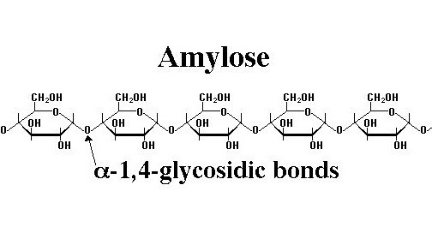
In case of amylose about 70-350 glucose units are linked together in a straight chain

Slide 27
Amylopectin
Amylopectin has both 1,4 and 1,6 glucosodic bonding
Its Highly branched structure
Serval hundred glucose units are linked together
In normal starch one part of amylose and 3 parts of amylopectin

Slide 28
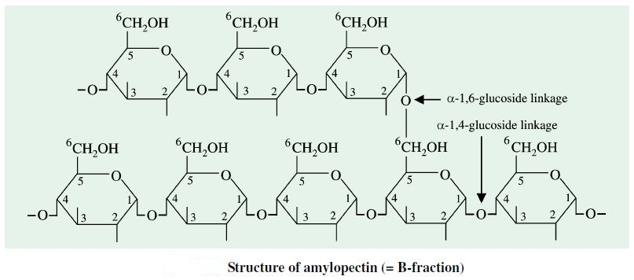
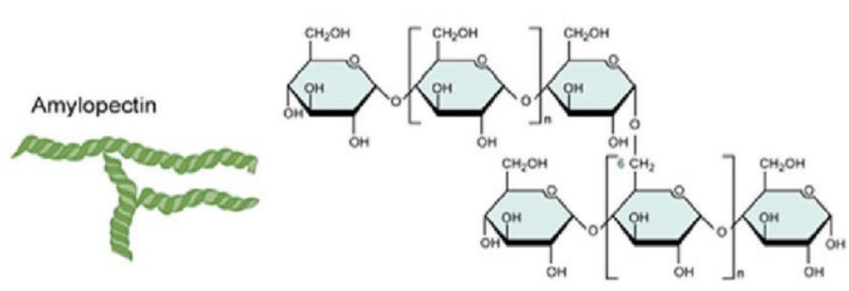
Amylopectin Structure

Slide 29
Amylo Cereals
Amylo cereals have 25% amylose and 75% amylopectin
Examples are ordinary eatable cereals
Waxy Cereals
Waxy cereals have 0% amylose and 100% amylopectin
Example is waxy corn
Waxy cereals are are not used as food purpose rather have industrial uses
In paper and textile industry as adhesive material

Slide 30
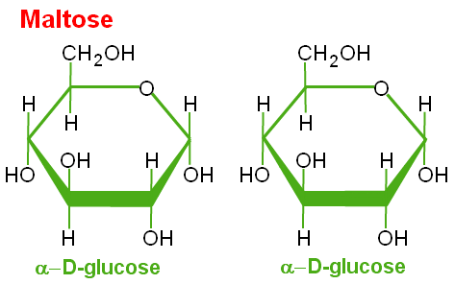
Properties of Starch
Starch is insoluble in cold water and soluble in hot water
Starch could be hydrolyzed into simpler molecules either by heating, with an acid or enzymes
Starch can be converted into maltose, which is utilized by yeast to produce alcohol

Slide 31
Gelatinization of starch
When starch is heated at 59 °C the starch get gelatinized
Starch absorb water and swells five times its original size
This property of search is widely use in food industry
Bread making
Soups
Jellies
Custard

Slide 32
Wheat Enzymes
Amylases
Amylases are hydrolases as they catalyse the hydrolysis of starch
α- Amylases
They are endo hydrolase
Act randomly on starch chain internally without any regular pattern
Produce a mixture of dextrin, maltose and other oligosaccharides

Slide 33
α- Amylases slowly react with damage starch and rapidly react with gelatinized starch
Damage starch
It refers to the portion of kernel starch that has been physically broken or fragmented during wheat milling.
Damage starch is a valuable parameter for assessing the quality of flours used in breads, cookies and other baked products
Calcium act as activator of this enzyme
Phytic acid act as inhibitor of this enzyme due to reaction with calcium and make it unavailable

Slide 34
β-Amylase
It is called exo hydrolases as it causes the breakdown of starch from side chains with a regular pattern
I acts on 1,4 glucosidic bonding of both amylose and amylopectin
This enzyme convert starch into maltose
For amylopectin its conversion is 60% due to the presence of 1,6 glucosidic bonding

Slide 35
Amount of maltose in a flour is an indication of β-Amylase activity
β-Amylase is inactive prior to germination but becomes active after germination
In high quality wheat flour the content of both α- Amylases and β-Amylase is low but if the rain comes before harvesting the inactive form of both these enzymes is converted into active form

Slide 36
Limit Dextrin
Highly branched polysaccharide fragments remaining after exhaustive hydrolysis of amylopectin by β-Amylase
Pullulanase or 1,4 and 1,6 glucosidase
This enzyme is capable of hydrolyzing 1,4 and 1,6 glucosodic bonds

Slide 37
Protease Enzyme
Protease breakdown the protein content
Protease reduces the consistency of dough after mixing
Endosperm has low proteolytic activity whereas as the aleuron, pericarp and germ being the main source
If flour is strong we can add proteases enzyme to
Reduce mixing time
Improve the extensibility

Slide 38
3-Ash
1.0-2.5%
Ash represents the inorganic compounds or minerals content of any food
Ash content depends upon type of flour whole wheat flour has higher ash content compare with white flour
Minerals are mostly attached with bran layer
Iron
Copper
Zinc
Phosphorous
Magnesium
38

Slide 39
4-Crude fiber
1-3.5%
Influenced by
- Grain size
- Grain shape
5-Vitamins
Whole wheat flour is a good source of Thiamine, Niacin and Riboflavin. Other B complex vitamins are present in small amount
Wheat germ is a rich source of vitamin E
Vitamin A, D and C is lacking in wheat

Slide 40
5- Fat
1-3%
Sometimes <2%
Lipids are mainly concentrated in germ portion
Wheat germ oil is a good source of vitamin E and polyunsaturated fatty acids
40

