Slide 1
Environmental impact assessment and initial environmental examination
SAEED HASSAN

Slide 2
Since the onset of industrialization various activities has impacted our environment in various ways leading to pollution and environmental degradation . Various pollution sources include : •Mining •Acid mine drainage •Heavy metals – Hg, Cr, Pb •Industrial / Commercial Pollution •Dyes and pigments •Petroleum / gasoline •Agricultural runoff •Pesticides •Nutrients – nitrates, phosphates •Salinization – Sodium, chloride •Sewage •Nutrients – Nitrates, phosphates •Contaminated animal feed

Slide 4
Introduction
All this pollutions can cause a great danger to humans and plant in the environment .
So as to minimize the negative effect of this pollutions scientists have various geophysical method to access the Impact on the environment where such things are carried out . This process is called ENVIRONMENTAL IMPACT ACCESSMENT (EIA).
So it is generally define as the process of examining the impacts of development on environment.

Slide 5
Major components of EIA
A summary of the EIS
A statement concerning the proposed acts, their purpose, and the need for the project.
A strict comparison of reasonable alternatives.
A to the point description of the environment affected by the proposed project.
A discussion of the proposed project, its environmental consequences, and alternatives. This must include direct and indirect effects; energy requirements and conservation potential; possible depletion of resources; impact on urban quality and cultural and/or historical resources; possible conflicts with state or local land-use plans, policies, and controls; and mitigation measures.

Slide 6
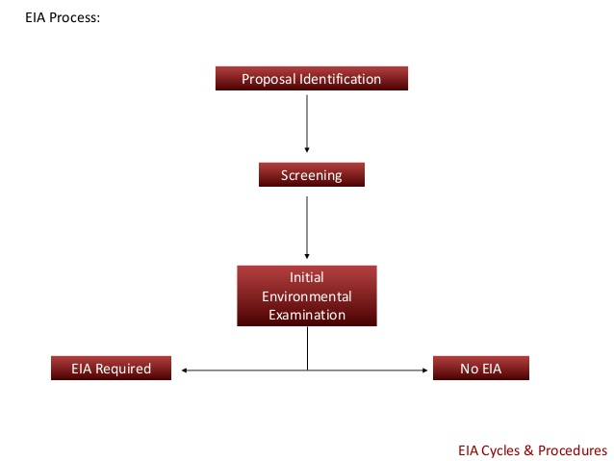

Slide 7
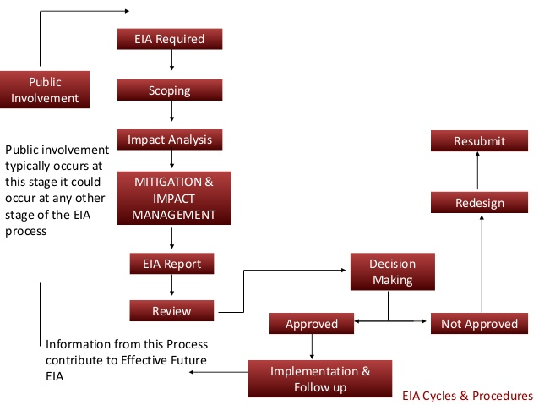
Scoping is the process of identifying important environmental issues that require detailed evaluation early in the planning of a proposed project.
Mitigation involves identifying actions that will avoid, lessen, or compensate for anticipated adverse environmental impacts of a particular project.

