Slide 1
Gene-environment interaction
Genetic resources and conservation
BS Biotechnology (6th Semester)
University of Sargodha

Slide 2
Gene-environment interactions
Gene–environment interaction (or genotype–environment interaction or G×E) is when two different genotypes respond to environmental variation in different ways.

Slide 3
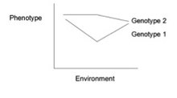
Gene-environment interactions
A norm of reaction (gene environment interaction) is a graph that shows the relationship between genes and environmental factors when phenotypic differences are continuous. They can help illustrate GxE interactions.
When the norm of reaction is not parallel, there is an interaction between gene and environmental factors. Each genotype responds to environmental variation in a different way. Environmental variation can be physical, chemical, biological, behavior patterns or life events.
No interaction
Strong
gene-environment interaction

Slide 4
Methods to analyse Gene environment interaction
Traditional Genetic Designs
Adoption studies: These studies have been used to investigate how individuals that have been adopted by different parents with different environments are influenced by genetics and environmental factors. For example, an adoption study showed that Swedish men with disadvantaged adoptive environments and a genetic predisposition were more likely to abuse alcohol.
Twin studies: Using monozygotic twins, the effects of different environments on identical genotypes could be observed. Later studies also included the comparisons of dizygotic twins to ultimately determine the different levels of gene expression in different environments.
Family studies: Family-based research focuses on the comparison of low-risk controls to high risk children to determine the environmental effect on subjects with different levels of genetic risk. For example, a Danish study on high-risk children with schizophrenic mothers depicted that children without a stable caregiver were associated with an increased risk of schizophrenia

Slide 5
Methods to analyse Gene environment interaction
Molecular analyses
Interaction with single genes: The often used method to detect gene–environment interactions is by studying the effect a single gene variation ( candidate gene) has with respect to a particular environment. Single nucleotide polymorphisms (SNP’s) are compared with single binary exposure factors to determine any effects. These studies are also often difficult to replicate commonly due to small sample sizes which typically results in disputed results. The polygenic nature of complex phenotypes suggests single candidate studies could be ineffective in determining the various smaller scale effects from the large number of influencing gene variants.
Interaction with multiple genes: Since the same environmental factor could interact with multiple genes, a polygenic approach can be taken to analyze GxE interactions. A polygenic score is generated using the alleles associated with a trait and their respective weights based on effect and examined in combination with environmental exposure. Though this method of research is still early, it is consistent with psychiatric disorders.
Genome-wide association studies and genome wide interaction studies: A genome wide interaction scan (GEWIS) approach examines the interaction between the environment and a large number of independent SNP’s. An effective approach to this all-encompassing study occurs in two-steps where the genome is first filtered using gene-level tests and pathway based gene set analyses. The second step uses the SNP’s with G–E association and tests for interaction. The differential susceptibility hypothesis has been reaffirmed through genome wide approaches

Slide 6
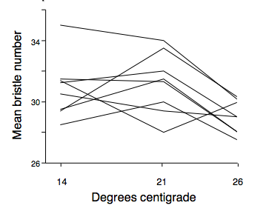
Example of gene-environment interaction
In Drosophila: A classic example of gene–environment interaction was performed on Drosophila by Gupta and Lewontin in 1981. In their experiment they demonstrated that the mean bristle number on Drosophila could vary with changing temperatures. As seen in the graph below, different genotypes reacted differently to the changing environment. Each line represents a given genotype, and the slope of the line reflects the changing phenotype (bristle number) with changing temperature. Some individuals had an increase in bristle number with increasing temperature while others had a sharp decrease in bristle number with increasing temperature. This showed that the norms of reaction were not parallel for these flies, proving that gene–environment interactions exist.

Slide 7
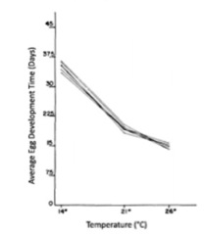
Example: Lack of gene-environment interaction
Contrary to the aforementioned example, length of egg development in Drosophila as a function of temperature demonstrates the lack of gene–environment interactions. The attached graph shows parallel reaction norms for a variety of individual Drosophila flies, showing that there is not a gene–environment interaction present between the two variables. In other words, each genotype responds similarly to the changing environment producing similar phenotypes. For all individual genotypes, average egg development time decreases with increasing temperature. The environment is influencing each of the genotypes in the same predictable manner. It means different genotypes do not respond to the environmental factor differently.

