Slide 1
History and Geography
Topic: Maps and use of Maps
By
Shamsa Mubeen

Slide 2
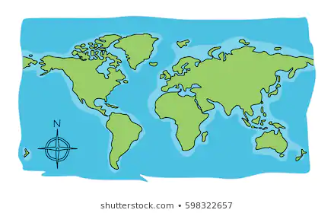
Definition of Maps:
a diagrammatic representation of an area of land or sea showing physical features, cities, roads, etc
A map is a symbolic representation of selected characteristics of a place, usually drawn on a flat surface

Slide 3
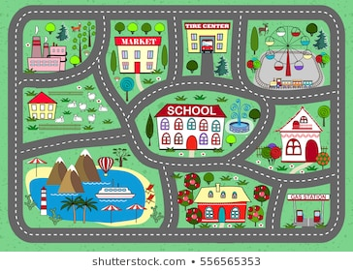

Slide 4
Basic Types of Maps:
There are two types of maps
1: Thematic Maps
2: Reference Maps

Slide 5
Reference Maps
show the location of geographic boundaries, physical features of Earth, or cultural features such as places, cities, and roads
Political maps
physical maps
road maps
topographic maps
time zone maps
geologic maps
zip code maps

Slide 6
Thematic Maps
A thematic map shows the spatial distribution of one or more specific data themes for selected geographic areas. The map may be qualitative in nature (e.g., predominant farm types) or quantitative (e.g., percentage population change).
Weather maps
Income maps
Resource maps

Slide 7
Political maps:
"Political maps" are among the most widely used reference maps. They are mounted on the walls of classrooms throughout the world. They show the geographic boundaries between governmental units such as countries, states, and counties. They show roads, cities and major water features such as oceans, rivers and lakes.
Political maps help people understand the geography of the world. They are usually the first type of map that students are introduced to in school. They are also known as "reference maps" because people refer to them again and again as they have questions.

Slide 8
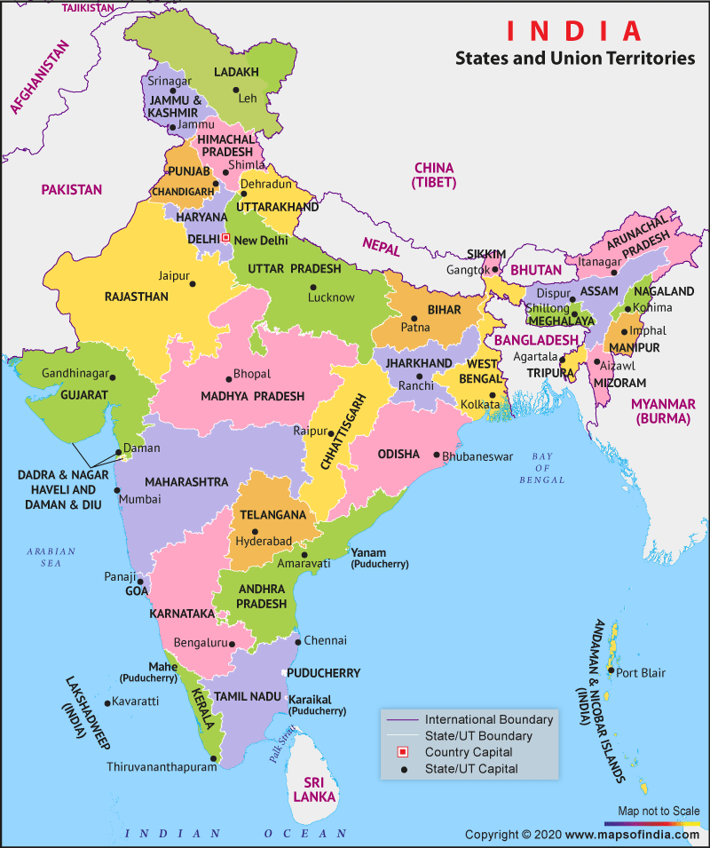

Slide 9
Physical Maps
Physical maps are designed to show the natural landscape features of Earth. They are best known for showing topography, either by colors or as shaded relief. Physical maps often have a green to brown to gray color scheme for showing the elevation of the land. Darker greens are used for near-sea-level elevations, with the color grading into tans and browns as elevations increase. The color gradient often terminates in shades of gray for the highest elevations.
Rivers, lakes, seas and oceans are usually shown in blue, often with a light blue color for the most shallow areas and darkening in a gradient or by intervals for areas of deeper water. Glaciers and ice caps are shown in white colors.

Slide 10
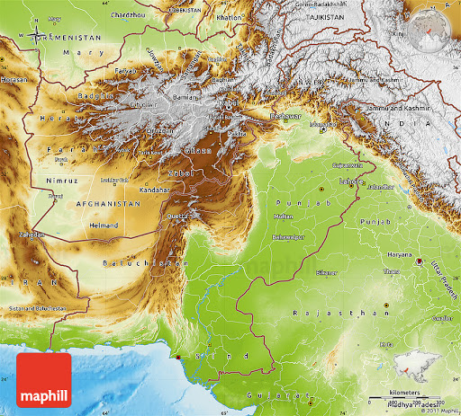

Slide 11
Road, street and Highway maps
Navigational water, railways, motorways, cycling and hiking trails. All types of roads fall within this category. However, the title is usually associated with highways. Road maps are available in all types of formats and many more areas. A trusted companion for in the car or on the bike.
“Road maps are available in all shapes and sizes, from a local to a national level.”

Slide 12
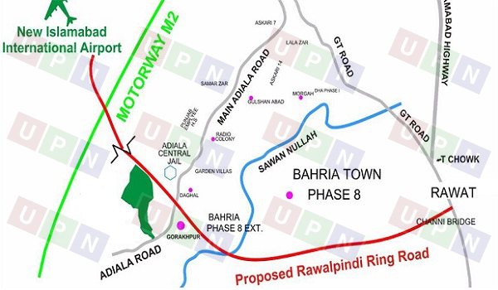

Slide 13
Topographical maps
The distinctive characteristic of a topographic map is the use of elevation contour lines to show the shape of the Earth's surface. Elevation contours are imaginary lines connecting points having the same elevation on the surface of the land above or below a reference surface, which is usually mean sea level. Contours make it possible to show the height and shape of mountains, the depths of the ocean bottom, and the steepness of slopes.

Slide 14
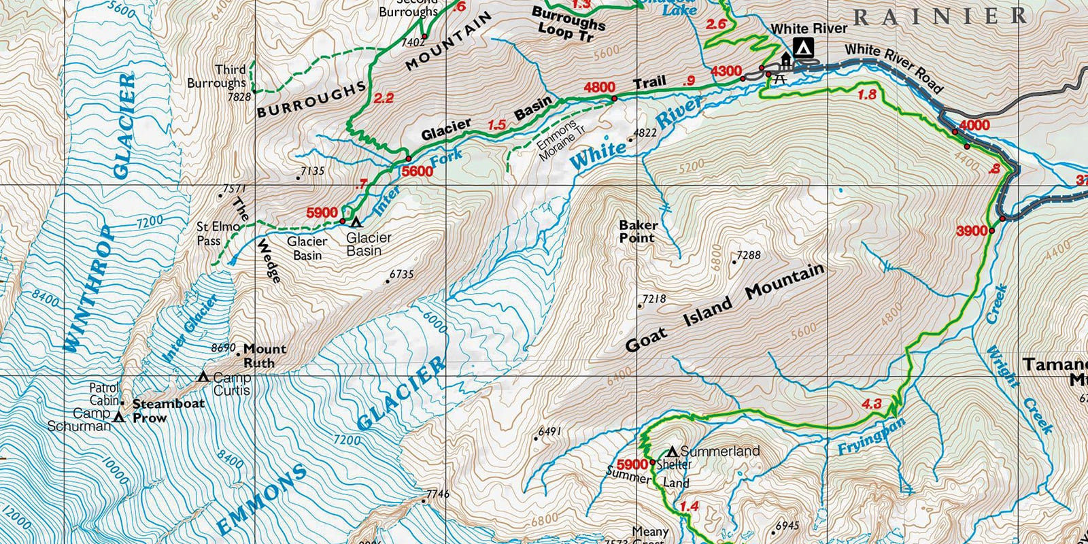

Slide 15
Time Zone maps
The world time zone map uses a repeating color scheme to designate the different standard time zones observed in each country. Most countries do not adjust their time zone observance and when they do it most likely involves small boundary changes or changes in the observance of daylight saving time.

Slide 16
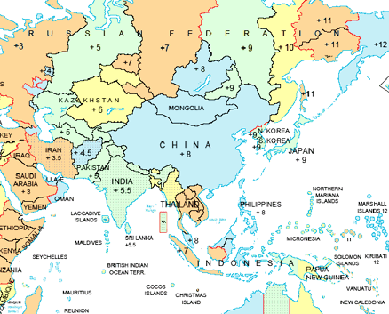

Slide 17
Geological maps:
A geologic map is a special-purpose map made to show various geological features. Rock units or geologic strata are shown by color or symbols. Bedding planes and structural features such as faults, folds, are shown with strike and dip or trend and plunge symbols which give three-dimensional orientations features.

Slide 18
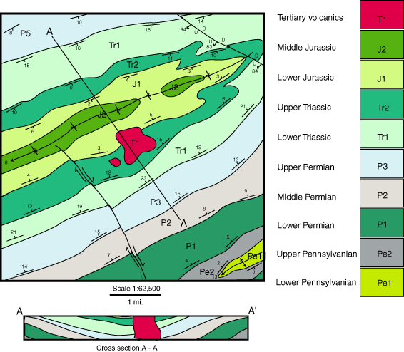

Slide 19
Zip code maps
US ZIP codes are a type of postal code used within the United States to help the United States Postal Service (USPS) route mail more efficiently. ZIP codes near me are shown on the map above. Some still refer to ZIP codes as US postal codes. The term ZIP stands for Zone Improvement Plan. The basic 5-digit format was first introduced in 1963 and later extended to add an additional 4 digits after a dash to form a ZIP+4 code

Slide 20
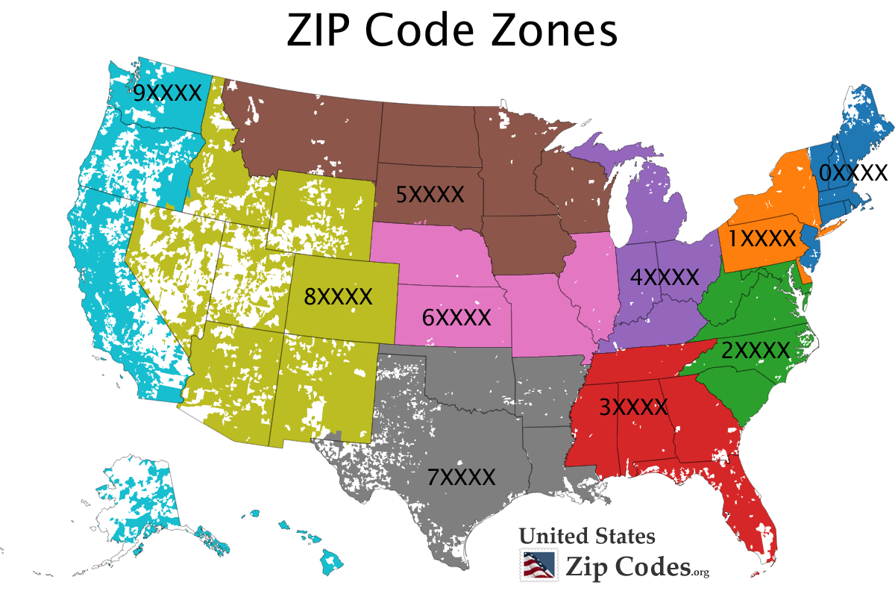

Slide 21
Weather Maps
A weather map, also known as synoptic weather chart, displays various meteorological features across a particular area at a particular point in time and has various symbols which all have specific meanings.[1] Such maps have been in use since the mid-19th century and are used for research and weather forecasting purposes.

Slide 22
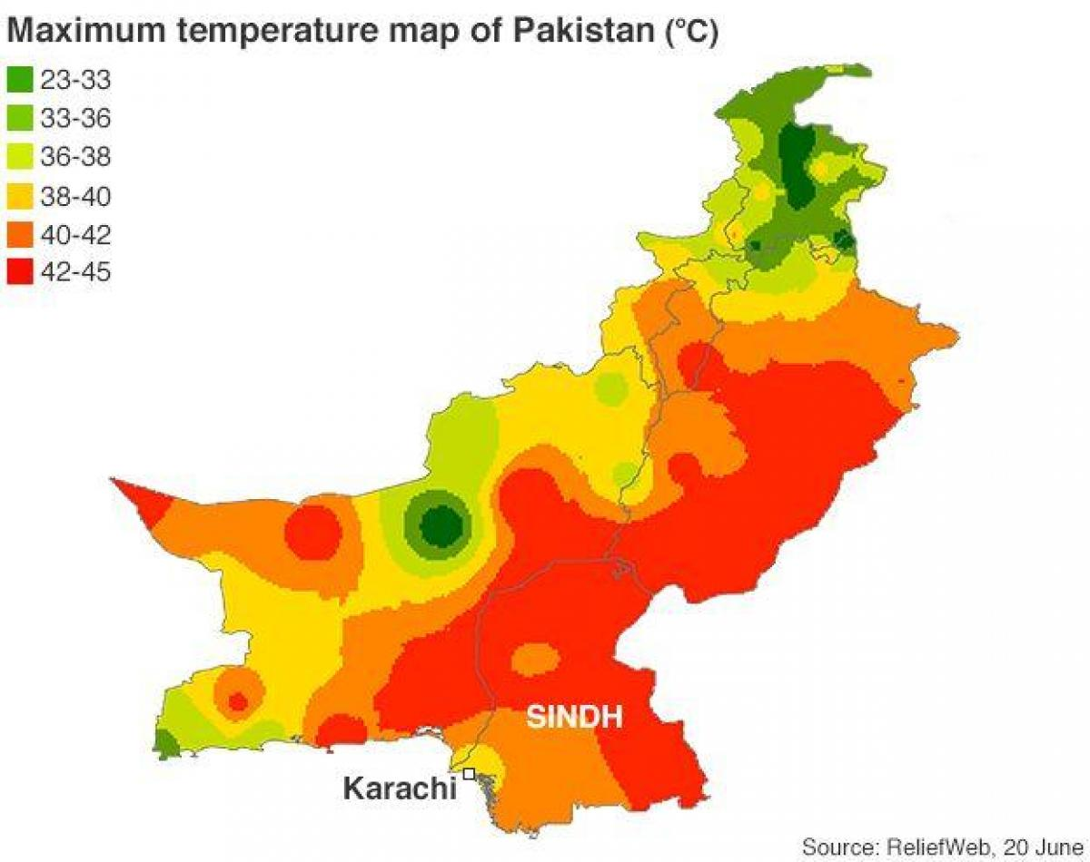

Slide 23
Income Maps

