Slide 1
WHAT ARE THE 10 KEY ELEMENTS OF A MAGAZINE LAYOUT DESIGN?
There are several important elements in a magazine layout, such as headline, image, image caption, running head, byline, subhead, body copy, etc. Here, we look into the ten most crucial (key) elements of a magazine layout.

Slide 2
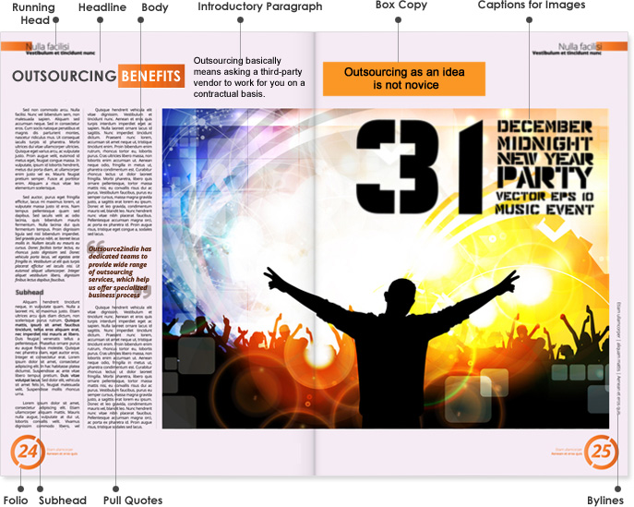

Slide 3
Headline
It is the most important element of a magazine layout design. It can be of various sizes, but should be set in a size bigger than the other text elements in the page. A headline should be interesting, meaningful and compelling enough as it increases the chances of an article to be read.

Slide 4
Introductory Paragraph
Also known as "intro" "kicker", "deck" or "stand-first", an introductory paragraph is the main piece of content that introduces a reader to an article. It carries forward what a headline has succeeded in doing - catching the attention of a reader. It connects a reader to the main article, taking forward a reader's journey into the midst of the article.
It sets the tone of the article for a reader and sometimes, also summarizes the entire article. In terms of font size, it should be smaller than the font size of the headline of an article. But, it should be slightly bigger or at least a little bolder than the rest of the article.

Slide 5
Body / Body Text / Body Copy
This is a more lengthy and detailed part of a magazine article when compared to the introductory paragraph of the heading / headline of an article. A well-written body copy keeps a reader engaged to an article for the most part, generally till the end of the article.
When one begins to design the magazine layout template, they should begin with designing the body copy of an article, because that takes maximum space, running into multiple paragraphs. It is important that you set the right margins in terms of columns and rows to improve readability. A key point to note here is that you should be consistent with the length of the body copy for all the articles in the magazine.

Slide 6
Bylines
It is important that you acknowledge the person and the team which has worked on an article. Usually, the author's name is written under the headline of the article, which is also known as the byline. It can be written in the same font size as that of the body copy.

Slide 7
Sub-headline / Subhead
These are used to break an article into various sections or compartments, indicating what the next set of paragraphs is going to talk about. It can be written in the same font in which the body copy is written, but it should stand out from the body copy at the same time. Hence, you can keep it "bold" so that it looks like a mini-heading or headline. An important thing to bear in mind is that you should not place subheads below an image or a quote in an article.

Slide 8
Pull Quotes
These usually provide a different dimension to an article in a magazine, making it look more interesting. Quotes aid in conveying your story to a reader, and if coupled with images, become potent. You can either have a quote verbatim from a portion of the body copy, or you could perhaps summarize a few points of the body copy in different words and have them as a quote or an excerpt. Ideally, the quotes or excerpts or blurbs should be in a font that is different from the font in which the body copy has been written.

Slide 9
Captions for Images
These should be written in a way that they complement the image being used in an article. A caption should describe an image and should ideally be placed immediately below the image. The font size for image captions can be the same as that of the font in which the body copy has been written or slightly smaller than that.

Slide 10
Section Head / Running Head
Every magazine article does not need a running head, but some do. These are usually placed at the top of every page of a magazine and aid readers in navigating through an article easily. A running head should be designed creatively so that it looks good, because it is present on almost all pages of the magazine and a reader sees it every now and then. So, it has to be visually attractive.

Slide 11
Folio
It should be designed in such a way that you do not annoy a reader who looks into it on almost every page of a magazine. It is a way of arranging sheets of papers in your magazine, by folding them in a certain manner. You should tread with caution especially when you have many pages in your magazine containing full bleed images. A reader could be annoyed if you place folios on those pages.

Slide 12
Box Copy / Panel
Such boxes contain important facts related to the topic of the article that a reader should know while reading a magazine article. These could be statistics or dates or anything factual in nature which is important to know and short in length. Such data is placed in a box to catch the attention of a reader. A box can have a dedicated heading as well.

