Slide 2
POSTURE
Dr Atif Malik

Slide 3
POSTURE
Attitude assumed by the body either with support during muscular inactivity, or by active co-ordinated action of the body muscles working together.
TYPE OF POSTURE:
Two type of posture
Inactive posture
Active posture

Slide 5
INACTIVE POSTURE
It is used during
Resting
Sleeping
Muscular activity is reduced to minimum
They make minimal demand on the essential body functions i.e. Respiration and circulation

Slide 6
ACTIVE POSTURE
This is in response to action of many integrated muscle activity.
This is of two type
Static posture
Dynamic posture

Slide 7
STATIC POSTURE: in this case muscle work statistically to stabilize the body joints and in opposition to gravity or other forces. In the erect posture they work to maintain the state of equilibrium.
DYNAMIC POSTURE: this is for efficient basis for movement. This is constantly modified and changed for the circumstances resulting from the movement.

Slide 8
POSTURAL MECHANISM
This involves following
The muscle
The nervous control

Slide 9
THE MUSCLE
The intensity and distribution of the muscle work that is required for the static or dynamic posture varies according to the pattern of the movement.
The muscle which are involved mostly are those which are involved in the erect position of body working against the gravity effects. These are the Anti gravity muscles they mostly act for the Extension of the joints.

Slide 10
THE MUSCLE
The anti gravity muscle are multi-pennate, fan shaped - - - - this result in the powerful action of the muscle against gravity.
Many of them are RED indicating the sustained contraction with out fatigue due to low metabolic rate of action.

Slide 11
NERVOUS CONTROL
Posture are maintained as a result of the neuro muscular co-ordination, and complex reflex mechanism

Slide 12
THE POSTURAL REFLEXES
Reflex is defined as the ‘an efferent response to the afferent stimulus’.
This is the motor response mostly antigravity muscles being the principle effector organs.

Slide 13
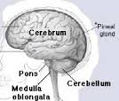
COORDINATION CENTER
The chief coordination center involved are
Cerebral cortex
Cerebellum
Red nucleus
Vestibular nucleus

Slide 14
AFFERENT STIMULI
These are arising from variety of sources
The muscle
The eye
The ear
Joint structure
Skin sensations

Slide 15
THE AFFERENT STIMULI
THE MUSCLE: neuromuscular and neurotendinous spindles within the muscle record changing tension.
Increase in tension cause stimulation lead to reflex contraction this may be Myotatic or stretch reflex.

Slide 16
THE EYE: this is one of the receptor for the rightening reflex which enable the head and body to restore themselves to erect position from other less usual attitude.
THE EAR: stimulation of vestibular nerve result from the movement of the fluid in the semicircular canals of the internal ear. Canals are in different plane, right angle to both the others, movement of the head lead to the distribution of the fluid.

Slide 17
JOINT STRUCTURE: in weight bearing the joint approximation lead to elicit reflex movement. These are in response to the proprioceptors that are located in the joints.
SKIN SENSATIONS: sole of the feet when body is in standing position.

Slide 18
THE PATTERN OF POSTURE
Pattern of posture, both static and dynamic result to the postural reflex. Some of them are inborn and some are conditioned, they result from repetition of the posture maintained by the voluntary control.
Posture are of two type.
Good posture
Poor posture

Slide 19
GOOD POSTURE
Posture is said to be good when it fulfill the purpose for which it is used.
i.e. with maximum efficiency and minimum effort
A dynamic posture involve the readjustment to maintain the efficiency of the postural background throughout the progress of the movement, they are much more like difficult to assess.
The muscle work is adjusted according to the requirement i.e. in erect position plane is vertical and in dynamic it may be horizontal

Slide 20
DEVELOPMENT OF GOOD POSTURE
Efficient posture develop quite naturally, provide the essential mechanism for its maintenance and adjustment are intact.
The factors involved are as following
A stable psychological background
Good hygienic condition
Opportunity for plenty of natural free movement

Slide 21
STABLE PSYCHOLOGICAL BACKGROUND: emotion and mental attitude has great effect on the individual.
Position of extension: Joy, happiness and confidence are reflected by alert posture
Flexion position: Unhappiness, conflict and a feeling of inferiority.
This connection between mental and physical attitude is always been recognized on stage and in dancing.

Slide 22
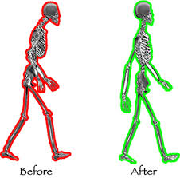
POSTURE

Slide 23
B. GOOD HYGIENIC CONDITION: particularly with regard to nutrition and sleep are essential for healthy nervous system and for the growth and development of bones and muscle.
C. OPPORTUNITY FOR THE PLENTY OF FREE MOVEMENTS: it develop harmonious development of the skeletal muscle. Activity that are much enjoyed are running, jumping and jogging and predominantly movement of active extension.

Slide 24
POOR POSTURE
When it is inefficient, that is when it fails to serve the purpose for which it was designed or unnecessary muscle work is used to maintain it.
i.e. standing square to the net while making a forehead derive at tennis.
Tension in the muscle other than those required to act either to produce movement or to maintain posture hinders the efficiency of both and waste energy.

Slide 25
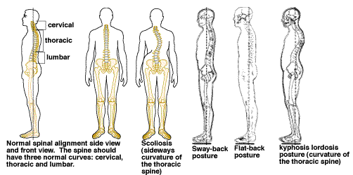
posture

Slide 26
FACTORS CAUSING POOR POSTURE
These are very obscure and if known even difficult to remove.
These may be because of following general condition
Mental attitude of the patient
Hygienic condition
Prolonged fatigue
Constitutional illness

Slide 27
Causes of Poor posture
Structural Causes
Permanent anatomical deformities not amenable to correction by conservative treatments
Positional Causes
Poor postural habit--for whatever reason, the individual does not maintain a correct posture
Psychological factors, especially self-esteem.
Respiratory conditions
General weakness
Loss of the ability to perceive the position of your body

Slide 28
CAUSES OF POOR POSTURE
Obesity
Pregnancy
Use High- heeled shoes
Shortening Of muscle
Decrease flexibility

Slide 29
ANY QUESTION

