Slide 1
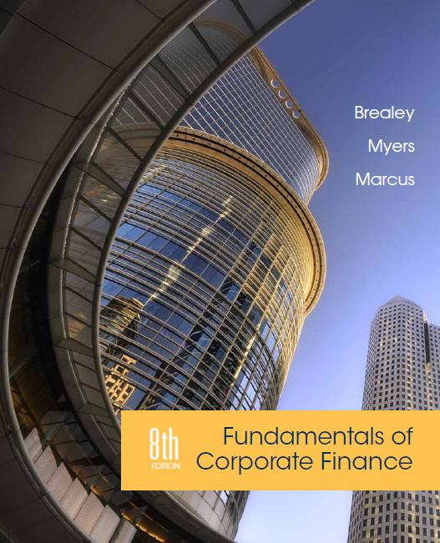
Chapter 19
Short-Term Financial Planning
Copyright © 2015 by The McGraw-Hill Companies, Inc. All rights reserved

Slide 2
Topics Covered
19.1 Links Between Long-Term and Short-Term Financing
19.2 Working Capital
19.3 Tracing Changes in Cash and Working Capital
19.4 Cash Budgeting
19.5 A Short-Term Financing Plan
19.6 Sources of Short-Term Financing
Notes:
2

Slide 3
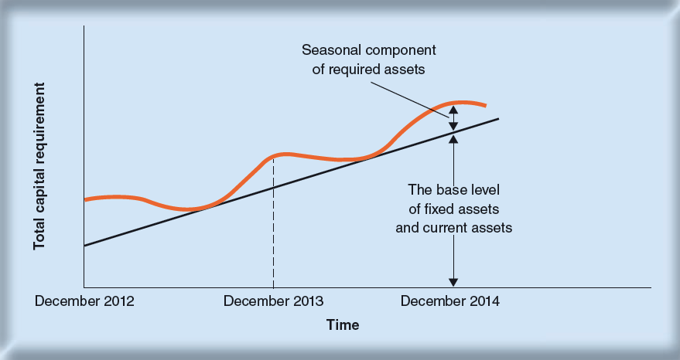
Firm’s Cumulative Capital Requirement
The firm’s total capital requirement grows over time. It also exhibits seasonal variation around the trend.

Slide 4
Firm’s Cumulative Capital Requirement
Dollars
A
B
C
Cumulative
capital requirement
Year 1
Year 2
Time
Lines A, B, and C show alternative amounts of long-term finance
Strategy A: A permanent cash surplus
Strategy B: Short-term lender for part of year and borrower for remainder
Strategy C: A permanent short-term borrower

Slide 5
Working Capital
Factors in establishing working capital levels:
Matching maturities
Permanent working capital requirements
The advantages of liquidity

Slide 6
Working Capital
Current assets and liabilities, U.S. manufacturing corporations, second quarter 2013 (figures in $ billions)

Slide 7
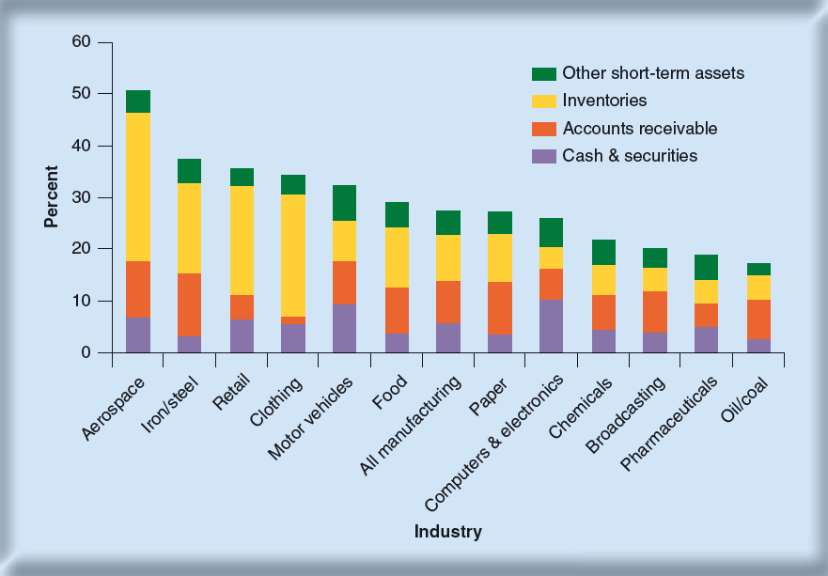
Working Capital
Current assets as a percentage of total assets in different industries

Slide 8
Working Capital
Net Working Capital
Current assets minus current liabilities
Often called working capital
Cash Conversion Cycle
Period between firm’s payment for materials and collection on its sales
Carrying Costs
Costs of maintaining current assets, including opportunity cost of capital
Shortage Costs
Costs incurred from shortages in current assets
Notes:
3

Slide 9
Working Capital
Simple Cycle of Operations
Cash
Receivables
Raw materials
inventory
Finished goods
inventory
Notes:
8

Slide 10
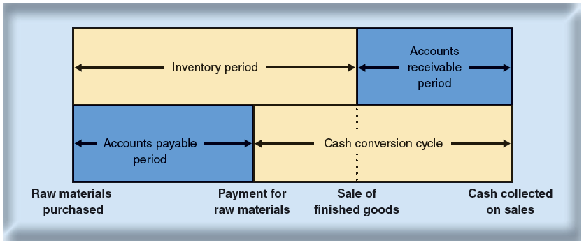
Working Capital
Cash Conversion Cycle

Slide 11
Working Capital
$$Cash conversion cycle=\left(inventory period+receivables period\right)$$
$$− accounts payable period$$
$$Inventory period=\frac{inventory}{annual COGS/365}$$
$$Accounts receivable period=\frac{accounts receivable}{annual sales/365}$$
$$Accounts payable period=\frac{accounts payable}{annual COGS/365}$$
Notes:
14

Slide 12
Working Capital
Example - Cash Conversion Cycle
Given the aggregate balance sheet and income statement for U.S. Manufacturing firms, calculate the cash conversion cycle.
Income Statement |  | Balance Sheet
 | 2013 |  | 2013
Sales | 6,660 | Inventory | 749
Costs | 6,120 | A/R | 701
 |  | A/P | 528
Notes:
15

Slide 13
Working Capital
Example - continued
Given the aggregate balance sheet and income statement for U.S. Manufacturing firms, calculate the cash conversion cycle.
Notes:
17

Slide 14
Working Capital
Example - continued
Given the aggregate balance sheet and income statement for U.S. Manufacturing firms, calculate the cash conversion cycle.
Notes:
18

Slide 15
Working Capital
Example - continued
Given the aggregate balance sheet and income statement for U.S. Manufacturing firms, calculate the cash conversion cycle.
Notes:
19

Slide 16
Working Capital
Example - continued
Given the aggregate balance sheet and income statement for U.S. Manufacturing firms, calculate the cash conversion cycle.
Inventory period = 44.7 days
Receivables period = 38.4 days
Payable period = 31.5 days
Cash conversion cycle = (44.7 + 38.4) – 31.5 = 51.6
Notes:
20

Slide 17
Changes in Cash & W.C.
Example - Dynamic Mattress Company
Assets | 2013 | 2014 | Liabilities and Equity | 2013 | 2014
Current assets |  |  | Current liabilities
Cash | $4 | $5 | Bank loans | $5 | $0
Market securities | 0 | 5 | Accounts payable | 20 | 27
Inventory | 26 | 25 | Total current liabilities | $25 | $27
Accounts receivable | 25 | 30 | Long-term debt | 5 | 12
Total current assets | $55 | $65 | Net worth | 65 | 76
Fixed assets |  |  | Total liabilities and owner’s equity | $95 | $115
Gross investment | $56 | $70
Less depreciation | 16 | 20
Net fixed assets | $40 | $50
Total assets | $95 | $115
Notes:
21

Slide 18
Changes in Cash & W.C.
Example - continued
Income Statement
Sales | $350
Operating costs | 321
Depreciation | 4
EBIT | $25
Interest | 1
Pretax income | $24
Tax at 50% | 12
Net income | $12
Assume:
Dividend = $1 million
R.E.= $11 million
Notes:
22

Slide 19
Changes in Cash & W.C.
Example - continued
Statement of Cash Flows
Cash flows from operating activities
Net income | $12
Depreciation | 4
Decrease (increase) in accts. receivable | -5
Decrease (increase) in inventories | 1
Decrease (increase) in accts. payable | 7
Net cash flow from operations | $19
Cash flow from investing
Investment in fixed assets | -$14
Cash flows from financing
Dividends | -$1
Sale (purchase) of securities | -5
Increase (decrease) in long-term debt | 7
Increase (decrease) in bank loans | -5
Net cash flows from financing | -$4
Increase in cash balance | $1
Notes:
23

Slide 20
Changes in Cash & W.C.
Example - continued
Dynamic Mattress Company Sources and Uses
Sources
Issued long-term debt | $7
Reduced inventories | 1
Increased accounts payable | 7
Cash from operations
Net income | 12
Depreciation | 4
Total sources | $31
Uses
Repaid short-term bank loan | $5
Invested in fixed assets | 14
Purchased marketable securities | 5
Increased accounts receivable | 5
Dividend | 1
Total uses | $30
Increase in cash balance | $1
Notes:
23

Slide 21
Changes in Cash & W.C.
Example - continued
Dynamic generated cash as follows:
Bet income was $12 mil, with $4 mil depreciation
Reduced inventory by $ 1 mil
Increased accounts payable by $7 mil
Issued $7 mil of LT debt
Notes:
24

Slide 22
Changes in Cash & W.C.
Example - continued
Dynamic used cash as follows:
Accounts receivable expanded by $5 mil
Invested $14 mil in fixed assets
Paid $1 mil dividend
Purchased $5 mil of marketable securities
Repaid $5 mil short term bank loans
Notes:
24

Slide 23
Cash Budgeting
Steps to preparing a cash budget:
Step 1 - Forecast the sources of cash
Step 2 - Forecast uses of cash
Step 3 - Calculate whether the firm is facing a cash shortage or surplus
Notes:
25

Slide 24
Cash Budgeting
Example - Dynamic Mattress Company
Dynamic forecasted sources of cash
AR ending balance = AR beginning balance + sales - collections
Quarter | 1st | 2nd | 3rd | 4th
Sales, $ millions | $87.50 | $78.50 | $116.00 | $131.00
Notes:
26

Slide 25
Cash Budgeting
Example - continued
Dynamic collections on AR
Quarter | 1st | 2nd | 3rd | 4th
1. Beginning receivables | $30.0 | $32.5 | $30.7 | $38.2
2. Sales | 87.5 | 78.5 | 116.0 | 131.0
3. Collections
Sales in current Q (80%) | 70.0 | 62.8 | 92.8 | 104.8
Sales in previous Q (20%) | 15.0 | 17.5 | 15.7 | 23.2
Total collections | 85.0 | 80.3 | 108.5 | 128.0
4. Receivables at end of period (4 = 1 + 2 – 3) | $32.5 | $30.7 | $38.2 | $41.2
Notes:
27

Slide 26
Cash Budgeting
Example - continued
Dynamic forecasted uses of cash
Payment of accounts payable
Labor, administration, and other expenses
Capital expenditures
Taxes, interest, and dividend payments
Notes:
28

Slide 27
Cash Budgeting
Example - continued
Dynamic
cash
budget
Quarter | 1st | 2nd | 3rd | 4th
Sources of cash
Collections on AR | $85.0 | $80.3 | $108.5 | $128.0
Other | 1.5 | 0.0 | 12.5 | 0.0
Total sources of cash | $86.5 | $80.3 | $121.0 | $128.0
Uses of cash
Payment of AP | $65.0 | $60.0 | $55.0 | $50.0
Labor and admin expenses | 30.0 | 30.0 | 30.0 | 30.0
Capital expenditures | 32.5 | 1.3 | 5.5 | 8.0
Taxes, interest, and dividends | 4.0 | 4.0 | 4.5 | 5.0
Total uses of cash | $131.5 | $95.3 | $95.0 | $93.0
Net cash inflow (sources – uses) | -$45.0 | -$15.0 | $26.0 | $35.0
Notes:
29

Slide 28
Cash Budgeting
Example - continued
Dynamic short term financing requirements
Quarter | 1st | 2nd | 3rd | 4th
Cash at start of period | $5 | -$40 | -$55 | -$29
+ Net cash flow | -45 | -15 | +26 | +35
= Cash at end of period | -$40 | -$55 | -$29 | +$6
Minimum operating balance | 5 | 5 | 5 | 5
Cumulative short-term financing required (min op. balance – cash at end of period) | $45 | $60 | $34 | -$1
Notes:
30

Slide 29
Cash Budgeting
Forecast uses of cash
Payments of accounts payable
Labor, administrative, and other expenses
Capital expenditures
Taxes, interest, and dividend payments

Slide 30
A Short-Term Financing Plan
Example - continued
Dynamic forecasted deferrable expenses
Quarter | 1st | 2nd | 3rd | 4th
Amount deferrable, $ millions | $52 | $48 | $44 | $40
Notes:
31

Slide 31
A Short-Term Financing Plan
Example - continued
Dynamic’s
Financing Plan
Quarter | 1st | 2nd | 3rd | 4th
Cash requirements
1. Cash for operations | 45.00 | 15.00 | -26.00 | -35.00
2. Interest on bank loan | 0 | .80 | .80 | .63
3. Interest on stretched payables | 0 | 0 | .79 | 0
4. Total cash required | 45.00 | 15.80 | -24.41 | -34.37
Cash raised
5. Bank loan | 40.00 | 0 | 0 | 0
6. Stretched payables | 0 | 15.80 | 0 | 0
7. Securities sold | 5.00 | 0 | 0 | 0
8. Total cash raised | 45.00 | 15.80 | 0 | 0
Repayments
9. Of stretched payables | 0 | 0 | 15.80 | 0
10. Of line of credit | 0 | 0 | 8.61 | 31.39
Increase in cash balances
11. Addition to cash balances | 0 | 0 | 0 | 2.98
Line of credit
12. Beginning of quarter | 0 | 40.00 | 40.00 | 31.39
13. End of quarter | 40.00 | 40.00 | 31.39 | 0
Notes:
32

Slide 32
Sources of Short-Term Financing
Line of Credit
Agreement by a bank that a company may borrow at any time up to an established limit
Bank loans
Secured loans
Inventory financing
Commercial paper
Notes:
33

Slide 33
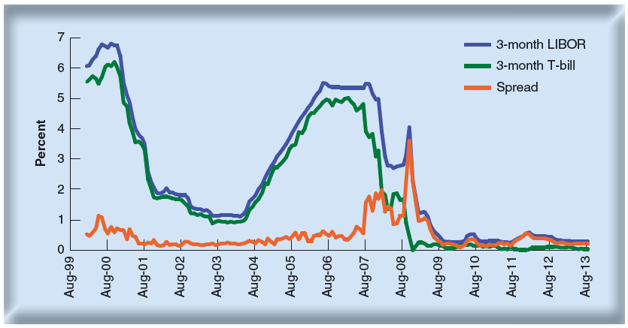
Short-Term Financing
Interest rates on 3-month Treasury bills and LIBOR. The orange line shows how the spread between the two rates (the TED spread) leapt up during the banking crisis.
Notes:
33

