Slide 1
Plant conservation
Conservation strategies;
In-situ Conservation
Ex-situ conservation
In vitro Conservation
Conservation vs Preservation

Slide 2
Conservation
Conservation is the sustainable use and management of natural resources including life, water, air, and earth deposits. Natural resources may be renewable or non-renewable. The conservation of renewable resources like trees involves ensuring that they are not consumed faster than they can be replaced.
The conservation of non-renewable resources like fossil fuels involves ensuring that sufficient quantities are maintained for future generations to utilize.

Slide 3
Plant conservation
Plant conservation includes the study of plant decline and its causes,
and techniques to conserve endangered plants.
Plant conservation can be considered a part of conservation biology, that emphasizes the conservation of biodiversity and whole ecosystems
© 2016 Asma Ashfaq

Slide 4
Within plant conservation can be found many subfields/emphases. These include:
Forest conservation: Conservation studies and practices involving whole forests, as opposed to specific species
Indigenous Plant conservation: Conservation of plants that are not cultivated by humans for agriculture or other purposes
Invasive species study and control: The study and control of species that have spread beyond their native area. Such species pose a significant threat for the conservation of native plants.
Medicinal plant conservation: Study and conservation of plants with medicinal properties
Crop diversity studies:
Preservation of crop species, especially those of indigenous cultures
© 2016 Asma Ashfaq

Slide 5
Why Conserve Plants?
The beautiful Jade Vine: Conservation status - vulnerable
© 2016 Asma Ashfaq

Slide 6
Preservation
Preservation, in contrast to conservation, attempts to maintain in their present condition areas of the Earth that are so far untouched by humans.

Slide 7
Preserv…
Like conservationists, some preservationists support the protection of nature for purely human-centred reasons. Stronger advocates of preservation however, adopt a less human-centred approach to environmental protection, placing a value on nature that does not relate to the needs and interests of human beings.
Deep green ecology argues that ecosystems and individual species should be preserved whatever the cost, regardless of their usefulness to humans, and even if their continued existence would prove harmful to us. This follows from the belief that every living thing has a right to exist and should be preserved.

Slide 8
Conservation Strategies
Conservation strategies involved in plant conservation including:
in situ conservation, the conservation of endangered species within their natural habitat, is considered a good way of conserving biodiversity
ex situ conservation, the propagation of endangered species outside of their native habitat, with hope of reintroducing them;
in vitro conservation is the conservation of tissues, cells, genomes and genes under controlled environmental conditions.
© 2016 Asma Ashfaq

Slide 9
In situ conservation
is defined as conservation of ecosystems and natural habitats, the maintenance of viable populations of the species in their natural surroundings ,
In situ conservation can be done in farmers’ fields, nature reserves, national parks, in pasture lands, and in protected areas
© 2016 Asma Ashfaq

Slide 10
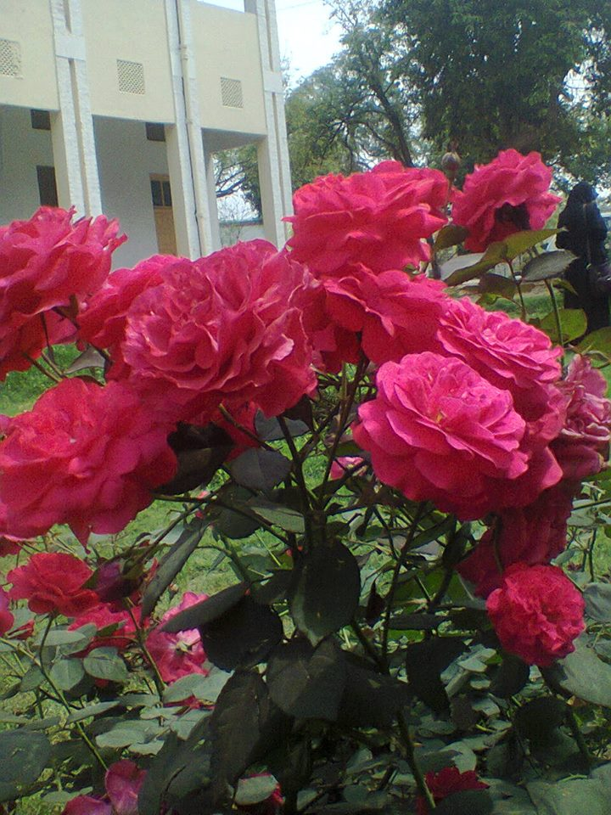
The advantages of in situ conservation
The species will have all the resources that it is adapted too
The species will continue to evolve in their environment
The species have more space
Bigger breeding populations can be kept
It is cheaper to keep an organism in its natural habitat
© 2016 Asma Ashfaq

Slide 11
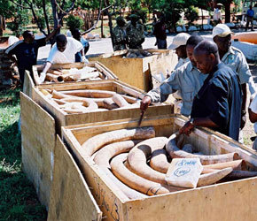
However there are problems
Environmental uncertainty due to random, or at least unpredictable, changes in weather, food supply, and the populations of competitors, predators, parasites, etc.
Natural catastrophes such as floods, fires, or droughts, which may occur at random intervals.
Alien species are difficult to control
Sciencemuseum.org
© 2016 Asma Ashfaq

Slide 12
Ex situ conservation
This involves
Gene banks, e.g. seed banks, field banks
The Kew Seed Bank in England has 1.5 per cent of the world's flora - about 4,000 species - on deposit.
Collecting living organisms for botanic gardens for research and public awareness
© 2016 Asma Ashfaq

