Slide 1
Plant responses towards temperature

Slide 2
Temperature is the main factor that determines the geographic distribution of organisms.
The thermal range of the Biosphere is broad and varies from +400ºC of the hydrothermal winds operating at the bottom of the oceans to -94,3ºC of the surface air of the Dome Argus – Antarctica.
No organism has the capacity to withstand the full range of Biosphere temperatures. Thus, life is limited to a much narrower temperature range, from -20 to +122ºC.
Specifically, the existence of plants is limited to an approximate thermal range of -10 to +60ºC, defined by the freezing point of intracellular water and the temperature of protein denaturation.
This survival range can be exemplified by the woody trees of regions such as Alaska, northern Canada , Europe and Asia, which are highly adapted to intracellular water freezing and by plants from arid regions such as cacti which tolerate high diurnal temperatures that exceed 60ºC.

Slide 3
What is stress?
A significant deviation from the conditions optimal for life, and eliciting changes and responses at all functional levels of the organisms.
Two ways
Temporary stress
Permanent stress

Slide 4
How to recognize stress?
Effects of stress
Stressor-specific effect involve a well-defined target within the plant. E.g. intense radiation causes direct damage to the thylakoid membrane.
Non-specific effect
stress responses within the plant is carried out bY phytohormones.
Eg. Alterations in membrane properties
Increased respiration
Inhibition of phototsynthesis
Growth disturbances
Lower fertility
Premature senescence
Decrease of availability of energy

Slide 6
Plant response to heat stress
Growth
Photosynthesis
Reproductive development
Yield
Oxidative stress

Slide 7
Growth
Among the growth stages of plant the germination is affected first of all
Major impacts caused by heat stress documented in various cultivated plant species are ( reduced germination percentage, plant emergence, abnormal seedlings, reduced radicle and plumule growth of germinated seedlings)
High temperature causes loss of cell water content for which the cell size and ultimately the growth is reduced
Reduction in net assimilation rate(NAR)is also another reason for reduced relative growth rate(RGR)
THE MORPHOLOGICAL SYMPOTOMS OF HEAT STRESS INCLUDE:
Scorching
Sunburns of leaves and twigs, branches and stems,
Leaf senescence and abscission
Shoot and root growth inhibition
Fruit discoloration

Slide 8
At extreme heat stress plants can show programmed cell death in specific cells or tissues may occur within minutes or seconds due to denaturation or aggregation of proteins, on the other hand moderately HTs for extended period cause gradual death: both types of injuries or death can lead to the shedding of leaves, abortion of flower and fruit or even death of entire plant.

Slide 9
Photosynthesis
Photosynthesis is one of the most heat sensitive physiological processes in plants.
High temperature has a greater influence on the photosynthetic capacity of plants especiallyofC3 plants and C4 plants.
In chloroplast, carbon metabolism of the stroma and photochemical reactions in thylakoid lamellae are considered as the primary sites of injury at HTs, thylakoids membrane is highly susceptible to HT.

Slide 10
Photosynthetic development
Although all plant tissues are susceptible to heat stress at almost all the growth and developmental stages the reproductive tissues are the most sensitive and a few degrees elevation in temperature during flowering time can result in the loss of entire grain crop cycles.
The reason for increasing sterility under the HT are:
Impaired meiosis in both male and female organs
Impaired pollen germination and pollen tube growth
Reduce ovule viability
Anomaly in stigmatic and style positions
reduced number of pollen grains retained by stigma

Slide 11
Different adaptation mechanisms of plant adaptation to heat stress
Avoidance mechanisms(A)
Under HT conditions plant exhibit various mechanisms for surviving which include long term evolutionary phonological and morphological adaptations and short term avoidance or acclimation mechanisms
Tolerance mechanisms(T)
The ability of the plant to grow AND produce economic yield under HT

Slide 12
AVOIDANCE MECHSNISMS (A)
Changing leaf orientation
Closure of stomata and reduced water loss
Alteration of membrane liquid compositions
Increased stomatal and trachomatous densities
Larger xylem vessels
Leaf rolling
Early maturation
Transpirational cooling
TOLERANCE MECHANISM ( T )
Ion transporters
Late embryogenesis abundant (LBA) proteins
Osmoprotectants
Antioxidant defense

Slide 13
Heat-Shock Proteins (HSPs)
High temperature stress causes extensive denaturation and aggregation of cellular proteins which if unchecked lead to cell death.
HSPs help cells to cope up with heat-induced damage to cellular proteins.
During stress HSPs function primarily to prevent aggregation and promote proper refolding of denatured proteins but because protein conformation is important right from the time a protein is synthesized.
HSPs play important roles under normal conditions as well, the principal role of HSPs under non-stress conditions is to assist in the synthesis, transport and proper folding of the target proteins.
Major families of heat shock proteins
Hsp100
Hsp90
Hsp70
Small hsps
The chaperonins

Slide 14
Cold stress
Introduction
Only one third of the total land area on earth is free of ice and 42% of land experiences temperature below -20ºC, in such cases plants require specialized mechanisms to survive exposure to low temperature , cold stress can be classified as chilling (0-15ºC) and freezing(<0ºC)stresses. Generally, plants originating from temperate regions ,such as spinach exhibit a variable tolerance of chilling and can increase their freezing tolerance during exposure to chilling and non freezing temperatures , this process is known as cold acclimation. On the other hand plants of tropical and subtropical origins are sensitive to chilling stress and lack the cold acclimation mechanism.

Slide 15
Cold temperature
Chilling
Freezing
Chilling : it is (T > 0c)plant chilling injury refers to an injury that is caused by a temperature drop to below 15Cbut above freezing point
Freezing it is ( T< 0C ) freezing injury in plants can be from two sources:
Freezing of soil water and
Freezing of the fluids with in the plants.

Slide 16
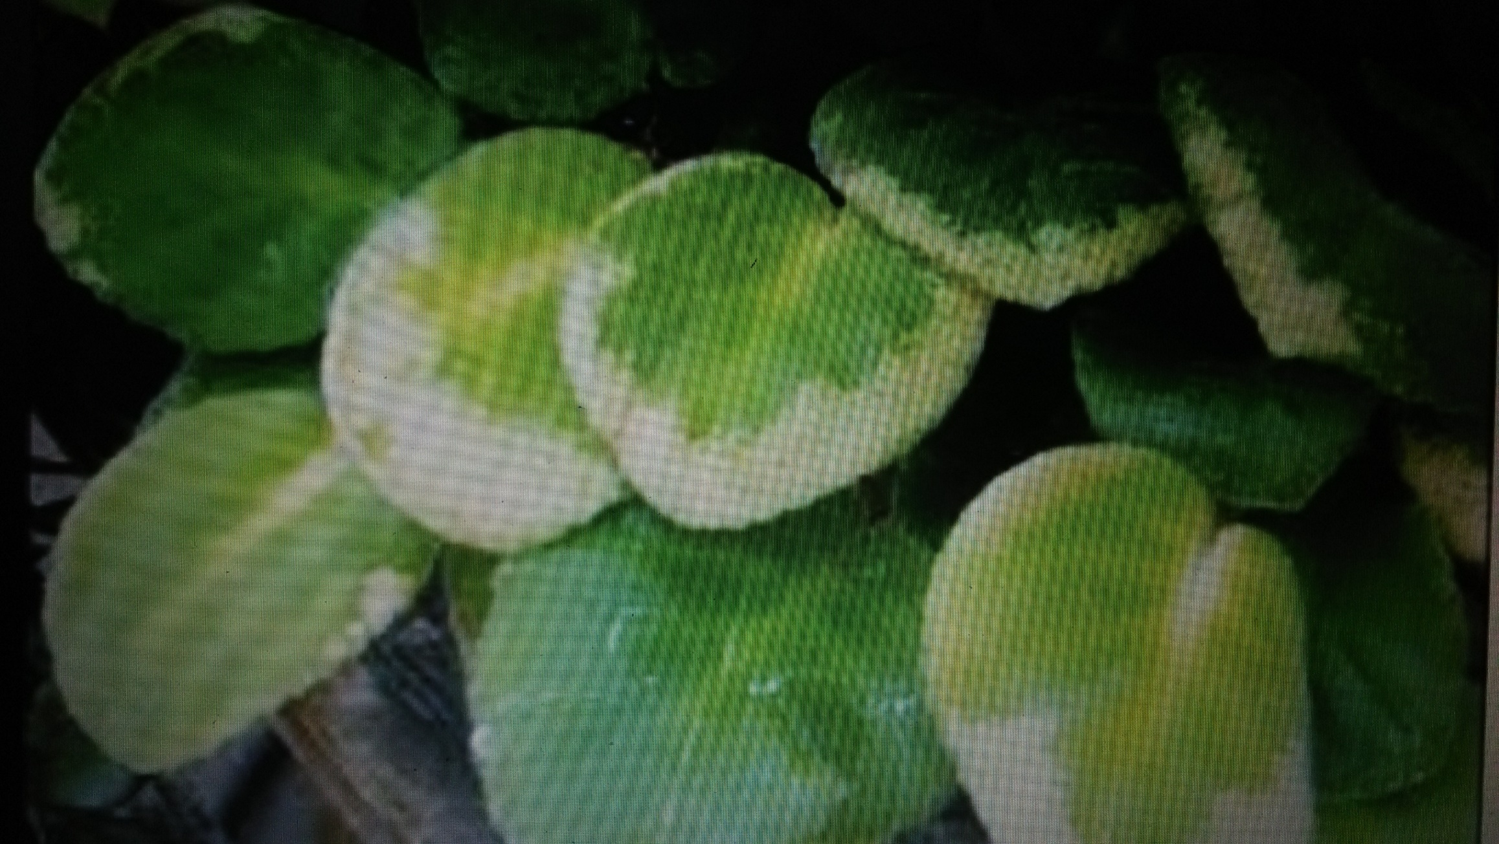
Chilling

Slide 17
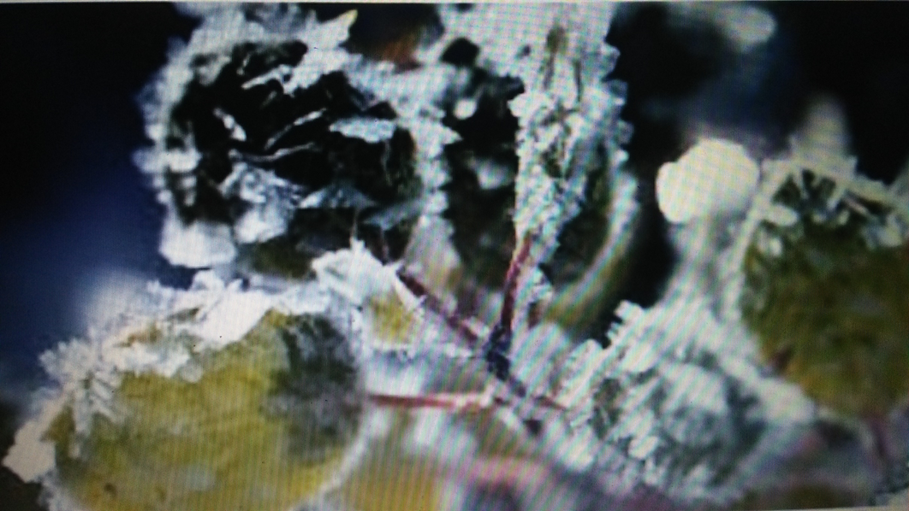
Freezing

Slide 18
Chilling Affects on plants
Injury causes several metabolic of or physiological dysfunction to the plant including
Disruption of the conversion of starch to sugars(amylotic activity)
Decreased carbon dioxide exchange
Reduction in net photosynthesis
The destruction/degradation of chlorophyll
Causes of chilling injury
The primary cause has been found to be the opening( and locking) of the leaf stomata when the permeability of the roots to water is low
The leaves lose water faster than it can be replaced and they become dehydrated
In some plants the stomata behave properly at chilling temperatures and the injury is said to be metabolic
A decrease in respiration , photosynthesis and fatty acid synthesis may all contribute to the chill starvation of some plants.

Slide 19
Freezing Injury
Two types of Freezing injury occur in plants cells and tissues;
Vitrification : solidification of the cellular content into non crystalline state. It occurs by rapid freezing of cells to a very low temperature.
Crystallization/ice formation : crystallization of ice occur either extracellularly or intracellularly.
Symptoms of freezing injury
desiccation or burning of foliage
Water-soaked areas that progress to necrotic spots on leaves, stems or fruit and death of sections of plants or the entire plant
Close examination of woody plants several days or weeks after freezing may reveal a dead or weakened root system or a split bark on stems or branches
Obvious symptoms on plant foliage may not be present until after the plant has been stressed by warm temperatures.
A hot bright day could increase transpirational water loss beyond the ability of injured roots or stem conductive tissue to replace
Wilting or desiccation as caused by direct drought stress

Slide 20
Preventions and protection
Cold hardening
Cold hardening alters the behavior of the stomata so that they close under the same conditions the root permeability is also increased.
Cold hardening affects the lipid content of cell membranes and has been found to lower the optimum temperature for photosynthesis and respiration.

Slide 23
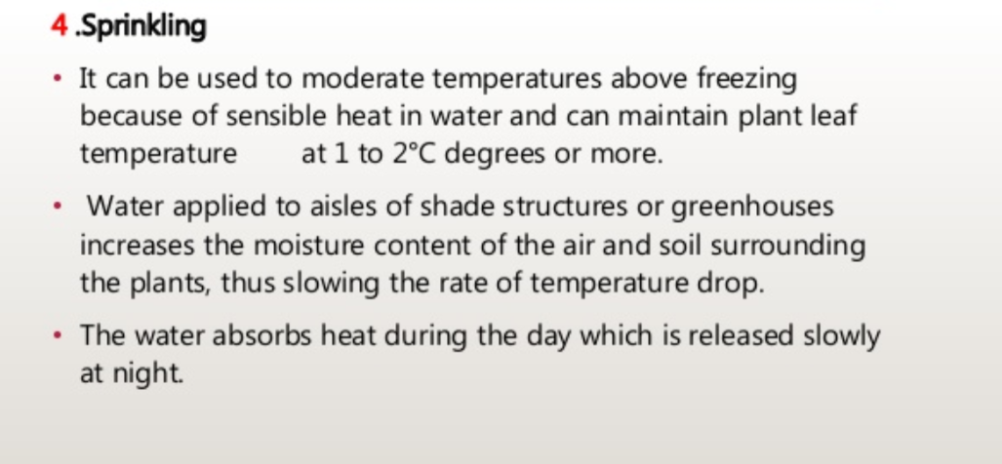

Slide 24
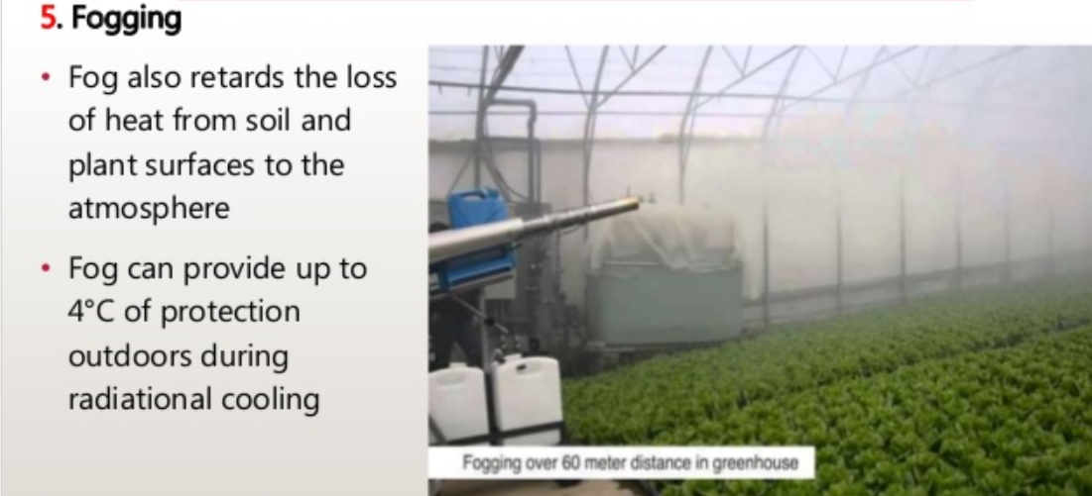

Slide 25
Thank you

