Slide 1
Chapter 2
The Internet & World Wide Web

Slide 2
The Internet
The Internet, also called the Net, is a worldwide collection of networks that links millions of businesses, government agencies, educational institutions, and individuals. The Internet is a widely used research tool, providing society with access to global information and instant communications.

Slide 3
The Internet
The Internet has its roots in a networking project started by an agency of the U.S. Department of Defense.
The goal was to build a network that
(1) allowed scientists at different locations to share information and work together on military and scientific projects and
(2) could function even if part of the network were disabled or destroyed by a disaster such as a nuclear attack.
That net work, called ARPANET, became functional in September 1969, linking scientific and academic researchers across the United States.

Slide 4
Connecting to network
Many home and small business users connect to the Internet via high-speed broadband Internet service
Cable Internet service provides high-speed Internet access through the cable television network via a cable modem.
DSL (digital subscriber line) provides high-speed Internet connections using regular telephone lines.
Fiber to the Premises (FTTP) uses fiber-optic cable to provide high-speed Internet access to home and business users.
Fixed wireless provides high-speed Internet connections using a dish-shaped antenna on your house or business to communicate with a tower location via radio signals.
A Wi-Fi (wireless fidelity) network uses radio signals to provide high-speed Internet connections to wireless computers and devices.

Slide 5
Connecting to network
A cellular radio network offers high-speed Internet connections to devices with built-in compatible technology or computers with wireless modems.
Satellite Internet service provides high-speed Internet connections via satellite to a satellite dish that communicates with a satellite modem.
Many public locations, such as airports, hotels, schools, and coffee shops, are hot spots that provide Wi-Fi Internet connections to users with mobile computers or devices.
Dial-up access takes place when the modem in your computer connects to the Internet via a standard telephone line that transmits data and information using an analog (continuous wave pattern) signal.

Slide 6
Access Providers
An access provider is a business that provides individuals and organizations access to the Internet free or for a fee.
An ISP (Internet service provider) is a regional or national access provider. A regional ISP usually provides Internet access to a specific geographic area. A national ISP is a business that provides Internet access in cities and towns nationwide.
an online service provider (OSP) also has many members-only features such as instant messaging or their own customized version of a Web browser. The two more popular OSPs are AOL (America Online) and MSN (Microsoft Network).

Slide 7
wireless Internet service provider
A wireless Internet service provider, sometimes called a wireless data provider, is a company that provides wireless Internet access to computers and mobile devices, such as smart phones and portable media players with built-in wireless capability (such as Wi-Fi) or to computers using wireless modems or wireless access devices. Wireless modems usually are in the form of a USB flash drive or a card that inserts in a slot in a computer or mobile device.

Slide 8
How Data and Information Travel the Internet
Computers connected to the Internet work together to transfer data and information around the world using various wired and wireless transmission media.
Several main transmission media carry the heaviest amount of traffic on the Internet. These major carriers of network traffic are known collectively as the Internet backbone.

Slide 9
How Data and Information Travel the Internet

Slide 10
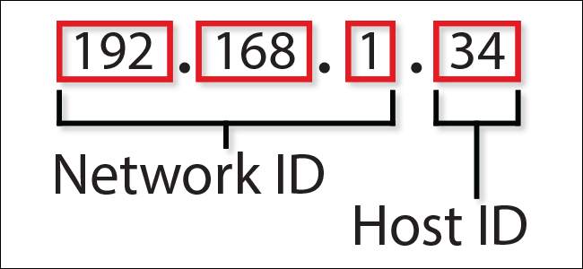
IP address
An IP address, short for Internet Protocol address, is a number that uniquely identifies each computer or device connected to the Internet.
The IP address usually consists of four groups of numbers, each separated by a period. In general, the first portion of each IP address identifies the network and the last portion identifies the specific computer.

Slide 11
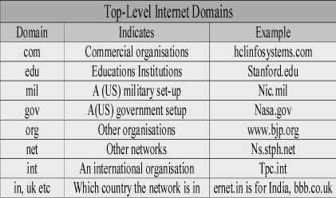
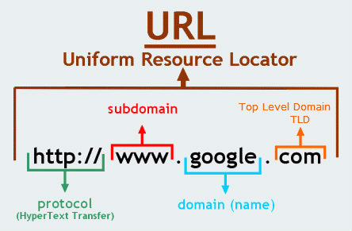
Domain name
A domain name is the text version of an IP address.
Every domain name contains a top-level domain (TLD), which is the last section of the domain name.

Slide 12
The World Wide Web
The World Wide Web (WWW), or Web, a widely used service on the Internet, consists of a worldwide collection of electronic documents.
Each electronic document on the Web, called a Web page, can contain text, graphics, animation, audio, and video.
Additionally, Web pages usually have built-in connections to other documents.
A Web site is a collection of related Web pages and associated items, such as documents and pictures, stored on a Web server.
A Web server is a computer that delivers requested Web pages to your computer.

Slide 13
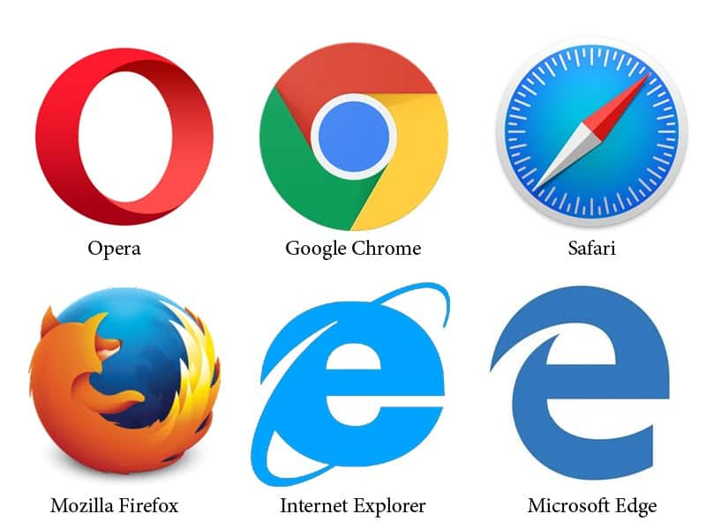
Browsing the Web
A Web browser, or browser, is application software that allows users to access and view Web. The more widely used Web browsers for personal computers are Internet Explorer, Firefox, Opera, Safari, and Google Chrome.
Downloading is the process of a computer or device receiving information, such as a Web page, from a server on the Internet.

Slide 14
Web Addresses
A Web page has a unique address, which is called a URL (Uniform Resource Locator) or Web address. For example, the home page for the United States National Park Service Web site has a Web address of http://www.nps.gov.
A Web browser retrieves a Web page using its Web address. If you know the Web address of a Web page, you can type it in the Address bar.

Slide 15
Navigating web pages
A link, short for hyperlink, is a built-in connection to another related Web page or part of a Web page. Links allow you to obtain information in a nonlinear way.
That is, instead of accessing topics in a specified order, you move directly to a topic of interest. Branching from one related topic to another in a nonlinear fashion is what makes links so powerful. Some people use the phrase, surfing the Web, to refer to the activity of using links to explore the Web.

Slide 16
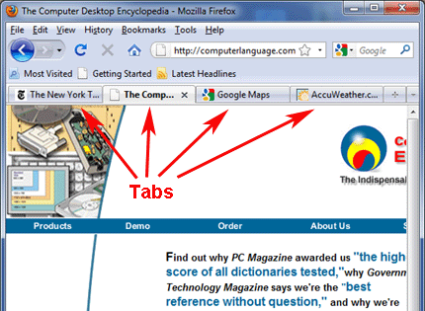
Tabbed browsing
Most current Web browsers support tabbed browsing, where the top of the browser displays a tab (similar to a file folder tab) for each Web page you open. To move from one open Web page to another, you click the tab in the Web browser

Slide 17
Searching the Web
Two types of search tools are search engines and subject directories.
A search engine is a program that finds Web sites, Web pages, images, videos, news, maps, and other information related to a specific topic.
A subject directory classifies Web pages in an organized set of categories or groups, such as sports or shopping, and related subcategories.
Some Web sites offer the functionality of both a search engine and a subject directory. Google and Yahoo!, for example, are widely used search engines that also provide a subject directory.

Slide 18
Search Engines
A search engine is helpful in locating information for which you do not know an exact Web address or are not seeking a particular Web site.
Some search engines look through Web pages for all types of information.
Others can restrict their searches to a specific type of information, such as images, videos, audio, news, maps, people or businesses, and blogs.

Slide 19
Search Engines
The following list identifies techniques you can use to improve your searches. To learn more about searching for information, complete the Learn How To 2 activity on pages 88 and 89.
Use specific nouns.
Put the most important terms first in the search text.
Use the asterisk (*) to substitute characters in words. For example, retriev* displays hits containing retrieves, retrieval, retriever, and any other variation.
Use quotation marks to create phrases so that the search engine finds an exact sequence of words.
List all possible spellings, for example, email, e-mail.
Before using a search engine, read its Help information.
If the search is unsuccessful with one search engine, try another

Slide 20
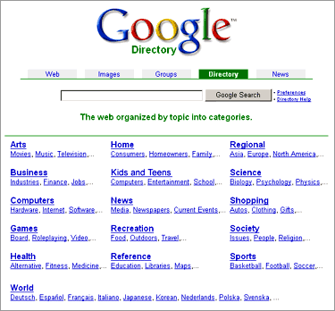
Subject Directories
A subject directory provides categorized lists of links arranged by subject (Figure 2-10). Using this search tool, you locate a particular topic by clicking links through different levels, moving from the general to the specific.

Slide 21
Types of Web Sites
Thirteen types of Web sites are portal, news, informational, business/marketing, blog, wiki, online social network, educational, entertainment, advocacy, Web application, content aggregator, and personal.
Many Web sites fall into more than one of these categories.

Slide 22
Portal
A portal is a Web site that offers a variety of Internet services from a single, convenient location. Most portals offer these free services: search engine; news; sports and weather; Web publishing; reference tools such as yellow pages, stock quotes, and maps; shopping; and e-mail communications services. Popular portals include AltaVista, AOL, Excite, GO.com, iGoogle, Lycos, MSN, and Yahoo!.

Slide 23
News
A news Web site contains newsworthy material including stories and articles relating to current events, life, money, sports, and the weather.
News papers and television and radio stations are some of the media that maintain news Web sites.

Slide 24
Informational
An informational Web site contains factual information. Many United States government agencies have informational Web sites providing information such as census data, tax codes, and the congressional budget.
Other organizations provide information such as public transportation schedules and published research findings.

Slide 25
Business/Marketing
A business/marketing Web site contains content that promotes or sells products or services.
Nearly every enterprise has a business/marketing Web site. Many companies also allow you to purchase their products or services online.

Slide 26
Blog
A blog, short for Weblog, is an informal Web site consisting of time-stamped articles, or posts, in a diary or journal format, usually listed in reverse chronological order.
A blog that contains video clips is called a video blog or vlog.
A microblog allows users to publish short messages, usually between 100 and 200 characters, for others to read. Twitter is a popular microblog.
The term blogosphere refers to the worldwide collection of blogs, and the vlogosphere refers to all vlogs worldwide.

Slide 27
Wiki
A wiki is a collaborative Web site that allows users to create, add to, modify, or delete the Web site content via their Web browser.
Most wikis are open to modification by the general public.
Wikis usually collect recent edits on a Web page so that someone can review them for accuracy.
The difference between a wiki and a blog is that users cannot modify original posts made by the blogger. A popular wiki is Wikipedia, a free Web encyclopedia

Slide 28
Online Social Networks
An online social network, also called a social networking Web site, is a Web site that encourages members in its online community to share their interests, ideas, stories, photos, music, and videos with other registered users. e.g; facebook.

Slide 29
Educational
An educational Web site offers exciting, challenging avenues for formal and informal teaching and learning.
For a more structured learning experience, companies provide online training to employees; and colleges offer online classes and degrees.
Instructors often use the Web to enhance classroom teaching by publishing course materials, grades, and other pertinent class information.

Slide 30
Entertainment
An entertainment Web site offers an interactive and engaging environment.
Popular entertainment Web sites offer music, videos, sports, games, ongoing Web episodes, sweepstakes, chat rooms, and more.

Slide 31
Advocacy
An advocacy Web site contains content that describes a cause, opinion, or idea. These Web sites usually present views of a particular group or association.

Slide 32
Web Application
A Web application, or Web app, is a Web site that allows users to access and interact with software through a Web browser on any computer or device that is connected to the Internet.
Examples of Web applications include Google Docs (word processing, spreadsheets, presentations), TurboTax Online (tax preparation), and Windows Live Hotmail (e-mail).

Slide 33
Content Aggregator
A content aggregator is a business that gathers and organizes Web content and then distributes, or feeds, the content to subscribers for free or a fee.
Examples of distributed content include news, music, video, and pictures.

Slide 34
Personal
A private individual or family not usually associated with any organization may maintain a personal Web site.
People publish personal Web pages for a variety of reasons. Some are job hunting. Others simply want to share life experiences with the world.

Slide 35
Evaluating a Web Site
Do not assume that information presented on the Web is correct or accurate. Any person, company, or organization can publish a Web page on the Internet.

Slide 36
Multimedia on the Web
Most Web pages include more than just formatted text and links. The more exciting Web pages use multimedia. Multimedia refers to any application that combines text with graphics, animation, audio, video, and/or virtual reality.

Slide 37
Graphics
A graphic, or graphical image, is a digital representation of non text information such as a drawing, chart, or photo. Many Web pages use colorful graphical designs and images to convey messages.
A thumbnail is a small version of a larger graphic. You usually can click a thumbnail to display a larger image.

Slide 38
Animation
Many Web pages use animation, which is the appearance of motion created by displaying a series of still images in sequence. Animation can make Web pages more visually interesting or draw attention to important information or links.

Slide 39
Audio
On the Web, you can listen to audio clips and live audio. Audio includes music, speech, or any other sound.
Simple applications on the Web consist of individual audio files available for download to a computer or device.
Once downloaded, you can play (listen to) the contents of these files. Audio files are compressed to reduce their file sizes. For example, the MP3 format reduces an audio file to about one-tenth its original size, while preserving much of the original quality of the sound.

Slide 40
Audio
To listen to an audio file on your computer, you need special software called a player. Most current operating systems contain a player, for example, Windows Media Player.
Some audio files, however, might require you to download a player. Players available for download include iTunes and RealPlayer.
Streaming is the process of transferring data in a continuous and even flow. Streaming allows users to access and use a file while it is transmitting. For example, streaming audio enables you to listen to music as it downloads to your computer. Podcasting is another popular method of distributing audio.
A podcast is recorded audio, usually an MP3 file, stored on a Web site that can be downloaded to a computer or a portable media player such asan iPod.

Slide 41
Video
On the Web, you can view video clips or watch live video. Video consists of images displayed in motion. Most video also has accompanying audio.
You can use the Internet to watch live and pre recorded coverage of your favorite television programs or enjoy a live performance of your favorite vocalist.
You can upload, share, or view video clips at a video sharing Web site such as YouTube. Educators, politicians, and businesses are using video blogs and video podcasts to engage students, voters, and consumers.

Slide 42
Virtual Reality
Virtual reality (VR) is the use of computers to simulate a real or imagined environment that appears as a three-dimensional (3-D) space.
VR involves the display of 3-D images that users explore and manipulate interactively.
A VR Web site, for example, might show a house for sale. Potential buyers walk through rooms in the VR house by moving an input device forward, backward, or to the side.

Slide 43
Plug-ins
Most Web browsers have the capability of displaying basic multimedia elements on a Web page. Sometimes, a browser might need an additional program, called a plug-in.
A plug-in, or add-on, is a program that extends the capability of a browser. You can download many plug-ins at no cost from various Web sites.
Examples are window media player, flash player, real player etc.

Slide 44
Web publishing
Web publishing is the development and maintenance of Web pages. To develop a Web page, you do not have to be a computer programmer. For the small business or home user, Web publishing is fairly easy as long as you have the proper tools. The five major steps to Web publishing are as follows:
1. Plan a Web site: Think about issues that could affect the design of the Web site.
2. Analyze and design a Web site: Design the layout of elements of the Web site such as links, text, graphics, animation, audio, video, and virtual reality.
3. Create a Web site: Use a word processing program to create basic Web pages or Web page authoring software to create more sophisticated Web sites.
4. Deploy a Web site: Transfer the Web pages from your computer to a Web server.
5. Maintain a Web site: Ensure the Web site contents remain current and all links work properly.

Slide 45
E-Commerce
E-commerce, short for electronic commerce, is a business transaction that occurs over an electronic network such as the Internet.
Three types of e-commerce are business-to-consumer, consumer-to-consumer, and business-to-business. Business-to-consumer (B2C) e-commerce consists of the sale of goods and services to the general public.

Slide 46
Other Internet Services
E-mail (short for electronic mail) is the transmission of messages and files via a computer network. Today, e-mail is a primary communications method for both personal and
A mailing list, also called an e-mail list or distribution list, is a group of e-mail names and addresses given a single name. When a message is sent to a mailing list, every person on the list receives a copy of the message in his or her mail box.
For example, your credit card company may add you to its mailing list in order to send you special offers. To add your e-mail name and address to a mailing list, you subscribe to it. To remove your name, you unsubscribe from the mailing list business use.

Slide 47
Instant Messaging
Instant messaging (IM) is a real-time Internet communications service that notifies you when one or more people are online and then allows you to exchange messages or files or join a private chat room with them.
Chat Rooms: A chat is a real-time typed conversation that takes place on a computer. A chat room is a location on an Internet server that permits users to chat with each other. Anyone in the chat room can participate in the conversation, which usually is specific to a particular topic.

Slide 48
VoIP
VoIP (Voice over IP, or Internet Protocol), also called Internet telephony, enables users to speak to other users over the Internet.
To place an Internet telephone call, you need a high-speed Internet connection (e.g., via cable or DSL modem); Internet telephone service; a microphone or telephone, depending on the Internet telephone service; and Internet telephone software or VoIP router, or a telephone adapter, depending on the Internet telephone service

Slide 49
FTP
FTP (File Transfer Protocol) is an Internet standard that permits the process of file uploading and downloading with other computers on the Internet. Uploading is the opposite of downloading; that is, uploading is the process of transferring documents, graphics, and other objects from your computer to a server on the Internet.

Slide 50
Newsgroups and Message Boards
A newsgroup is an online area in which users have written discussions about a particular. To participate in a discussion, a user sends a message to the newsgroup, and other users in the newsgroup read and reply to the message.
A popular Web-based type of discussion group that does not require a newsreader is a message board. Many Web sites use message boards instead of newsgroups because they are easier to use.

Slide 51
Netiquette
Netiquette, which is short for Internet etiquette, is the code of acceptable behaviors users should follow while on the Internet; that is, it is the conduct expected of individuals while online.
Netiquette includes rules for all aspects of the Internet, including the World Wide Web, e-mail, instant messaging, chat rooms, FTP, and newsgroups and message boards.

