Slide 1
Active Citizenship by Active Learning
Active citizenship is a way of development greater young citizen responsibility.
It is a combination of obligations and responsibilities through involvement in civic issues.
Be an active citizen need new ways of educating students which are different from traditional learning methods.
Active learning method derived from learned-centred approaches stress more on students as intelligent entities rather than just receivers.
Employing methods of active learning in citizenship education has some obstacles but the advantages are greater than passive ways of learning.

Slide 2
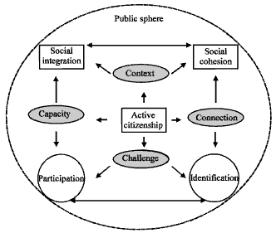

Slide 3
Dimension of active citizenship:
Active citizenship has four dimensions related to citizenship practices which summarizing sociological conditions represent as the
capacity (how people can act based on their rights),
connection (relationship with others),
challenge (desire of self in practices during involvement)
context (how people aware of diverse options during social practices)
sphere, representing various social places or public sphere for different practices of active involvement. This figure shows the importance of participation for social integration, while identification exaggerates cohesion in the society with double headed arrows of their relations in making citizens active in a society.

Slide 4
Function of active learning:
It was anticipated that youth in active learning environments demonstrate increased engagement in contrast to passive learning environments which consist of telling, or instructing and learners as ‘empty vessels’ filled with information. Active learning researchers believe that either listening or reading can be passive because all of cognition is active in the sense of involving activity in youth mental life. Active learning can act as below:
• Encouraging involvement at the same time with learning activities
• Teach learners processing competencies
• Make courses with its higher order thinking aspects
• Let students to engage with their activities
• Allow them to explore their ideals about learning

Slide 5
OUTCOMES OF ACTIVE LEARNING
The component of this kind of learning includes talking, listening, reading, writing and reflecting. Effects on student learning are:
• Engage students beyond listening and reading
• Promote learning, not just acquisition of facts
• Encourage interaction between students
• Develop high-order thinking skills
• Persuade accountability with learning process
• Develop competencies
• Allow students to monitor their own learning and lastly
• Endorse deep learning

Slide 6
Approaches to active citizenship:
There are two approaches about citizenship which can explain active citizenship
Psychological theories often focus on personal development in contrast with sociologists’ focus on social and structural forces and environment in the course of socialization
Sociological theories focus more on teaching individual at each life stage to socialize them for new roles riley .Based on this approach, socialization has two seemingly contradictory functions, one of which is “fitting people into social roles” and the other of which is freeing them from it by the way of “individuation”

Slide 7
APPROACHES TO ACTIVE LEARNING TOWARDS ACTIVE CITIZENSHIP
In a teacher-focused approach, educator ask students to recall information he or she gave to learners to classify it by low thinking skills.
In this approach students must reproduce knowledge but in a learner-centred approach students find meaning from knowledge and interpret it.
The recommendation of this literature is that the development of civic skills in college students can be assisted through active, experiential learning that promotes outcomes such as critical thinking, moral reasoning, social responsibility, civic mindedness, exposure to diversity and leadership

Slide 8
