Slide 1
Electrodynamics-II
Muhammad Amer Mustafa
Lecturer UOS Sub Campus Bhakkar

Slide 2
Chapter#5 (Introduction to Electrodynamics (4th edition) by David J Griffith)
Magnetostatics
Lecture Content
5.1 Lorentz Force Law
5.1.1 Magnetic Field
5.1.2 Magnetic Forces

Slide 3
5.1 Lorentz Force Law
Electrostatics | Magnetostatics
In Electrostatics we study the electric fields due to stationary charges Remember, we have a collection of $q_{1},q_{2},q_{3},….q_{n}$which are the source charges and we want to calculate the electric force they exert on test charge $Q$ (rest charge), The total force is the vector sum of all the individual forces. All these charges were stationary so it is the simplest case of electrostatics. | We study the magnetic fields due to continuously moving charges. All moving charges produce the current in the conductor. Magnetostatics is study of motion of all those charges which constitute steady current (The current whose magnetic field is not varying at point)in the conductor.

Slide 4
5.1.1 Magnetic Fields
Parallel Currents attract each other. Why?
Do the wires attract each others due to charges in wire?
Answers: NO
The reason is magnetic one
not electrostatic.

Slide 5
5.1.1 Magnetic Fields
Currents in opposite direction repel each others.
Magnetic field due to stationary charges is zero.
Stationary Charges have only electric fields.
Detection of magnetic fields
Magnetic field is lot easier to detect using the
Boy Scout Compass

Slide 6
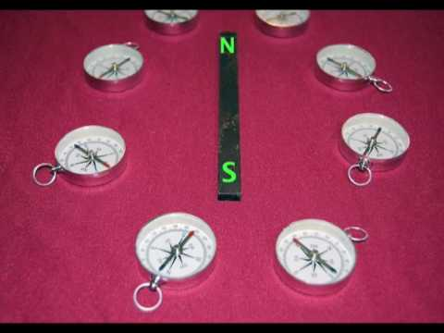
Magnetic Field Lines
Magnetic Field Detection using compass
Magnetic field lines originate from North pole and
end at south poles

Slide 7
Magnetic Field Lines due to straight wire

Slide 8
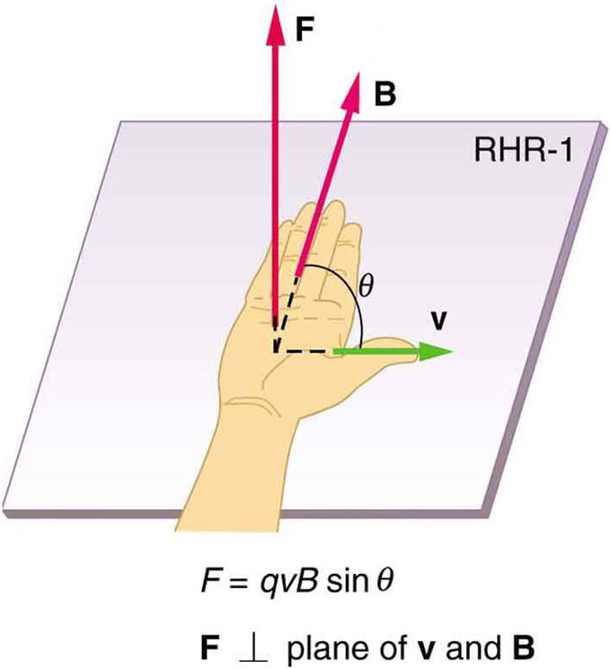
Forces between the parallel currents
Why two parallel current attract each other?
At the position of wire 2 magnetic field is into the page.
Current is in upward direction
Using the right hand rule we can find out the force
acting on the wire 2. Force onWire 2 is due to external
magnetic field of wire 1.(Purely Magnetic force)

Slide 9
Conventions about the direction of Magnetic Field

Slide 10
5.1.2 Magnetic Forces
If charge $Q$ is moving with velocity $\vec{v}$ in magnetic field $\vec{B},$magnetic force acting on the charge is
$$\vec{F}=Q(\vec{v}×\vec{B})$$
(5.1)
This is called Lorentz force law.
In the presence of both electric and magnetic field and charge $Q$ is moving in this field, net force acting on the charge (General case of Lorentz Force Law) is
$$\vec{F}=Q\vec{E}+Q\left(\vec{v}×\vec{B}\right)$$
(5.2)

Slide 11
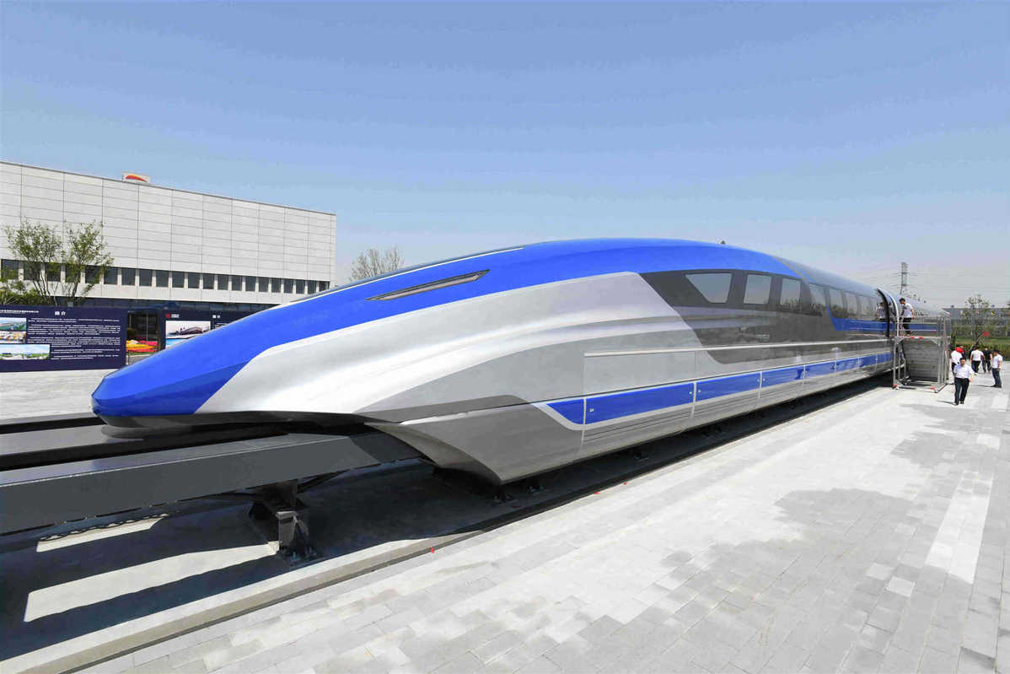
Magnetic Forces does not work?
World Fastest Magnetic Train
Magnetic Crane

Slide 12
Does magnetic field work?
Ans. NO
Magnetic field change only the
direction of velocity.
Because magnetic force is
perpendicular to plane of
magnetic field and velocity.

Slide 13
5.1.1 Magnetic Fields
We prove Mathematically that magnetic force does not work.
Infinitesimal displacement covered in time $dt$ is
$$d\vec{l}=\vec{v}dt$$
Then work done in time $dt$ is
$$dW=\vec{F}.d\vec{l}=Q\left(\vec{v}×\vec{B}\right).\vec{v}dt$$
$\vec{v}×\vec{B}$ is perpendicular to $\vec{v}$
We will explain it further in example 5.3
So
$$dW=\vec{F}.d\vec{l}=Q\left(\vec{v}×\vec{B}\right).\vec{v}dt=0$$

