Slide 1
Nutrition in Bacteria
The bacteria can be classified into two nutritional categorise on the basis of their nutritional requiremet .
Autotrophic Bacteria
Heterotrophic Bacteria

Slide 2
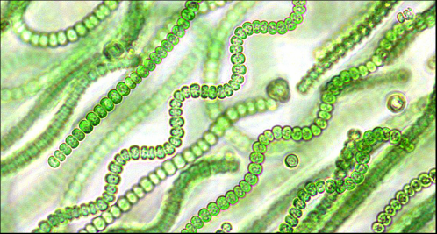

Slide 3
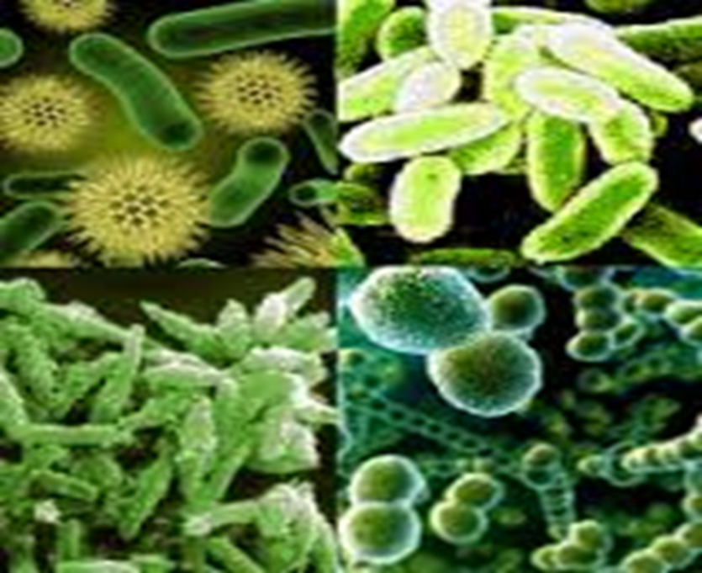
Autotrophic Bacteria
The bacteria that are able to synthesize organic compound necessary for their survival from simple organic substance are called autotrophic bacteria. They obtain carbon from inorganic compounds,mostly from carbon dioxide.
There are two types of autotrophic bacteria.
Photoautotrophs
2. Chemoautotrophs

Slide 4
Photosynthetic Bacteria:
These include all the three, coccal, bacillary and spirillum forms. All are anaerobes which grow in light and are usually found in sulphur springs where hydrogen sulphide is normally present.
These bacteria are unique because they are the only organisms which are capable of synthesizing carbohydrate food without chlorophyll a. Moreover, photosynthesis in photosynthetic bacteria like Rhodospirillum is different from photosynthesis in green plants.

Slide 5
No free oxygen is released as a byproduct in bacterial photosynthesis. Hydrogen is provided by donor substances other than water. Hydrogen sulphide is the source of hydrogen. The by-product is sulphur and not oxygen.
2H2S + CO2 ---------------- [CH2O] + 2S + H2O
The two common examples of photosynthetic bacteria are the purple sulphur bacteria and green sulphur bacteria. The former contain bacteriochlorophyll and carotenoids ad the photosynthetic pigments .

Slide 6
Green Sulphur Bacteria
The process takes place at low expenditure of energy. Chlorobium limicola is another example of photosynthetic autotrophs. It is a green sulfur bacterium. The hydrogen sulfide is the donor of hydrogen in this case also.
Light splits hydrogen sulphide in both cases. Hydrogen combines with carbon dioxide to form CH2O. The sulphur which is a by-product is stored as globules in the cells of sulphur bacteria but excreted in the green sulphur bacteria

Slide 7
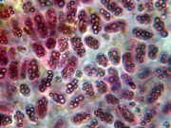
Purple Sulphur Bacteria
The bacteria which use sulphur compounds as source of electrons and proton for example Chromatiumokenii.
2CO2 + 5H2O + Na2S2O3 2(CH2O) + 2H2 + NHSO2 + Energy

Slide 8
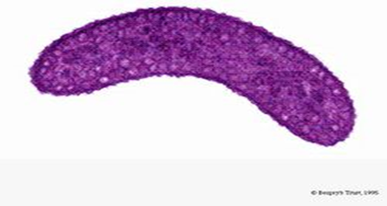
Non-Sulphur Bacteria:
There are non-sulphur purple and brown bacteria found in the mud and stagnant water.
They are photosynthetic and contain bacteriochlorophyll pigment. They use organic hydrogen donors and sulphur is not the by-product in their case. Light is still the source of energy.
For exemple Rhodospirullurubrum which use propyl alcohol.

Slide 9
Chemosynthetic Bacteria
These are non-photosynthetic autotrophs (nitrifying bacteria) which lack pigments. They get energy for food synthesis by the oxidation of certain inorganic substances such as ammonia, nitrites, nitrates, ferrous iron, hydrogen sulphides and a number of other metallic and n The bacteria absorb inorganic molecules of the substances into the body where a chemical reaction takes place. In this reaction the chemical bonds are broken and energy is released.
This energy is used up by the bacterial cell to combine CO2 and water into food molecules.This process of manufacturing food is called chemosynthesis. It is a chemical process and is evidently a form of respiration.

Slide 10
No light is involved in chemosynthesis. The reactions are all exothermic. These bacteria are thus independent both of light and of organic materials. They are unique because they can live even under conditions unfavourable for plant growth.
No light is involved in chemosynthesis. The reactions are all exothermic. These bacteria are thus independent both of light and of organic materials. They are unique because they can live even under conditions unfavourable for plant growth.
Examples of chemosynthetic bacteria are sulphur bacteria, iron bacteria, nitrifying bacteria and hydrogen bacteria.

Slide 12
Sulphur Bacteria :
Sulphur bacteria oxidise sulphur compounds present in water in which they live. The energy released in the reaction is utilized for food synthesis. Sulphur remains behind as a residue in the cytoplasm of the cell.

Slide 13
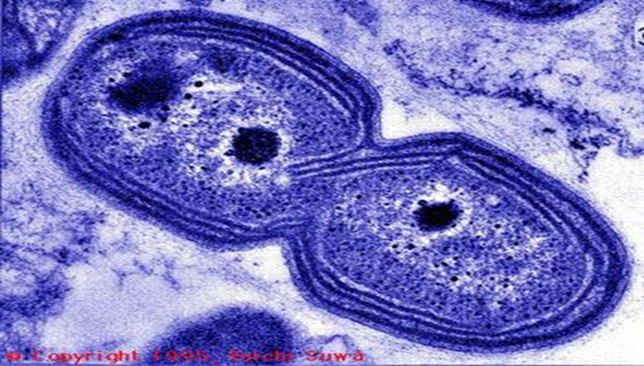
Nitrifying bacteria
These bacteria inhabit the soil and oxidize ammonia into nitrites , For example Nitrosomonas ; or nitrites into nitrates for example Nitrobactor .The energy released is used by these bacteria in synthesis of food .

Slide 14
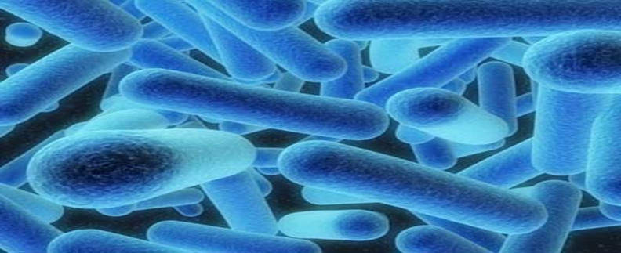
Iron Bacteria
These bacteria are present in iron rich water . These bacteria oxidize ferrous compound into ferric compound and obtain energy . Common example are Leptothrix , Cladothrix and Ferrobacillus .

Slide 15
Hydrogen Bacteria
These bacteria grow in organic media containing hydrogen ,carbon dioxide and can oxidise hydrogen with the liberation of energy .
2H2+CO2 -------------------- (CH2O)+H2O +118Kcals

Slide 16
Methane bacteria
These bacteria oxidize methane to carbon dioxide . Methane is the source of both carbon as well as energy to these bacteria , for exemple Methanosomonas .
CH4+2O2 -------------- CO2+2H2O+Energy

Slide 17
Heterotrophic Bacteria
The word heterotroph comes from the Greek "heteros," which means "other" or "different," and "trophe," which means "nutrition."
The colourless heterotrophic bacteria, which form the majority, cannot synthesize organic compounds from simple inorganic substances.
Lacking the pigment, they cannot capture solar energy which is essential to synthesize the substances they need as food.

Slide 19
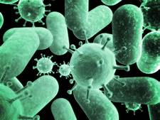
Parasitic Bacteria:
They live on or within living organisms both plants and animals. They obtain their organic food from the host on which they grow. Not all parasitic bacteria cause disease.
Some may be harmless to their hosts and others cause serious diseases in them.
To the former category species which give something belong the symbiotic useful to the host and receive
shelter and food in return.
The numerous coli bacteria inhabiting the
intestines in man

Slide 20
The numerous coli bacteria inhabiting the intestines in man
The common examples of human diseases which are bacterial in origin are cholera, pneumonia, diphtheria, tuberculosis, tetanus, typhoid and many others. There are relatively few bacterial pathogens of plants.

Slide 21
Saprotrophic :
Saprotroph, also called saprophyte or saprobe, organism that feeds on nonliving organic matter . The etymology of the word saprotroph comes from the Greek saprós (“rotten, putrid”) and trophē (“nourishment”)
They grow in dead, decaying organic material, and live by digesting and absorbing them .
This they do by secreting enzymes. The breakdown of carbohydrates is called fermentation
The breakdown of protein materials is called putrefaction

Slide 22
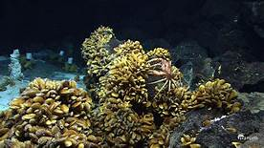
Symbiotic Bacteria
There are certain bacteria for example Rhizobium radicicola , Which form symbiotic association with teguminous plants.
They form nodules ,fix atmospheric nitrogen ,and supply nitrogenous compound to the plants and get food in turn from plants.

