Slide 1
Safety Technology
OSHE BS ET 7th Term 2015-2019
Importance of Safety Practice
Basic Concept of Plant Safety
Safe Machinery

Slide 2
Importance of Safety Practice
A serious workplace injury or death changes lives forever – for families, friends, communities, and coworkers too. Human loss and suffering is immeasurable.
Occupational injuries and illnesses can bother major crises for the families in which they occur. In addition to major financial burdens, they can impose considerable time demands on uninjured family members.

Slide 4
Can you imagine the knock on the door to tell you your loved one will never be returning home?
Or the phone call to say he’s in the hospital and may never walk again? Ensuring that husbands return to their wives, wives to their husbands, parents to their children, and friends to their friends — that is the most important reason to create a safe and healthy work environment.

Slide 5
REDUCING INJURIES REDUCES COSTS TO YOUR BUSINESS:
If a worker is injured on the job, it costs the company in lost work hours, increased insurance rates, workers' compensation premiums and possible litigation.
Productivity is lost when other workers have to stop work to deal with the injury.
Even after the injured employee has been sent home or taken to the hospital, other employees may be distracted or need to take time off from work in the consequences of the incident.

Slide 6
SAFE WORKERS ARE LOYAL WORKERS:
Any industry knows that employee wear & tear and absence can be major obstacles.
When you create a healthy and safe workplace, you reduce those issues in several ways. By financial plan for safety improvements and making safety part of your operational plan, you produce trust.
By involving employees in safety decisions—through reporting, committees, walk-throughs and meetings—you show that their opinion matters to you.
By following through on their input and improving safety, you prove quite actually that you care about their well-being.

Slide 7
SAFETY IMPROVES QUALITY
Companies that put safety first turn out higher quality products.
In some cases, that’s because a safe workplace tends to be a more efficient.
By working in a clean, efficient environment, workers are able to reduce distractions and truly focus on the quality of what they do.
The results? Better products that create customer loyalty, bigger margins and increased sales.
In these ways and others workplace safety is about much more than laws (rules) . It’s about creating the kind of productive, efficient, happy and inspiring workplace .of It’s about creating a highly profitable company. And that’s why it’s important.

Slide 8
Why workplace safety is important? There is more to this question than one think.
Workplace safety is very important for each and every employee in the industry because all the workers desire to work in a safe and protected atmosphere. Health and safety is the key factor for all the industries in order to promote the wellness of both employees and employers. It is a duty and moral responsibility of the company to look after the employee’s protection.

Slide 10
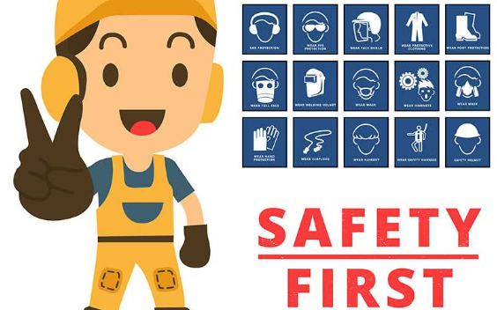

Slide 11
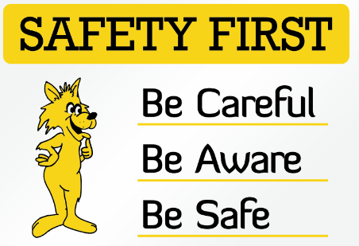

Slide 14
Plant Safety

Slide 15
Safety discrepancy in refinery plants, nuclear power plants, and petrochemical plants can threaten the environment and the health of employees and local residents.
In the event of damage, downtime and loss of production can acquire large added costs.
We can provide complete safety verification services throughout the entire life cycle of your refinery, petrochemical and power plants.

Slide 16
