Slide 2
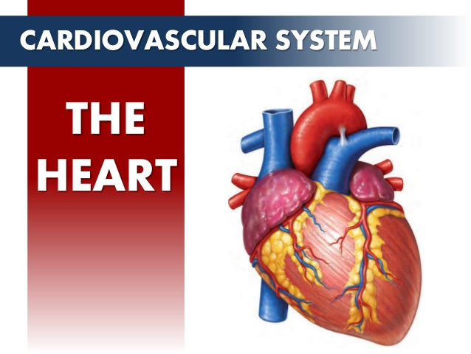
The Cardiovascular System: The Heart med Taseer Ahmad Pharm.D, MPhil, PhD Scholar Lecturer College of Pharmacy, University of Sargodha
Notes:
taseer.ahmad@uos.edu.pk Pharm.D B.Pharm https://www.the-scientist.com/news-opinion/new-discoveries-in-human-anatomy--67055

Slide 3
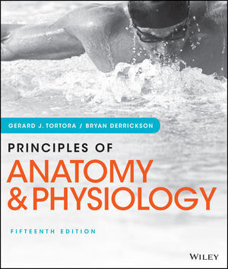
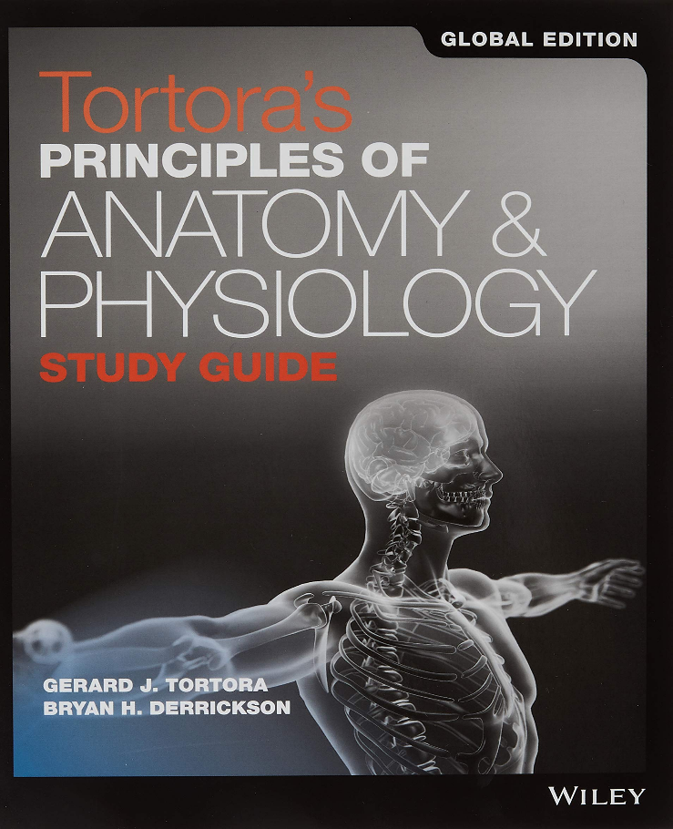
The cardiovascular system consists of the heart, which is an anatomical pump, with its intricate conduits (arteries, veins, and capillaries) that traverse the whole human body carrying blood.

Slide 4
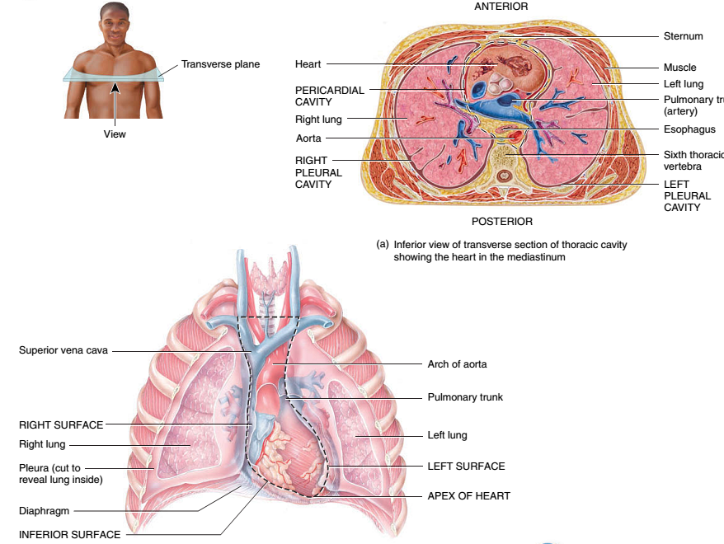
Notes:
Visceral: Referring to the viscera, the internal organs of the body, specifically those within the chest (as the heart or lungs) or abdomen (as the liver, pancreas or intestines).

Slide 5
Pericardium
Membrane surrounding and protecting the heart
Confines while still allowing free movement
2 main parts
Fibrous pericardium – tough, inelastic, dense irregular connective tissue – prevents overstretching, protection, anchorage
Serous pericardium – thinner, more delicate membrane – double layer (parietal layer fused to fibrous pericardium, visceral layer also called epicardium)
Pericardial fluid reduces friction – secreted into pericardial cavity
Notes:
Confines,,,boundries limitation
anchorage
an area off the coast which is suitable for a ship to anchor.

Slide 6
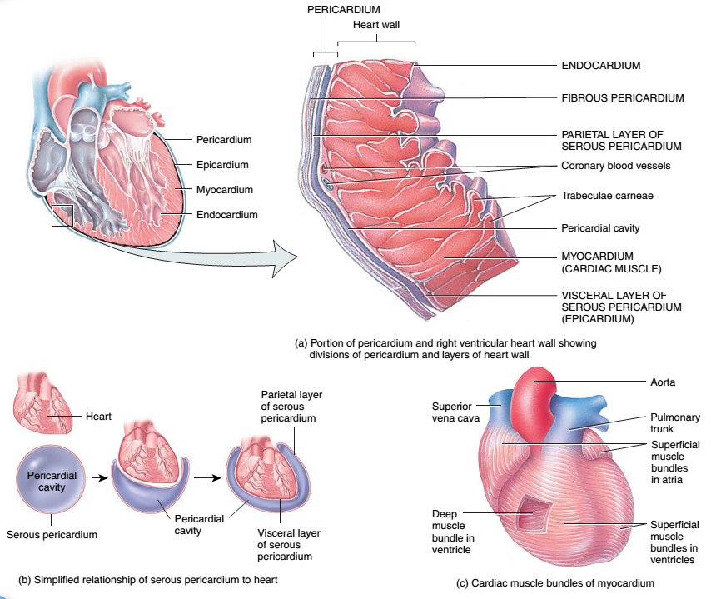
Notes:
Serous ,,, of, resembling, or producing serum. In physiology, the term serous fluid or serosal fluid is any of various body fluids resembling serum, that are typically pale yellow and transparent and of a benign nature.

Slide 7
Layers of the Heart Wall
Epicardium (external layer)
Visceral layer of serous pericardium
Smooth, slippery texture to outermost surface
Myocardium
95% of heart is cardiac muscle
Endocardium (inner layer)
Smooth lining for chambers of heart, valves and continuous with lining of large blood vessels

