Slide 1
Embryo culture and Embryo Rescue

Slide 2
What is Embryo Culture?
The Embryo of different developmental stages, formed within the female gametophyte through sexual process, can be isolated trough maternal tissues of ovule and ripped seed.
Isolated embryo then cultured in vitro aseptic and controlled physical conditions in glass vials containing nutrient solid and liquid medium to grow into plantlet.

Slide 3
Types of Embryo Culture
According to Pierik (1989) there are two types of embryo culture
Mature embryo culture (seed dormancy)
Immature embryo culture / Embryo rescue ( To avoid embryo abortion)

Slide 4
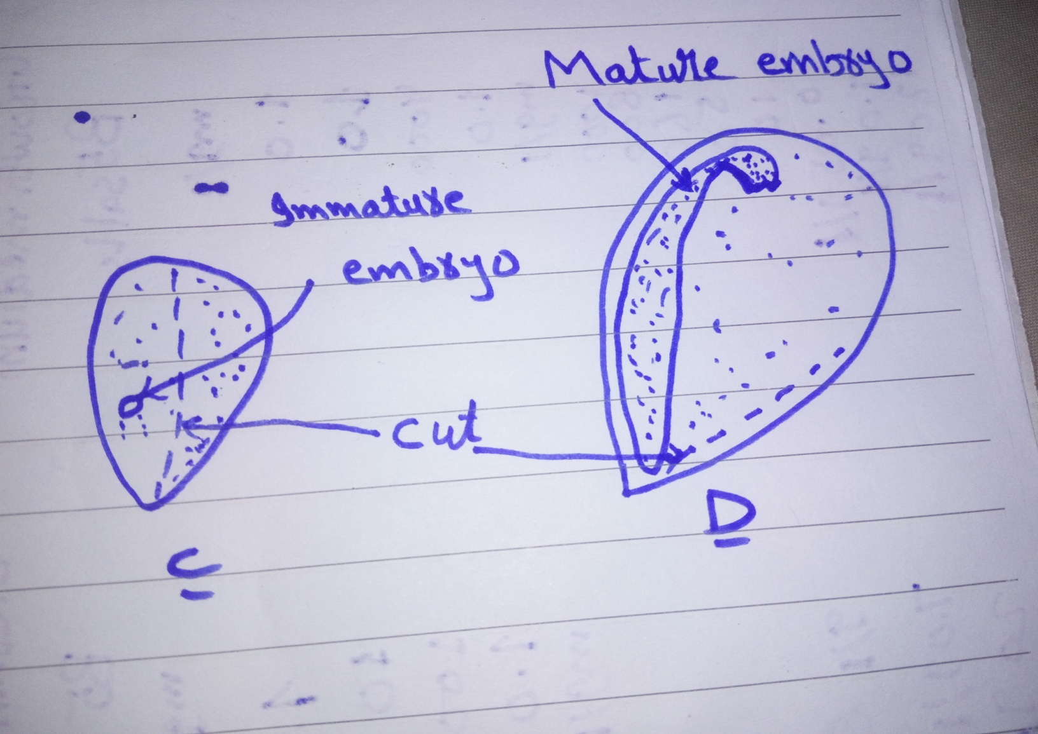

Slide 6
Two most important aspects to embryo culture is
Composition of culture media
Excision of the embryo

Slide 7
Embryo culture grown on a simple inorganic medium supplemented with energy source (usually sucrose)
Composition of the Medium
Inorganic constituents of MS, B5 or White’s media are adequate
Sucrose is most commonly used as a energy source
Ammonium nitrate is a preferably used as a source of nitrogen

Slide 8
Casein hydrolysate , rich in various amino acids is frequently used
Certain natural plant extracts with embryo factor are used e.g. liquid endosperm of coconut milk
The PH range 5-7.5
An incubation temperature 24-26 ˚C is ideal
Better growth in embryos observed in darkness which are then transferred to light for germination

Slide 9
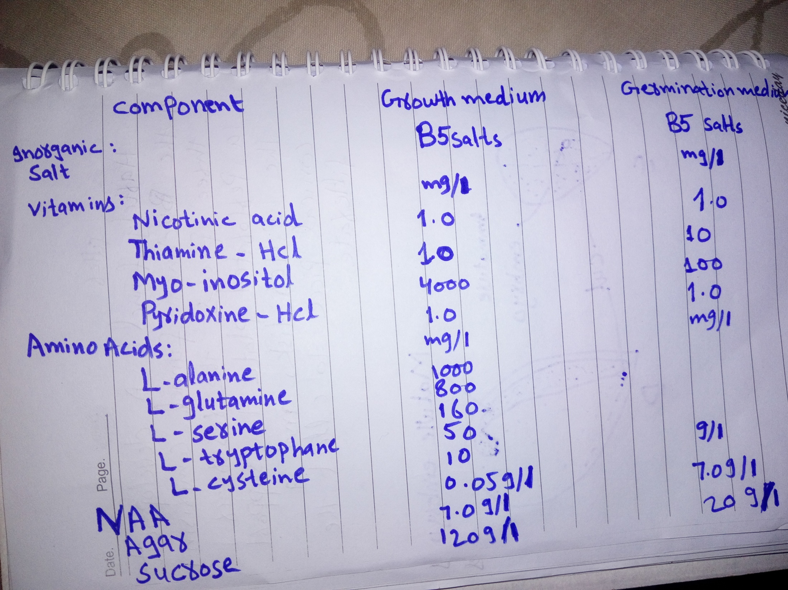

Slide 10
Embryo Rescue
Embryo rescue involves the culture of immature embryos to rescue them from unripe to hybrid seeds which fail to germinate
Wide Crosses / wide hybrid
Wide hybridization involves hybridization between cultivated species and their wild relatives. ... Inter specific hybrids can be produced through direct crosses between rice and AA genome wild species, and wild species genes can be transferred following backcrossing with the recurrent rice parent.

Slide 11
Application of Embryo Culture
Prevention of embryo abortion in wide crosses
Production of haploid
Overcoming of seed dormancy
Shortening of breeding cycle
Clonal propagation

Slide 12
What is Embryo Rescue
Embryo rescue is one of the earliest and successful forms of in vitro culture techniques that is used to assist in the development to plant embryos that might not survive to become viable plants
Why Embryo need to be Rescue?
Hybridization involving crossing of two different species from the inter specific and inter generic often result in failure. This is mainly because the normal development of zygote and seed in hindered due to genetic barrier

Slide 13
The endosperm may produced the toxins that ultimately kill the embryo
Maximum number of embryo abortions are due to failure of endosperm development

Slide 14
Culture Technique for Embryo Rescue
The most widely used embryo rescue procedure is referred to as embryo culture and involves excising plant embryos and placing them onto a complex culture media.
The culture plates or culture tubes with excised embryos are transferred to a culture room maintain at a suitable
Temperature (25 to 30 ˚C)
Photoperiod
Humidity
The frequency of excised embryos that gives rise to seedling generally varies greatly

Slide 15
The hybrids raised through culture have been utilized for:
Phylogenetic studies
Genome analysis
Transfer of useful agronomic traits from wild genera to the cultivated crops
To raise the synthetic crops
For adequate nutritional support of immature embryos, Embryo endosperm transplant is used

Slide 16
