Slide 4
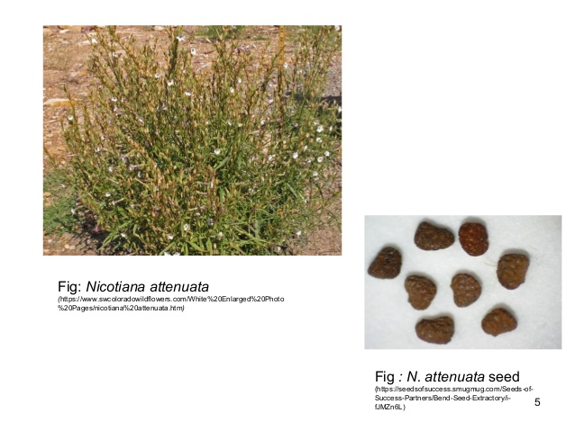

Slide 5
Causes of dormancy:

