Slide 1
Types of programming Languages

Slide 2
Types of Programming Languages:
The different types of programming languages are discussed below.
Procedural Programming Language
The procedural programming language is used to execute a sequence of statements which lead to a result. Typically, this type of programming language uses multiple variables, heavy loops and other elements, which separates them from functional programming languages. Functions of procedural language may control variables, other than function’s value returns. For example, printing out information.
.
Step 1: Start
Step2: Declare variables num1, num2 and sum.
Step 3: Read values num1 and num2. Step 4: Add num1 and num2 and assign the result to sum. sum←num1+num2
Step 5: Display sum
Step 6: Stop

Slide 3
Object-oriented Programming Language:
This programming language views the world as a group of objects that have internal data and external accessing parts of that data. The aim this programming language is to think about the fault by separating it into a collection of objects that offer services which can be used to solve a specific problem. One of the main principle of object oriented programming language is encapsulation that everything an object will need must be inside of the object. This language also emphasizes reusability through inheritance and the capacity to spread current implementations without having to change a great deal of code by using polymorphism.
Scripting Programming Language:
These programming languages are often procedural and may comprise object-oriented language elements, but they fall into their own category as they are normally not full-fledged programming languages with support for development of large systems. For example, they may not have compile-time type checking. Usually, these languages require tiny syntax to get started.

Slide 4
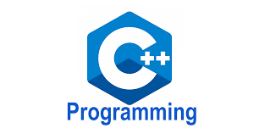
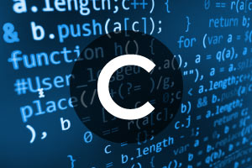
The Difference Between Different Programming Languages
C++ Language
The C++ language has an object oriented structure which is used in large projects. Programmers can collaborate one program into different parts or even one individual work on each part of the program. The structure of object oriented also permit code to be reused many times.This language is an efficient language. But, many programmers will disagree.
Syntax to add two numbers:
int x = 5; int y = 6; int sum = x + y; cout << sum;
C Language
The C language is a basic programming language and it is a very popular language, particularly used in game programming, Because C language includes the additional packing of the C++, Every programmer uses this language because it makes programs faster . However the value of this language gives the reusability of C++ to get the slight increase in performance with C language.
#include <stdio.h>
int main()
{ int number1, number2, sum;
printf("Enter two integers: ");
scanf("%d %d", &number1, &number2);
// calculating sum sum = number1 + number2;
printf("%d + %d = %d", number1, number2, sum);
return 0; }

Slide 5
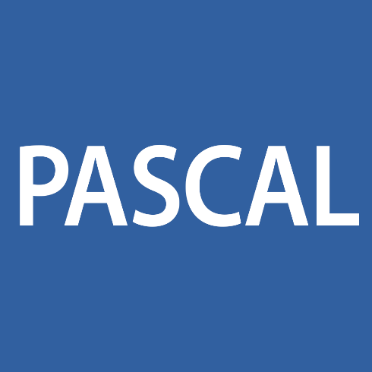
Pascal Language
Pascal language is mostly a teaching language and few industries uses this language to write the programs. This language tends to use keywords instead of symbols and braces in C language. So this language is very easy for beginners to understand than a programming language like C, C++. Borland is a compiler software company, which is using Delphi programming language for industrial strength. Delphi is an object oriented language of Pascal, and presently Borland compilers only use it.
Fortran Language
Fortran language is a number crunching language and still it is used by scientists. This language allows different sizes of variables up to the memory limit in the machine. This language is suitable for engineers, who have to calculate values with high precision. Program in Fortran is inflexible and sometimes it makes difficult to read

Slide 6
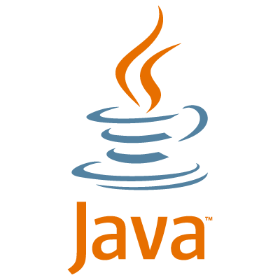
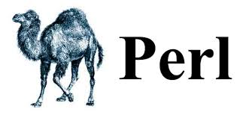
Java Language
The Java language is a multi platform language that’s particularly helpful in networking. Of course, mostly this language is used on the web with Java applets. However, this language is used to design cross platform programs, Since it similar to C++ in structure and syntax. For C++ programmers, Java language is very easy to learn and it offers some advantages provided by object oriented programming. Like reusability and it can be difficult to write efficient code in Java. But, nowadays the speed of the Java language has increased and 1.5 version offers some good features for easy program making.
Perl Language
Perl language is a file management language for UNIX. But it is more popular for its common gateway interface programming (CGI). It is a term for programs that web servers can perform to allow additional capabilities of web pages. Pearl language is a method for searching text and it is used for useful server functions and other databases, and it is very easy to pick up the fundamentals if you have any experience in any language. As a CGi language, web hosting services select Perl language over C++ language. Because, the web hosts can review Perl script files. Since they are text files, when C++ is compiled.

Slide 7
PHP Language
The PHP language is used to design web pages and sometimes it is also used as scripting language. This language is designed to develop a rapid website, and as a result comprises features which make it easy generate HTTP headers and link to databases. As a scripting language, it includes a set of components permit the programmer to easily get up to speed. However, it has more sophisticated object oriented features.
This is all about the differences between programming languages and few major programming languages are discussed. And, the remaining languages like Python, Smalltalk, COBOL, C# and Prolog are similar to the above languages which are discussed. But selecting the suitable language for developing a program or application is very important

