Slide 1
Definitions of culture
Man made environment
That complex whole which includes knowledge , belief, art , law , customs and any other capabilities and habits acquired by a man as a member of society.
Culture is everything made, learned, or shared by the members of a society, including values, beliefs, behaviours, and material objects.
Culture is learned, and it varies tremendously from society to society. We begin learning our culture from the moment we’re born, as the people who raise us encourage certain behaviours and teach their version of right and wrong.

Slide 2
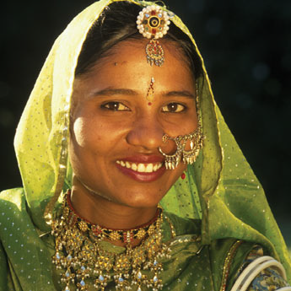
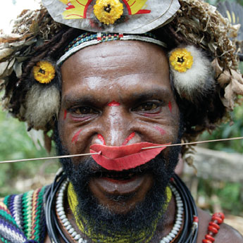
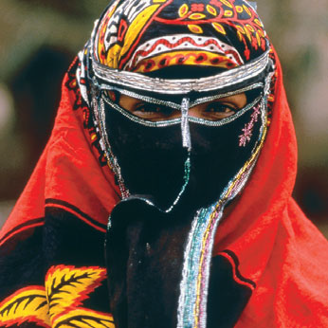

Slide 3
characteristics of culture
Adaptation….. Biological adaptation in humans is important but humans have increasingly come to rely upon cultural adaptation
Transmitted….one generation to another.
Dynamic…continuously changing
Gratifying…satisfies many biological and social need
Learned…through socialization not innate
Historical back ground
Shared…it belongs not to single individual or group but belong to all members of society
Accumulative….it goes on increasing in size
Universality…all societies has culture but may be different only human being posses not animals

Slide 4
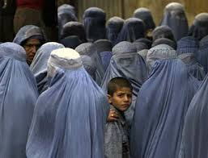
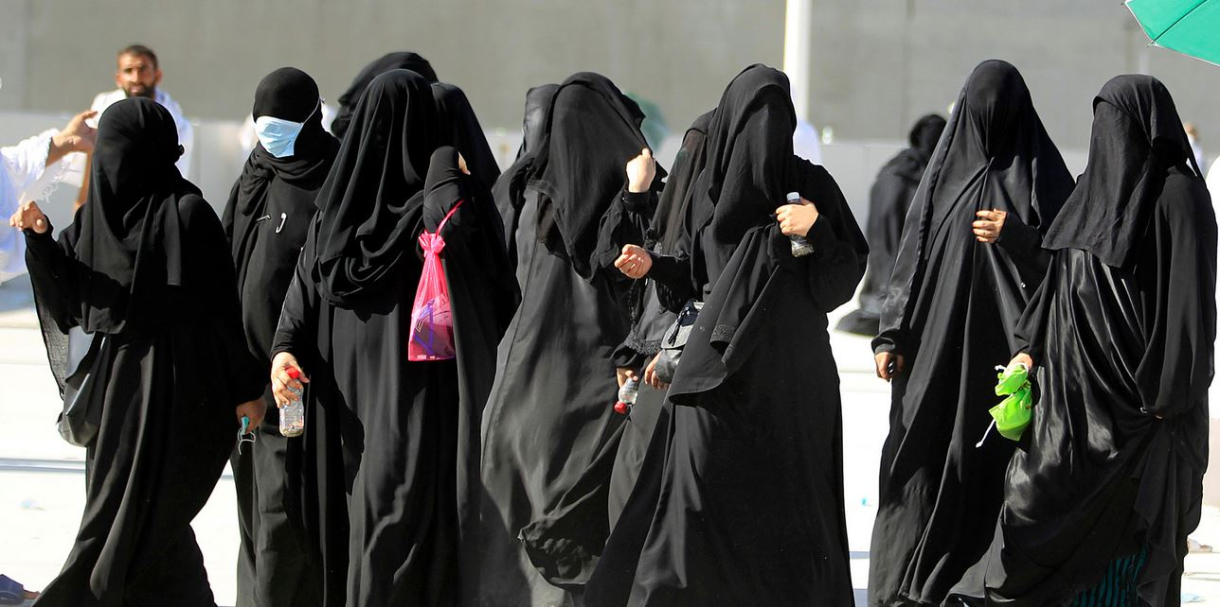

Slide 5
Types of culture
Ideal culture
The way things should be and that a culture claims to have. It involves an idealized, uncompromising value system that dictates perfect behavior. Using ideal culture as a standard, you are either right or wrong. Rules are black and white, with no grey areas and no exceptions
E.g corruption should be eliminated, women should have in proper dressing, every individual has to abide by the laws
Social patterns mandated by values and norms
Real culture
They way things actually occur in everyday life
Social patterns that only approximate cultural expectations
values and norms that are actually followed by a culture. It involves an adaptable value system that is used mostly as a set of guidelines for preferred behaviour. Right and wrong are separated, but exceptions exist for pretty much everything.
Example:
In ideal culture the woman is the housekeeper, and takes care of the babies while the man works. In real culture nowadays some men stay home with the children while their wife is the breadwinner.

Slide 6
Material culture
refers to the physical objects, resources, and spaces that people use to define their culture. These include homes, neighbourhoods, cities, schools, churches, synagogues, temples, mosques, offices, factories and plants, tools, means of production, goods and products, stores, and so forth. All of these physical aspects of a culture help to define its members' behaviours and perceptions.
Non‐material culture
refers to the nonphysical ideas that people have about their culture, including beliefs, values, rules, norms, morals, language, organizations, and institutions. For instance, the non‐material cultural concept of religion consists of a set of ideas and beliefs about God, worship, morals, and ethics. These beliefs, then, determine how the culture responds to its religious topics, issues, and events.

Slide 7
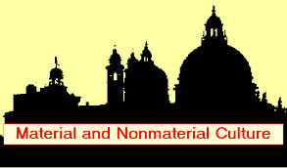
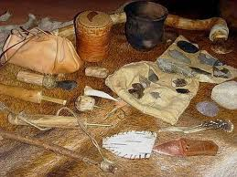
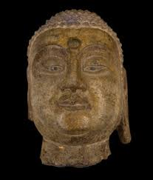
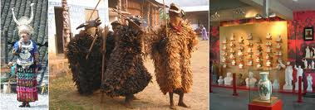
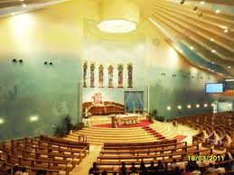
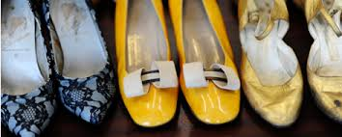

Slide 8
Cultural lag
Period of maladjustment when non material culture is still struggling to adapt to new material conditions.

Slide 9
Elements of culture
The major aspects of culture that shape the way the members of a society live;
Language
Norms
Sanctions
Values
beliefs

Slide 10
language
Language is in fact , the foundation of every culture.
Language is an abstract system of words , meanings and for all aspects of culture.
It include speech , written characters , numerals , symbols and gestures and expressions.

Slide 11
Language cont-------------
Language reflects the priorities of a culture.
Examples;
In the old west , words such as gelding , stallion, mare, piebald , sorrel , etc were all used to describe one animal – horse.
Slave Indians of north Canada who lived in a frigid climate have 14 terms ice, including 8 for different kinds of “solid ice” and other for “seamed ice” , “cracked ice” and “floating ice”.
Cold war era(1950 – 1975s) study of Russian language by Americans
After sept.11, 2001 (learning Arabic by Americans)

Slide 12
Social Norms
Established standards of behavior maintained by a society.
Social norms are standards, rules, guides and expectations for actual behaviour
Honesty is value. the expectation that students will not cheat or use such material forbidden by the codes in the examinations is a norm.

Slide 15
Types of Norms
Formal
Law
Informal
Folkways
Mores

Slide 16
Law
It refers to the Governmental social control
Parliament make laws, judiciary explain them and administration implements

Slide 17
Folkways
A norm governing everyday behavior whose violation raises comparatively little concern e.g. the ways of eating, talking, dressing. Taking three time a meal, walking on the right side of the road, regular teeth brush, wife and husband mutual love etc.

Slide 18
Mores
Norms highly necessary to the welfare of a society. They give instructions and provide guidance for the people to behave in a particular way. e.g. respecting elders, worshipping God, speaking the truth, leading a righteous life, don’t appear before the people without dress, don’t be cruel to wife and children, don’t be Irreligious, don’t tell lies….

Slide 19
Social Sanctions
Penalties and rewards for conduct concerning a social norms

Slide 20
Types of Sanctions
Social Sanctions
Formal
Informal
Negative
Positive

Slide 21
Types of sanctions
Formal:
Rewards or penalties on conformity or non conformity of laws
Informal:
Rewards or penalties on conformity or non conformity of informal norms
Negative:
Non-conformity to a norm
Positive:
Conformity to a norm

Slide 22
Values
Collective conceptions of what is considered good, desirable and proper in a culture (Equality, Respect to elders etc)
Values sometimes create conflict…. Equal opportunity vs racism
values are abstract conceptions of what is important and worthwhile
Honesty is a general value

Slide 23
Beliefs
Holding a statement true without any verification
US Women can be president

Slide 24
Concepts related to culture

Slide 25
Ethos
It is the flavor or the central point of a culture.
It is the philosophy or the ideology of entire culture around which the entire society rests. For example;
Pakistani culture is attributed as religious.
American culture is competitive.
Japanese culture is cooperative.
Russian culture is accommodative.

Slide 26
Ethnocentrism
The belief that one’s own culture is superior to all others and is the standard by which all other cultures should be measured.
The tendency to judge the other cultures by the standards of one’ own culture -- Ian Robertsons.
The tendency to assume that one’s own culture and way of life are superior to all others – W.G Sumner.

Slide 27
Merits of ethnocentrism
1-unity and loyalty
2-patriotism
3-integration

Slide 28
Demerits of ethnocentrism
grouping
injustice
non-cooperation
intolerance
hindrance in the way of social change

Slide 29
Sub-culture
A segment of society that shares a distinctive pattern of mores , folkways and values that differs from the patterns of larger society.

Slide 30
Prominent sub-cultures in Pakistan
Punjabi
Sindhi
Blochi
Pashtun
Balti

Slide 31
Counter culture
The culture and life style of those people , especially among the young who reject or oppose the dominant values and behavior of society.

Slide 32
Cultural shock
The feelings of surprise and disorientation that people experience when they encounter cultural practices that are different from their own.
For example , a Pakistani visiting Korea asked a special dish for dinner--------dog meat

Slide 33
xenocentrism
Xenocentrism is the preference for the products , styles, or ideas of some one else’s culture rather than of one’s own.
Pakistani women belief that European cosmetics are far superior to those produced domestically.
Americans belief that Europeans produce superior automotive vehicles .

Slide 34
Consequences of xenocentrism
Loss of business in the home country.
Loss of jobs in the home country.
Overall reduction of moral with in the nation.
We can say xenocentrism is the killer of culture.

Slide 35
Cultural uniformities and variability
Among the societies there are certain common traits which have biological , geographical and social background.
On the same ground , a similarity among all the cultures is found . This similarity among all the cultures is called cultural uniformity.
Due to this uniformity , cooperation among societies develop in different fields.

Slide 36
Contin………
All the things are not alike in all the cultures of the world societies . There are also differences in elements of culture among the world’s many nations ’even with in a single nation, which is called cultural variability.
Cultural variability create differences in economic , political and general social ways of life. These differences lead to conflict and wars.

Slide 37
Examples
Language
Family and marriage
Social institutions
Social norms
Social values
Social groups
Agriculture
Transport and communication

