Slide 1
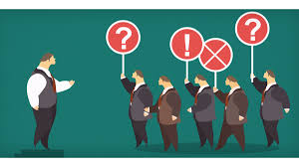

Slide 2
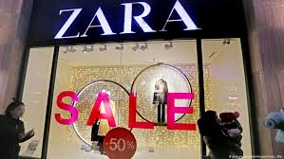
Name 5 things that influence a fashion brand’s public opinion

Slide 3
PUBLIC OPINION
• Suffering a loss of public opinion is not a small issue •
No individual or organization can suffer to tarnish their reputation
• A negative public opinion can result in a loss of prestige and/or business
• The way customers, vendors, suppliers, retailers, the media, and the community perceive the brand has an effect on the organization
• In most cases this leads to a loss of $$$$

Slide 4
Public- a group of individuals who share a common interest in a specific subject
• Opinion- the expression of an attitude on a particular topic, when attitudes become strong enough they surface as an opinion, when opinions become strong enough they lead to verbal or behavioral actions
• Attitudes◊ Opinions◊ Actions
• Public Opinion- the compilation of many individual opinions on a particular issue that affects a group– a consensus

Slide 5
• It is difficult to change individuals’ minds.
• It is even harder to move them away once they have formed an opinion
• Most PR programs are meant to Persuade individuals to change their minds
• Crystallize uninformed or undeveloped opinions
• Reinforce existing opinions

Slide 6
What is an Attitude?
• We all have one, but what are they?
• Attitudes are evaluations that we make about specific problems or issues
• They are positive, negative, or nonexistent; for something, against something, or neutral
• Attitudes and behaviors are both situational-- influenced by specific issues in specific situations
• When others with similar attitudes reach similar opinions, public opinion is born

Slide 8
How Are Attitudes Developed?
• Personal- physical and emotional; size, age, social status
• Cultural- Rural and Urban, North and South
• Educational- an individual’s level of education alters their attitude about specific issues or events
• Familial- we acquire our parents’ tastes, biases, and political views
• Religion- allows us to form attitudes about specific topics
• Social Class- when status changes, so does attitude
• Race
• Friends
• Celebrities and Community Leaders
• The Product

Slide 9
Changing Attitudes
• It is very hard to change the minds of individuals who strongly support or oppose an issue or individual
• This is why those in the middle, or who remain neutral to an issue or individual are important to shaping public opinion.
• Those in the middle are usually the easiest to sway one way or another, because typically these individuals are passive or indifferent.

Slide 10
• Cognitive dissonance- the idea that individuals avoid information that is dissonant or opposes their own points of view, and they tend to seek out information that supports their attitudes
• Social Judgment- individuals may have a range of opinions on a certain subject, anchored by a clear attitude
• While it is hard to change individuals’ positions, communicators can work to modify an individual’s opinion

Slide 11
Motivating Attitude Change
• Motivation is key to changing anyone’s attitude from latent to aware and finally active
• Maslow’s Hierarchy of Needs helps us understand what motivates us:
• Psychological Needs- food, water, sleep
• Safety Needs- security, protection
• Love Needs- love, belonging, affection
• Esteem Needs- recognition and prestige
• Self-Actualization- becoming what is capable of becoming
According to Maslow, all 5 lead to motivation

