Slide 1
Extension Program Development
AEE-301 3(2-1)

Slide 2
Meaning and concept
The term Program is used to convey different meanings, thoughts, ideas, and practices.
Program:
“a product resulting from all the programming activities in which the professional educator and leaner is involved.” Boyle (1981)
“a program is a set of purposeful, planned, and interrelated experiences to reach our educational objectives and to solve problems. Forest and Baker (1994)

Slide 3
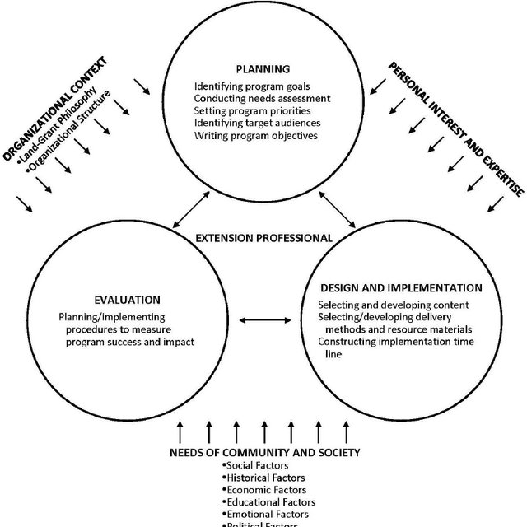
Programme Development
A deliberate series of actions and decisions through which representatives of the people affected by the potential program are involved with a programmer to:

Slide 4
Continued….
Develop an organizational structure
Effective utilization of resources
Prioritization of problems
Identify desired outcomes
Identify resources for promotion
Designing instructional plan
Implementing the plan of action
Develop accountability approaches

Slide 5
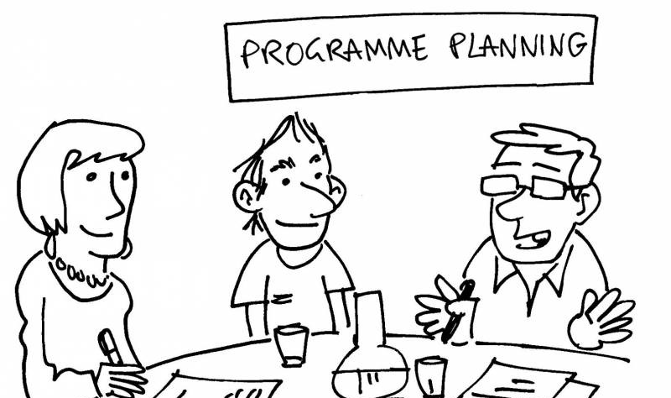
Program Planning is an intentional effort carefully designed to attain specific and pre-determined goals assumed to be important for the people.

Slide 6
Need & Importance of Program Development
What Should be?
NEED
Gap
What is?

Slide 7
Philosophy of Agri. Extension Program Development
Philosophy concentrates on studying human beliefs about the nature of reality, type of knowledge to be acquired and values.
What is real or nature of reality?
What is good value?
What is true knowledge?
Metaphysics
Axiology
Epistemology

Slide 8
Practical Activities
Visit the office of an extension agent in your area and discuss with him the followings:
Objectives of extension program running by him/her in the area.
---------------------------------------------------------------------------------------------------
---------------------------------------------------------------------------------------------------
------------------------------------ at least 500 words --------------------------------------
---------------------------------------------------------------------------------------------------
---------------------------------------------------------------------------------------------------
Reasons for designing and executing the program in the area.
---------------------------------------------------------------------------------------------------
---------------------------------------------------------------------------------------------------
------------------------------------ at least 500 words --------------------------------------
---------------------------------------------------------------------------------------------------
---------------------------------------------------------------------------------------------------

