Slide 1
Quality Planning 1. Flow Charting 2. Process Charting 3. Purchase Planning 4. Planning for JIT ( Just in Time )
TQM
Lecture 3

Slide 4
Quality Planning
A quality plan is a document, or several documents,
that together specify quality standards, practices,
resources, specifications, and the sequence of
activities relevant to a particular product, service,
project, or contract.
Quality plans should define: .. “ A method for
measuring the achievement of the quality objectives”

Slide 6
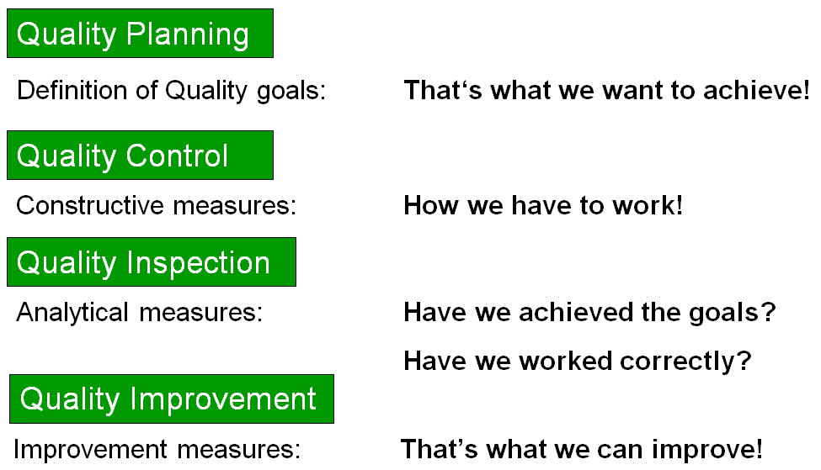

Slide 7
Basic Quality Tools
1.Flow Charting 2. Process Charting 3. Purchase Planning 4. Planning for JIT ( Just in Time )
1.Flow Charting
A flowchart is a diagram that shows the step-by-step flow of operation to get a solution of a problem or to figure out the correct sequence of the process.

Slide 8
Flow Charting
Basic Flowchart Symbols
1. The Oval
An End or a Beginning ,The oval, or terminator, is used to represent the start and end of a process
2. The Rectangle
A Step in the Flowcharting Process. The rectangle is your go-to symbol once you've started flowcharting.

Slide 9
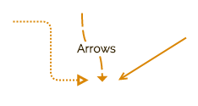
Flow Charting
3. The Arrow
Indicate Directional Flow. The arrow is used to guide
the viewer along their flowcharting path.
4. The Diamond, Indicate a Decision
The diamond symbolizes that a decision is required to
move forward.

Slide 10
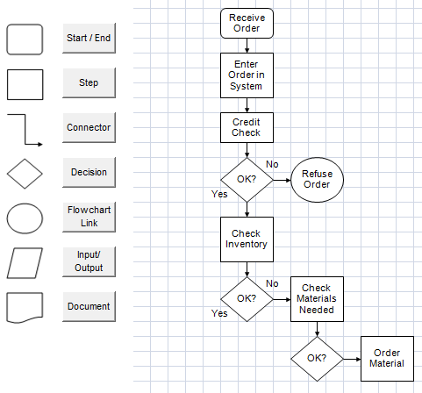

Slide 11
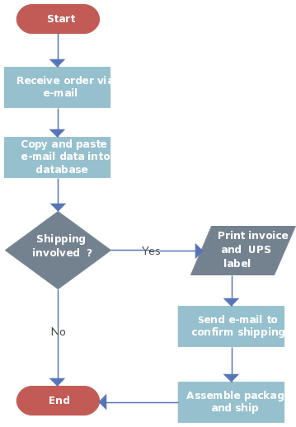
Example of Flow chart

Slide 12
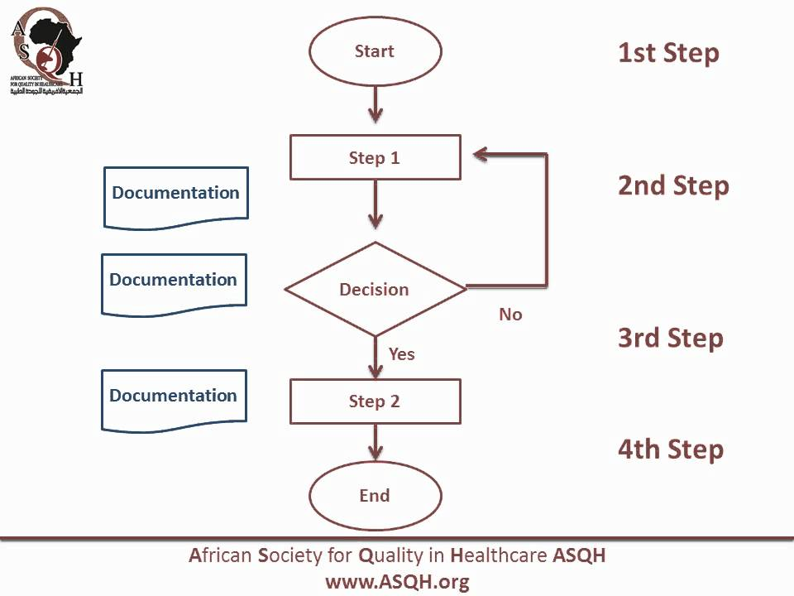

Slide 13
Example of Flow chart

Slide 14
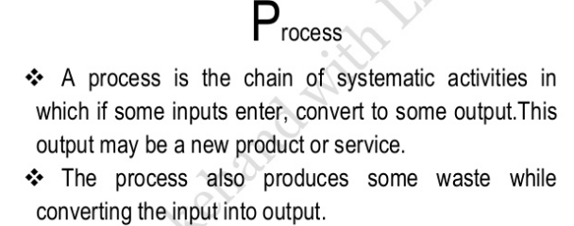
Process charting
Quality planning is the task of determining what
factors are important to a project and figuring out
how to meet those factors.
Some common steps in the process include knowing
responsibilities, outlining documents, understanding procedures, designing, monitoring and wrapping up.

Slide 16
The acceptable quality limit (AQL)

Slide 18
Purchase planning
Purchase planning is the process of establishing objectives and tactics to obtain the best value in a specific purchase.
Objective of Purchase Planning
Lower costs. This is by far the primary function of the purchasing department.
Reduce risk and ensure the security of supply.
Manage relationships.
Improve quality.
Pursue innovation.
Leverage technology.

Slide 20
Purchase Planning module determines material requirements (both for raw materials used in production and purchased items sold to customers), based on sales orders, open work orders or frequency of need.

Slide 22
Planning for JIT
What is Just in Time (JIT). Just in time is a common inventory management technique and type of lean methodology designed to increase efficiency, cut costs and decrease waste by receiving goods only as they are needed.
It was not so long ago when organizations were overstocking their warehouses with resources just in case a customer demand appears.
However, having a lot of inventories automatically means higher costs for maintaining these extra resources. Logically, more inventories require more space and additional workforce.
In the middle of 20th century, struggling to reduce their high inventory costs, Toyota built the foundation of Lean manufacturing.

Slide 24
Just in time is a common inventory management technique and type of lean methodology designed to increase efficiency, cut costs and decrease waste by receiving goods only as they are needed.
JIT inventory at a glance: the pros and cons
With the right approach, utilizing a JIT inventory management strategy has a number of potential benefits for businesses:
Lower inventory holding costs – with inventory purchased or produced at short notice there’s no need to have unsold inventory taking up valuable warehouse space.
Improved cash flow – without the need to store large volumes of inventory at all times, capital expenditure is reduced, and cash can be invested elsewhere.
Less dead stock – because inventory levels rely on customer demand, there’s less risk of unwanted stock left sitting in your warehouse.

Slide 25
Just in Time inventory management isn’t without its potential disadvantages:
Problems with order fulfillment – if a customer orders a product and you don’t yet have it in stock, you run the risk of not being able to fulfill the order in a timely fashion.
Little room for error – doing JIT right means having accurate demand forecasts and insights into customers’ buying habits at all times. Any miscalculation could have a significant negative impact on business operations.
Price shocks – with a Just in Time system, you don’t have the luxury of waiting around for the best prices on goods. When prices go up, profit margins go down.

Slide 26
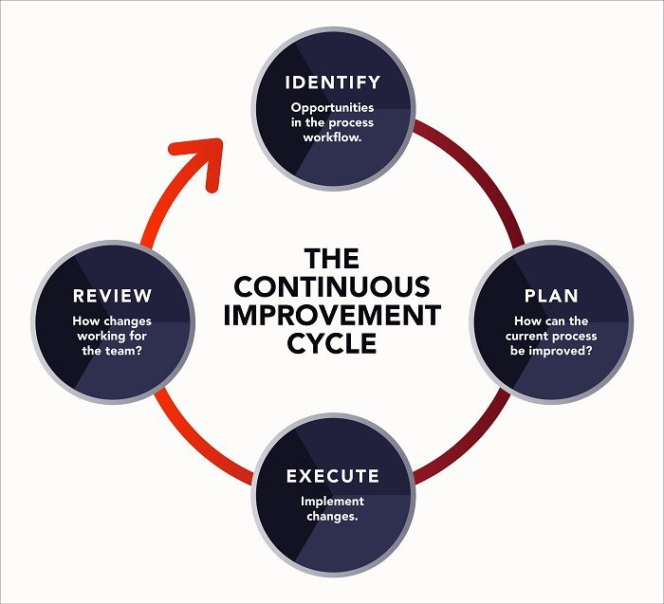
Lean methodology is a way of optimizing the people, resources, effort, and energy of your organization toward creating value for the customer. It is based on two guiding tenets, continuous improvement and respect for people.

Slide 29
Just-in-Time Production: The Path to Efficiency

