Slide 1
PREVENTION PRACTICE: A HOLISTIC PERSPECTIVE FOR PHYSICAL THERAPY
HEALTH AND WELLNESS

Slide 2
HEALTH
Derived from Old English term “hal” meaning sound, or whole
Health is essentially a purpose of medicine, the promotion and restoration of wholeness.
By Webster Dictionary “stat of being healthy, happy, and prosperous”

Slide 3
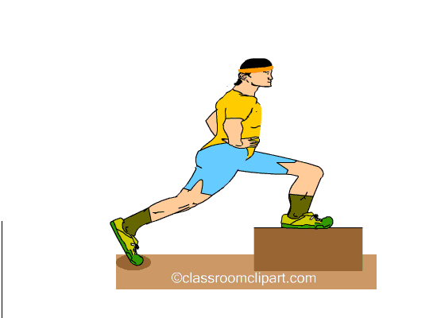
According to WHO
“A stat of complete physical, mental, social and spiritual well-being.”

Slide 4
In community health & education and promotion manual health is defined as a more dynamic process,
“A quality of life involving dynamic interaction and independence among an individual’s physical well being, his/her mental and emotional reaction, and the social complex in which he/she exist”.

Slide 5
HEALTH
Spiritual health or passion::: to fulfill a need or personal goal another aspect of health.
Physical, mental social and spiritual components are key factors for comprehensive health examination.
Medical professionals notice a shift in their health care paradigm perspective from one emphasizing illness to one stressing health, function, quality of life and wellbeing
Shift in health care --→prevention--→ disease by helping & modifying life style--→optimal health
Notes:
Shift in health care resulted in prevention

Slide 6
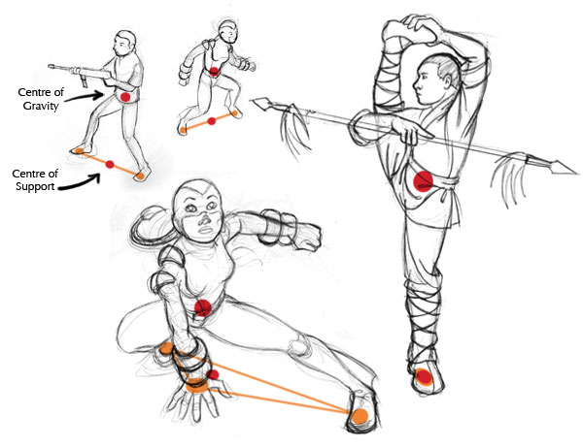
Optimal health:
Balance of physical, mental, spirtual, and social health
Life style changes:
1. enhance self awareness and knowledge of healthy habits
2. change behaviors interfere with good health
3. create environment support good health

Slide 7
POOR HEALTH
Include physical ailments --→acute & chronic disabilities,
mental health issues--→limit independent functioning.
Poor health --→significant impact on individual, family, community and society---→ depending on severity individual lose functional independently and opportunity to fulfill role in community and home.
Family members lose support who are ill and disabled.

Slide 8
POOR HEALTH
Musculoskeletal disabilities in US cost more than 1 trillion dollar/year in total costs.
National center for chronic disease prevention and health promotion.: unhealthy life style lead to early diseases-→ increase risk factors for heart, kidney diseases and diabetes chronic diseases--→disabilities → early deaths.
Life style risk factors include: smoking, tobacco, eating high fat/trans fat food,/ low fiber diets, sedentary life style, alcohol & drug abuse
. Emphasis is on effective prevention, active intervention for disability progression.

Slide 9
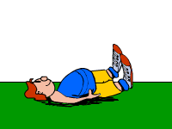
WELLNESS
an active, life long process of becoming aware of choices and making decisions toward a more balanced and fulfilling life.
Wellness involves choices about one’s life and the priorities that determine one’s lifestyle.
Wellness integrates mental, social, occupational, emotional, spiritual, and physical dimensions of one’s life and reflects how one feels about life as well as one’s ability to function effectively.

Slide 10
WELLNESS
A state of good health often achieved through healthy lifestyle choices including the following six dimensions of wellness described by the National Wellness Institute
1:Social wellness:
perception of having support from family or friends in time of need; and perception of being valued support provider.
Interacting and contributing to one’s community or environment→ establish meaningful relations that enhance quality of life
Social support valuable asset for health and wellness as well recovery from injury.
Notes:
Social wellness

Slide 11
■ 2:psychological wellness:
General perception that one will experience positive outcomes to events and circumstances in life.
The mix qualities of optimism, determination, hope; are vital in preventive practice and positively dealing with life problem.

Slide 12
■ 3:Spiritual:
Belief in unifying force b/w mind and body.
Finding and living a life that has meaning and purpose.
It include person’s ability to establish values and act on system of belief as well as to establish meaningful & constructive lifetime goals
■ 4: Physical:
Positive perception and expectation of health.
It include ability to meet daily demands at work & to use free time.
Making appropriate nutritional choices and participating in regular physical activity.

Slide 13
WELLNESS
5. Intellectual:
Perception of being internally energized by an optimal amount of intellectually stimulating activities.
Actively using your mind to develop new skills and learn new information.
■ 6.Emotional: progression of secure, self identity and positive sense of self regard & self esteem.
Ability to cope with daily circumstances & to deal with personal feeling in positive, optimistic & constructive manner.
Notes:
Accepting and managing our feelings in all personal interactions.

Slide 14
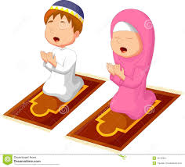
WELLNESS
Howard clinebell provide more comprehensive seven dimension of wellness:
1. The Spiritual Well being dimension incorporates healthy religious beliefs, practices, values, and institutions that energize and enrich all aspects of our lives.
it addresses an individual’s need for purpose, guidance, meaning and values.

Slide 15
2.The Mental Well being dimension represents profound interdependence of the mind and body that manifests itself in our mental and physical health. it incorporates problem solving ,creativity, clarity in thinking ,services and productivity.
3. The Physical Wellbeing dimension reflects the body’s health. Physical well being is evidenced by ability to experience sensations without pain, to effectively function with adequate energy to be responsible for self care and to care others.

Slide 16
4.The Relationship Wellbeing dimension represents the most important factors for our healing and general wellness. It incorporates the need for progress and love, forgiving and receiving, for empowering others and for creating interpersonal bonds.
5. The Work wellbeing dimension satisfies the thirst for purpose. It addresses the need for fulfilling the purpose in one’s profession.
Self worth, satisfaction and personal fulfillment are all related to individual's ability to serve community in meaningful way.

Slide 17
6.The Play Wellbeing dimension acknowledges that play provides the individual with laughter, cheer, energy and balance. It is ability to successfully play that provides the needed healing and revitalization to meet the demands of other dimensions.

Slide 18
7.The Wellbeing of Our World dimension reflects an individual’s perspective on living in a healthy environment and protecting natural resources.
it incorporates a broad overview of the world. it includes responsibility, justice, an earth caring lifestyle, desire of wellbeing for all and adequate health care.
Seven dimensions provide a framework for exploring various aspects of health & wellness, including versatile individual & perspective of world.

Slide 19
Models of wellness
Provide multidimensional aspects of wellness give framework for clients needs for management of illness
Signs….. Symptoms…… Disability….. Premature death
Signs:
changes due to any pathology that is detected on diagnostic tests(i.e. lab test) by a pathologist, or by a physician, or therapist.
They are physiological and anatomical markers of pathology
Example ; Hb levels, findings of CBC, PCR etc

Slide 20
Symptoms:
sensation or changes in the bodily function experienced by a client or patient
Pain….. etc
Disability :
Inability to engage in gainful activity or work, often results from chronic and long term illness and has significant impact on an individual’s well-being
Advantage of model: help in early identification of sings &symptoms of pathology -→early intervention-→ prevent disability and premature death.

Slide 21
HOLISTIC HEALTH
This holistic perspective looks beyond the physical functioning of the individual and recognizes the importance of multiple factors contributing to good health and optimal wellness, emphasizing the unity of mind, spirit, and body.
According to American Holistic Health Association, perspective of holistic health considers “the whole person and the whole situation”

Slide 22
Principles of Holistic Medical Practice
The goal of holistic medical practice is achieving optimal health for each client. Optimal health involves both a conscious awareness of wellness domain( social, spiritual, mental, emotional, physical, and environmental) and chieving balance in these domains.
Practitioner offer “holistic care” i.e, care to entire person(mind, body, and spirit)
Holistic medicine is person-centered, treating the individual with pathology rather than focusing on the pathology itself.

Slide 23
4. Practitioners helps clients take control of their health and use their innate abilities to heal.
5. Holistic medicine involves health promotion, preventive care, and education designed to increase awareness of factors contributing to illness while emphasizing options that optimize well-being
6. Holistic medicine incorporates a variety of healing system, including lifestyle changes, conventional medicine(drugs and surgery), and alternative and complementary medicine, to meet each individual’s unique needs.
7. The relationship of the practitioner and client focuses on the client’s autonomy and needs, while valuing the insights of both parties

Slide 24
8. Using love, kindness, acceptance, grace, humor, enthusiasm, and hope, practitioners help clients optimize their lives while managing any illness
9. Practitioners serve as role models of optimal care by incorporating the principles of holistic medicine into the healing relationship shared with their client
10. Life experiences(birth, suffering, and dying) are viewed as profound learning experiences for both the client and the practitioner of holistic medicine. The quality of life is emphasized as key component of healing.

Slide 25
Comparing Holistic Medicine and Conventional Medicine
 | Holistic Medicine | Conventional Medicine
Philosophy Primary objective of care Diagnosis Primary method of care Primary care treatment option | Based on allopathic, osteopathic, naturopathic, energy To promote optimal health To prevent and treat disease Medical history, physical exam, laboratory data, holistic health care sheet Empower patient to heal themselves through health promotion and lifestyle changes Diet, Ex, environmental measures, attitudinal,& behavioral modification; relationship & spiritual counseling | Based on allopathic medicine To cure and reduce pathology Medical history, physical exam, laboratory data Eliminate sign and symptoms Medication & surgery

Slide 26
 | Holistic Medicine | Conventional Medicine
Secondary care treatment options Weakness Strength | Botanical(herbal) medicine, homeopathy, acupuncture, manual medicine, biomolecular therapies,PT, medications, & surgery Shortage of holistic physicians and training prog; time-intensive, requiring a commitment to a healing process, not a quick fix Teaches pt to take rspnsibility for their health_cost effective_treating both acute and chronic illness, therapeutic in preventing and treating chronic disease, and essential in creating optimal health | Diet, Ex, PT and stress medicine Ineffective in preventing and curing chronic disease; expensive Highly therapeutic in treating both acute and life-threatening illness and injuries

Slide 27
Prevention Practice
Prevention practice encompasses health acre designed to promote health, fitness, and wellness through education and appropriate guidance designed to prevent or delay the progression of pathology
It also minimizes the impairments and functional limitation
Health care profession are involved in three types of preventive practice
Primary prevention
Secondary prevention
Tertiary prevention

Slide 28
Primary Prevention
Is preventing a target condition in a susceptible or potentially susceptible population through specific measures, such as general health promotion efforts.

Slide 29
Secondary Prevention
is decreasing the duration of illness, severity of disease, and numbering of sequelae (abnormalities following or resulting from disease, injury, or treatment)through early diagnosis and prompt intervention.

Slide 30
Tertiary Prevention
involves limiting the degree if disability and promoting rehabilitation and restoration of function in patients with chronic or reversible disease.

Slide 31
Risk Reduction
Risk factors that may predispose an individual to diminished well-being and health problems include physical risk factors: poor nutrition, physical inactivity, a poor physical environment, and substance abuse; psychological, spiritual, and social risk factor: low self-esteem, and lacking values and a direction in one’s life; and environment risk factors: person, things, or conditions that negatively influence other dimensions.
By identifying and addressing these risk factors, the health professional can reduce the incidence of injury and illness
Populations that are susceptible to illness or injury are in particular need of this awareness, accomplished through appropriate education and guidance

Slide 32
The Physical Therapist’s Role in Promoting Health and Wellness
Physical therapist play a major role in prevention practice
Physical therapist were traditionally involved in the management of physical impairments.
Their current role is, identifying the risk factors and developing health promotion strategies.
Physical therapist are experts in examining and evaluating the motor capabilities, goals, and functional limitations of individual with
Musculoskeletal
Neurological
Cardiopulmonary
Integumentary
And other body system

