Slide 1
Chapter #04
Measures of Dispersion, Moments & Skewness

Slide 2
Introduction:
The word dispersion has a technical meaning in statistics. The average measures the center of the data, dispersion means the spread or scatterness of observations in a data set.
Another feature of the observation is how the observations are spread about the center. The observations may be close to the center or they may be spread away from the center.
If the observations are close to the center (usually the arithmetic mean or median), we say that dispersion, scatter or variation is small.
If the observations are spread away from the center, we say dispersion is large.

Slide 3
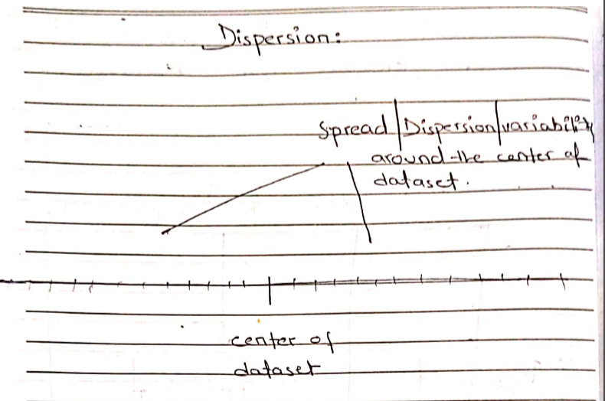

Slide 4
Measure of Dispersion: A measure of central tendency only describe the center of the data. It does not tell us anything about the spread of the data. Because any two data sets with different variability may have same central tendency. For example: We have two data sets. Data set I Data set II 8,7,5,8,6 1,4,7,10,12 $\overline{x}$ = $\frac{{Ʃx}_{i}}{n}$ $\overline{x}$ = $\frac{{Ʃx}_{i}}{n}$ $\overline{x}$ = 6.8 $\overline{x}$ = 6.8 (Less Variation or Dispersion) (More Variation or Dispersion)

Slide 5
Characteristics of Measure of Dispersion:
It should be easy to calculate & simple to understand.
It should be based on all the observations of the series.
It should be rigidly defined.
It should not be affected by extreme values.

Slide 6
Types of Measures of Dispersion
Absolute Measure of Dispersion
Relative Measure of Dispersion

Slide 7
Absolute Measure of Dispersion:
An absolute measure of dispersion gives an idea about the amount of dispersion/spread in a set of observations in which units are same. Absolute measure cannot be used to compare the variation of two or more series/ data set.
The Range.
The Quartile Deviation.
The Mean Deviation.
The Variance and the Standard Deviation.

Slide 8
Relative Measure of Dispersion:
A relative measure of dispersion is one that is expressed in the form of a ratio, co-efficients or percentage and is independent of the units of measurement. It is useful for comparison of data of different nature.
These measures are calculated for the comparison in two or more than two sets of observations. These measures are free of the units in which the original data is measure. Thus the relatives measures of dispersion are:
Coefficient of Range.
Coefficient of Quartile Deviation.
Coefficient of Mean Deviation.
Coefficient of Variance and the Standard Deviation.

