Slide 1
Chapter 1
The History of Management
For MS Students
Courtesy of Deborah Baker Texas Christian University
Management
4th Edition
Chuck Williams

Slide 2
What Would You Do?
ISG Steelton—International Steel Group, Steelton, Pennsylvania
You are a shift supervisor responsible for motivating six college students to move numerous stacks of scrap metal
Pieces are 92 pounds each and are carried up a ramp
The task will require six weeks--and you have two weeks to complete it
What would you do to motivate the students?

Slide 3
In the Beginning
After reading the next section, you should be able to:
explain the origins of management.

Slide 4
Management Ideas and Practice Throughout History
5000 BC
Sumerians
Record keeping
4000-2000 BC
Egyptians Planning, organizing, controlling.
Plan, organize, control. Written requests.
1800 BC
Hammurabi
Controls and written documentation
600 BC
Nebuchadnezzar
Wage incentives, production control
500 BC
Sun Tzu
Strategy
400 BC
Xenophon
Management as a separate art
400 BC
Cyrus
Human relations and motion study
175
Cato
Job descriptions
284
Diocletian
Delegation of authority
900
Alfarabi
Listed leadership traits
1100
Ghazali
Listed managerial traits
1418
Barbarigo
Different organizational forms/structures
1.1
1436
Venetians
Numbering, standardization, interchangeability
1500
Sir Thomas More
Critical of poor management and leadership
1525
Machiavelli
Cohesiveness, power, and leadership

Slide 5
Why We Need Managers Today
Then
Now
Work in families
Work in factories
Skilled laborers
Specialized, unskilled laborers
Small, self-organized groups
Large factories
Unique, small batches of production
Large standardized mass production
1.2

Slide 6
The Evolution of Management
After reading the next four sections, you should be able to:
explain the history of scientific management.
discuss the history of bureaucratic and administrative management.
explain the history of human relations management.
discuss the history of operations, information systems, and contingency management.

Slide 7
Scientific Management
Scientific Management
Studies and tests methods to identify the best, most efficient ways
“Seat-of-the Pants” Management
No standardization of procedures
No follow-up on improvements
2

Slide 8
Frederick W. Taylor
Frederick Taylor is known today as the "father of scientific management." One of his many contributions to modern management is the common practice of giving employees rest breaks throughout the day.
Frederick W. Taylor, 1856-1915

Slide 9
Taylor’s Four Management Principles
Develop a science for each element of a man’s work, which replaces the old rule-of-thumb method.
Scientifically select and then train, teach, and develop the workman.
Cooperate with the men to insure all work is done in accordance with the principles of the science.
There is almost equal division of the work and the responsibility between management and workmen.
2.1
Adapted from Exhibit 2.2

Slide 10
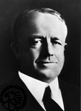
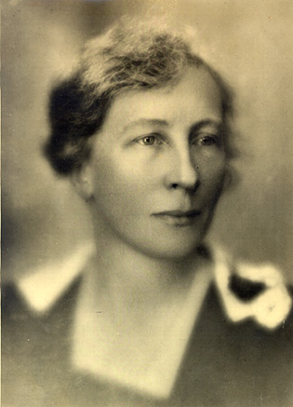
Frank & Lillian Gilbreth
Frank and Lillian Gilbreth were prolific researchers and often used their family as guinea pigs. Their work is the subject of Cheaper by the Dozen, written by their son and daughter.
2.2

Slide 11
Motion Studies: Frank & Lillian Gilbreth
Time Study
Timing how long it takes good workers to complete each part of their jobs.
Motion Study
Breaking each task into its separate motions and then eliminating those that are unnecessary or repetitive.
2.2

Slide 12
Charts: Henry Gantt
2.3

Slide 13
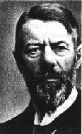
Bureaucratic Management
Max Weber, 1864-1920
Bureaucracy
The exercise of control on the basis of knowledge, expertise, or experience.
3.1
Notes:
.

Slide 14
The Aim of Bureaucracy
1. Qualification-based hiring
2. Merit-based promotion
3. Chain of command
4. Division of labor
5. Impartial application of rules and procedures
6. Recorded in writing
7. Managers separate from owners
3.1

Slide 15
Administrative Management: Henri Fayol
1. Division of work
8. Centralization
2. Authority and responsibility
9. Scalar chain
3. Discipline
10. Order
4. Unity of command
11. Equity
5. Unity of direction
12. Stability of tenure of personnel
6. Subordination of individual interests
13. Initiative
7. Remuneration
14. Esprit de corps
3.2
Adapted from Exhibit 2.4

Slide 16
Human Relations Management
Efficiency alone is not enough to produce organizational success.
Success also depends on treating workers well.
4

Slide 17
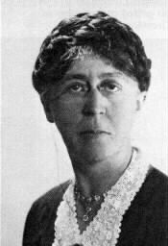
Mary Parker Follett
Mary Parker Follett is known today as the “mother of scientific management." Her many contributions to modern management include the ideas of negotiation, conflict resolution, and power sharing.
Mary Parker Follett, 1868-1933

Slide 18
Constructive Conflict and Coordination: Mary Parker Follett
Domination
Dealing with Conflict
Compromise
Integration
4.1

Slide 19
Constructive Conflict and Coordination: Mary Parker Follett
Fundamental Principals of Organizations
Coordination as reciprocal relating all the factors in a situation
Coordination by direct contact of the responsible people concerned
Coordination in the early stages
Coordination as a continuing process
4.1

Slide 20
Hawthorne Studies: Elton Mayo
Workers’ feelings and attitudes affected their work
Financial incentives weren’t the most important motivator for workers
Group norms and behavior play a critical role in behavior at work
4.2

Slide 21
Cooperation and Acceptance of Authority: Chester Barnard
Managers can gain cooperation by:
Securing essential services from individuals
Unifying people by clearly formulating an organization’s purpose and objectives
Providing a system of effective communication
4.3

Slide 22
Cooperation and Acceptance of Authority: Chester Barnard
People will be indifferent to managerial directives if they…
are understood
are consistent with the purpose of the organization
are compatible with the people’s personal interests
can actually be carried out by those people
4.3

Slide 23
Operations, Information, Systems, and Contingency Management
Operations Management
Systems Management
Information Management
Contingency Management
5

Slide 24
Operations Management Tools
Quality control
Forecasting techniques
Capacity planning
Productivity measurement and improvement
Linear programming
Scheduling systems
Inventory systems
Work measurement techniques
Project management
Cost-benefit analysis
5.1

Slide 25
Operations Management Tools
Guns
Origins of Operations Management
Geometry
Fire
5.1

Slide 26
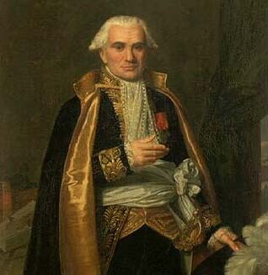
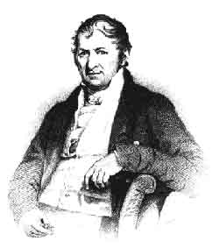
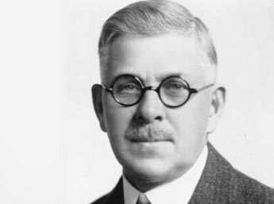
Whitney, Monge, and Olds
Eli Whitney, 1765-1825
Gaspard Monge, 1746-1818
Ransom Olds, 1864-1950

Slide 27
Information Management
Milestones in information management:
1400s Horses in Italy
1500-1700 Creation of paper and the printing press
1850 Manual typewriter
1860s Vertical file cabinets and the telegraph
1879 Cash registers
1880s Telephone
1890s Time clocks
1980s Personal computer
1990s Internet
5.3

Slide 28
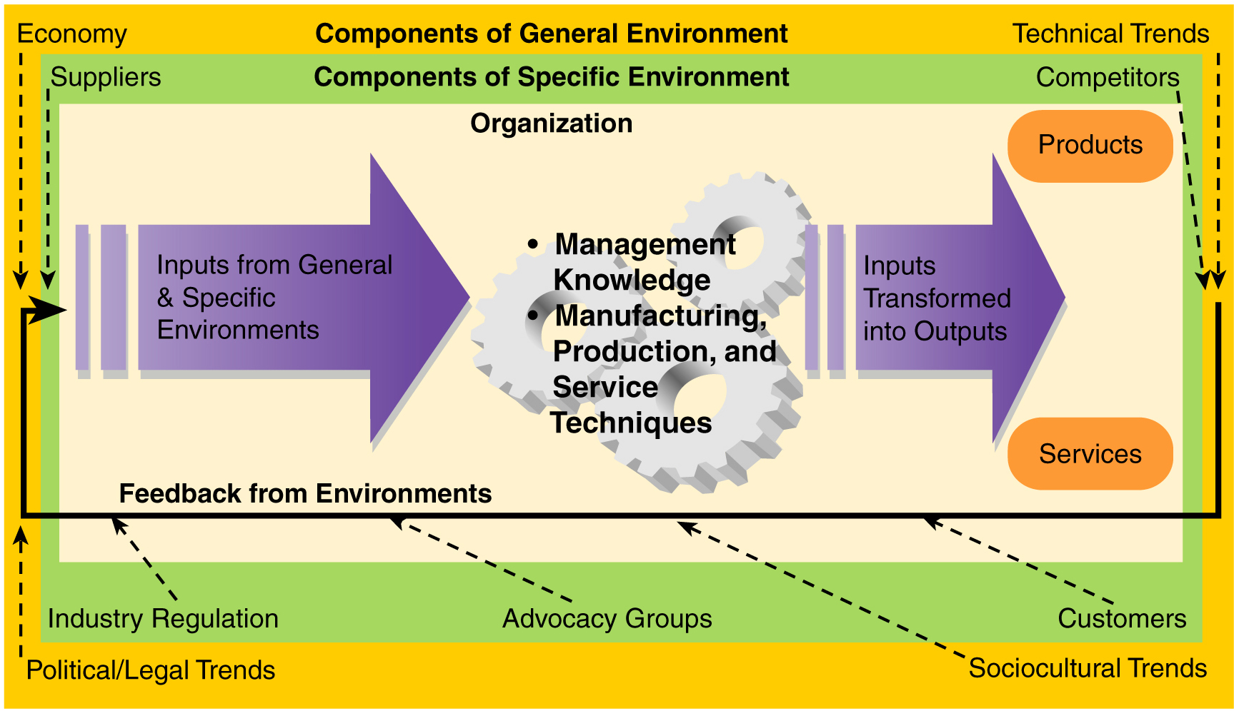
Systems Management
5.3

Slide 29
Contingency Management
Contingency Approach
Holds that the most effective management theory or idea depends on the kinds of problems or situations that managers are facing at a particular time and place.
5.4

Slide 30
Contingency Management
Management is harder than it looks
Managers need to look for key contingencies that differentiate today’s situation from yesterday’s situation
Managers need to spend more time analyzing problems before taking action
Pay attention to qualifying phrases, such as “usually”
5.4

