Slide 1
Redox potiential and electrochemical series

Slide 2
Oxidation : loss of electrons or increase if positive charge
Reduction: gain of electron or decrease of positive charge
Fe+2 → Fe+3 e- (oxidation )
Cl +e- → Cl- (Reduction)

Slide 3
Oxidizing agents cause oxidation & are themselves reduced eg. KMnO₄ ,k₂Cr₂O₇ HNO₃
Reducing agent cause reduction and themselves oxidized eg . Na

Slide 4
Oxidation potiential of an electrode is its standard electrode potiential in volts as compared with that of standard hydrogen electrode fixed as zero at 25˟C when it is in contact with 1M solution of its cation.
Reduction potiential of an electrode is oxidation potiential with changed sign and that is measure of tendency to gain electrons.
Reduction potiential of zinc is-0.76 and that of copper is +0.34 volts.

Slide 5
Electrochemical / electrolytic cell= electrode 1 + electrode 2
= Half cell 1 + half cell 2

Slide 6
Zn/Zn ⁺² Cu/Cu ⁺² Fe/Fe⁺²
H₂/2H⁺ Cl₂/2Cl⁻

Slide 9
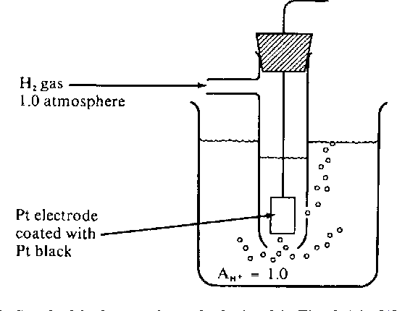

Slide 10
