Slide 1
Emergency Care of Cervical Spine Injuries

Slide 2
Objectives
Mechanism of spinal cord injury
Assessment of SCI
Management of spinal cord injury

Slide 3
Mechanism of spinal cord injury

Slide 4
If hyperextension is the mechanism for injury, the posterior vertebral structures are compressed and the anterior soft tissues (i.e., the anterior vertebral ligaments) will be stretched.
Disruption of the disc, along with compression of the interspinous ligaments and/or fracture of the posterior vertebrae, is possible.
Instability of the cervical spine may be present if there is injury to the ligaments and/or fracture of the vertebrae.

Slide 5
Hyperflexion may cause fractures to the anterior body of the vertebrae,stretching or rupture of the posterior longitudinal and interspinous ligaments, compression of the spinal cord,and disruption of the disc.
Rotational injuries are much less common. Injuries incurred with rotational forces most often manifest themselves in the upper cervical spine or the lumbar spine. This mechanism may cause stretching or tearing of ligaments, subluxation or dislocation, and/or fracture.

Slide 6
Lateral flexion occurs when a force is applied to the side of the head, forcing the ear toward the shoulder. Injuries from this mechanism would cause compression fractures of the vertebrae on one side and stretching or tearing of the ligaments and muscle tissue on the opposite side.
This may also lead to instability of the spine. The amount of force necessary to cause injury with lateral flexion is generally less than that needed with extension or flexion injuries. An axial load is one in which a force is applied through the length of the spine,as is the case when an athlete is struck on the top of the head with the body fixed .

Slide 7
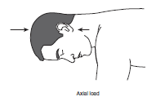

Slide 8
The forces are generated along the long axis of the spine, most often causing compression fractures of the vertebrae, herniation of the disc,and compression of the spinal cord.
Distraction of the cervical spine is the opposite of loading and is much less likely in the athletic setting.This mechanism is most commonly seen in hangings and causes stretching of the soft tissues including the spinal cord.

Slide 9
Neuropraxia
Commonly known as “stingers” or “burners,”
This injury typically involves either a stretching or a compression of one or more nerves of the brachial plexus as a result of a combination of cervical and shoulder girdle motions.
The force imparted to the nerve creates a temporary disruption of nerve function.
Signs and symptoms include the following: Immediate onset of burning pain, numbness, or tingling in the supraclavicular region that typically extends down into the arm, sometimes as far as the hand.

Slide 10
Neuropraxia
Some degree of motor function disruption in the shoulder and arm, manifesting along a continuum from mild weakness to complete loss of function.
Cervical range of motion is typically pain free and full. Two main characteristics of a stinger distinguish it from a more serious injury to the spinal cord:
1. Signs and symptoms of a stinger are unilateral and only in the upper extremity. Bilateral signs and symptoms,or signs and symptoms that are felt in the upper and lower extremity on the same side, are not consistent with a stinger and should be regarded as very serious.
2. Signs and symptoms are transient, usually lasting only a few seconds to a few minutes.
Signs and symptoms that persist longer than several minutes should be regarded as more serious.

Slide 11
Primary and secondary injuries to Spinal cord
PRIMARY INJURIES
Immediate effect on function as a result of:
Compression
Stretching
Laceration
Concussion of the spinal cord
SECONDARY INJURIES
Delayed effect on function, usually as a result of progressive or ongoing ischemia.
Spinal cord contusion
Spinal cord compression
Spinal cord hemorrhage

Slide 12
Transection
A complete transection is one in which the spinal cord is totally cut and the ability to send and receive nerve impulses is therefore entirely lost.
If the transection is incomplete, some fibers of the spinal cord remain intact, which may allow for some function.
The amount of disability suffered by the victim is determined by the level of the transection on the spinal cord.
Nerve roots exiting the spinal cord below the level of the transection will no longer provide for function in the areas they innervate.

Slide 13
For example, injury below the T1 level will result in incontinence and paraplegia and injuries in the cervical region will result in quadriplegia, incontinence, and possible respiratory paralysis.
Partial transections may be described in three types: anterior cord syndrome, central cord syndrome, or BrownSequard’s syndrome

Slide 14
Anterior cord syndrome
Anterior cord syndrome is caused by a disruption of the blood supply to the spinal cord as a result of compromise of the arterial supply.
This is usually secondary to bone fragments or a compressive force preventing the supply of blood to the spinal cord.
The prognosis in these cases is poor. Athletes suffering anterior cord syndrome will present with a loss of pain sensation and motor function, loss of light touch sensation,and loss of temperature control distal to the level of the injury.

Slide 15
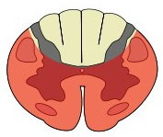
Loss of motor, pain and temperature
Preserved propioception and deep touch

Slide 16
Central cord syndrome
Central cord syndrome is most commonly seen as the result of a hyperextension injury. It is often associated with a preexisting condition of arthritis or a narrowing of the vertebral canal. The results are motor weakness of the upper extremities rather than the lower extremities and, possibly, loss of bladder control.
Of the three syndromes associated with incomplete transections of the spinal cord,central cord syndrome has the best potential for recovery

Slide 17
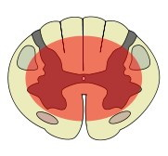
Weakness :
upper > lower
Variable sensory loss
Sacral sparing

Slide 18
Brown-Sequard’s syndrome
Brown-Sequard’s syndrome is caused by a penetrating injury that severs one side of the spinal cord.
The athlete will present with loss of sensory and motor function on the affected side and loss of pain and temperature perception on the opposite side. Unless the penetration is direct, some recovery may be expected.

Slide 19
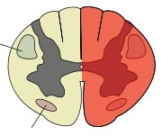
Loss of ipsilateral motor and propioception
Loss of contralateral pain and temperature

Slide 20
Spinal shock
Spinal shock may be present when there is trauma to the spinal cord. Spinal shock is a temporary condition triggered as the body’s response to injury. It is identified when the body becomes flaccid and without sensation, causing the athlete to be unable to move and appear to be paralyzed below the level of the injury. It may be accompanied by loss of bladder and bowel control and, in males, priapism.
It is common for hypotension to be present as a result of vasodilation (also known as vasodilatation).Spinal shock is a transient condition unless the spinal cord has been seriously damaged.

Slide 21
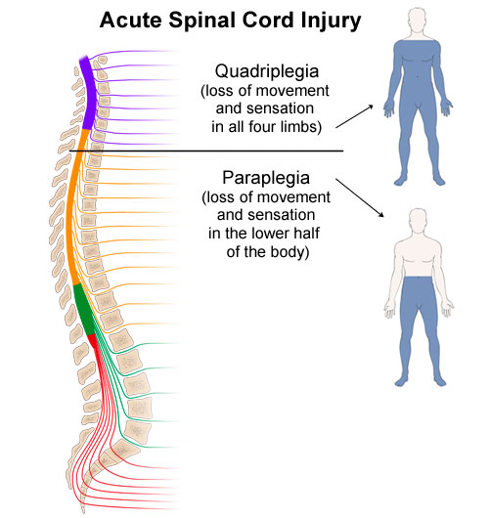

Slide 22
Neurogenic Shock
Temporary loss of autonomic function of the cord at the level of injury
results from cervical or high thoracic injury
Presentation
Flaccid paralysis distal to injury site
Loss of autonomic function
hypotension
vasodilatation
loss of bladder and bowel control
loss of thermoregulation
warm, pink, dry below injury site
bradycardia

Slide 23
Signs and symptoms of neurogenic shock include bradycardia; hypotension; shocklike symptoms above the level of the injury;
Warm,dry,and flushed skin below the injury level; and priapism in males.

Slide 24
Neurogenic Shock Management
A direct consequence of the large scale vasodilatation is pooling of blood throughout the body, resulting in essentially what is known as hypovolemia.
Because of the lack of sympathetic response, heart rate does not increase adequately to overcome the loss of volume , and shock results.
To treat this,a fluid challenge is followed by the introduction of a vasopressor (powerful class of drugs that induce vasoconstriction) such as dopamine

Slide 25
Neurogenic Shock Management
The fluid challenge is accomplished by infusing 250 mL of IV fluid through a large-bore IV catheter. If the response to this infusion is that of increased blood pressure, slower heart rate, and better perfusion, then a second infusion should be considered.
If there is not a positive response to the first bolus of fluid, then the administration of a vasopressor (dopamine) should be considered. If the bradycardia persists, then the use of atropine(medication used for slow heart rate, and to decrease saliva production during surgery may be indicated to increase the heart rate)

Slide 26
Neurogenic Shock Management
The incidence of serious spinal cord injury in the athletic population is small, but the potential for permanent disability or death is always present.
Appropriate evaluation and management of these injuries are only possible if careful planning and practice of these skills are carried out.
The significance of the injury may not be immediately apparent, so a high level of suspicion should always be maintained in cases of potential cervical spine injury

Slide 27
Assessment
Assessment of an athlete with a potential spinal cord injury should begin with trying to determine the mechanism of injury . If the mechanism of injury is not known, then one should always assume the cervical spine is injured until proven otherwise, especially in athletes with a decreased level of consciousness or that are unconscious.
Because the athlete may not be able to appropriately answer or respond to questions, knowing the mechanism of injury is the most critical piece of information needed to make treatment decisions when a cervical spine injury is possible.

Slide 28
Assessment
Any athlete with a head injury should also be treated as if he or she has a cervical spine injury until a thorough evaluation can be completed and injury to the cervical spine is no longer suspected.

Slide 29
Assessment
On-Field Assessment of an Athlete with a Potential Cervical Spine Injury
1. Determine mechanism of injury if possible.
2. While moving to athlete, determine level of consciousness of athlete if possible (is the athlete moving?).
3. Manually stabilize head and neck of injured athlete.

Slide 30
Assessment
4. Determine level of consciousness; if unconscious, activate EMS.
5. Check ABCs. This may require rolling a prone athlete.
6. Activate EMS, manage airway, and begin rescue breathing or CPR if necessary.
7. Perform secondary assessment.
8. Continue to monitor vital signs for changes.

Slide 31
Assessment
During the approach toward a downed athlete, the athletic trainer can observe many things that help form a picture of the potential problem. Note the positioning of the athlete and if the athlete is moving any extremities.
The reaction of teammates may also help determine the severity of the injury. If the athlete is unconsciousness, on your arrival immediately consider a cervical spine injury and apply manual stabilization to the head and neck in the position found If the athlete is supine,maintain the cervical spine position by placing your hands on either side of the head

Slide 32
with the heel of the hands resting just laterally to the occiput while spreading the fingers out over the side of the face.Care should be taken not to apply traction or compression to the spine .
If the athlete is wearing a helmet, the hand placement will be on the helmet in a similar fashion to that described earlier

Slide 33
Airway maneuvers are more difficult when cervical spine precautions are indicated; practice of these skills is therefore essential.
If the athlete is found to be apneic, an oral airway should be inserted and ventilations with a bag valve mask should be initiated.
Advanced airway procedures including intubation with cervical spine precautions may be indicated. If the athlete is wearing a helmet, the face mask or even the helmet itself will need to be removed for advanced airway procedures.

Slide 34
Athlete who does not have a pulse, chest compressions should be performed while manual stabilization of the cervical spine is maintained. If the cervical spine is not in a neutral position, the athletic trainer should gently attempt to move the head to get the spine to neutral.
If any resistance is felt,or the conscious athlete indicates significant apprehension and/or an increase in pain, immediately stop the movement and immobilize in that position.
It is critical to discontinue movement at the first sign of resistance, athlete apprehension, or increased pain; failure to do so may cause

Slide 35
further damage to the cervical spinal column and/or spinal cord. At this time examine the cervical spine for rigidity, painful palpation,sensation changes,and deformity.

Slide 36
Manual stabilization of the head & neck
Manual stabilization of the cervical spine. Hands should be on both sides of the head with fingers spread to provide the most control over head and neck movements. Traction/compression is not recommended

Slide 37
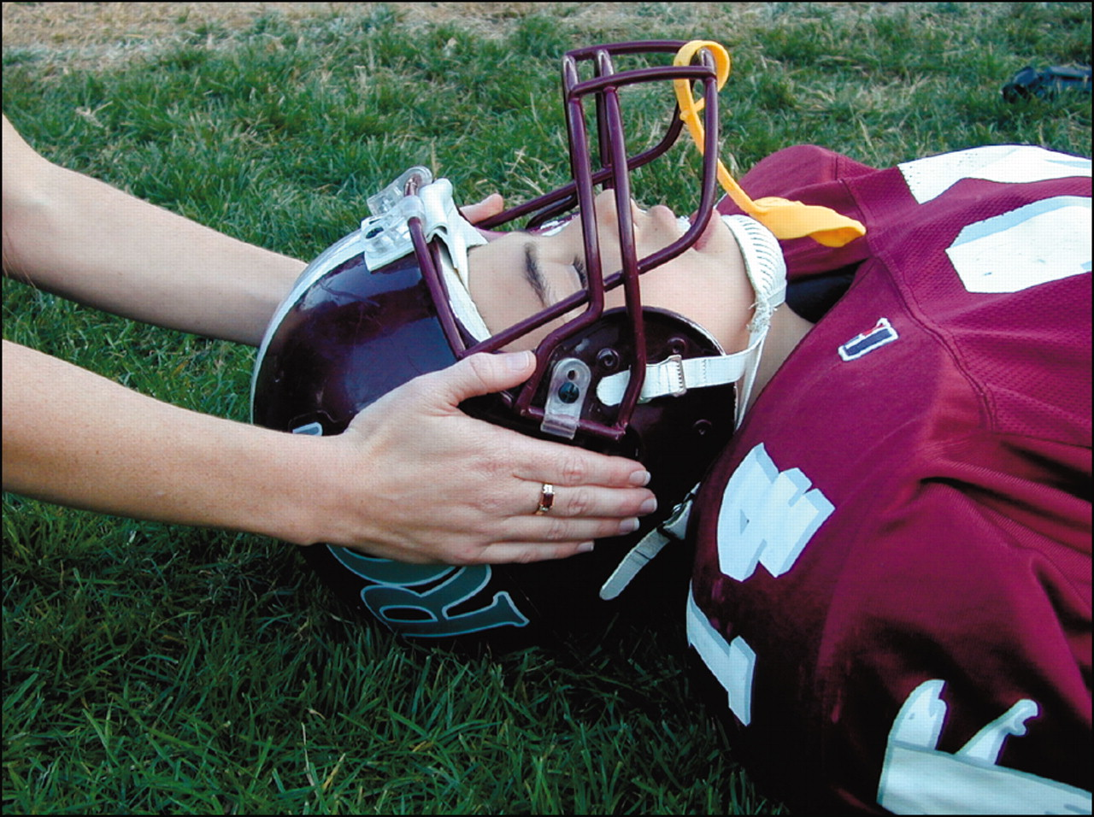

Slide 38
Application of a rigid cervical collar
Manual stabilization is maintained while the second rescuer applies the collar.

Slide 39
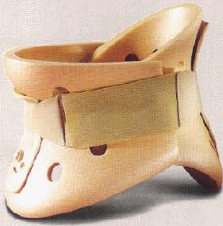
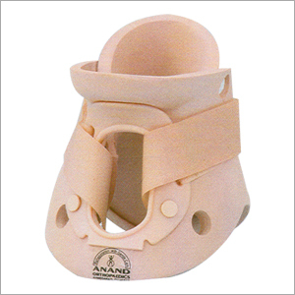
Philadelphia hard collar

Slide 40
On-Field Secondary Assessment
Performing a rapid trauma assessment is an effective way to achieve this. Begin by palpating the spine for pain, deformity, crepitus, muscle spasm, or warmth of the skin .
Move on to inspecting the distal extremities and evaluate for both motor and sensory function.When assessing for motor function, perform all tests bilaterally, looking for resistance to be equal .

Slide 41
On-Field Secondary Assessment
1. Palpation of neck: pain, obvious deformity, bleeding, spasm?
2. Motor testing of upper extremities
3. Sensory testing of upper extremities
4. Motor testing of lower extremities
5. Sensory testing of lower extremities
6. Reassessment of vital signs
7. Continued reassurance of injured athlete

Slide 42
First, test grip strength by having the athlete squeeze your index and middle finger as hard as possible.
Test finger abduction and adduction by having the athlete spread his or her fingers while you attempt to squeeze the second, third, and fourth fingers.Finally, test wrist and finger extension

Slide 43
To assess the sensory function of the upper extremity, first question the athlete regarding any sense of numbness, tingling, paralysis, and pain.
To test for sensation, have the athlete close his or her eyes and attempt to distinguish between sharp and dull touch.
This can be accomplished by using a ball point pen or a safety pin to lightly touch the athlete with either the pointed or the rounded ends). The athlete should be able to identify the difference over all dermatomes.

Slide 44
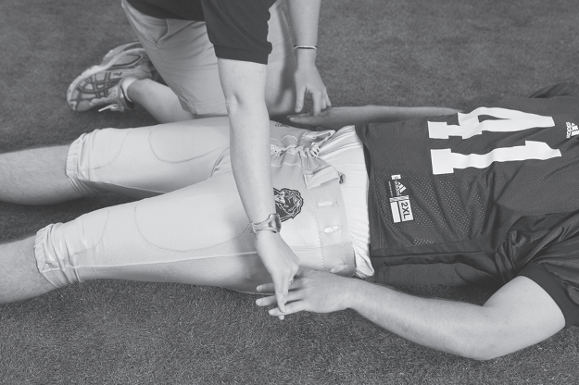
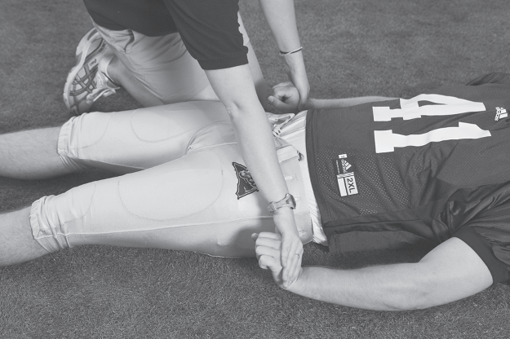
Motor assessment
Upper-extremity motor function testing.
Upper left: Bilateral comparison of grip strength.
Right: Finger abduction/adduction.
Lower left: Wrist extension.

Slide 45
Motor assessment
Finger extension

Slide 46
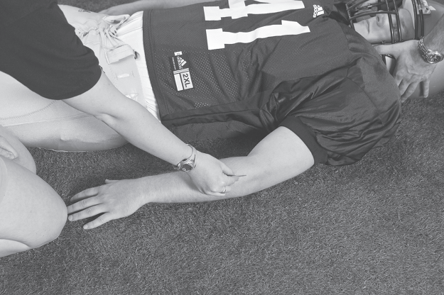
Sensory assessment
Upper-extremity sensory testing.
Left: Soft brush, repeated over as many dermatomes as possible.
B: Sharp pin, repeated over as many dermatomes as possible.

Slide 47
Motor and sensory function should next be assessed in the lower extremities. To perform these assessments, place your hands against the bottoms of the feet and have the athlete attempt to “push on the gas pedal”.
Next, place your hands on the top of the toes and have the individual attempt to pull the toes toward the head.The sensory function can then be evaluated in the same manner as the upper extremity with the athlete attempting to note sharp from dull sensation.

Slide 48
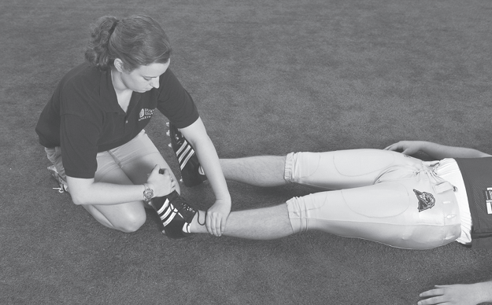
Lower-extremity motor function testing
Lower-extremity motor function testing.
Left:“Pushing on the gas pedal” (ankle plantarflexion).
right: Pulling toes toward the head (ankle dorsiflexion).

Slide 49
If during the examination you are able to determine areas where sensation is diminished or absent, it may be helpful to mark this area for further reference. Care should be taken not to alarm the athlete if it is recognized that sensation is not present.If the athlete recognizes a loss of sensation,be sure to keep him or her calm.
Any positive finding in this examination should cause one to anticipate a spinal cord injury and lead one to treat the athlete appropriately. Careful assessment of the vital signs should follow. Continually evaluating the vital signs is essential. The presence of shallow, diaphragmatic or absent respirations, hypotension, or bradycardia is a strong indication of injury to the spinal cord

Slide 50
Take particular care with the athlete who has a mechanism of injury that creates concern for the cervical spine without any other signs of spinal cord injury.
Serious cervical spine injuries are not always apparent;in some cases,athletes with cervical spine fractures have walked off the field on their own before the medical staff was aware there had been an injury.
Serious cervical spine injuries do not always exhibit measurable signs of neurological deficit or changing vital signs.

Slide 51
Monitoring of vital signs is imperative. Recheck vital signs every 5 minutes and note any changes.
Any change in level of consciousness, responsiveness, sensory,or motor function should be noted, keeping in mind that these findings may be improvements or deteriorations.
Watch closely for a slowing pulse rate or the pulse rate staying the same while the blood pressure drops or a blood pressure that falls without any signs of shock. Any deterioration in vital signs is indicative of an emergent situation.

Slide 52
Athletic trainers must keep in mind that if not managed appropriately, an otherwise stable injury may become unstable because of improper handling, thus placing the athlete at significant risk for a catastrophic outcome.

Slide 53
Management
Specific equipment required for spine boarding procedure: long spine board with handles, rigid cervical collar, head immobilization device, straps.

Slide 54
Log roll method
1. All commands will come from the rescuer controlling the head of the athlete.
2. The athlete is positioned with arm overhead, straight legs.
3. Rescuers and spine board are positioned.
4. The athlete is grasped by rescuers.
5. On command, the athlete is carefully rolled toward rescuers until the command to stop is given; the athlete is held against rescuers’ thighs.
6. The spine board is positioned.
7. On command, the athlete is carefully rolled back to supine position.

Slide 55
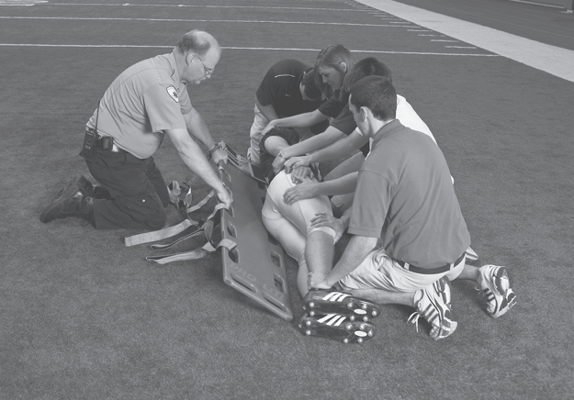
The Log Roll Method
Notes:
Log roll method. left: Five rescuers are involved: one at the head maintainingmanual stabilization and directing the procedure, one controlling the spine board, and three positioned to roll the athlete.The rescuer controlling the spine board ensures that the straps are out of the way and will not be trapped under the athlete.The hands of the rescuers rolling the athlete are reaching under the athlete; clothing is not grasped because it tends to slip during the roll.The knees of the rescuers rolling the athlete will block the athlete from sliding toward the rescuers during the roll. The arm of the athlete on the side of
the direction of the roll is abducted as high as possible.On command, the athlete is carefully rolled as a unit toward the three rescuers until the “stop”command is given. right:Once the athlete is rolled to one side, the spine board is pushed into position against the athlete,
angled upward, and held firmly in that position. On command, the athlete is then carefully rolled back onto the spine board, which is lowered to the ground.The athlete is now
supine on the spine board.

Slide 56
Straddle Slide Method
1. Sit or stand with one leg on either side of.
All commands will come from the rescuer controlling the head of the athlete.
2. The athlete is positioned with straight legs, arms at sides.
3. Rescuers and spine board are positioned.
4. The athlete is grasped by rescuers.
5. On command, the athlete is carefully lifted straight up until the command to stop is given.
6. The spine board is positioned.
7. On command, the athlete is carefully lowered back down to the spine board.

Slide 57
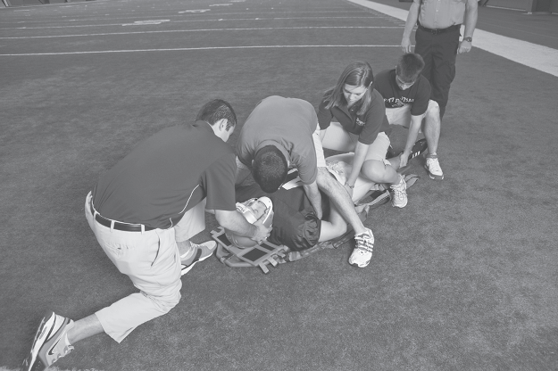
The Straddle Slide Method

Slide 58
Log Rolling From a Prone Position
When applying manual stabilization to a prone athlete ,the lead rescuer should initially use a crossed-arm technique. .Once the athlete is rolled to supine ,the lead rescuer’s arms will have been uncrossed.
When an athlete is found in the prone position, it is best to log roll directly onto a spine board to avoid the necessity of a second log roll or lift for board placement.
If ABCs cannot be effectively checked in a prone athlete ,or if they are not Present the athlete must immediately be log rolled.

Slide 59
Log Rolling From a Prone Position
1. All commands come from the rescuer controlling the head of the athlete.
2. The athlete’s arms and legs are carefully straightened as directed.
3. Three (or four) rescuers are positioned on the side of the direction of the roll with the spine board lying against their upper legs; one rescuer is positioned on the opposite side of the athlete to help control the roll and to help prevent the athlete from sliding as the board is lowered.

Slide 60
Log Rolling From a Prone Position
4. On command, the athlete is carefully rolled from prone to sidelying and then down onto the spine board; the position of the head in relation to the trunk is maintained throughout the roll.
5. The spine board is carefully lowered to the ground.
6. The head can then be slowly and incrementally returned to a neutral position as discussed earlier in this chapter.
7. A rigid cervical collar should then be applied. Or, in cases where the athlete is wearing a helmet, the face mask should be removed.

Slide 61
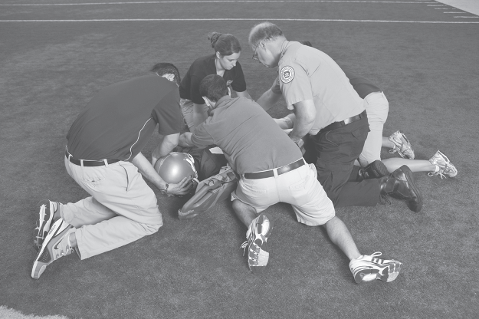
Log Rolling From a Prone Position

Slide 62
Log Rolling From a Prone Position

Slide 63
Immobilization
A person who is not secured to the spine board is not considered to be immobilized. The head of the athlete should be placed in an immobilizing device. A number of different products are available for immobilizing the head of an athlete on a spine board . Alternately, tightly rolled towels can be used in combination with sturdy tape to secure the athlete’s head to the board. Manual stabilization must be maintained until the head of the athlete is secured to the spine board

Slide 64
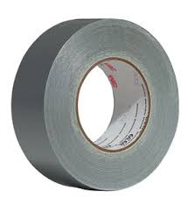

Slide 65
Immobilization
The athlete should be strapped to the board in a manner that will not allow movement even in the event that the board needs to be turned to the side if vomiting were to occur.
Special strapping techniques are also required if the athlete needs to be extricated (free (someone or something) from a constraint or difficulty) up or down stairs or in tight corridors where the spine board may need to be stood up on end

Slide 66
Head immobilization devices
Head immobilization device.
Firm blocks on either side of the head prevent
motion in rotation or lateral flexion. These
blocks are easily adjustable to provide for a
tight fit against different sizes of head or helmet. Two straps across the forehead and chin
of the athlete prevent movement in the direction
of flexion.
Instead of straps, strong tape
can be used for this same purpose.

Slide 67
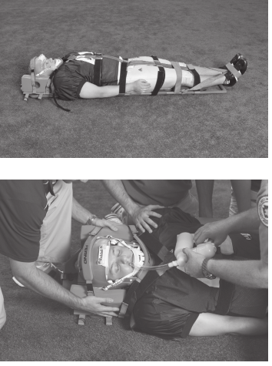
Strapping technique to secure
the athlete to the spine board. Notice that the
arms and feet of the athlete are also secured.
The arm is easily accessible to EMS personnel
in the event an IV is warranted.
Turning the spine board to manage
vomiting
with manual suction.
A properly
secured athlete will not slide on the spine
board even when it is turned to the side.
Notice the large-bore tubing being used on
the suction unit.

Slide 68
The Lift and Transfer
Transfer will most often be directly onto an ambulance gurney (a wheeled stretcher used for transporting hospital patients)
or onto a motorized cart for transport off the field.

Slide 69
Managing Protective Equipment
If the decision has been made to spine board an injured football player, the player should be immobilized with all of the equipment on if possible. The face mask should always be completely removed to allow access to the athlete’s airway in the event that respiratory distress or arrest occurs. Athletic training professionals currently universally support the theory that the helmet and shoulder pads should remain in place until definitive care can be achieved. Some controversy has existed with EMS professionals who have been taught to remove helmets prior to spine boarding a person.

Slide 70
The most common reasons given for helmet removal include inability to obtain proper immobilization with the helmet in place, inability to visualize injuries to the skull, inability to control the airway, and hyperflexion of the neck with the helmet in place.
These reasons certainly may apply to motorcycle and auto racing helmets but not to the football helmet.
The football helmets used today are designed to fit snugly and therefore do not allow the head to move inside the shell

Slide 71
Therefore, immobilizing the helmet on the spine board will also effectively immobilize the head inside the helmet.The mechanism of injury in a football player is generally axial loading or an extreme motion in one direction, such as hyperextension.
Traumatic injuries to the skull and soft tissues of the head and face are simply not seen as is frequently the case in motorcycle accidents, which involve exponentially higher forces than those experienced in collision sports such as football. The ears can be visualized through the ear holes, and the neck can be palpated and pupils checked without difficulty with the helmet in place. There is no need to remove a football helmet for this reason.

Slide 72
Removal of the face mask will allow the rescuer to effectively maintain control of the airway. The vast majority of cervical spine injuries in football players occur at the lower level of the cervical spine C5-C7.
For this reason respiratory distress is rare. In the event that airway difficulties are present, all appropriate procedures can be carried out with little difficulty once the face mask is removed .
There is no need to remove the entire helmet to effectively manage the airway of an injured athlete.

Slide 73
A person wearing a motorcycle helmet or a football helmet without shoulder pads who is supine will be forced into a position of cervical hyperflexion because of the thickness of the back of the helmet .
Shoulder pads elevate the thorax such that the spine will be in a neutral position when an athlete wearing a helmet is supine. Removing the helmet and not the shoulder pads would therefore allow the cervical spine of the athlete to fall into a position of hyperextension

Slide 74
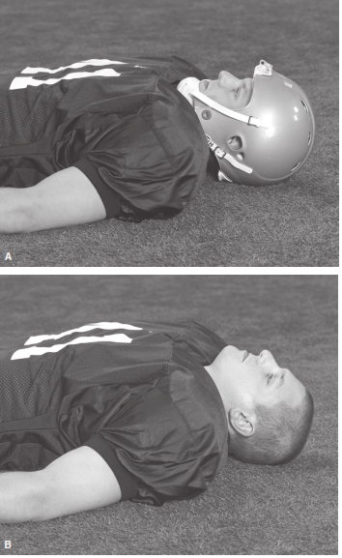
AA: With helmet in place, the position of the cervical spine is essentially neutral. BB: With the
helmet removed but shoulder pads remaining in place, significant cervical extension occurs.

Slide 75
Face Mask Removal

Slide 77
Removal of equipment
Protective equipment such as helmets and shoulder pads should not be removed unless absolutely necessary
The airway can be controlled and an AED can be applied with only the helmet face mask removed.
If the face mask cannot be removed in a relatively short amount of time, or if it appears that the helmet and/or shoulder pads fit loosely and therefore will not hold the athlete motionless once secured to the spine board, it is recommended that the helmet and shoulder pads be removed. Helmet and shoulder pads are always removed together, never one or the other.

Slide 78
Removal of equipment
If the helmet is removed, the shoulder pads must also be removed to prevent potential hyperextension of the athlete’s cervical spine.

Slide 79
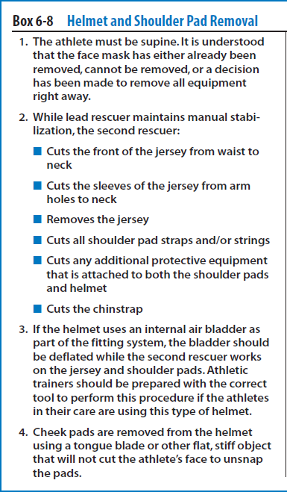

Slide 80
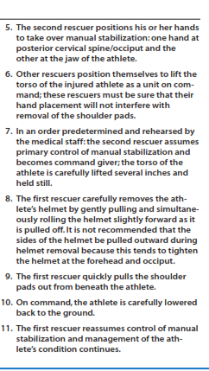

Slide 81
Steroids
In the event of a spinal cord injury, the secondary injury caused by inflammation may compound the damage., steroids have been used to limit the inflammatory process and therefore reduce the damage that could occurdue to swelling.
The most commonly used steroids for this purpose are methylprednisolone and dexamethasone.
These medications are most effective if administered within the first eight hours of trauma.

