Slide 1
Environmental related Conditions

Slide 2
Objectives
To understand the environmental conditions and disorders that can affect the athlete

Slide 3
Common environmental condition that can affect the Athletes
Heat illness disorders
Cold injuries
Lightning strikes
Altitude disorders

Slide 4
Core Body Temperature-;
In humans, the average internal temperature is 37.0 °C (98.6 °F), though it varies among individuals. However, no person always has exactly the same temperature at every moment of the day.
Normal‎: ‎36.5–37.5 °C (97.7–99.5 °F)
Fever‎: ‎>37.5 or 38.3 °C (99.5 or 100.9 °F)
Hyperpyrexia‎: ‎>40.0 or 41.0 °C (104.0 or 105.8 ...

Slide 5
The warmer and more humid the air is, the harder it will be for sweat to evaporate and the higher an athlete’s core temperature will become.
As water is lost through sweating, electrolytes and other chemicals are also lost from the body. This loss of electrolytes can also contribute to an imbalance of the cooling system and lead to hyperthermia.
It is important for the athlete to replace both fluids and electrolytes as they are lost through sweating associated with exercise.

Slide 6
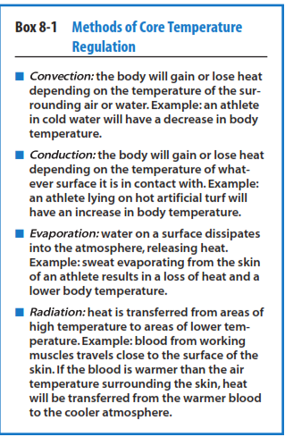

Slide 7
Heat illness
Heat illness disorders are classified as
Heat cramps
Heat exhaustion
Heat stroke

Slide 8
Heat cramp
Heat cramps tend to occur mainly in the leg area such as the calf and hamstring muscles.
Thought to be caused by muscle fatigue with rapid water and electrolyte loss via the sweating mechanism
Risk factors include
Lack of acclimatization......resulting in a less-efficient sweat mechanism and excessive sweating
Irregular meals .... resulting in less than optimal electrolyte stores
A history of cramping

Slide 9
Heat cramp
Remove athlete from activity
Rehydrate and replace electrolyte losses
Try gentle passive stretching of involved muscle
Try light massage with ice to reduce the Muscle spasm

Slide 10
Heat Exhaustion
Heat exhaustion is a condition when the body is near to total collapse because of dehydration and a dangerously elevated core temperature
Precursor to heat stroke

Slide 11
Signs and Symptoms of Heat Exhaustion
Athlete has elevated core body temperature
Athlete may feel generally weak or fatigued
Athlete may feel nauseated
Athlete has sweaty/wet skin
Athlete’s skin is pale
Athlete’s breathing is rapid and shallow
Athlete’s pulse is weak

Slide 12
Sweat Rate
The amount of fluid you lose, primarily through sweat, during each hour you exercise under your normal exercise conditions.
Weight loss between practice sessions should be kept to only 2% to 3% of the athlete’s pre-practice bodyweight, or less if at all possible.
5% should be monitored closely.
It is commonly recommended that athletes drink approximately 15 ounces of fluid for every pound of body weight lost during a practice session.
(1 cup = 8 ounce; 1 gulp = about 1 ounce)

Slide 13
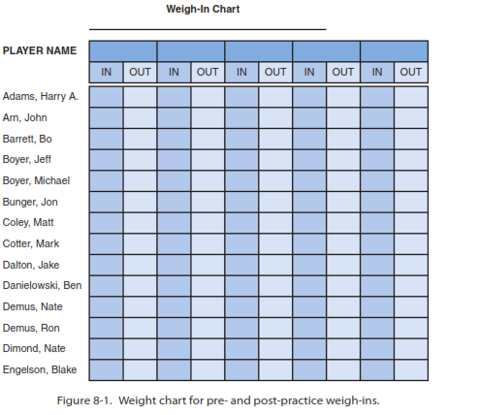

Slide 14
Treatment of Heat Exhaustion
Check all vital signs
Measure core body temperature (rectal)
Remove excess clothing
Cool athlete with ice towels/ice bags
Place athlete in a cool or shaded area
Start fluid replacement
Alert team physician or transfer athlete to local emergency care facility

Slide 15
Heat Stroke
A breakdown of the body’s heat regulation mechanism resulting in a dangerously high core temperature

Slide 16
Signs and Symptoms of Heat Stroke
Athlete has an increased core body temperature of more than 104°F
Athlete has hot and dry/wet skin
Athlete’s skin is red
Athlete’s pulse is strong and rapid (110–120 bpm )
Athlete may be weak and nauseated
Athlete’s mental status is altered or athlete exhibits irrational behaviour
Athlete may be unconscious

Slide 17
Treatment of Heat Stroke
Move the athlete out of the sun
Check and monitor all vital signs
Measure core body temperature (rectal is most accurate)
Assess cognitive function
Activate emergency action plan
Remove all excess clothing

Slide 18
Heat stroke: Treatment
Lower the core body temperature as quickly as possible
Immerse body in pool or tub of cool water
Manage airway if athlete is unconscious
Transport to emergency care facility as quickly as possible

Slide 19
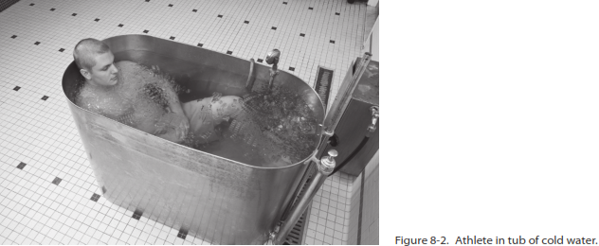

Slide 20
Prevention of Heat-Related Emergencies
Ensure the presence of appropriate medical personnel
Conduct an approved pre-participation physical examination
Educate athletes and coaches regarding recognition and care of heat illness and the risks

Slide 21
Prevention of Heat-Related Emergencies
Measure factors of heat and humidity by determining the wet-bulb globe temperature (WBGT) before and during all outdoor sporting events
Consider adjusting practice and game times with respect to heat and humidity factors
Acclimatize properly before the season begins
Ensure sufficient fluid replacement is available and consumed before, during, and after athletic activities

Slide 22
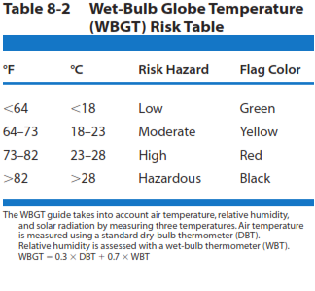

Slide 23
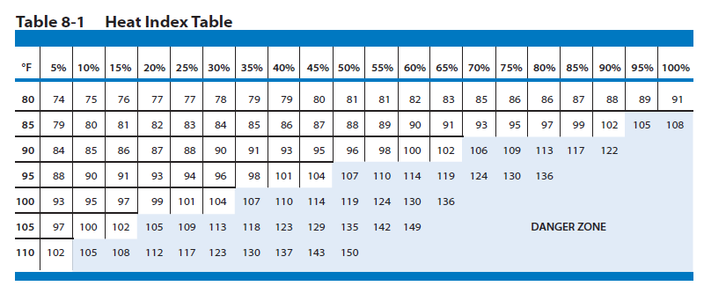
Temperature& humidity

Slide 24
Prevention of Heat-Related Emergencies
Minimize the amount of equipment and clothing
Weigh athletes before and after athletic activities when the weather is hot and humid

Slide 25
Cold related emergency
Hypothermia and frostbite

Slide 26
Hypothermia
Hypothermia is a condition in which the body’s temperature becomes dangerously low

Slide 27
Signs and Symptoms of Hypothermia
Individual feels cold and begins to shiver
Individual has difficulty thinking and becomes mentally confused
Individual loses the ability to shiver
Individual’s heart starts beating irregularly
Individual falls into a coma and death may occur

Slide 28
Treatment of Hypothermia
Monitor/maintain airway, breathing, and circulation
Move the athlete out of the cold
Take off cold and wet clothing
Wrap the athlete in warm blankets and cover the head
Do not try to warm cold skin by rubbing or massage
Do not allow the athlete to walk
Do not give anything by mouth if the athlete is not alert
Transport to an emergency care facility as soon as possible

Slide 29
Treatment of Hypothermia
Re -warming the athlete must be done slowly to prevent a rush of blood to the surface of the body away from the vital organs that need blood.
Athlete will recover in 3 to 12 hours with treatment. In some cases , hypothermia can result in permanent disability or death.

Slide 30
Frostbite
Frostbite is a medical condition in which the nerves, blood vessels, and other cells of the body are temporarily frozen by exposure to cold temperature

Slide 31
Frostbite: Pathology
In frostbite, intracellular water freezes
Blood supply to the affected areas is compromised or even stopped altogether, resulting in a skin injury
Frostbite commonly occurs at the extremities: toes, fingers, tip of the nose, earlobes, and cheeks
In most circumstances, the wind chill factor determines how quickly frostbite occurs

Slide 32
levels of severity of frostbite
Frostnip
Superficial frostbite
Deep frostbite

Slide 33
Frostnip:
Skin appears white and waxy.There is possible numbness or pain in affected areas.No skin blistering occurs.
2. Superficial frostbite:
Skin appears white,blue,or gray.Superficial skin feels hard but deeper tissue is soft and insensitive to touch.This is a serious medical condition; permanent damage is imminent.Skin blistering to affected areas is possible

Slide 34
3. Deep frostbite:
Skin is white or blue and has a hard, wooden feel.The tissue underneath is hard and cold to touch.
The entire area is numb.Skin blistering occurs to affected areas.It is a life-threatening emergency because of probable hypothermia and later risk of infection to affected body parts.

Slide 35
Treatment for Frostbite
Do not rub area
Remove all wet clothing
Cover area with dry bandage and/or clothing
Gently rewarm the area by blowing warm air on area.
Place the area against a warm body part

Slide 36
Treatment for Frostbite
Place the area into warm (98°F –102°F) water for several minutes
If not certain that the area will stay warm after rewarming, do not rewarm it. Refreezing thawed frostbitten tissue can cause more extensive tissue damage
If an athlete is also suffering from hypothermia, the first concern is core rewarming
Transport athlete to an emergency care facility as soon as possible

Slide 37
Prevention of cold related emergency
1. Have a wind chill chart on hand to determine the possibility of hypothermia or frostbite
2. Dress in layers
3. Cover the head to prevent excessive heat loss
4. Stay dry by wearing breathable and water-repellent clothing materials.
5. Stay adequately hydrated before and during activity

Slide 38
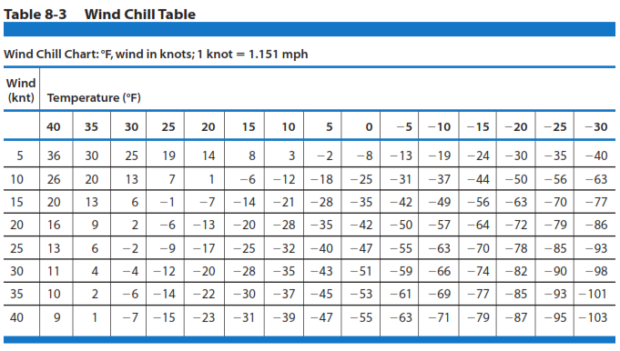

Slide 39
Prevention of cold related emergency
6. Eat regular and nutritious meals so the body is well fuelled
7. Avoid alcohol and nicotine because they accelerate heat loss
8. Educate athletes, coaches, officials, and parents to recognize cold-related emergencies.
9. If unsure whether an athlete is suffering from hypothermia and/or frostbite, always stay on the side of caution and treat accordingly

Slide 40
Lightning
According to the United States Weather Service,the annual number of lightning-related injuries in this country has been estimated to vary between 200 to 1000 people.Also, approximately 100 fatalities as a result of lightning strikes in the United States occur each year. Although the chance of being struck by lightning is very low ,the odds are significantly greater when a storm is in the area of athletic events and the proper safety precautions are not followed

Slide 41
Lightning
Direct Strike:most commonly occurs to the head, and lightning current enters the orifices
Contact strike: most commonly occurs when the lightning victim is touching an object that is in the pathway of the lightning current
Side flash: most commonly occurs when the lightning strikes an object near the victim and then jumps from the object to the victim

Slide 42
Lightning
Ground current: most commonly occurs when the lightning current flowing in the ground radiates outward in waves from the strike point.
Blunt injury: most commonly occurs when the lightning current causes violent muscular contractions that throw victims a distance from strike point.

Slide 43
Guidelines on Lightning Safety
Establish a chain of command that identifies who is to make the call to remove individuals from the athletic field.
Name a designated weather watcher to consider and then communicate possible threatening weather to the chain of command.
Have a means of subscribing to a weather monitoring system to receive forecasts and warnings.This is best done through a lightning detection device,a computer link to weather radar,or television or radio announcements from the National Weather Service.

Slide 44
4. Designate a safe shelter for each outdoor venue.A safe shelter should be a building with four solid walls,electrical wiring,and plumbing.
A secondary shelter would be an enclosed vehicle with a metal roof and windows completely closed.
5. Use the flash-to-bang count to determine when to go to safety.By the time the flash-to-bang count approaches 30 seconds,all individuals should already be inside a safe shelter .Once the activities have been suspended,wait at least 30 minutes after the last lightning flash before resuming an activity

Slide 45
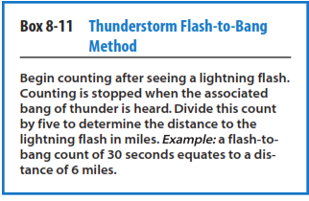
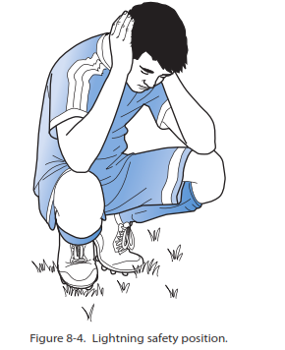
Lightning 30/30 rule: If it takes less than 30 seconds to hear thunder after seeing the flash, lightning is near enough to pose a threat; after the storm ends, wait 30minutes before resuming outdoor activities

Slide 46
7. Avoid being,or being near,the highest point in an open field.Do not take shelter under or near trees, flagpoles,or light poles.
8. For those individuals who are caught in the open and who feel their hair stand on end,feel their skin tingle, orhear“crackling”noises,assume the lightning safety position.
This position includes crouching on the ground,with weight on the balls of the feet,feet together,head lowered,and ears covered . An individual should never lie flat on the ground.

Slide 47
adopt a position where the knees are bent and the upper body is brought forward and down, typically in order to avoid detection

Slide 48
9.Observe the emergency first aid procedures in managing victims of a lightning strike
10. All individuals have the right to leave an athletic site to seek a safe shelter if the person feels in danger of impending lightning activity—without fear of penalty from anyone.
11. Blue sky and the absence of rain are not protection from lightning.Lightning can,and does,strike as far as 10 miles away from the rain.It does not have to be raining for lightning to strike

Slide 49
Emergency First Aid Procedures: Lightning Strike
Activate local emergency medical service.
Lightning victims do not “carry a charge” and are safe to touch.
Move the victim with care to a safer location.
Evaluate airway, breathing, and circulation.
Begin cardiopulmonary resuscitation (CPR) or rescue breathing if necessary.

Slide 50
Emergency First Aid Procedures: Lightning Strike
Evaluate for apnea and asystole.
Evaluate and treat for shock and hypothermia.
Evaluate and treat for fractures and/or burns.
Transport to emergency care facility.

Slide 51
Altitude disorders
Altitude disorders occur at altitudes more than 3000 meters above sea level but it may occur in altitudes as low as 2000 m.
These disorders are classified as acute mountain sickness, high-altitude pulmonary edema, and high-altitude cerebral edema.
All are treated with rapid descent from high altitude

Slide 52
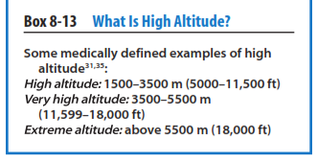

Slide 53
In high-altitude sports participation, the most obvious change is an increase in pulmonary ventilation, which can give the feeling of being out of breath.
Because there is less oxygen in the atmosphere at altitude, the heart rate in an athlete may be elevated to increase cardiac output and maintain an adequate oxygen supply to the body,both at rest and during exercise.

Slide 54
Acute mountain sickness
General symptoms for acute mountain sickness are characterized by headache, light-headedness, breathlessness, fatigue, insomnia, loss of appetite, and nausea
Usually, these symptoms will begin 2 to 3 hours after the athlete has reached peak ascent, but the condition is generally self-limiting and most of the symptoms disappear after 2 to 3 days

Slide 55
Acclimatization-;
is the process of the body adjusting to the decreasing availability of oxygen. Some authors suggest that with any ascent to an altitude above 3000 m ,there should be a 2- to 3-day rest before further heavy athletic activity occurs.
Treatment of acute mountain sickness by oxygen or descent is not usually required; aspirin, acetaminophen, or ibuprofen may relieve most headaches.

Slide 56
Other medications such as acetazolamide and dexamethasone may be given by a physician if the symptoms are severe.
Severe prolonged acute mountain sickness responds to descent to a more normal altitude for the athlete.

Slide 57
High-Altitude Pulmonary Edema
Fluid in the lung
Signs and symptoms of high-altitude pulmonary edema may include extreme fatigue, breathlessness at rest, severe cough with sputum, gurgling breaths, chest tightness, and blue- or gray-colored lips and fingernails

Slide 58
Treatment
Treatment for high-altitude pulmonary edema is immediate descent to a safe altitude. Delay may be fatal.
Safe altitude is usually described as the last elevation where the athlete felt well on awakening from a restful sleep.
Oxygen should be administered if available. Medications such as nifediphine, salmeterol,and sildenafil may be given by a physician to help relieve the symptoms of high-altitude pulmonary edema

Slide 59
High-Altitude Cerebral Edema
It is defined as a condition in which the brain swells and ceases to function properly.
Like high-altitude pulmonary edema,the cause of high-altitude cerebral edema is poorly understood but is again likely related to changes in cellular permeability.
Once high-altitude cerebral edema is present, it can progress rapidly and can be fatal within a few hours. Athletes with this illness are often confused and may not recognize that they are ill.

Slide 60
High-Altitude Cerebral Edema
Signs and symptoms may include confusion, changes in behaviour, unusual or irrational behaviour, and lethargy. It may be easier to recognize a characteristic loss of coordination called ataxia
This is a staggering walk that resembles the way a person walks while intoxicated on alcohol.The most extreme cases of high-altitude cerebral edema may involve the athlete going into a coma with death occurring within hours.
The classic sign of high-altitude cerebral edema is a change in the ability to think
Descent
Oxygen administration and Dexamethasone.

Slide 61
