Slide 1
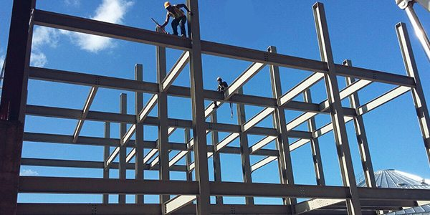
COLLEGE OF ENGINEERING AND TECHNOLOGY UNIVERSITY OF SARGODHA DESIGN OF STRUCTURES (CE-409) 01-Credit Hour
LECTURE-5
SERVICEABILITY

Slide 2
SERVICEABILITY
In earlier lectures, limit state design was discussed. The limit states (at which the structure becomes unfit for its intended function) were divided into two groups: those leading to collapse and those which disrupt the use of structures but do not cause collapse. These were referred to as ultimate states and serviceability limit states, respectively
The major serviceability limit states for reinforced concrete structures are caused by excessive crack widths, excessive deflections and undesirable vibrations.
Although fatigue is an ultimate limit state, it occurs at service loads and so is considered here.
The term service loads and working loads refer to loads encountered in the everyday use of structure.
Service loads are generally taken to be the specified loads without load factors

Slide 3
SERVICEABILITY…….
Historically deflection and crack width have not been a problem for reinforced concrete structures.
But, with the advent of strength design and Grade 60 reinforcement, however, the reinforcement stresses ate service loads have increased by about 50 percent.
Because crack widths, deflections and fatigue are all related to steels stresses each of these, each of these have become more critical.
In early, RCC designs, questions of serviceability were dealt with indirectly by limiting the stresses in concrete and steel at service loads to the rather conservative values that had resulted in satisfactory performance.
In contrast with current design methods that permit more slender members through more accurate assessment of capacity and with higher-strength materials further contributing to the trend toward smaller member sizes, such indirect methods no longer work.

Slide 4
SERVICEABILITY…….
The current approach is to investigate service load cracking and deflections after proportioning members based on strength requirements.
Serviceability Limit states:
A statement of the limit state causing the problem. Typically serviceability limit states (SLS) include deflection, cracking, vibrations and so on.
One or more load combinations to be used in checking the limit state. Traditionally, the SLS load combinations used a load factor of 1 on all service loads.
This assumes that all the specified variable loads have the values that they would have at an arbitrary point in time.
Generally the variable loads are lower than this, especially for wind loads or snow loads.

Slide 5
SERVICEABILITY…….
The selection of the load factors must consider probability of occurrence of the loads involved either by themselves or in conjunction with other loads.
Generally, service load design codes do not adequately handle offsetting loads.
In some structures, the number of loading cycles exceeding the limit during service life is important.
A calculation procedure to be used to check the limit state. Traditionally, serviceability-limit-state calculations for concrete structures are carried out using elastic analysis and the straight-line theory of flexure based on average material properties.
A criterion to be used to judge whether the limit state is exceeded:-

Slide 6
SERVICEABILITY…….
Typically, this is one of the following forms:
(Calculated deflection or other limit state) < (Limiting value)
or, for a prestressed concrete bridge pier,
“ Cracks in the concrete should be open less than 100 times in life of the structure”

Slide 7
CRACKING
Deformation or deterioration occurs concrete due to uneven loads, temperature change or freezing and thawing.
Cracking of concrete occurs due to several reasons like due to constructional movement, shrinkage etc.
After hardening, cracks occur due to chemical reactions, thermal changes etc.
However, Reinforced Concrete has its specific crack phenomenon which will be discussed in detail here in this course.

Slide 8
REASONS FOR CONTROLLING CRACK WIDTH
Crack widths are of concern of three main reasons:
1. Appearance
2. Leakage
3. Corrosion
Wide cracks are unsightly and sometimes lead to concern by owners and occupants.
Crack width surveys suggest that, on easily observed clean smooth surfaces, cracks wider than 0.01 to 0.013 in can lead to public concern.
Wide cracks are tolerable, if the surfaces are less easy to observe or are not smooth.
On the other hand, cracks in exposed surfaces may be accentuated by streaks of dirt leached materials.

Slide 9
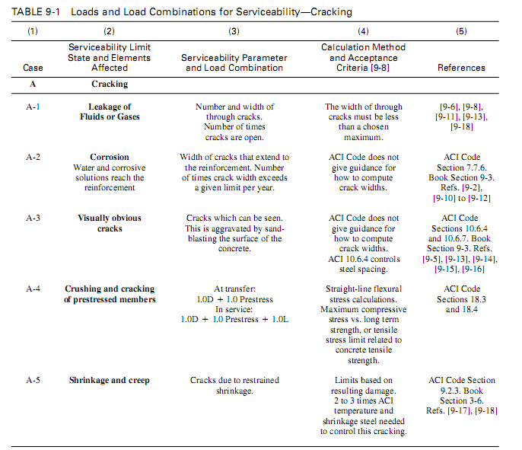

Slide 10
REASONS FOR CONTROLLING CRACK WIDTH……
Sand blasting the surface will accentuate the apparent width of cracks, making small cracks much more noticeable.
Limit states resulting from cracking of concrete are summarized in table 9-1.
It should be noted that reinforced concrete structures normally crack when carrying service loads.
Crack control is important in the design of liquid-retaining structures, Leakage is a function of crack width, provided the cracks extend through the concrete member.
Corrosion of reinforcement has traditionally been related to crack width. More recent studies suggest that the factors governing the eventual development of corrosion are independent of crack width, although the period of time required for corrosion to start is a function of crack width.
Reinforcement surrounded by concrete will not corrode until an electrolytic cell can be established.
This will occur when the carbonization of the concrete reaches the steel or when chlorides penetrates through the concrete to the bar surface.

Slide 11
REASONS FOR CONTROLLING CRACK WIDTH……
The time taken for this to occur will depend a number of factors: whether the concrete is cracked, the environment, the thickness of the cover and the permeability of the concrete.
If the concrete is cracked, the time required for a corrosion cell to be established is function of crack width.
After a period of 5 to 10 years, however, the amount of corrosion is essentially independent of crack width.

Slide 12
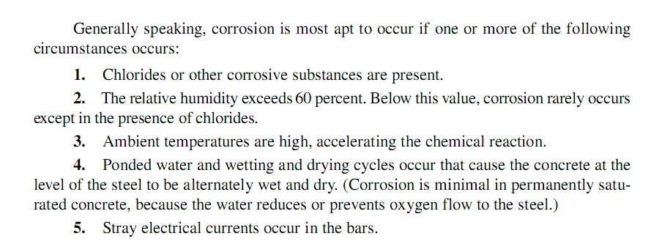

Slide 13
LIMITATIONS ON CRACK WIDTH

Slide 14
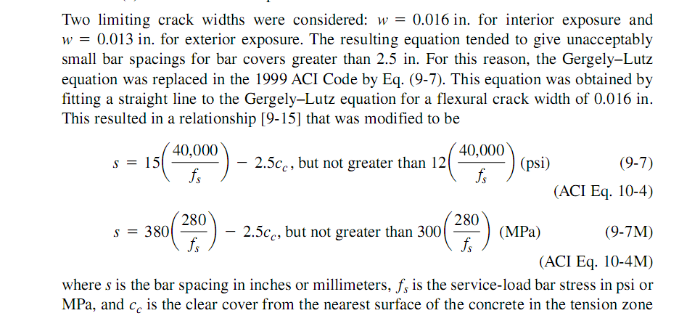
LIMITATIONS ON CRACK WIDTH…..

Slide 15
LIMITATIONS ON CRACK WIDTH…..

Slide 16
LIMITATIONS ON CRACK WIDTH….. (EXAMPLE FROM MACGREGGOR)

Slide 17
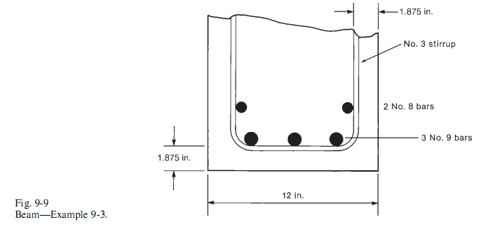
LIMITATIONS ON CRACK WIDTH….. (EXAMPLE FROM MACGREGGOR)

Slide 18
LIMITATIONS ON CRACK WIDTH….. (EXAMPLE FROM MACGREGGOR)

Slide 19
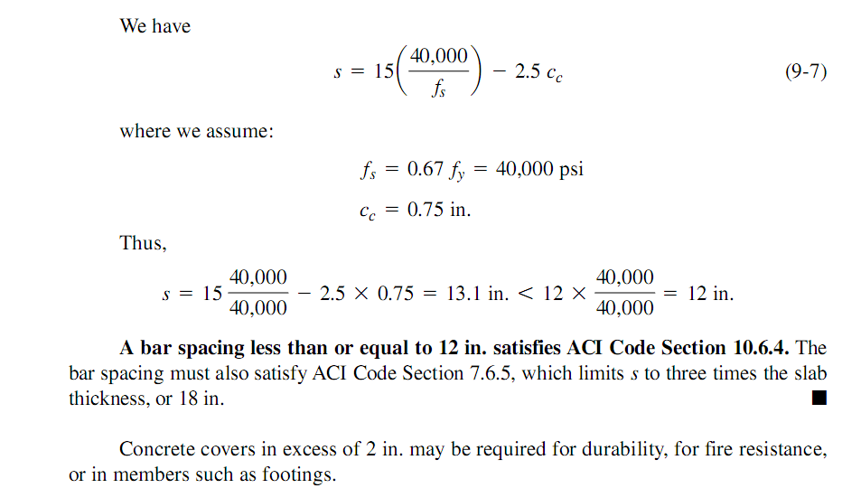
LIMITATIONS ON CRACK WIDTH….. (EXAMPLE FROM MACGREGGOR)

Slide 20
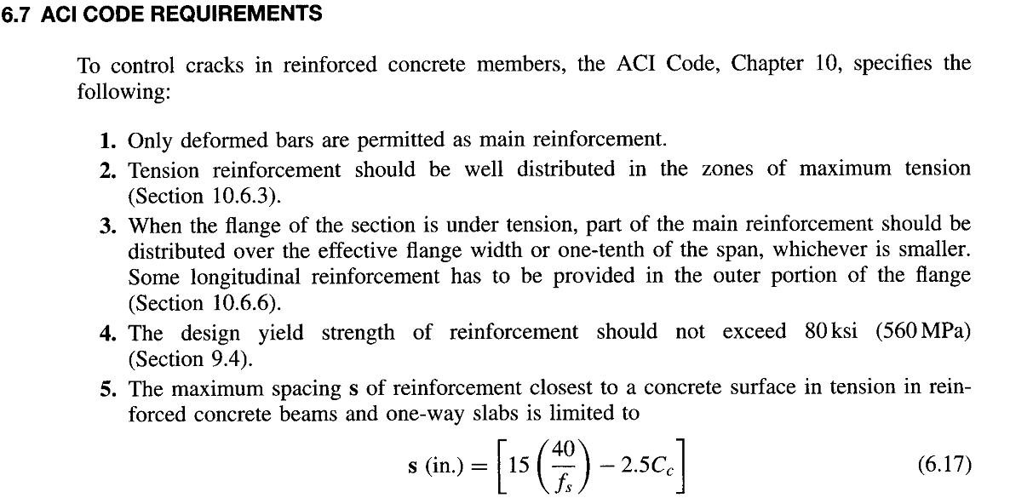

Slide 21
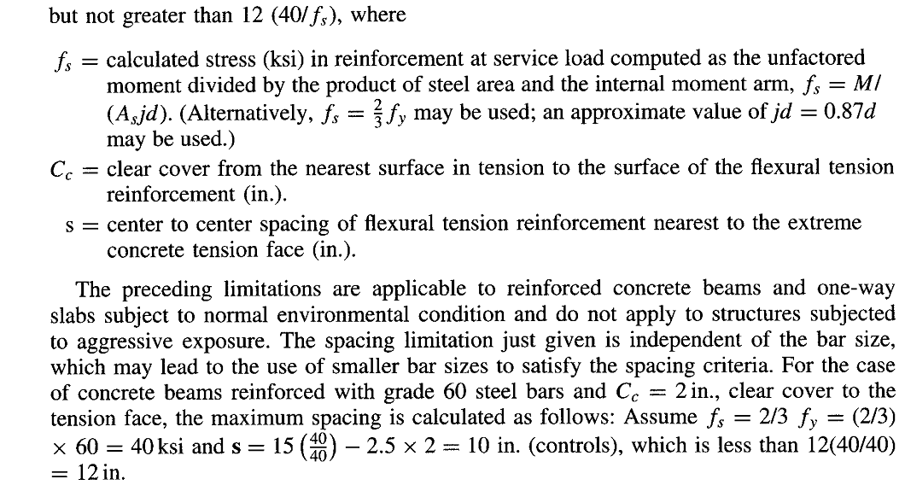

Slide 22
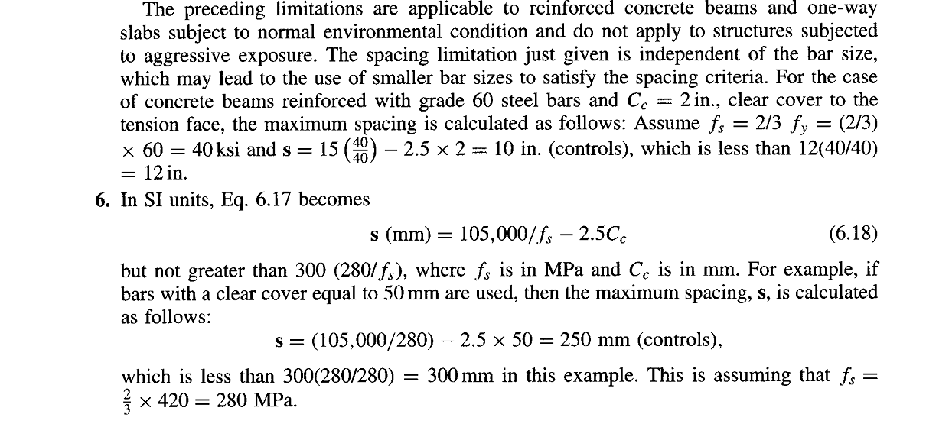

Slide 23
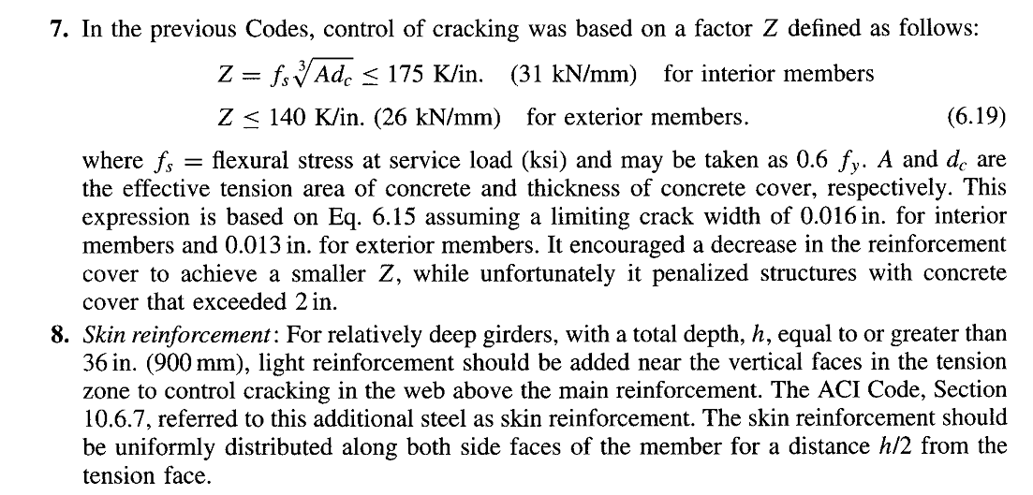

Slide 24
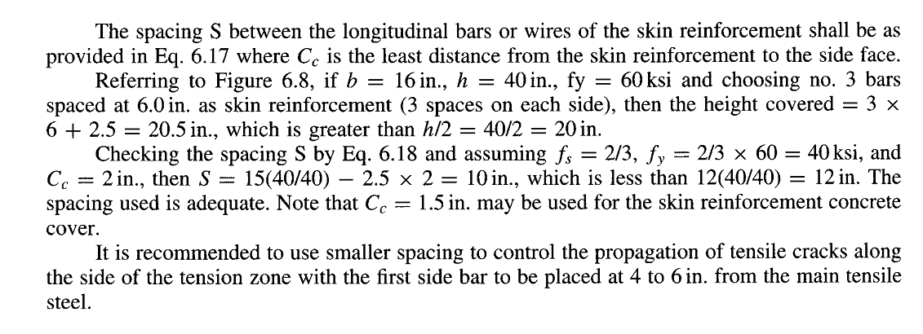

Slide 25
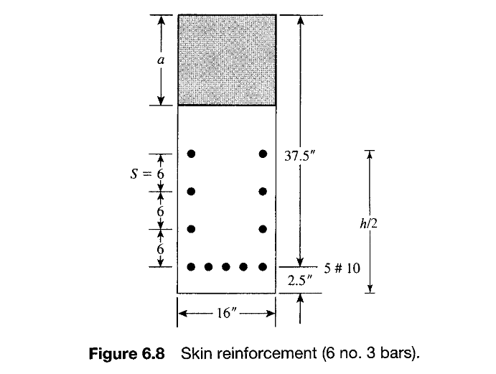

Slide 26
