Slide 1
Uses and Gratifications Theory

Slide 2
Introduction
Audience-centered approach
What do people do with the media?
Message makers – Message Receivers
Active media consumers

Slide 3
History
1940s and revival in 1970s and 1980s
Herza Herzog
Mcquail, Blumler & Brown
Self rating, social interaction, excitement and educational appeal

Slide 4
Assumptions
Active audience
Goal oriented
Choice
Competition among different media
Favorite media
Awareness on part of audience
Judgments

Slide 5
By: Katz, Blumler & Gurevitch
“Uses and gratifications focused on the social and psychological origins of needs which generate expectations of the mass media or other sources which lead to differential patterns of media exposure (or engagement in other activities) resulting in need gratifications and other consequences, perhaps mostly unintended ones”.

Slide 6
Audience Goals for Media Use
To be informed or educated
Entertainment
Social Interaction
Escape from stress

Slide 7
Audience Needs for Media Consumption
Cognitive needs
Affective needs
Personal integrative needs
Social integrative needs
Tension release needs

Slide 8
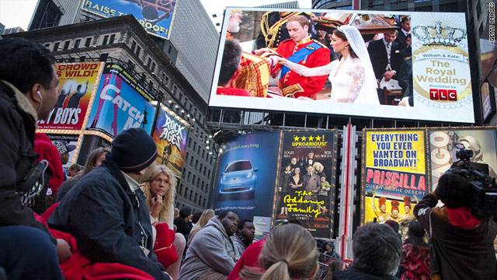
Cognitive Needs
Media is used by people to acquire information
and knowledge.
Example

Slide 9
Affective Needs
People use media for seeking pleasure or to
satisfy emotional needs.
Example

Slide 10
Personal Integrative Needs
Sometimes people utilize media to reassure
their status.
Examples

Slide 11
Social Integrative Needs
Internet and social media are normally used to satisfy this need which is to integrate and connect with family or friends.
Example

Slide 12
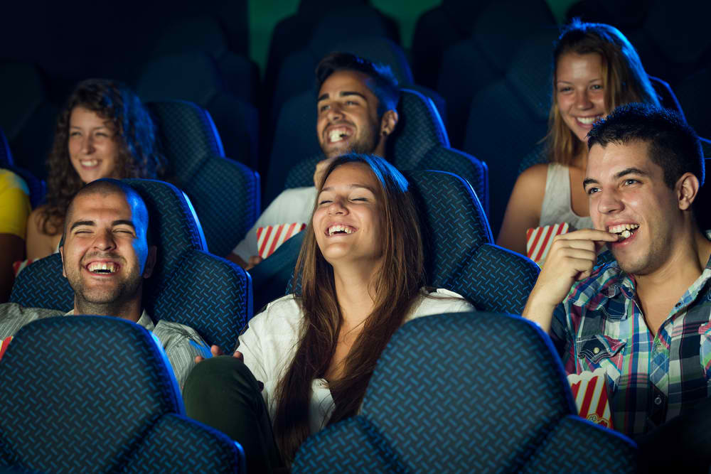
Tension Release Needs
Media is also used for the purpose of catharsis
and escape from the daily routine.
Example

Slide 13
What Gratifications are Sought and Obtained from Media?
Denis McQuail
1987

Slide 14
Needs
Personal Identity
Integration and Social Interaction
Information
Entertainment
Media
Gratification

Slide 15
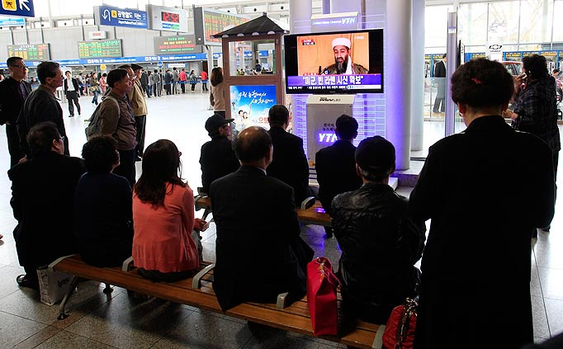
Information
Events, happenings
Advice
Curiosity
Interest
Learning, self-education
Sense of security through knowledge

Slide 16
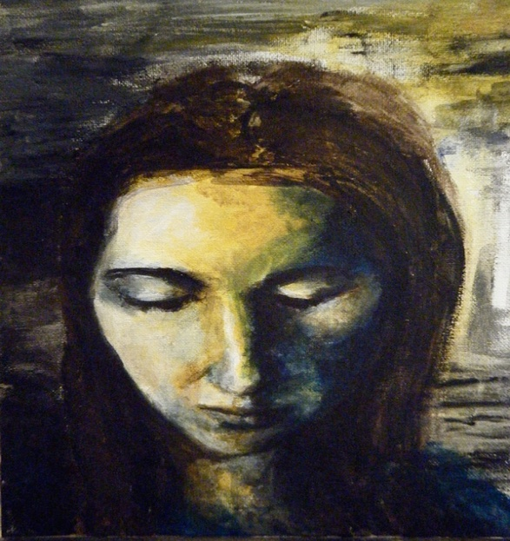
Personal Identity
Reinforcement
Models of behavior
Insight into one’s self

Slide 17
Integration and Social Interaction
Social empathy
Sense of belonging
Social interaction
Social roles
Connection with family, friends and society

Slide 18
Entertainment
Relaxation
Escaping
Filling time
Enjoyment

Slide 19
How are Media used in the Gratification Process?
Kim & Rubin 1997
Selectivity
Attention
Involvement

Slide 20
Modern Applications of U & G

Slide 21
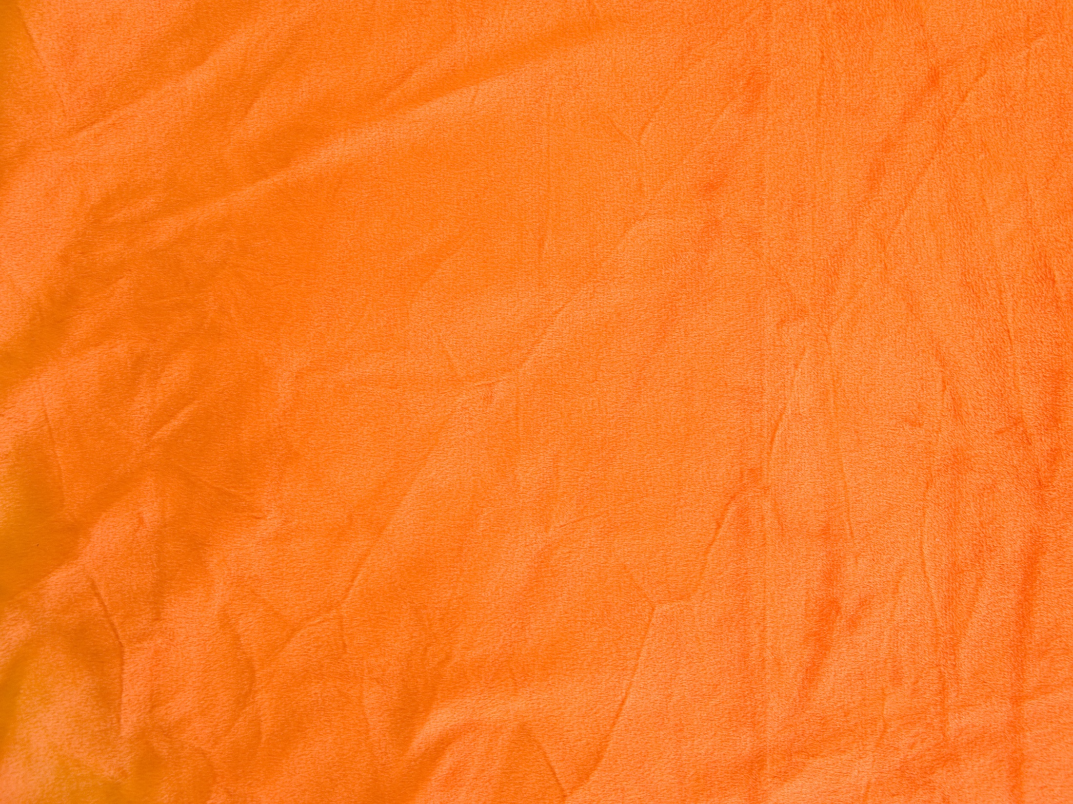
Criticism
People often do not select media willingly and independently
Audience- centered approach
Doubtful nature of the study
Individualistic
Attention towards media consumers

