Slide 1
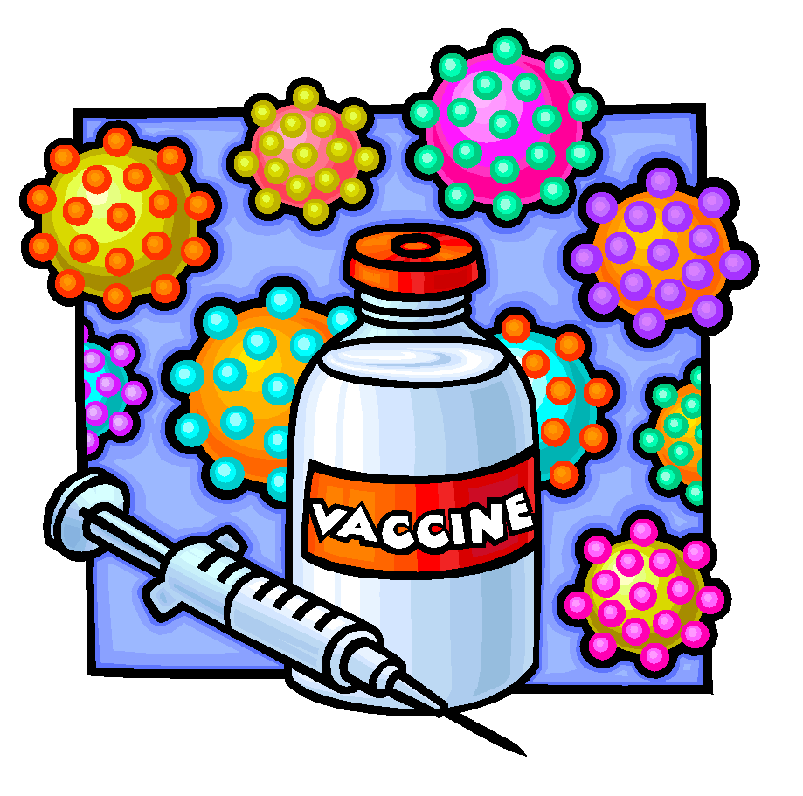
VACCINES
AND THEIR DEVELOPMENT

Slide 2
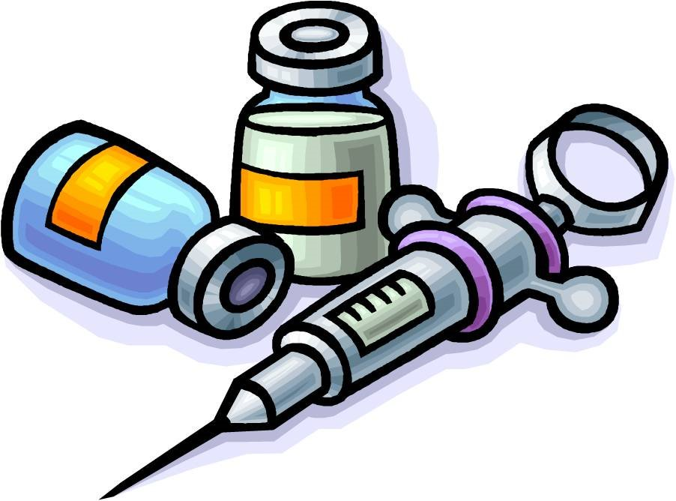
VACCINATION
VACCINATION

Slide 3
Definition
Vaccine applies to all biological preparations, produced from living organisms, that enhance immunity against disease and either prevent (prophylactic vaccines) or, in some cases, treat disease (therapeutic vaccines).

Slide 4
Goals of vaccination
Vaccinate the largest possible number of individuals in the population at risk.
Vaccinate each individual no more frequently than necessary.
Vaccinate only against infectious agents to which individuals have a realistic risk of exposure and subsequent development of disease.

Slide 5
How vaccines are made

Slide 6
how vaccines work
Vaccines usually stimulate the immune system
to recognize the infectious agent and to produce
antibodies to the disease.
If the immunized animal is later exposed to the
infectious agent, the antibody-producing cells
“remember” their earlier encounter with the
infectious agent and respond quickly to make
more antibodies.

Slide 8
Types of vaccines
TYPES OF VACCINES

Slide 9
1. Live/attenuated vaccines
These vaccines contain a version of the living
microbe that has been weakened in the lab so
it cannot cause disease.
Example: Small pox vaccine.

Slide 10
Advantages:
Good teachers of immune system
Elicit strong cellular and antibody response
Confer life long immunity with only 1-2 doses
Disadvantages:
Remote possibility exists that microbe could revert to a virulent form & cause disease.
Not everyone can safely receive live vaccines
Need refrigerated to stay potent
Difficult to be transported to underdeveloped places.

Slide 11
2. killed/inactivated vaccines
Scientists produce inactivated vaccines by killing
the disease-causing microbes with chemical, heat
and radiation.
Example: Typhoid vaccine.

Slide 12
Advantages:
More stable and safer.
Dead microbes cannot mutate back.
No refrigeration required.
Can be transported over long distances.
Disadvantages:
Stimulate weaker immune response.
Several additional doses required.
Not effective for people who don’t have regular access to health care.

Slide 13
3. Subunit vaccines
Instead of the entire microbe, subunit vaccines
include only the antigens that best stimulate the
immune response. In some cases, these vaccines
use epitopes, the very specific part of the
antigens that antibodies or T-cells recognize and
bind to.
Example: Influenza vaccine.

Slide 14
Advantages:
Lower chances of adverse reactions.
Stable and safer.
Disadvantages:
Identifying best antigens is a tricky and time-consuming process.
Expensive to manufacture.
Require boosters.

Slide 15
4. Toxoid vaccines
For bacteria that secrete toxins or harmful
chemicals, a toxoid vaccine might be the solution.
Scientists inactivate toxins by treating them
with formalin. Such “detoxified” toxins are called
toxoids.
Example: Tetanus vaccine.

Slide 16
Advantages:
Safer to use.
Immune system learns to fight off natural toxins.
Disadvantages:
Initiate weak immune response.
Require boosters.

Slide 17
5. Conjugate vaccines
If a bacterium possess an outer coating of
polysaccharides, as many harmful bacteria do,
researchers may make a conjugate vaccine for it.
Polysaccharide coating disguises the bacterium’s
antigens from the immune system. In conjugate
vaccines, scientists link antigens to the
polysaccharide coating so they can be recognized
by the immune system.
Example: Haemophilus Influenza B vaccine.

Slide 18
Advantages:
Higher efficacy.
Cannot cause disease.
Disadvantages:
Difficult to make.
Expensive.

Slide 19
6. Dna vaccines
In particular, DNA vaccines use the genes that
code for all important antigens. There genes are
inserted into the body and taken up by cells. The
DNA instructs those cells to make, secrete and
display the antigens on their surfaces to be
recognized by the immune system.
Example: Herpes vaccine.

Slide 20
Advantages:
Evoke a strong antibody response.
Stimulate a strong cellular response.
Cannot cause the disease.
Easy and inexpensive to design.
Disadvantages:
May cause adverse reaction.
Potential for disrupting normal cellular processes.

Slide 21
7. Recombinant vector vaccines
In these vaccines, attenuated viruses or bacteria
are used to introduce microbial DNA to the cells
of body. The genetic material in bacteria cause
them to display antigens on their surfaces. In case
of viruses, the genes are inserted into the cells
and antigens displayed on them. Both cases
generate an immune response.
Example: HIV vaccine.

Slide 22
Advantages:
Closely mimic natural infection.
Good at stimulating the immune system.
Strong immune response evoked.
Disadvantages:
Expensive to produce.
Weakened microbes may mutate to disease causing state.
Not everyone can receive these vaccines.
Need refrigeration.

Slide 24
ROUTES OF ADMINISTRATION of vaccines
ROUTES OF ADMINISTRATION OF VACCINES

Slide 25
1. Subcutaneous route
If you are giving a subcutaneous injection, you will
inject directly into the fatty tissue (under the
skin and overlying the muscle) on the back of the
upper arm.
For infants, fatty tissues over the thigh muscles
and for babies older than 12 months, fatty tissues
in the upper arm are the site of injection.

Slide 26
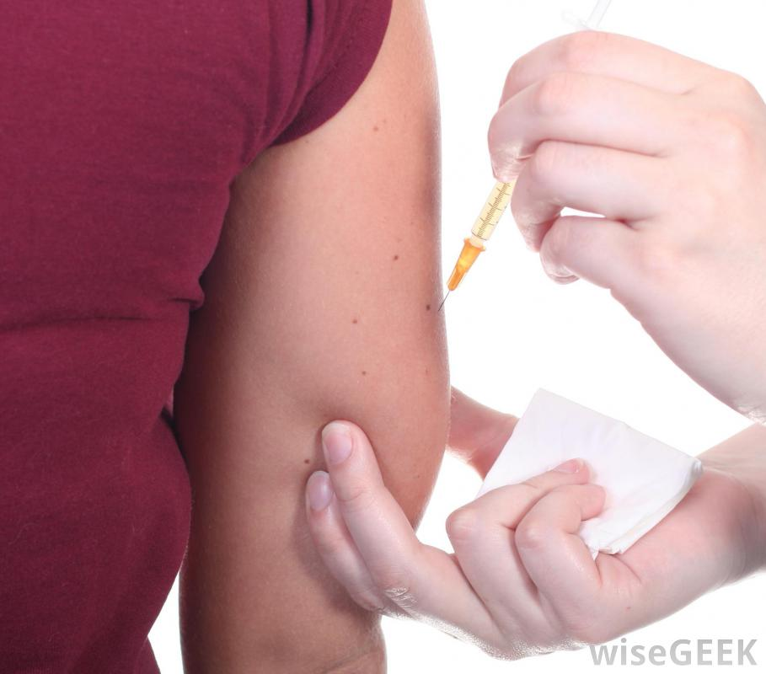
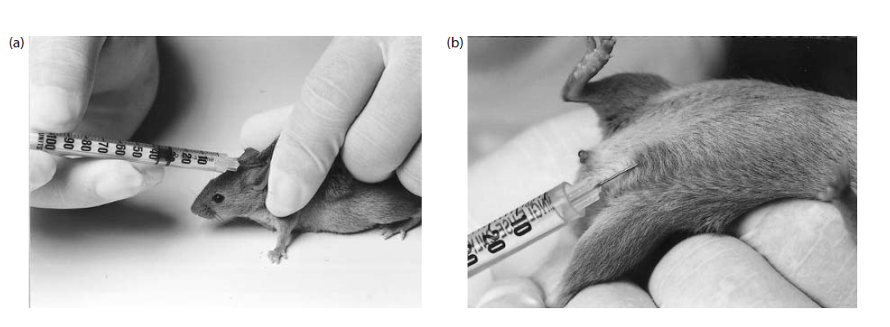

Slide 27
2. Intramuscular route
If you are giving an intramuscular
injection, you will inject directly into the
Deltoid muscle, below the shoulder on the
upper arm.
In children, anteriolateral thigh muscles are
used to inject vaccines.

Slide 28
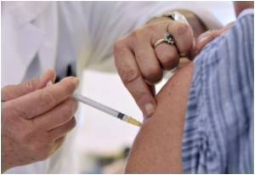
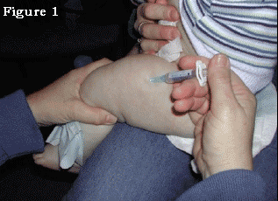

Slide 29
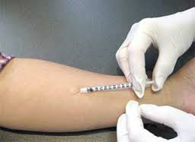
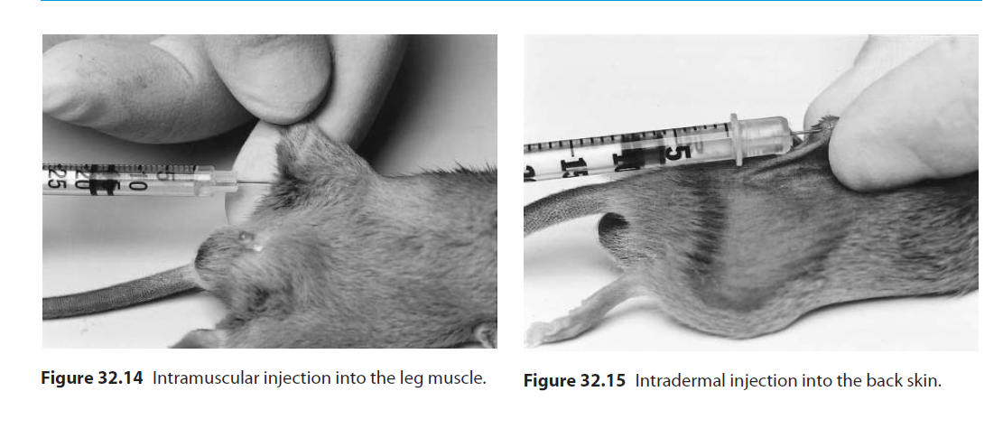
3. Intradermal route
An intradermal (ID) injection is the injection
of a small amount of fluid into the dermal
layer of the skin. Appropriate site for
intradermal vaccine injection is the inner arm.

Slide 30
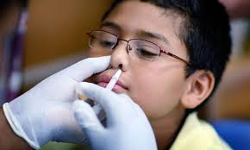
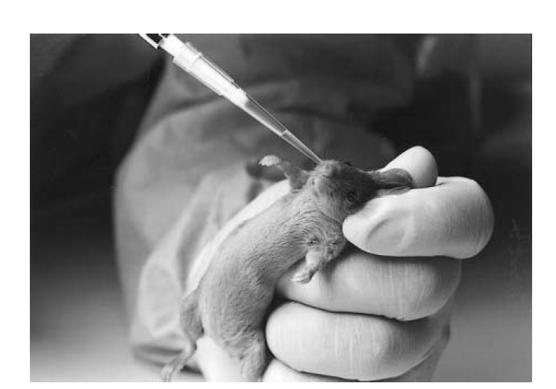
4. Intranasal route
The patient is made to sit upright with the
head tilted. Tip of the sprayer is inserted
slightly into the nostrils and vaccine is
sprayed.

Slide 31
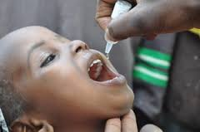
5. Oral route
It is administered slowly and carefully into
the mouth and never directly into the throat.

Slide 32
ADJUVANTS

Slide 33
DEFINITION
An adjuvant (from Latin, adiuvare: to aid) is a pharmacological and/or immunological agent that modifies the effect of other agents.
Adjuvants may be added to vaccine to modify the immune response by boosting it such as to give a higher amount of antibodies and a longer lasting protection, thus minimizing the amount of injected foreign material.

Slide 34
MECHANISM OF ADJUVANTS
Adjuvants can enhance the immune response to the antigen in different ways:
extend the presence of antigen in the blood
help absorb the antigen presenting cells antigen
activate macrophages and lymphocytes
support the production of cytokines

