Slide 1
Egg shapes and proteins
Dr. M. Asam Riaz
Assistant Professor
Entomology
University of Sargodha, Sargodha, Pakistan

Slide 2
Important Components of eggs
stored components important in the physiology of the embryo
mitochondria,
ribosomes,
lipid,
glycogen,
uric acid,
vitamins,
conjugated hormones and
Minerals
protein and lipid yolk predominate.
These proteins are stored primarily in yolk granules, large membrane-bound quasicrystalline storage vesicles (Anderson, E., 1970; Roth, T. et al., 1976).

Slide 3
Yolk proteins
Vitellogenins (Vg)
Vitellins (Vt)
Lipophorins (LP)

Slide 4
Vitellogenins (Vg)
insect males incapable of Vg synthesis (see Hagedorn, H., vol. 8).
Female prepare Vg
Precursor of Vt
Vitellogenin (Vg) is synthesized in
fat body in widely different insect groups (Pan, M. et al., 1969),
In ovarian cell e.g., Dipteran Vg (Srdic, Z. et al., 1979; Jowett, T. and Postlethwait, J., 1980; Brennan, M. et al., 1982).

Slide 5
Vitellin, the major yolk proteins
Major nutritive yolk protein has been assigned the generic name Vitellin (Vt)
Its precursor is found in bloodstream and has been given the generic name vitellogenin (Vg)
The differences between Vg and Vt are subtle

Slide 6
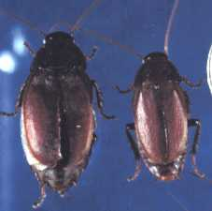
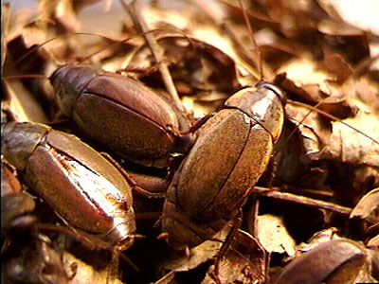
Constituents of Yolk protein
Proteins
Yolk provide raw materials for more extensive embryonic development
In viviparous species, the cockroach (Diploptera punctata) deposit substantial yolk to allow development to a larva which can start drinking a uterine milk, the nourishment for extended growth in the female's uterus (Ingram, M. et al., 1977).

Slide 7
Lipophorin (LP)
Synthesis of LP occurs in the fat body (Peled, Y. and Tietz, A., 1975).
It is synthesized as an 85K polypeptide without translational modification.
This protein functions as a hemolymph transport carrier for hydrocarbons, cholesterol and diglycerides (Chino, H. et al., 1981a; see Chino, H., vol. 10)
Vt and Lp, are stored in the egg by maternal efforts prior to ovulation.

Slide 8
Lipid composition in yolk protein

Slide 9
vitellin preparations and may be important contributors to the stored nutriments in eggs of certain taxa such as Bombyx mori (Irie, K. and Yamashita, O., 1980).
Lps are similar to Vt with respect to amino acid composition, polypeptide size and proteolytic sensitivity, and immunological properties (Harry, P. et al., 1979; Pattnaik, N. et al., 1979).

Slide 10
Carbohydrates as mannose

Slide 11
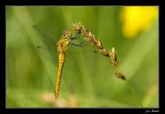
Chorion
Protein such as Chorionin
Carbohydrate and lipids
Glucosamine absent but it is identified in Sympetrum chorion (Kawasaki et al 1974)

Slide 13
Egg Shapes
Dr M Asam Riaz
Assistant Professor
University of Sargodha, Sargodha, Pakistan

Slide 14
Brown marmorated stink bug eggs hatched

Slide 15
silver eggs, Spined Soldier Bug, Pentatomidae, Podisus, Apateticus

Slide 16
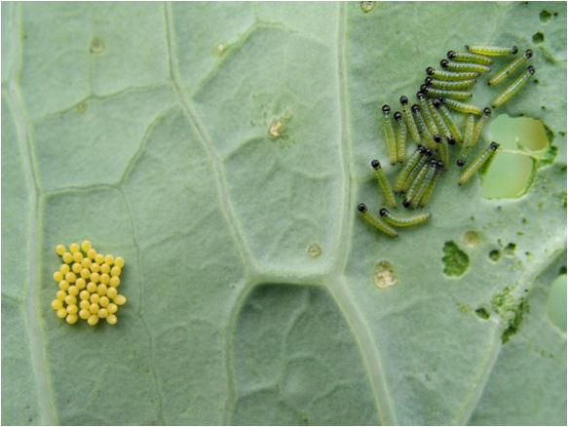
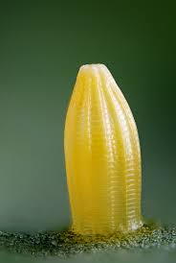
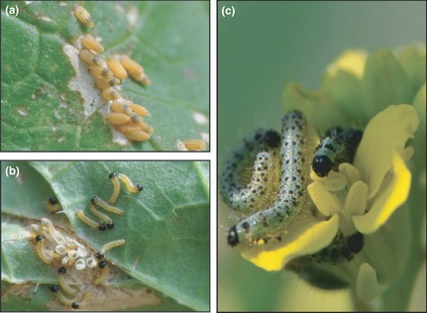
Pieris brassicae

Slide 20
Vitelline membrane:
An egg's cell membrane is known as the vitelline membrane.
It is a phospholipid bilayer similar in structure to most other animal membranes.
Yolk:
It surrounds the entire contents of the egg cell, most of which consists of yolk
(food for the soon-to-develop embryo).

Slide 21
Periplasm:
The cell's cytoplasm is usually distributed in a thin band just inside the vitelline membrane and in diffuse strands that run throughout the yolk (cytoplasmic reticulum).
Nucleus:
The egg cell's nucleus (haploid) lies within the yolk, usually close to one end of the egg.
Near the opposite end, the öosome (a region of higher optical density) may be visible as a dark region in the more translucent yolk

Slide 22
In most insects the egg is covered by a protective "shell" of protein secreted before oviposition by accessory glands in the female's reproductive system. This egg shell, called the chorion, is often sculptured with microscopic grooves or ridges that may be visible only under the high magnification of an electron microscope. The chorion is perforated by microscopic pores (called aeropyles) that allow respiratory exchange of oxygen and carbon dioxide with relatively little loss of water. The micropyle, a special opening near the anterior end of the chorion, serves as a gateway for entry of sperm during fertilization.

Slide 23
Egg of giant water bug
Aeropyle for oxygen entry
Micropyle for sperm entry
Aeropyle

Slide 24
Micropyle

