Slide 1
Interphase, Mitoses & Significance

Slide 2
Cell Cycle
A typical cell goes through a process of growth, development and reproduction called the Cell Cycle.
The longest phase in the cell cycle is Interphase.
The 3 stages of interphase are called G1, S and G2.
Cell cycle is divided into 2 main phases
A) Interphase: which prepares cell foe division.
B) M phase: where division actually takes place.

Slide 3
Three Stages Of Interphase

Slide 4
G1 phase(the first gap phase): the first stage of the Interphase
During the G1 phase or the gap 1 phase the protein syntheses and the RNA syntheses within the cell resume that was interrupted during the process of mitoses. Growth and young cell maturation occurs which accomplish the physiological function. G1 phase is the phase during which the cell cycle starts with the syntheses of RNA and proteins required by the young cells for their growth and maturity. The time period of G1 phase of the interphase is varied highly among the different species eukaryotic cells.
G1 phase is usually termed as the prior to DNA syntheses phase.

Slide 5
S Phase: the Second Stage Of Interphase
The S phase of the Interphase deals with the semi-conservative syntheses of DNA occurs. Replication of cellular DNA begins with the S phase which when gets duplicated with the cell containing nearly double the amount of chromosomes the cell from the S phase move into G2 phase. S which stands for syntheses.

Slide 6
G2 phase (the Second Gap Phase): the third Stage of Interphase
During the G2 phase there is an increase in the syntheses of the RNA and the protein which is followed by another round of proof reading and subsequent repair among the newly synthesized DNA sequences before the cell cycle transits to mitotic cycle.

Slide 7
History
Mitosis was first discovered in plant cells by strawsburger (1875).
Later on W.Flemming (1879) discovered it in animal cell. The term coined by Flemming (1882).

Slide 8
Occurrence
The mitosis cells undergoing mitosis are called mitocytes. In plants the mitocytes are mostly meristematic cells.
In animals the mitocytes are stem cells germinal epithelium and embryonic cells.
It also occur during the regeneration.
Root tip is the best material to study mitosis.

Slide 9
Reason for Mitosis
There are 3 main reasons:
1) Growth
2) Repair/healing
3)A-sexual reproduction

Slide 10
Two Fundamental types of (Organisms)
Eukaryotic
Prokaryotic

Slide 11
Type of cell
1) Eukaryotic cell
membrane bound organelles including a nucleus
Genetic material DNA contained within the nucleus
Cell division of somatic cells called Mitotic cell division
Examples
Fungi, Protest, Plants, Animals

Slide 12
Type of cell
2) Prokaryotic Cell
No nucleus-genetic material (DNA) in cytoplasm
No-membrane-bound organelles
Cell divisions is called binary fission
Example
Bacteria

Slide 13
Depending on cell type
Mitosis can take few minutes or a few days
Muscle cells
Nerve cells
Skin cell
Digestive tract cell

Slide 14
Steps of Mitosis
Prophase
Prometaphase
Metaphase Karyokinesis
Anaphase
Telophase
C-phase or Cytokinesis

Slide 15
Prophase
Early Prophase:
Centrioles produces out fine microtubular fibrils called Aster rays.
Plants cells do not contain centrioles so called Acentric mitosis
Animals - centric mitosis

Slide 16
Prophase
Mid Prophase:
Chromosomes shift towards the periphery and leave a clear area.
It becomes shorter and thicker.
Each chromosomes consists of two longitudinal threads called chromatids.

Slide 17
Prophase
Late prophase:
Spindle fibers start appearing around the nucleus.
Size of chromosomes is much reduced.
Spindle poles are forms without asters in plants(anastral mitosis).
With asters in animals (astral mitosis).

Slide 18
Prophase

Slide 19
Metaphase
The chromosomes line up at the equator of the cell (metaphase plate), with the centrioles at opposite ends and the spindle fibers attached to the centromeres.

Slide 20
Metaphase

Slide 21
Anaphase
The spindle fibers contract and the chromosomes are pulled to opposite poles.
It is the shortest of all stages of mitosis.

Slide 22
Anaphase

Slide 23
Telophase
In telephase the nucleus actually divides.
The chromosomes are at the poles of the cell.
The nuclear envelope re-forms around the two sets of chromosomes.
It is considered as the reverse of prophase.

Slide 24
Telophase

Slide 25
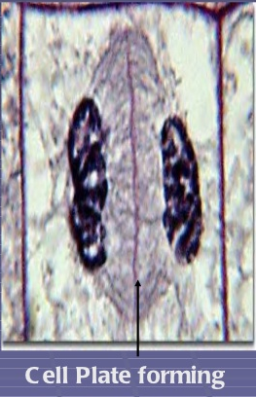
Cytokinesis
The division of the cytoplasm.
In animal cells, a cleavage Furrow forms and separates Daughter cells.
In plant cell, a cell plate forms and separate Daughter cell

Slide 26
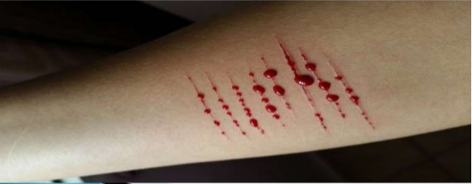
Significance of Mitosis
Mitosis is important for sexual reproduction indirectly.
It allows the sexually reproducing organisms to grow and develop from a single cell into a sexually mature individual.
This allows organisms to continue to reproduce through the generation.
Repair of worn out parts (healing of wounds) takes place by Mitosis

Slide 27
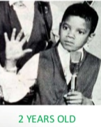
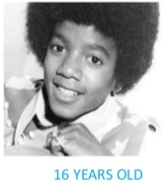
Significance of Mitosis
Growth involves increase in the size of organisms and increase in the number of cells
Cell division is the process to which this is achieved
The new cell arise from pre existing cell only through the process of cell division. Cell division essential for the growth.

Slide 28
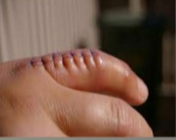
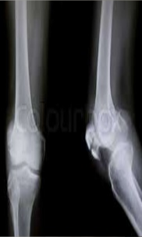
Significance of Mitosis
Mitosis is important to us because it facilitate growth it also helps in cell replacement as through our lifespan, a lot of our cells die and are replaced and this would not be possible without mitosis.

Slide 29
Significance of Mitosis
Genetic stability:
It maintains constant chromosomes number and genetic stability in all somatic are vegetative cells of the body.
Surface volume ratio:
As the size of a cell increases, the surface area decreases accordingly. By mitosis, the cell becomes smaller in size and the surface volume ratio is restored.

Slide 30
Conclusion
Mitosis is the one of the important part of the growth and deployment process both animals and plants. The cells are dividing because of mitosis are usually found on the meristem the tips of roots and shoots.
However in animals the dividing cells can happen in any tissue that is growing but the dividing cell are mostly found in dividing embryos mainly the blastulas.

