Slide 1
Welcome

Slide 2
Department of Animal Sciences
AS 302 2(1-1)
INTRODUCTION TO ANIMAL SCIENCES
SPRING 2009
Dr. Imtiaz Hussain
Lecturer

Slide 3
ANIMAL:
Major group of multicellular eukaryotic organisms of the kingdom Animalia.
LIVESTOCK:
Agricultural animals, animals kept for profit.
Domesticated animals intentionally reared in an agricultural setting to produce things such as food or fibre, or for its labour.

Slide 4
CATTLE:
Family Bovidae
European Cattle ,non Humped belonged to Bos taurus
Subcontinent (Indo pak cattle) ,humped belonged to Bos Indicus
SPECIE:
A specie is often defined as a group of organisms capable of interbreeding and producing fertile offspring.

Slide 5
BREED:
A group of related animals which are genotypically and phenotypically sufficiently similar to produce physically similar offspring when they are mated with each other.
TRUE BREED:
Produce offspring that are very similar to the parent(s); refers to homozygotes.

Slide 6
BREED CLASS AVERAGES:
The average production performance for all animals in the breed, arranged in groups according to age and sex.
MILCH BREED:
Cattle that are reared for their milk.
DRAUGHT BREED:
Cattle that are reared for draught (labour etc.)

Slide 7
CATTLE
MILCH BREEDS OF CATTLE

Slide 8
RED SINDHI BULL

Slide 9
RED SINDHI COW

Slide 10
SAHIWAL BULL

Slide 11
SAHIWAL COW

Slide 12
DRAUGHT BREEDS OF CATTLE
HEAVY DRAUGHT

Slide 13
BHAGNARI BULL

Slide 14
BHAGNARI COW

Slide 15
DAJAL BULL

Slide 16
DAJAL COW

Slide 17
MEDIUM DRAUGHT
DHANNI

Slide 18
DHANNI BULL

Slide 19
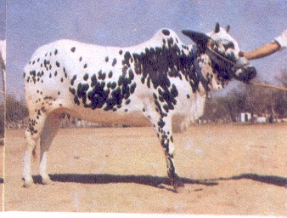
DHANNI COW

Slide 20
LIGHT DRAUGHT
LOHANI

Slide 21
LOHANI BULL

Slide 22
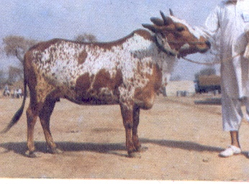
LOHANI COW

Slide 23
ROJHAN BULL

Slide 24
ROJHAN COW

Slide 25
DUAL PURPOSE BREEDS
KANKREJ

Slide 26
KANKREJ BULL

Slide 27
KANKREJ COW

Slide 28
THARPARKER (THARI) BULL

Slide 29
THARPARKER (THARI) COW

Slide 30
BUFFALOES
Three Types
Cape Buffalo of Africa
Water Buffalo of Near and Middle East
Swamp or Marsh Buffalo of Far East
In Pakistan Buffaloes are considered triple purpose animals (Milk, meat and draught)

Slide 31
KUNDI

Slide 32
KUNDI

Slide 33
NILI RAVI

Slide 34
NILI RAVI

