Slide 1
Pest of Citrus and Mango
Dr. M. Asam Riaz
Assistant Professor
Entomology, College of Agriculture, University of Sargodha, Sargodha, Pakistan

Slide 2
Major Pests of Citrus and Missing links in their Control
Citrus leaf minor (Feb – March & Sep. October)
Asiatic Psyllid (Spring Growth and September)
Citrus catterpillar
Thrips (March)
Flies (White fly, (Spring and July to October)
black fly Fruit fly)
Mites (Spring to Summer Season)
Scales
Cottony Cushion (Rainy season)
Scales

Slide 3
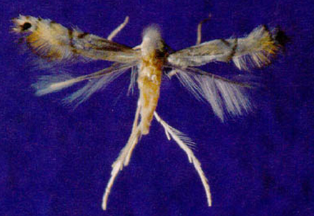
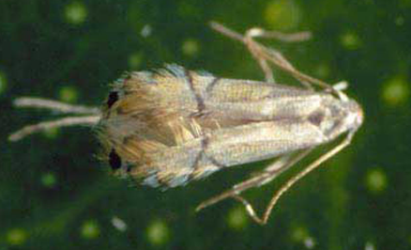
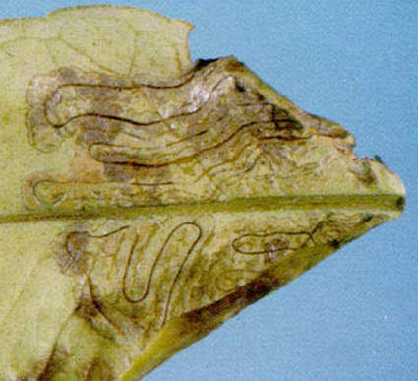
Citrus leaf-miner (Phylllocnistis citrella; Gracilaridae, Lepidoptera)
Host plant: citrus, pomelo, willow, cinnamon and
Active period: Feb – March & Sep. October
Egg: minute, flattened, transparent eggs; laid singly on young leaves or tender shoots on the lower surface near midrib; hatch in 2-10 days
Larvae: legless; pale yellow with light brown well developed mandible; mine into leaf tissues and remain inside; larval life 8-16 days;
Pupae: brownish; larvae spin cocoon; pupal life 5-25 days
Adult: tiny moth, FW have brown stripes and prominent black spot along tips; HW pure white; both are fringed with hairs
Damage:
Larvae make zig-zag galleries in young leaves
Attacked leaves twist
Brownish patches are formed on older leaves which serve as focii of infection for citrus canker
In larger tree, photosynthesis is severly affected, reduction in yield
Control:
A pheromone (7Z, 11Z)-7, 11-hexadecadienal) to attract males of CLM
Petroleum oil 2.5-5 ml/L of water reduced the no of mines (Beattie et al 2007-Austral Entomology)
Bifenthrin (Talstar 10 EC, FMC) 250 m
Imidacloprid 40ml/100L of water
Fenvalerate 50 ml /100L of water
Notes:
Cinnamon (dar chini)::A pheromone to attract males of CLM (was developed in Japan by Ando et al. (1985), called (7Z, 11Z)-7, 11-hexadecadienal)

Slide 4
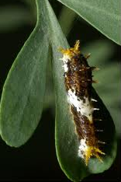
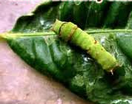
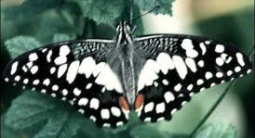
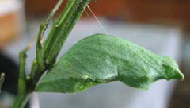
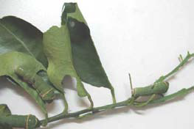
Citrus caterpillar (Papilio demoleus; Papilionidae, Lepidoptera)
Host plant: all varities of cultivated and wild citrus and species of family Rutaceae
Active period: March - November
Egg: round, pale yellow; 75-120 eggs/female; laid singly or in groups on tender shoots and fresh leaves on the undersurface; hatch in 3-4 days
Larvae: young larvae are dark brown having white band on the body with spines; full grown larvae are green; larval life 8-16 days;
Pupae: Pupae are pale green; mature larve spin gridle around its body and pupate on twing, dry stick or raised structure; hibernate in pupal stage; pupal life 8 days
Adult: head and thorax black, wing dully black with yellow markings
Damage:
feed on fresh leaves and terminal shoots
Destroy nursery plants
Heavily attacked plants bear no fruits
Control:
Hand picking and destruction of larvae
Use of entomopathogenous fungus, Bacillus thuringiensis
Trichogramma chilonis and the scelionid Telenomus sp. (Krishnamoorthy and Singh 1986-Current Science)
Chemical Control
1. Flubendamide (Belt 48% SC/480 SC) 25 ml/A (Bayer)
2. Methoxyfenaside (Runner 120 EC) 200 ml (Arista)
3. Lufeneuron (Match 50 EC) 200 ml (Syngenta)
4. Spintoram (Radiant 120SC) 40 ml

Slide 5
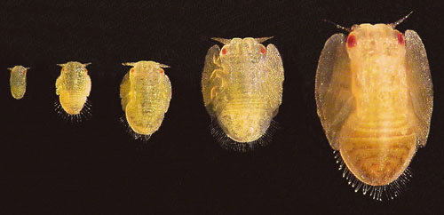
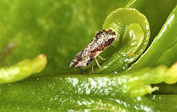
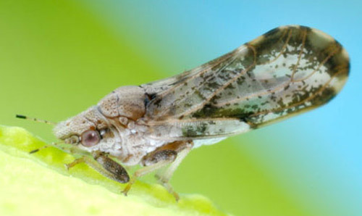
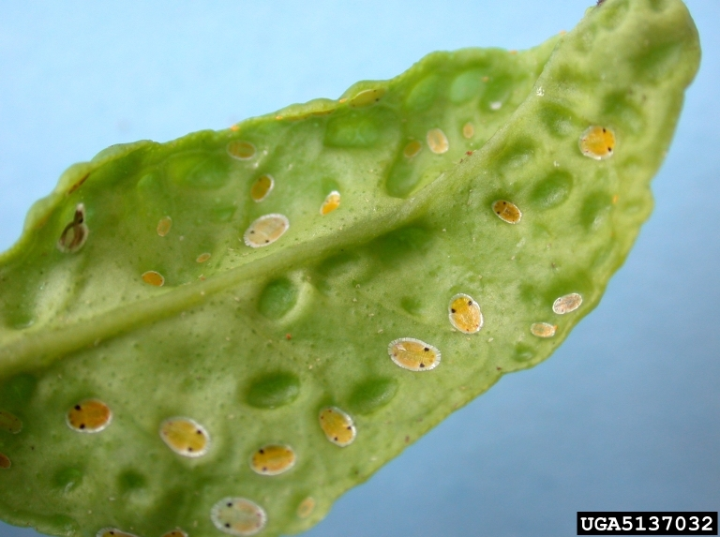
Citrus psylla (Diaphorina citri; Psyllidae: Hemiptera)
Host plant: all varities of cultivated and wild citrus and species of family Rutaceae
Active period: Spring Growth and September
Egg: stalked, almond-shaped, orange; 500 eggs/female; laid singly or in groups on tender leaves and shoots; egg stalk is embedded in plant tissues; arranged in straight line; hatch in 4-6 days
Nymph: flat, louse-like, orange yellow; congregate on young leaves; nymphal life 10-11 days;
Adult: : insect brown with its head lighter brown and pointed; wings membraneous, semi-transparent with brown band; adult live for 12-26 days in summer 190 days in winter
Damage:
Suck the cell sap
Young leaves and shoots stop growing
Leaf bud, flower buds and leaves may wilt and die
Fruit falls off prematurely
Sooty mold develop and interfere with photosynthesis
Insect responsible for citrus greening virus
If pest is not controlled, the entire orchard may be lost
Control:
Use of natural enemies such as
Coccinella septempunctata,
C. transversalis,
Menochilus sexmaculatus,
Chrysoperla carnea larvae feed on nymphs.
Imidacloprid (Confidor 200 SL) 200 ml (Bayer)
Deltamethrin 250 ml
Fenvalerate 250 ml

Slide 6
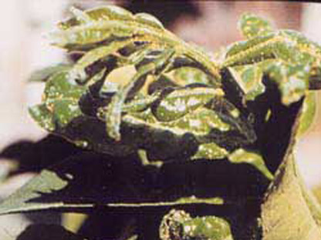
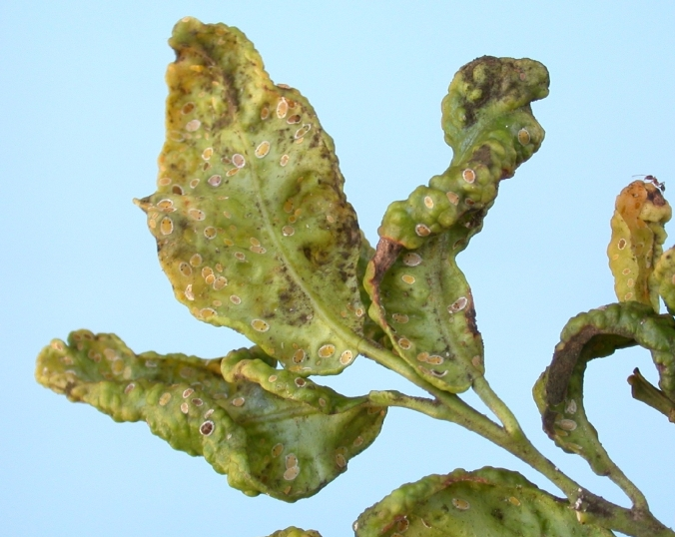
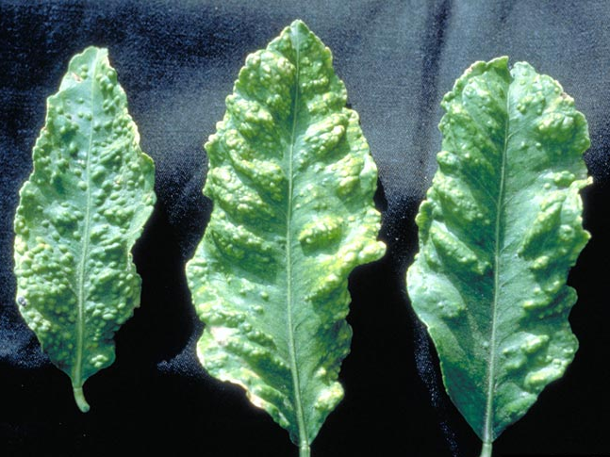
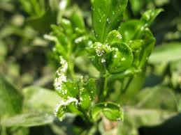
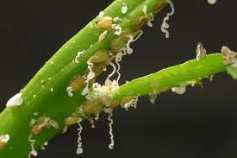
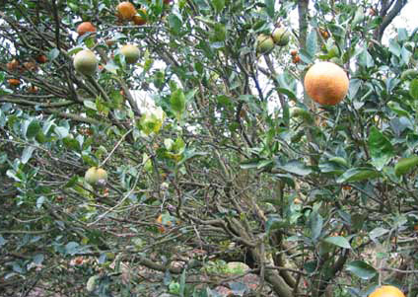
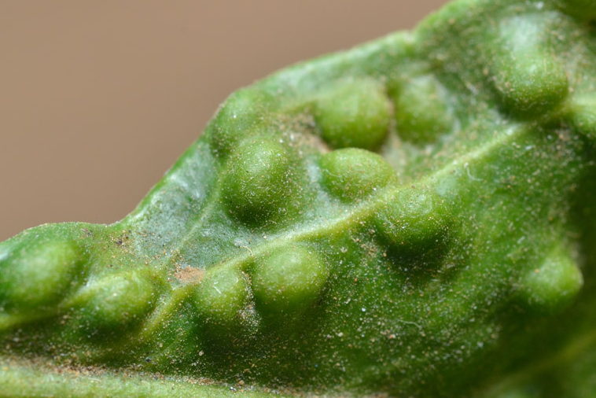

Slide 7
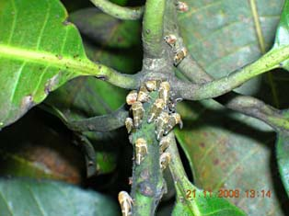
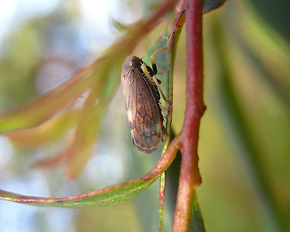
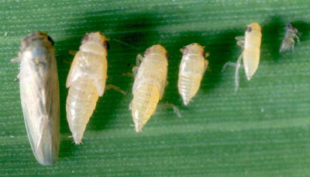
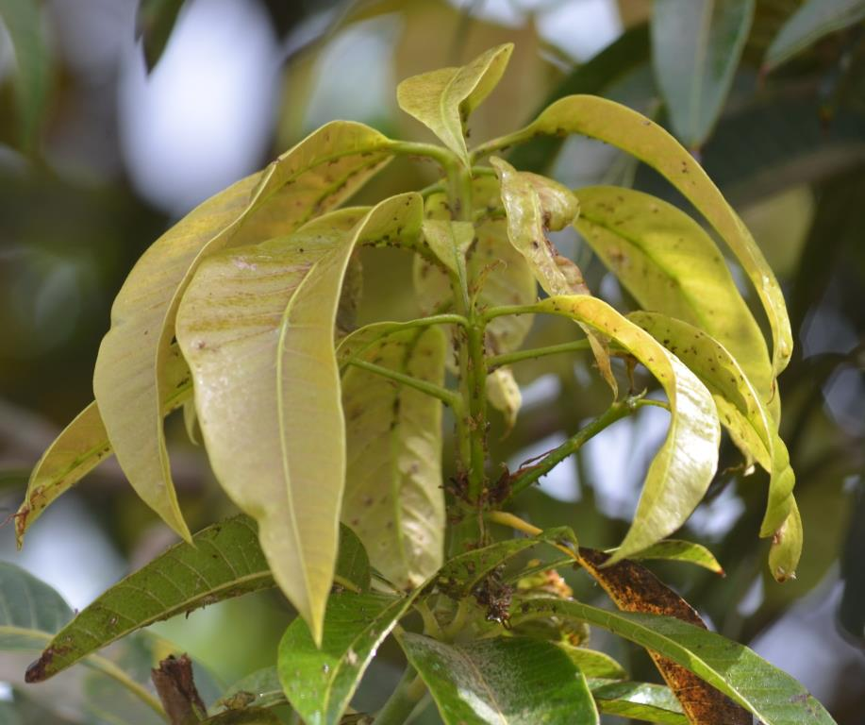
Insect pests of Fruit Crops Mango leafhopper (Amritodus atkinsoni ; Cicadellidae, Homoptera)
Host plants: Mango
A destructive pest of Mango plant, widely distribute in mango orchards
Identification
Adult: Pale brown in color
Eggs: 200 , laid singly in panicle tissues, unopened
flowers, and your foliage.
Nymph: Pale yellowish in color
Life history:
Life cycle: One month
Eggs: about 200 eggs per female (hatching in one week)
Nymph: One to three weeks
No. of generations: 2 per year (Feb. And in June)
Damage:
Active period: Throughout the year
(Maxi. population in May, June)
Maximum damage caused in February-March (to inflorescence and young sprouts).
De-saping of young foliage and sprouts, and tender leaves and twigs.
Withering , deformation and yellowing of plant leaves and twigs
Pre-mature fruit dropping and poor-quality fruits
Control:
Chemical control (Acetamiprid, Imidacloprid, Bifenthrin, Lamda-cyhalothrin)
Biological contorl by releasing lacewings, coccinallid beetles etc.

Slide 8
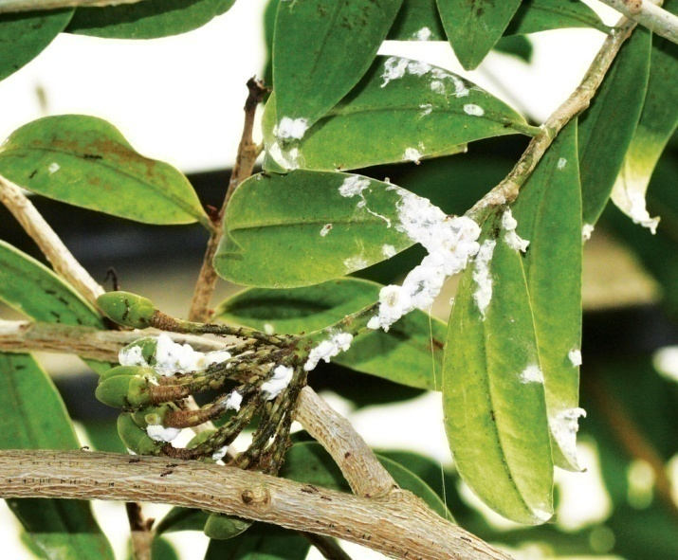
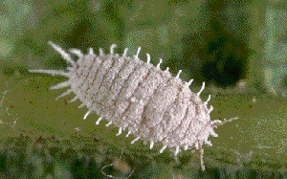
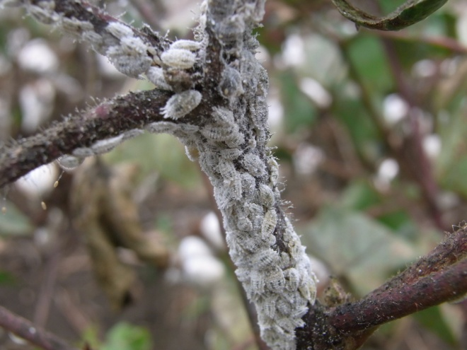
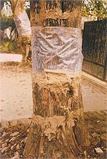
Insect pests of Fruit Crops Mango mealybug (Drosicha stebbingi ; Monophlebidae, Homoptera)
Host plants: Mango, Mulberry, Peaches, guava, fig, rose etc.
A destructive pest of Mango plant/ widely distribute in mango orchards in Pakistan.
Identification
Adult: Females are wingless, oval, flattend body covered with a white mealy powder
Males are dipterous with black forewings and hindwings modified as halteres and with crimson colored body.
Eggs: Pink clored minute egg (masses), which later on turns pale near maturity.
Pupa: Only occurs in Male lifespan.
Life history:
Life cycle: One year
Eggs: about 200 eggs/ female laid singly.
Nymph: 3 – 6 months
Pupa: 4 – 7 months (in soil near trunk)
No. Of generations per annum: One
Damage:
Active period: Jan. to June (Maxi. Population in Jan. to April)
After egg-laying adults die in June
Egg hatching in 2nd fortnight of December and nymphs
crawl up on the tree trunk in January and cluster around
twigs, shoots, leaves, inflorescence, young fruits etc.
De-saping of young foliage and sprouts, and tender leaves and twigs.
Retarded plant growth and pre-mature fruit falling

Slide 9
Control:
Regular ploughing of soil under tree trunk from May to November
Collection and desctruction of egg masses
Mealybug sticky traps on tree trunks
Chemical control
Imidacloprid (Confidor 200 SL, Bayer) 200ml
Profenophos (Curacron) 1000ml
Lambda-cyhalothrin+chlorpyriphos (Bolten, Swat agro) 500ml
Metrine (Legend 0.5 AS) 500 ml (Evyol)

Slide 10
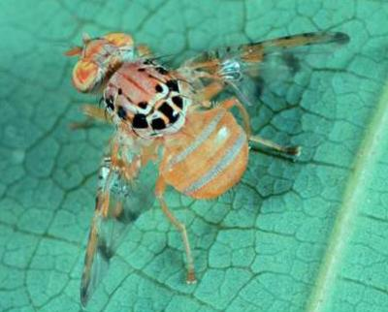
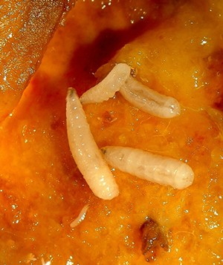
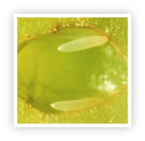
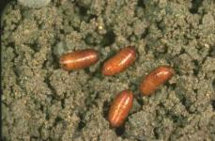
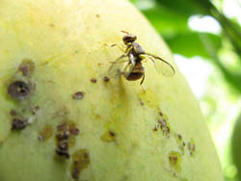
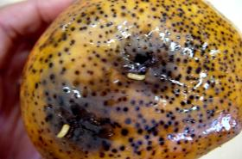
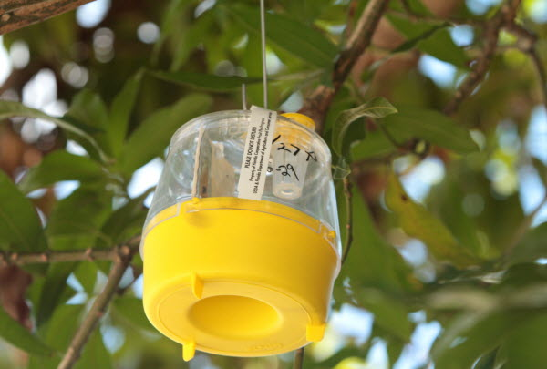
Insect pests of Fruit Crops Mango fruit fly (Ceratitis cosyra ; Tephritidae, Diptera)
Host plants: Mango, guava, ber, peach
A destructive pest of Mango plant/ fairly distributed in mango orchards
Identification
Adult: Brownish yellow with shinny black spots, wings are spotted
Eggs: Whitish yellow elongated eggs laid inside the mature green fruits.
Larvae: Apodous, creamy white maggots
Pupa: Yellowish brown in color (in 5-10 cm upper soil layer)
Life history:
Life cycle: 1 – 1.5 month
Adult: 4 – 5 days
Eggs: Hatching takes place in 2 – 3 days.
Larvae: One to two weeks
Pupa: 2-3 weeks
No. Of generations: 2 per year
eggs
Damage:
Active period: March to November
(Pupal hibernation: November to Feburary)
Maximum damage caused in August to November
Egg-laying in fruits by puncturing with ovipositors
Attacked fruit skin got rotten, giving strong smell
and contain several maggots later on.
Fruit quality deteriorate
Larvae
Pupae
Notes:
Mango Fruit fly (Ceratitis cosyra). The body and wing colour is yellowish, with black spots. Adult mediterrenean fruit flies are 4-6 mm long,The wings are spotted or banded with yellow and brown margins.
Fruit flies lay eggs under the skin of mature green and ripening fruit. Some fruit flies such as Bactrocera invadens, a new species recently introduced into East Africa, also lay eggs on small fruit. The eggs hatch into whitish maggots within 1 to 2 days. The maggots feed on the fruit flesh and the fruit starts to rot. After 4 to 17 days, the maggots leave the fruit, making holes in the skin. Adult fruit flies are about 4-7 mm long.

Slide 11
Control:
Plouging of soil under tree trunk
Regular removal and destruction of rottened and fallen fruits
Pheromone traps 10/A (methyl eugenol oil)
Poison traps (5 liter water+ 1.5 kg molasses + Triazophos 60ml) hanging in small cups
Chemical control
Spinosad+protein hydrolysate (GF-120, Arista ) 500ml
Tricholorphon (Dipterex 30 T 60, ICI) 100 grams
Malathion 250 ml+protein hydrolysate 500 (Bioguard plus, Evyol group)
Dimethoate (Danadim 40EC, Swat Agro) 330 grams)

