Slide 1
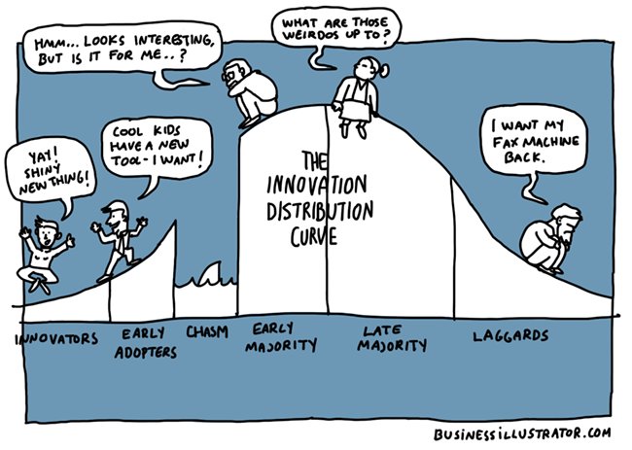
ADOPTER CATEGORIES

Slide 2
There are different categories of farmers. According to Rogers (1971), the farmers based on their innovativeness can be classified as:
1. Innovators
2. Early adopters
3. Early majority
4. Late majority
5. Laggards

Slide 3
Characteristics of farmers
All individuals in a social system do not adopt an innovation at the same time.
Rather, they adopt in an ordered time sequence, and they may be classified into adopter categories on the basis of when they first begin using a new idea.
In technology transfer program, it is of great practical utility for the extension workers to identify the individuals who are likely to adopt innovations early and who may lag behind.
The adoption of an innovation over time follows a normal, bell-shaped curve when plotted over time on frequency basis.

Slide 4
Continued…..
If the cumulative number of adopters is plotted, it results in an S-shaped curve.
The S-shaped curve rises slowly at first when there are few adopters in a time period, accelerate to a maximum when about half of the individuals in the system have adopted and then increases at a gradually slower rate as the few remaining individuals finally adopt (Fig. 1).
The S-shaped curve is like that of a 'learning curve' as propounded by the psychologists.
Each adoption in the social system is in a sense equivalent to a learning trial by an individual.

Slide 5
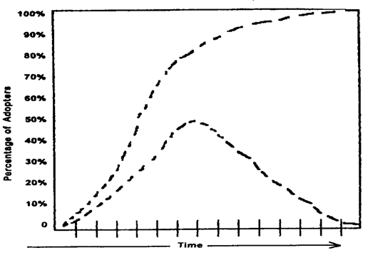
Fig.1 The bell shaped frequency curve and the S-shaped cumulative curve for adopter categories

Slide 6
Continued…..
Both of these curves are for the same data, the adoption of an innovation over time by the members of a social system.
But the bell-shaped curve shows these data in terms of the number of individuals adopting each year, whereas the S-shaped curve shows these data on cumulative basis.

Slide 7
Continued…...
The distribution of adopters over time closely approaches normality, and may be explained by the statistical concept of normal curve.
The distribution of the adopters may be partitioned into five adopter categories by using the mean (x) and standard deviation.
The area lying to the left of the mean time of adoption minus two standard deviations includes 2.5 per cent of the individuals who are the first to adopt an innovation and is known as innovators.
The next 13.5 per cent between the mean minus one standard deviation and the mean minus two standard deviations to adopt the new idea are called as early adopters.

Slide 8
Continued….
The next 34 per cent of the adopters between the mean date of adoption and minus one standard deviation are known as early majority.
Between the mean and one standard deviation to the right of the mean are located the next 34 per cent to adopt the new idea, the late majority.
The last 16 per cent to the right of mean plus one standard deviation are the last to adopt the innovation the laggards.
The five-adopter categories are conceptualized as ideal types and are presented in below figure.

Slide 9
Continued…..

Slide 10
Continued….
The innovativeness dimension, as measured by the time at which an individual adopts an innovation, is continuous.
However, this variable may be partitioned into five adopter categories by lying of standard deviations from the average time of adoption.

Slide 11
1:- Innovators
They are eager to try new ideas.
This interest leads them out of a local circle of peers and into more cosmopolite social relationships.
Communication patterns and friendships among a group of innovators are common; even though the geographical distance between the innovators may be great.
Being an innovator has several prerequisites.

Slide 12
Continued….
These include control of substantial financial resources to absorb the understand and apply complex technical knowledge.
He desires the hazardous, the rash, the daring, and the risky. The innovator also must be willing to accept an occasional setback when one of the new ideas he adopts proves unsuccessful.
These are the first people to adopt a new idea, much ahead of other people. They are very few in numbers, probably not more than one or two in a community.

Slide 13
Characteristics
Have larger farms.
Financially strong.
Willing to take risks.
Usually below middle age
Generally well educated
Have respect and prestige in progressive communities.
Mentally alert and actively seeking new ideas.
They have much formal and informal contact outside the immediate locality.
They often by-pass the local extension worker in getting information from the originating sources, and may learn about new things even before he does.
They sometimes manage to get samples of seeds or chemicals even before they are released for public use.
They subscribe to many farm magazines and specialized publications.
Other farmers may watch the innovators and know what they are doing.

Slide 14
2:- Early Adopter
Early adopters are a more integrated part of the local social system than are innovators.
Whereas innovators are cosmopolites, early adopters are localities.
This adopter’s category, more than any other, has the greatest degree of opinion leadership in most social systems.
Potential adopters look to early adopters for advice and information about the innovation.
The early adopter is considered by many as "the man to check with" before using a new idea.
This adopter category is generally sought by change agents to be a local missionary for speeding the diffusion process.

Slide 15
Continued….
Because early adopters are not too far ahead of the average individual in innovativeness, they serve as a role model for many other members of a social system.
Members of a social system respect the early adopter.
The early adopter is respected by his peers.
He is the embodiment of successful and discrete use of new ideas.
And the early adopter knows that he must continue to earn this esteem of his colleagues if his position in the social structure is to be maintained.

Slide 16
Characteristics
Younger than those who have a slower adoption rate, but not necessarily younger than the innovators
They are not the persons who test the untried ideas but they are quickest to use tried ideas in their own situations.
Have large farms and higher income.
Higher education than those who adopt more slowly.
They participate more in the format activities of the community.
They also participate more in government programs.
They read papers and farm journals and receive more bulletins than people who adopt later.
They may be regarded as community adoption leaders.

Slide 17
3:- Early Majority
The early majority adopts new ideas just before the average member of a social system.
The early majority interacts frequently with their peers, but leadership position; are rarely held by them.
The early majority's unique position; between the very early and relatively late to adopt make; them an important link in the diffusion process.
The early majority may deliberate for some time before completely adopting a new idea.
Their innovation-decision is relatively longer than that of the innovator and the early adopter.

Slide 18
Characteristics
Slightly above average in age, education and farming experience.
They take a few more farm journals and bulletins than the average.
They have medium high social and economic status.
Less active in formal groups than early adopters, but more active than those adopting later.
In many cases, they are not formal leaders in the association
They also attend extension meetings and farm demonstrations.
They associate mainly with people of their own community.
They value highly the opinions their neighbors and friends hold about them; for this is their main source of status and prestige.
They are mostly mentioned as "neighbors and friends" from whom the majority of farmers seek information.

Slide 19
4:- Late Majority
The late majority adopts new ideas just after the average member of a social system.
Adoption may be both an economic necessity and the answer to increasing social pressures.
Innovations are approached with a skeptical and cautions air, and the late majority do not adopt until most other in their social system have done so.
The weight of system norms must definitely favor the innovation before the late majority is convinced.
They can be persuaded of the utility of new ideas, but the pressure of peers is necessary to motivate adoption.

Slide 20
Characteristics
Those in this group have less education and are older than the early majority.
They form the major part of formal organizational membership, although they participate less in such formal groups.
They take fewer leadership roles than the earlier adopters.
They take and read fewer papers, magazines and bulletins, than the early majority.
They do not participate in as many activities outside the community as do people that adopt earlier.

Slide 21
5:- Laggards
Laggards are the last to adopt an innovation.
They possess almost no opinion leadership.
They are the most localite in their outlook of all adopter categories, many are near isolates.
Decisions are usually made in terms of what has been done in previous generations.
This individual interacts primarily with others who have traditional values.
When laggards finally adopt an innovation, it may already have been superseded by another more recent idea, which the innovators are already using.
Laggards tend to be frankly suspicious of innovations, innovators, and change agents.
Their tradition direction slows the innovation decision process.

Slide 22
Characteristics
Least education.
Older as compared to other groups
Participate least in formal organizations, cooperatives and government programs.
They hardly read farm magazines and bulletins.
don’t possess decision making abilities.
Very less land size and financially weak

