Slide 1
Requirements Management

Slide 2
The boundary between requirements development and requirements management

Slide 3
Changing requirements
The business and technical environment of the system always changes after installation.
New hardware may be introduced, it may be necessary to interface the system with other systems, business priorities may change, and new legislation and regulations may be introduced that the system must necessarily abide by.
The people who pay for a system and the users of that system are rarely the same people.
System customers impose requirements because of organizational and budgetary constraints. These may conflict with end-user requirements and, after delivery, new features may have to be added for user support if the system is to meet its goals.

Slide 4
Requirements management
Requirements management is the process of managing changing requirements during the requirements engineering process and system development.
New requirements emerge as a system is being developed and after it has gone into use.
You need to keep track of individual requirements and maintain links between dependent requirements so that you can assess the impact of requirements changes.
You need to establish a formal process for making change proposals and linking these to system requirements.

Slide 5
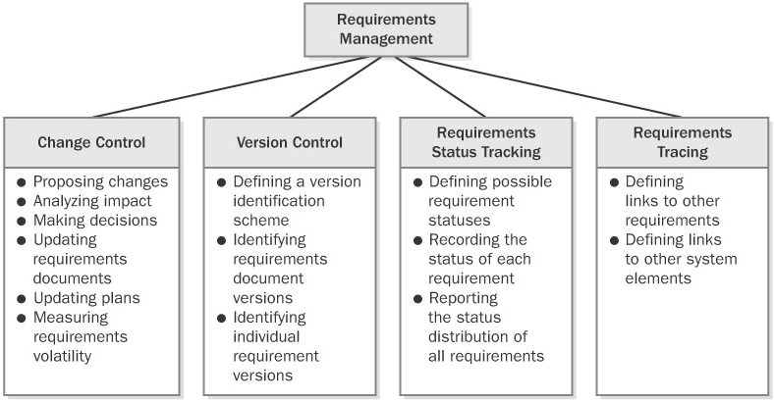
Major requirements management activities

Slide 6
Major requirements management activities
Controlling changes to the requirements baseline
Keeping project plans current with the requirements
Controlling versions of both individual requirements and requirements documents
Tracking the status of the requirements in the baseline
Managing the logical links between individual requirements and other project work products

Slide 7
Various ways of responding to new or changed requirements
A development team that accepts newly proposed requirements changes might not be able to fulfill its existing schedule and quality commitments.
The project manager must negotiate changes to those commitments with affected managers, customers, and other stakeholders.
The project can respond to new or changed requirements in various ways:
Defer lower-priority requirements
Obtain additional staff
Mandate overtime work, preferably with pay, for a short time
Slip the schedule to accommodate the new functionality
Let quality suffer in the press to ship by the original date (Too often, this is the default reaction.)

Slide 8
Requirements Version Control
"I finally finished implementing the multivendor catalog query feature," Shari reported at the Chemical Tracking System's weekly project status meeting. "Man, that was a lot of work!"
"Oh, the customers canceled that feature two weeks ago," the project manager, Dave, replied. "Didn't you get the revised SRS?"
Shari was confused. "What do you mean, it was canceled? Those requirements are at the top of page 6 of my latest SRS."
Dave said, "Hmmm, they're not in my copy. I've got version 1.5 of the SRS. What version are you looking at?"
"Mine says version 1.5 also," said Shari disgustedly. "These documents should be identical, but obviously they're not. So, is this feature still in the baseline or did I just waste 40 hours of my life?"

Slide 9
Requirements Version Control
Version control is an essential aspect of managing requirements specifications and other project documents.
Every version of the requirements documents must be uniquely identified.
Every team member must be able to access the current version of the requirements, and changes must be clearly documented and communicated to everyone affected.
To minimize confusion, conflicts, and miscommunication, permit only designated individuals to update the requirements and make sure that the version identifier changes whenever a requirement changes.

Slide 10
Requirements Version Control
Each circulated version of the requirements documents should include a revision history that identifies
the changes made,
the date of each change,
the individual who made the change, and
the reason for each change

Slide 11
Tracking Requirements Status
"How are you coming on that subsystem, Jackie?" asked Dave.
"Pretty good, Dave. I'm about 90 percent done."
Dave was puzzled. "Weren't you 90 percent done a couple of weeks ago?" he asked.
Jackie replied, "I thought I was, but now I'm really 90 percent done."

Slide 12
Tracking Requirements Status
Software developers are sometimes overly optimistic when they report how much of a task is complete.
They often give themselves credit for activities they've started but haven't entirely finished.
This tendency to overestimate progress leads to the common situation of software projects or major tasks being reported as 90 percent done for a long time.
Tracking the status of each requirement throughout development provides a more accurate gauge of project progress.

Slide 13
Requirement Statuses
Status | Definition
Proposed | The requirement has been requested by an authorized source
Approved | The requirement has been analyzed, its impact on the project has been estimated, and it has been allocated to the baseline for a specific release. The key stakeholders have agreed to incorporate the requirement, and the software development group has committed to implement it.
Implemented | The code that implements the requirement has been designed, written, and unit tested. The requirement has been traced to the design and code elements.
Verified | The correct functioning of the implemented requirement has been confirmed in the integrated product. The requirement has been traced to relevant test cases. The requirement is now considered complete.
Deleted | An approved requirement has been removed from the baseline. Include an explanation of why and by whom the decision was made to delete it.
Rejected | The requirement was proposed but is not planned for implementation in any upcoming release. Include an explanation of why and by whom the decision was made to reject it.

Slide 14
Change Control
Uncontrolled change is a common source of project chaos, schedule slips, and quality problems, especially on multisite and outsourced development projects.
An organization that's serious about managing its software projects must ensure that
Proposed requirements changes are carefully evaluated before being committed to.
Approved changes are communicated to all affected participants.
The project incorporates requirements changes in a consistent fashion.

Slide 15
Change Control
Unless project stakeholders manage changes during development, they won't really know what will be delivered, which ultimately leads to an expectation gap.
The closer you get to the release date, the more you should resist changing that release because the consequences of making changes become more severe.

Slide 16
Managing Scope Creep
Creeping requirements
include new functionality and significant modifications that are presented after the project requirements have been baselined.
Capers Jones (1994) reports that creeping requirements pose a major risk to
80 percent of management information systems projects.
70 percent of military software projects.
45 percent of outsourced software projects
The requirements for management information systems typically grow about 1 percent per month (Jones 1996)

Slide 17
Managing Scope Creep
Some requirements evolution is legitimate, unavoidable, and even advantageous.
Business processes, market opportunities, competing products, and technologies can change, and management might determine that redirecting the project in response is necessary.
Uncontrolled scope creep,
in which the project continuously incorporates new functionality without adjusting resources, schedules, or quality goals, is more harmful.
A small modification here, an unexpected enhancement there,
and soon the project has no hope of delivering what the customers expect on schedule and with acceptable quality.

Slide 18
Managing scope creep steps
The first step in managing scope creep is
to document the vision, scope, and limitations of the new system as part of the business requirements
Evaluate every proposed requirement or feature against the business objectives, product vision, and project scope.
Engaging customers in elicitation reduces the number of requirements that are overlooked, only to be added to the team's workload after commitments are made and resources allocated (Jones 1996).
Prototyping is another effective technique for controlling scope creep (Jones 1994).
A prototype provides a preview of a possible implementation, which helps developers and users reach a shared understanding of user needs and prospective solutions.
Using short development cycles to release a system incrementally provides frequent opportunities for adjustments when requirements are highly uncertain or rapidly changing (Beck 2000)

Slide 19
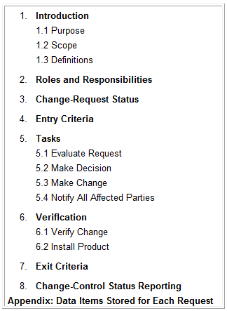
Change Control Process template

Slide 20
Change Control Process Roles and Responsibilities
Role
CCB Chair | Chairperson of the change control board; generally has final decision-making authority if the CCB does not reach agreement; selects the Evaluator and the Modifier for each change request
CCB | The group that decides to approve or reject proposed changes for a specific project
Evaluator | The person whom the CCB Chair asks to analyze the impact of a proposed change; could be a technical person, a marketing person, or a combination
Modifier | The person responsible for making changes in a work product in response to an approved change request
Originator | Someone who submits a new change request
Request Receiver | The person to whom new change requests are submitted
Verifier | The person who determines whether the change was made correctly

Slide 21
The Change Control Board (CCB)
The change control board (sometimes known as the configuration control board) has been identified as a best practice for software development (McConnell 1996).
The CCB is the body of people, be it one individual or a diverse group,
who decides which proposed requirement changes and newly suggested features to accept for inclusion in the product.
The CCB also decides which reported defects to correct and when to correct them.
Many projects already have some de facto group that makes change decisions;
establishing a CCB formalizes this group's composition and authority and defines its operating procedures.

Slide 22
CCB Composition
The CCB membership should represent all groups who need to participate in making decisions within the scope of that CCB's authority. Consider selecting representatives from the following areas:
Project management
Requirements analyst
Development
Testing or quality assurance
Marketing or customer representatives
User documentation
Technical support or help desk
Configuration management
Only a subset of these people need to make the decisions, although all must be informed of decisions that affect their work.
The same handful of individuals will fill several of these roles on small projects, and other roles won't need to examine every change request

Slide 23
CCB: Decisions Making
As with all decision-making bodies, each CCB needs to select an appropriate decision rule and process (Gottesdiener 2002).
The decision-making process description should indicate the following:
The number of CCB members or the key roles that constitutes a quorum for making decisions
Whether voting, consensus, or some other decision rule is used
Whether the CCB Chair may overrule the CCB's collective decision
Whether a higher level of CCB or someone else must ratify the decision

Slide 24
CCB: Communicating Status
Once the CCB makes its decision,
a designated individual updates the request's status in the change database.
Some tools automatically generate e-mail messages to communicate the new status to the originator who proposed the change and to others affected by the change.
If e-mail is not generated automatically, inform the affected people manually so that they can properly process the change.

Slide 25
CCB: Renegotiating Commitments
It's not realistic to assume that stakeholders can stuff more and more functionality into a project that has schedule, staff, budget, and quality constraints and still succeed.
Before accepting a significant requirement change, renegotiate commitments with management and customers to accommodate the change (Humphrey 1997).
You might negotiate for more time or staff or ask to defer pending requirements of lower priority.
If you don't obtain some commitment adjustments, document the threats to success in your project's risk list so that people aren't surprised if the project doesn't fully achieve the desired outcomes.

Slide 26
Requirements Traceability
Requirements tracing, documents the dependencies links between individual requirements and other system elements.
These elements include
other requirements of various types,
business rules,
architecture and other design components,
source code modules,
test cases, and
help files.
Traceability information facilitates impact analysis by helping you identify all the work products you might have to modify to implement a proposed requirement change.

Slide 27
Requirements Traceability
Traceability links allow you to follow the life of a requirement both forward and backward, from origin through implementation
To permit traceability, each requirement must be uniquely labeled so that you can refer to it unambiguously throughout the project.
Write the requirements in a fine-grained fashion, rather than creating large paragraphs containing many individual functional requirements

Slide 28
Four types of requirements traceability
Customer needs are traced forward to requirements,
so you can tell which requirements will be affected if those needs change during or after development.
This also gives you confidence that the requirements specification has addressed all stated customer needs
Conversely, you can trace backward from requirements to customer needs to identify the origin of each software requirement.

Slide 29
Four types of requirements traceability
As requirements flow into downstream deliverables during development, you can trace forward from requirements by defining links between individual requirements and specific product elements.
This type of link assures that you've satisfied every requirement because you know which components address each one.
The fourth type of link traces specific product elements backward to requirements
so that you know why each item was created.

Slide 30
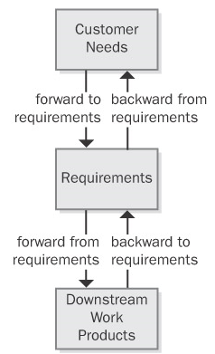
Four types of requirements traceability

Slide 31
Four types of requirements traceability
Suppose a tester discovers unexpected functionality with no corresponding written requirement.
This code could indicate that a developer implemented a legitimate implied requirement that the analyst can now add to the specification.
Alternatively, it might be "orphan" code, that doesn't belong in the product.
Traceability links —traced back to—can help you sort out these kinds of situations and build a more complete picture of how the pieces of your system fit together.
Conversely, test cases that are derived from individual requirements provide a mechanism for detecting unimplemented requirements because the expected functionality will be missing.

Slide 32
Traceability links
Traceability links help you keep track of parentage and dependencies among individual requirements.
This information reveals the propagation of change that can result when a specific requirement is deleted or modified.
If you've mapped specific requirements to tasks in your project's work-breakdown structure, those tasks will be affected when a requirement is changed or deleted.

Slide 33
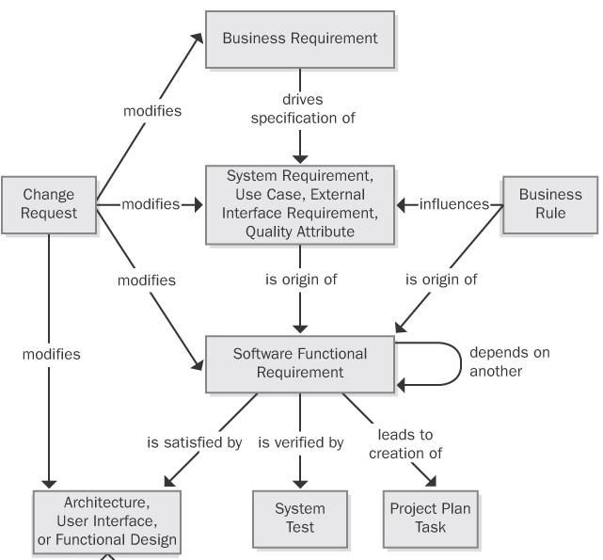
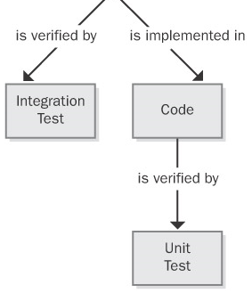
Types of traceability relationships

Slide 34
Requirements Traceability Matrix

Slide 35
Cardinality between system elements
One-to-one One design element is implemented in one code module.
One-to-many One functional requirement is verified by multiple test cases.
Many-to-many Each use case leads to multiple functional requirements, and certain functional requirements are common to several use cases.
Similarly, a shared or repeated design element might satisfy a number of functional requirements.
Ideally, you'll capture all these interconnections, but in practice, many-to-many traceability relationships can become complex and difficult to manage.

Slide 36
Two way traceability matrix

