Slide 1
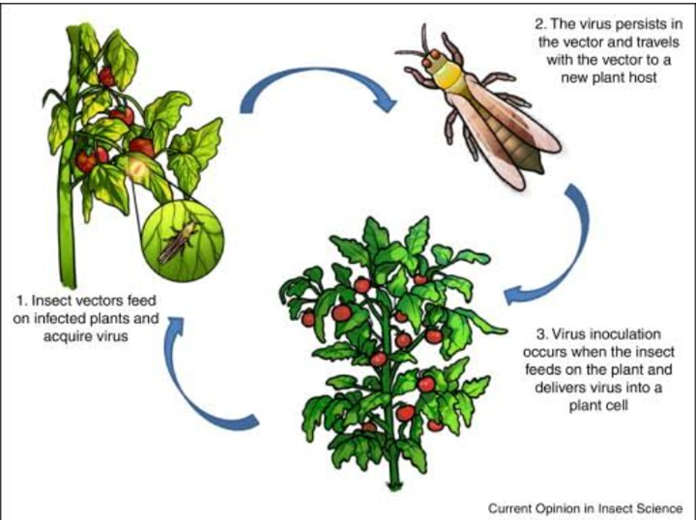
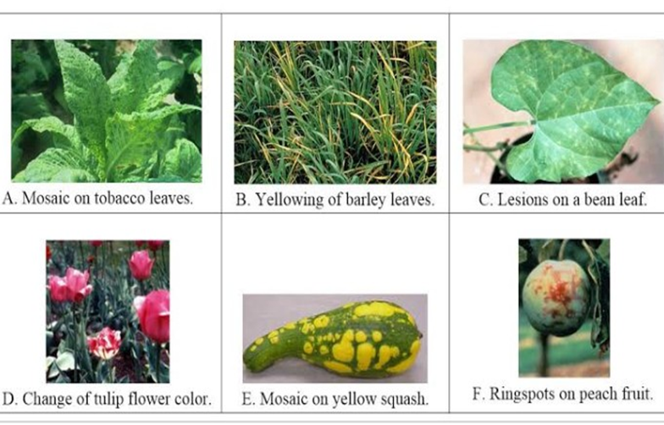
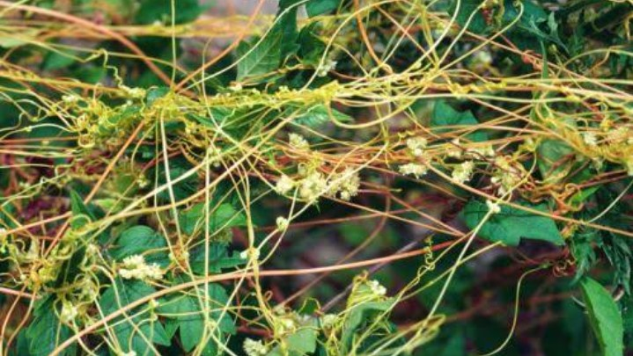
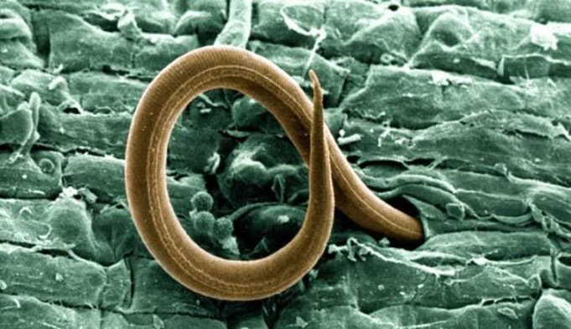
Viral transmission

Slide 2
Content
Introduction
History
Features
Chemical composition of plant viruses
Types of viral transmission
No of ways of viral transmission
Plant viruses symptoms
Protection
Conclusion

Slide 3
Introduction
Plant pathology:study of plant diseases including the reasons of diseases called plant pathology.
Plant viruses: viruses that effect the plants are called plant viruses .
Plant viruses are pathogenic to higher plants
These are normally insects a few are fungi
Plant viruses are harmless to human and other organisma.

Slide 4
History
Beijerinck (1987) coined the Latin name “VIRUS” meaning poisons .
He studied filtered plant juices and found they caused healthy plant to become sick.
Wendell Stanely (1935) crystallised sap from sick tobacco plants.
He discovered viruses were made of nucleic acid and proteins .

Slide 5
Features
Outside is a protein coat
Consist of a single nucleic acid.
Non living and non cellular structure.
Non cellular sub microscopic entity.
Most viruses infect only SPECIFIC host.
May be transmitted by pollens

Slide 6
Chemical composition of plant viruses
Protein (capsid)
Capsomeres
Nucleic acid
DNA: ssDNA ,dsDNA
RNA: +VE strand RNA ,_ve strand RNA ,ssRNA , dsRNA

Slide 7
Types of viral transmission
There are two types of plant virus transmission .
Horizontal transmission
Transmission by vector ,human pruning shears and tools or by direct external contamination iscalled horizontal transmiossion .
Vertical transmission
Vertical transmission occurs when a plant gets its from its parent plants .either through asexual propagation via cutting or sexual reproduction via infected seed .

Slide 8
WAYS OF VIRUS TRANSMISSION
Transmission of viruses by vegetative propagation
Mechanical transmission of viruses through sap
Transmission by seeds
Transmission of viruses by pollens
Transmission of viruses by dodder.
Transmission by vector
Insect transmission
Mite transmission
Nematode transmission
Fungus transmission.

Slide 9
Transmission by vegetative propagation
Plants are propagated vegetative by budding ,grafting,by cutting ,by the use of tubers,corms ,bulbs or rhizoms.
Any virus present in mother cell from which these organs are taken will almost always be transmitted to the progeny.
Transmission of viruses may also occurs through natural root grafts of adjacent plant.

Slide 10
Non propagative transmission
Insect which bite or suck plant tissues are the ideal means of transmitting viruses to new host .this is known as non propagative transmission .

Slide 11
Transmission through sap
This is usually accomplished by grinding the leaves of a diseased plant and rubbng the infectious sap on the leaf of a healthy plant .
When strong wind injures the leaves of adjacent diseased and healthy plant
Or when plants are wounded during cultural practices by tools,hands or clothes
Or by animals feedings on the plants
Sap carrying viruses is transmitted to healthy plant.

Slide 13
Transmission by pollens
Viruses transmitted by pollens may infect not only the seed but also the seedling the grow from it .
Cross pollination by pollen from virus infected plants may infect the seeds and the seedling that will grow from it.
In some case can be spread through the fertilized flower down into the mother plant
Eg: .tomato and tobacco black ring viruses.

Slide 15
Transmission by vectors
Insect transmission
Mite transmission
Nematode transmission
Fungus transmission

Slide 16
Insect transmission
Most common and economically most important means of transmission is insect transmission.
Eg:Grapevine virus A
Turnip yellow mosaic virus

Slide 17
Seed Transmission
Result in reduced fruit set,may infect seed and seedling.
In some cases spread through the fertilized flower into mother plant.
Eg :sour cherry with prunus necrotic ring spot virus.

Slide 18
Mite Transmission
Mite of family Eriophyidae is known as gall mites, .
These mites have piercing and sucking mouth parts.
Eg : Wheat streak mosaic virus

Slide 19
Nematode Transmission
Tranmitted by feeding on roots of infected plants.
or
Moving on to the roots of a healthy plants
Transmit at least two viruses including tobraviruse ,tobacco rattle
Eg: nematode of genra Trichodorus

Slide 20
Fungal transmission
Transmitted by zoo spores of root infecting fungus and fungul like organisms.
Eg:
tobacco necrosis type viruses
Single strand RNA genome

Slide 21
Transmission through dodder
Several plant viruses can be transmitted from one plant to another plant through the bridge formed between the two plants by twining stem of parasitic plant called dodder transmission .
Eg: cuscuta species
Green strain of cucumber mosaic viruse.

Slide 22
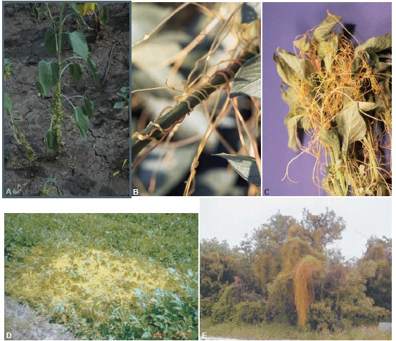
Dodder transmission

Slide 23
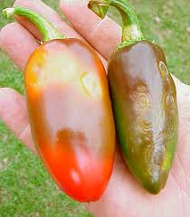
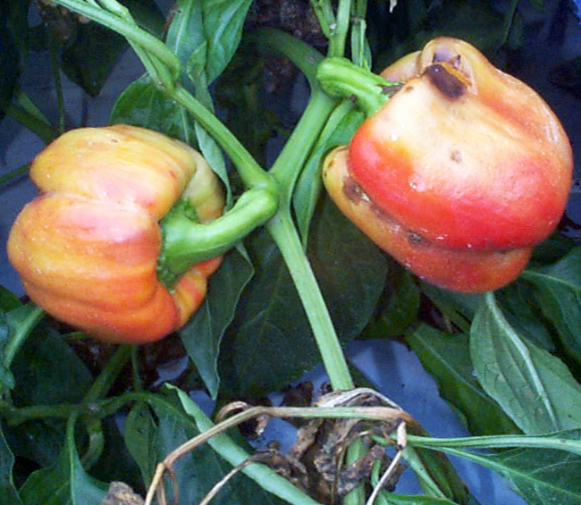
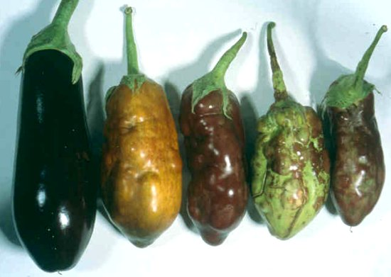
Plant viruses symptoms
Mosaic
Mottle
Yellowing
Chlrosis
Vein clearing
Vein bending
Necrosis
Wilt
Ring spot
Stunting

Slide 24
Protection
Discard virus infected plants
Purchase virus free plants
Remove all crop debris from benches and the green house structure
Remove all weeds since these may be harbor both virusesand insects.
Maintain strict viruses and mite control

Slide 25
Conclusion
Plant viruses and viroid are unusual groups of plant pathogens that infect and cause disease in many crop plants.
Because these pathogens depends on normal cellular machinery of their plant host for their reproduction ,it is difficult to eliminate them without damaging the host plant.

Slide 26
