Slide 1
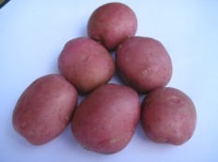
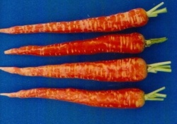
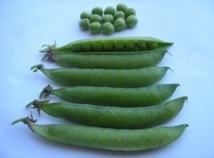
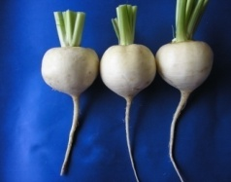
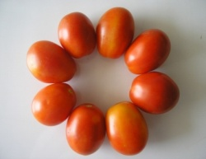
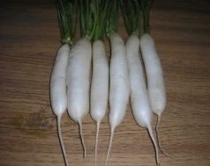
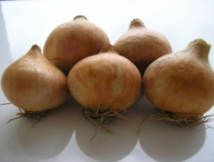
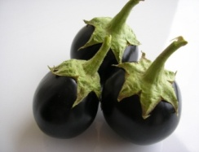
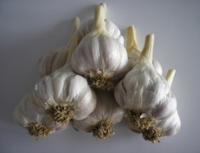
Horticulture?
HORT-201
University College of Agriculture,
University of Sargodha

Slide 2
Plant Environment

Slide 3
Plant Environment
includes
Climate
Light
Temperature
Soil
Nutrition
Water
Air

Slide 4
Light
Sunlight
ultimate source of energy
Plants
convert Solar E to Chem E by photosynthesis
Other process effected
Seed germination
Vegetative & reproductive Morphology

Slide 5
Definitions
Ways of light movement
Waves
Discrete particles
Wave Length
Distance between successive (consecutive) trough and crest of a wave
Frequency
Number of crest in a given point in a unit time
WL prop to I/F
Increase in Frequency cause decrease in Wavelength
Short waves so high frequency high energy
Long waves so low frequency low energy
Visible light
Portion of the electro magnetic spectrum which human eye is sensitive
Range 380-760 nm
Sensitivity range 550 nm
PAR (photo synthetically active radiation)
Lies with in visible portion of spectrum
50% radiation receive on earth is in visible WL
Air filters allows visible light & restrict the penetration of high energy waves

Slide 6
Light Measurement
Light meter
To check exposure for photography
Foot candle (ft-c)
Light from rounded candle on one ft² surface of candle
One foot square surface from the candle
Lumen lm/m² :
Lumen per square meter
Metric unit of light lux (lx) =one lm/m²
I ft-c=10.76 lx
Full sunlight is summer is about 10,000 ft-c or 10,8000 lux
Full moonlight is 1/50 ft-c
20 ft-c is enough for reading
40W florescent Tube emits 25 lx
Wide use ft-c & lux (simple, low cost instruments )

Slide 7
Radiant energy is measured and expressed variously. A light meter used to
determine the proper exposure time for photography is familiar to all of us.
A foot-candle (ft-c) is defined as the illuminance from a standard candle received
on a one-foot square surface one foot from the candle. This has been
replaced by a more reproducible reference unit, called one lumen (lm) per
square foot. The metric unit of light is the lux (Ix), which is defined as one
lumen per square meter. Thus, one ft-c equals 10.76 lux. A few examples
from everyday life are: full sunlight at noon in summer is about 10,000 ft-c
or 108,000 lux; full moonlight is about 1/50 ft-c. About 20 ft-c is considered
adequate for r~ading; a 40W florescent tube emits about 25 lux.
The ft-c and lux have been widely used by researchers because of the
simplicity and availability of low-cost measuring instruments. The trend in
agricultural research is to express radi~nt energy in terms of PAR, which is
the part of the spectrum primarily absorbed by chlorophyll molecules. It is
measured by sensitive instruments and expressed in ffiicro-einsteins per
square meter per second (!lE m-2 sec-I) in the wavelength range of
400-700 nm. An einstein (E) is the energy in one mole, or Avogadro's
number (6.02 x 1023) of photons. In Pakistan, we are fortunate to have
ample sunshine throughout the year. Light is never considered to be a
limiting factor in the cultivation of horticultural crops in this country.

Slide 8
Plant Responses to Light
Photomorphogenic responses
Photoperiodism
Photoperiodism is the developmental response of plants to the relative lengths of light and dark periods.
Relative length of light and dark effecting plant growth and development (bloom)

Slide 9
, \\\
Flowering
Tuber/bulb formation
Dormancy/rest period
Relative length of light and dark effecting plant growth and development (bloom)

Slide 10
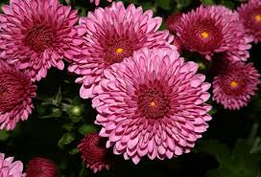
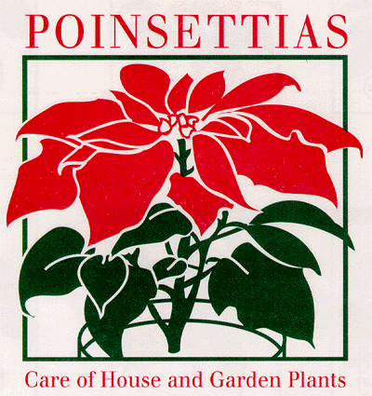
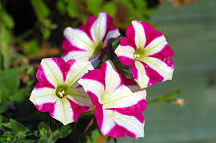
Flowering
Short day plant
Day length less than 12hrs. e.g Chrysanthemum, poinsettia, etc
Long day plants
Day length greater than 12hrs. e.g Spinach, beets, and reddish
Day neutral plant
Independent of day length. e.g petunia, tomato, rose, etc

Slide 11
Tuber and bulb formation
Flowering, tuberization, and bulb formation evolved for common function.
Reproduction
Survival in unfavorable condition.
Bulb & tuber
storage organs.
more development with light stimulus.
Tuber formation under short day formation
Flowering in potato in long day
Onion bulb requires long photoperiods(12-15hrs)
Onion flowering also requires Long day Photoperiods
Both bulb formation and flowering are long-day responses in onion

Slide 12
Bud dormancy
In deciduous trees, BD is directly related to shortening of days during late summer and before the onset of cold winter weather.
More daylight break dormancy in spring
Most deciduous trees broke dormancy through chilling or cold hours

Slide 13
Transpiration
Loss of water vapor through the stomata
Stomata open in light
Closed in dark
So it directly depend upon light
Cactus ; open stomata at night and closed at day

Slide 14
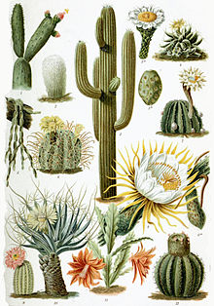

Slide 15
Seed germination
Requires light stimulus
Seed germinate when soil is disturbed. e.g. Lettuce
Seed absorbs water in dark, a few germinate
If exposed to red light (660 nm) than 100% germinate then far red light reversed red light exposure
Some cucurbit spp. germination inhibited by light

Slide 16
Phototropism
Response of plant growth to light
Bending towards light then +ve phototropism (shoot)
Bending against light then –ve phototropism (root)
Polarity is even found in embryonic tissue of radicle and plumule

Slide 17
Transpiration
Loss of water vapor through stomates
Control uptake/distribution of water, minerals, and gases
Light effects both directly and indirectly
Direct
In C3 plants stomates open during day (light) and closed during night (dark)
In some succulents (cacti) stomates open in night in closed during day.
Mechanism of CO₂ fixation occur in dark and formed organic acids called Crassulacean-Type metabolism, it is common in Crassulaceae and other succulents.
Indirect
By determining leaf temp.
Leaves absorb PAR but transmit and reflect IR with strong heating effect.
Of light absorbed only fraction is used for photosynthesis most is converted to heat.

Slide 18
