Slide 1
Sociology ^{BBA} Semester: 3rd ^{Lecture No. 08} ^{Instructor: Mumtaz Hussain} University of Sargodha Sb Campus ^{Bhakkar}

Slide 2
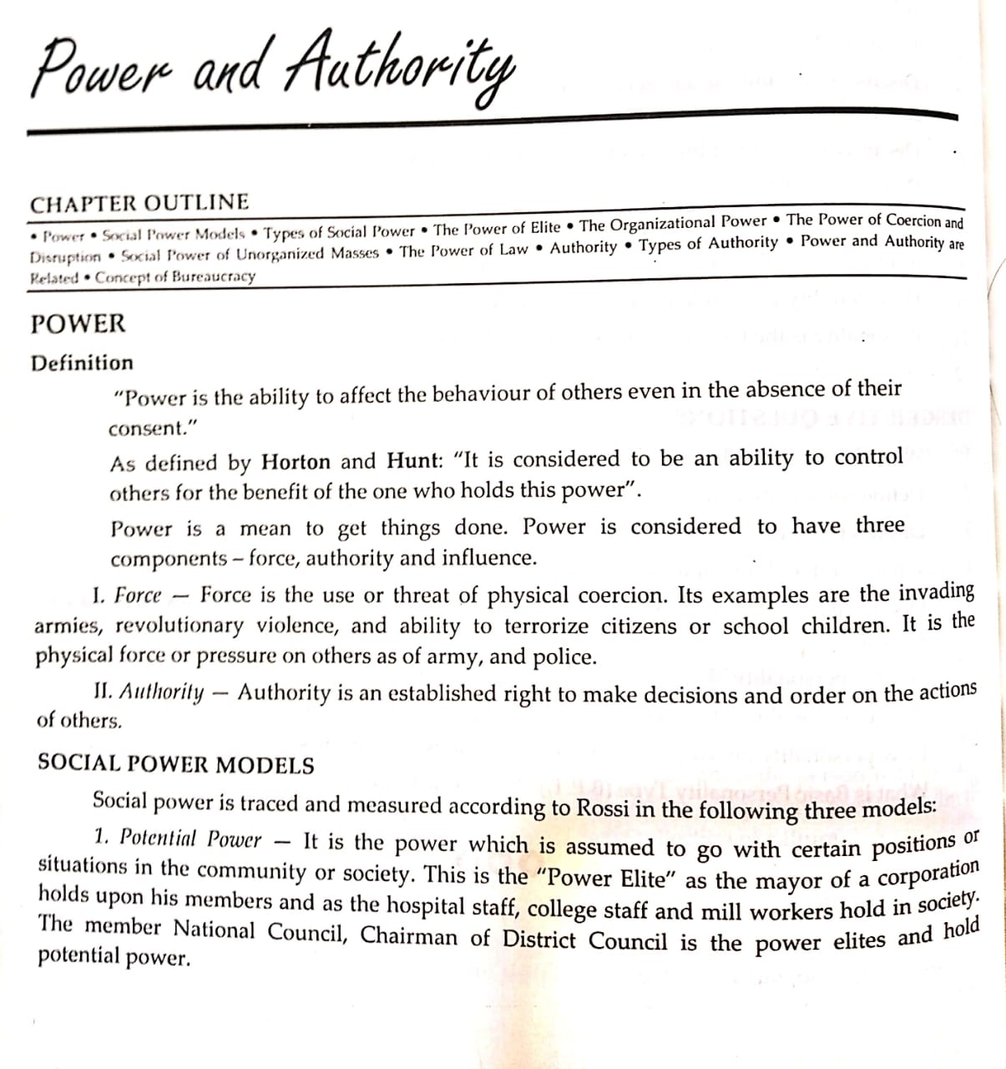

Slide 3
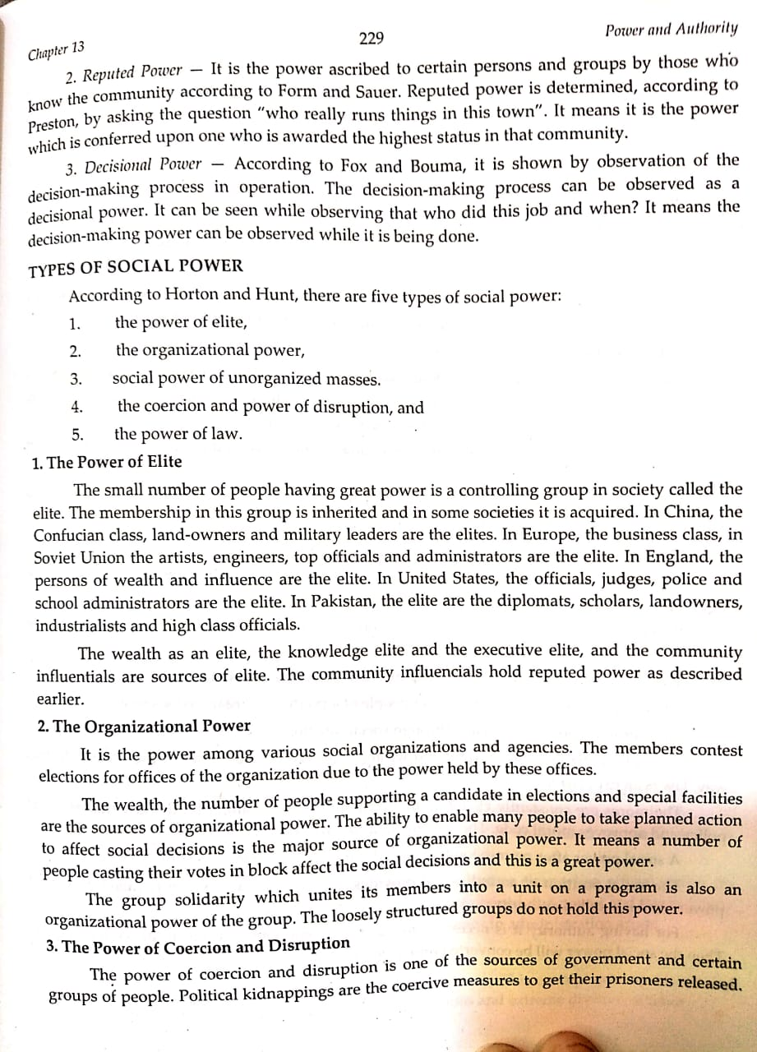

Slide 5
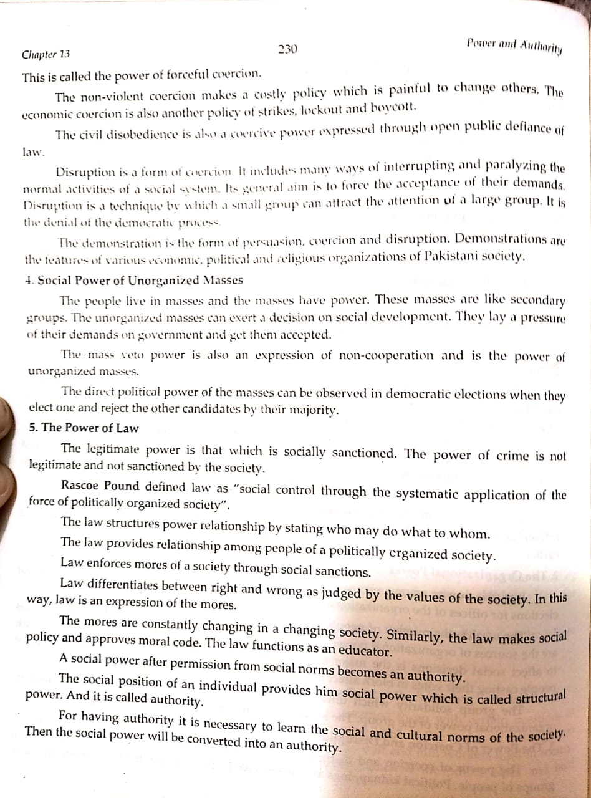

Slide 7
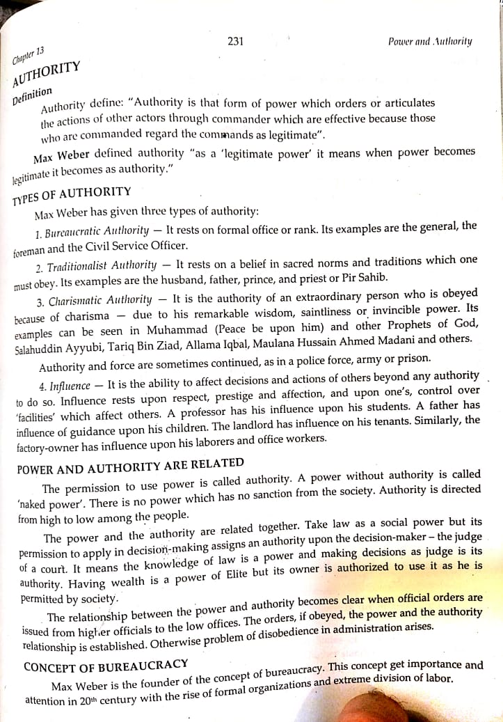

Slide 10
Thank You

