Slide 1
Comparsion b/w popular CASE tools Presented to:mr.Abdul ghaffar khan Presented by:aRooba Sultan tiwana BSEf17e028

Slide 2
Here ,different CASE tools are compared according to their unique characteristics.i-e upper CASE ,lower CASE and intermediate CASE tools.

Slide 3
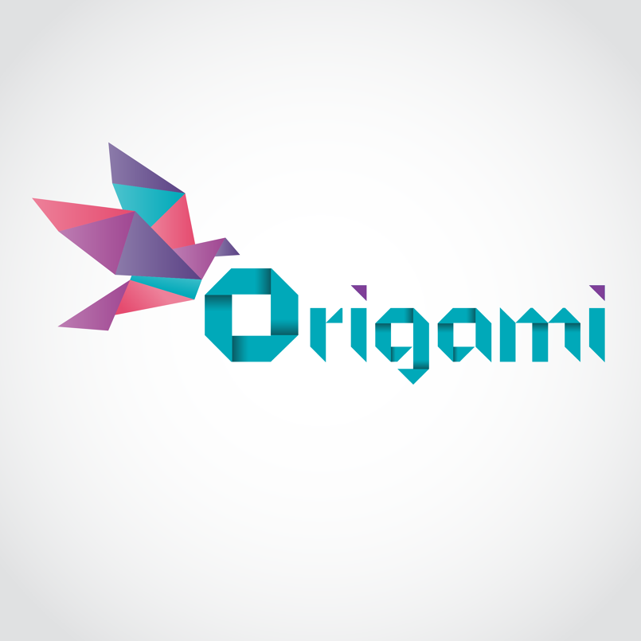
VS
Prototyping tools

Slide 4
Comparison b/w popular prototyping CASE tools
InVision
Origami Studio
Invision offers a free plan to anyone that is limited to one project, but after one free project it provides different paid offers like $25/month.
Invision works as an all-in-one environment for product design and unfortunately it does not integrate with other tools. This may be a nuisance for teams that want to integrate different tools in their workflow.
Origami is available for Mac as well as for android.
Origami is offered to the public completely free, no monthly plans, no upfront cost alongwith live session facility.
Sketch and Photoshop designs can be imported into Origami, and your project layers will be preserved, ready to be linked, animated and transformed as needed.
Origami plugin for Quartz Composer, which is built by Apple. Therefore, Origami is only available for Mac.

Slide 5
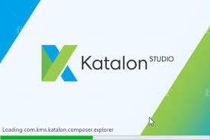
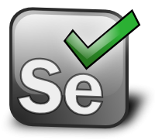
VS
Testing tools

Slide 6
Comparison b/w popular testing CASE tools
Katalon Studio
Selenium
Users could be the testers with limited technical knowledge. Katalon Studio provides friendly UI with the manual mode.
Katalon Studio is released with pre-defined sets of commonly used keywords or actions, users will easily start implementing most test cases.
Katalon Studio provides intuitive reports with friendly and readable messages and captured screenshots at the time of failure which can be exported into CSV, HTML and PDF files.
Selenium is more suitable for testers who possess good programming skills. They will typically need to use an IDE like Eclipse or Visual Studio, to import Selenium libraries.
Selenium users have to build common and reusable actions on their own in forms of programming functions.
Selenium does not have reporting tools themselves, but based provides some simple report templates.

Slide 7
VS
Management tools

Slide 8
Comparison b/w popular management CASE tools
JIRA
Appian
It’s the most versatile and trending tool with a lot of features and no user interface restrictions.
JIRA provides the unique features like compatibility testing,deployment management and debugging.
JIRA provides reports and analytics in user friendly and easily understandable format.
JIRA has a complete control on source .
Appian is the popular software management tool with features like collaboration tools and mobile development but has many UI restrictions.“
Appian does not provides the features like compatibility testing,deployment management and debugging that’s a major drawback.
Appian does not provide reports and analytics in user friendly and easily understandable format.
Appian hasn’t a control on source .

Slide 9
THANKS
☺

