Slide 1
Chlorofluorocarbons and its effects.

Slide 2
Chlorofluorocarbons (CFCs) are organic compounds that is a hydrocarbons which encompass of carbon, chlorine, and fluorine, formed as volatile byproduct of methane, ethane, and propane.
The utmost common symbolic of CFC’s are dichlorodifluoromethane or R-12 or Freon-12.
They are utilized for the manufacturing of aerosol sprays, blowing agents used for foams and packing materials, solvents, and also as refrigerants.

Slide 3
Properties of CFC’s
As similar to alkanes, carbon in the CFCs make bonds with tetrahedral symmetry. Since the fluorine and chlorine atoms change significantly in size and actual charge from hydrogen, the methane-derived CFCs diverge from tetrahedral symmetry.
The CFCs have larger boiling points as the chloride is more polarizable than fluoride
https://goo.gl/cB2Z4M

Slide 4
The CFCs are very less combustible than methane, which is because they have fewer C-H bonds.
The concentrations of CFCs are greater than to the corresponding alkanes.
Commonly the density of the compounds correlates with the amount of chlorides.

Slide 5
` Function and Application of CFC’s
CFCs and HCFCs are used in a several applications because of their low toxic, reactive and flammable nature.
Every variation of fluorine, chlorine and hydrogen based on methane and ethane has been inspected and most of them have been commercialized.
Billions of kilograms of chlorodifluoromethane are manufactured yearly as precursor to tetrafluoroethylene, the monomer which is converted into Teflon.

Slide 6
Impact of CFC’s Environment
CFCs were scaled backed through the Montreal Protocol because of their part in ozone depletion.
Yet, the atmospheric impacts of CFCs are not controlled to its function as an active ozone reducer.
This anthropogenic composite is also a greenhouse gas, with a much greater potential to increase the greenhouse effect than carbon dioxide.

Slide 7
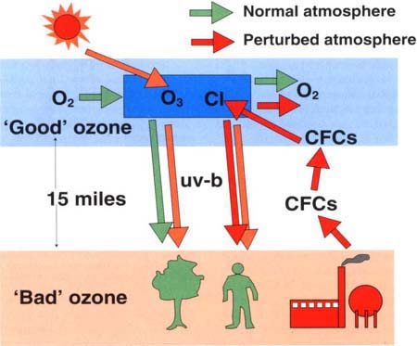

Slide 8
Impact of CFC’s Environment
CFCs are less likely to have any direct effect on the environment in the instant vicinity of their release.
At a global level however, releases of CFCs have critical environmental after effects.

Slide 9
Various Environmental effects of CFC’s
Ozone depletion
Chlorofluorocarbons (CFCs) and hydrofluorocarbons (HCFCs) are man-made compounds and halons eradicate ozone in the upper atmosphere i.e. stratosphere.
The stratospheric ozone layer is that makes life possible by protecting and shielding the earth from destructive ultraviolet (UV-B) rays produces from the sun.
Diminished concentration of stratospheric ozone allows to amplify the amounts of UV-B to spread the earth's surface.

Slide 10
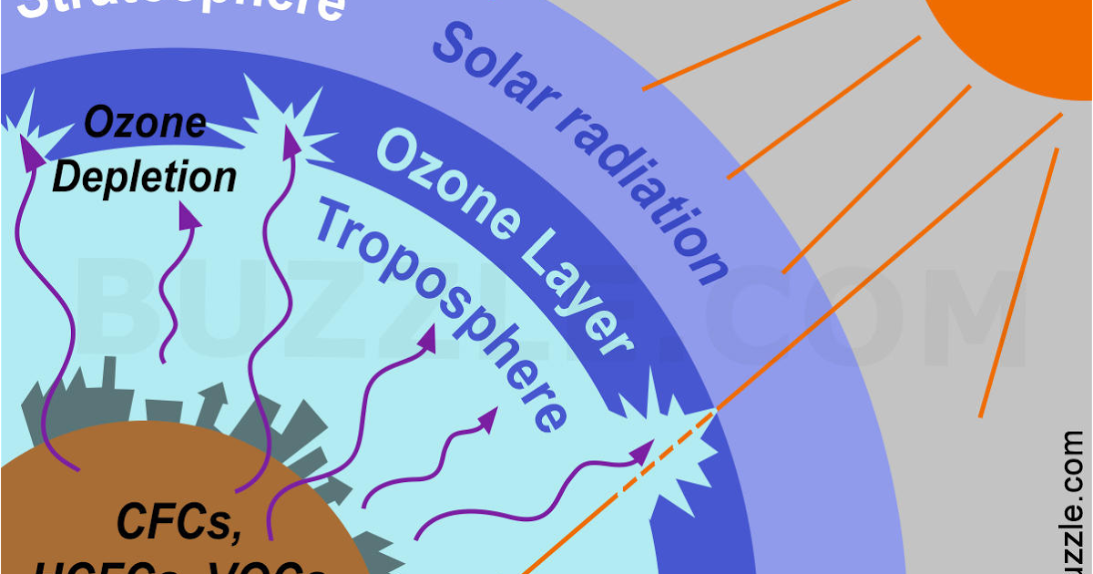

Slide 11
Various Environmental effects of CFC’s
Stratospheric ozone damage can effect in harm to human health and to the environment, including:
Increased in occurrence of skin cancer and cataracts
Immune system impairment
Demolition to terrestrial and aquatic plant life
Formation of ground-level ozone pollution

Slide 12
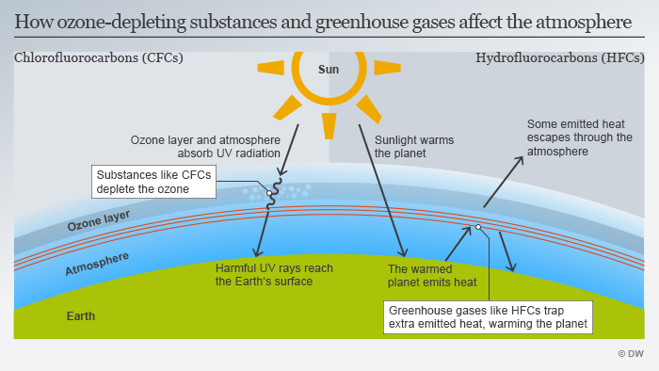

Slide 13
Climate change
When acting to destroy ozone, CFCs and HCFCs also act to trap heat in the lower atmosphere, making the earth warm and changing the climate and weather.
HFCs, that originally were industrialized to substitute CFCs and HCFCs, also soaks and trap ultraviolet radiation or heat in lesser atmosphere of the earth. HFCs, CFCs and HCFCs are a subgroup of a large group of climate changing gases called greenhouse gases (GHGs).
Put together greenhouse gases are probable to warm the planet with 2.5-8 degrees Fahrenheit by the end of century.
https://

Slide 14
