Slide 1
Grafting

Slide 2
A technique in which two living parts of different plants are joined together
Graft has two portion
1) stock (rootstock)
2) Scion ( more then one bud)

Slide 3
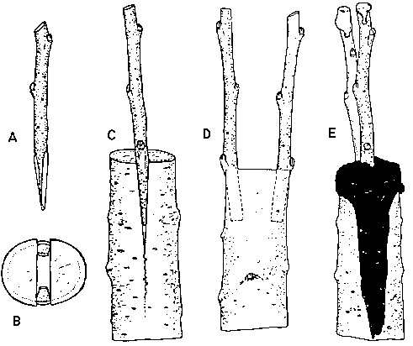
1. The Cleft Graft

Slide 4
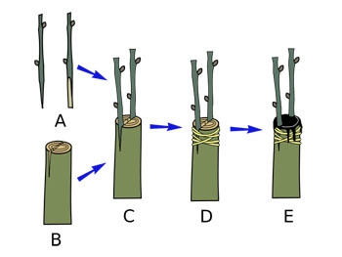

Slide 5
Cleft Grafting
One the oldest method
Mostly used for fruit plant propagation
Rootstock diameter grater then scion
Usually done late dormant season or just before the start of active growth season
Indicated by swelling

Slide 6
Procedure
Cut off the top of the stock about 30 minutes before grafting.
Split the rootstock with a blade or chisel.
Hold the split open and prepare the scions by cutting one end to a “v” shape.
Place one scion on each side to fit with the cambium.
Tape the split area together

Slide 7
2. Bark graft (veneer graft)
Bark grafting is similar to cleft grafting
Sometimes preferred to cleft because no splitting of stock.
and preventing entry of decay organisms
Done in spring
Scion should be dormant
If stock is thick, many scions can be inserted

Slide 8
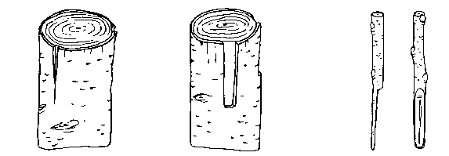

Slide 9
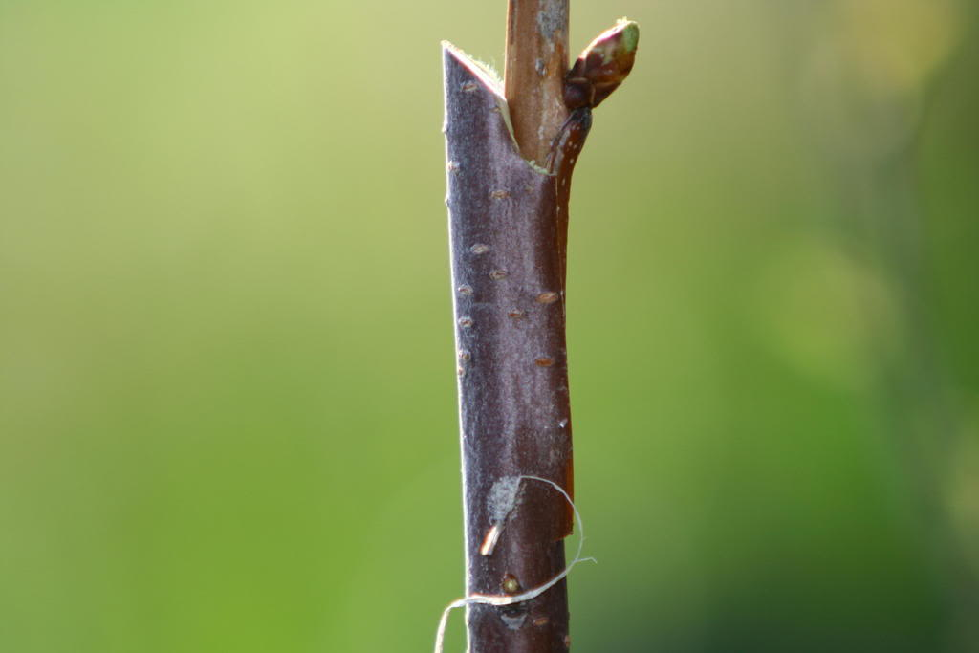

Slide 10
Procedure
Bark is split downward
Prepare the scion by cutting a pattern into the basal end.
Make matching pattern cuts on the rootstock.
Insert scion and secure it to the rootstock with a grafting band or tape.

Slide 11
3. Side graft
thickness of R/S is more as compare to scion
Insertion of scion base about 2.5 cm under the bark of R/S
The plant or branch that will serve as the stock should be between 1 and 2 inches in diameter.
The scion should be about 1/4 inch in diameter.
The scion is inserted into the side of the stock, which is generally larger in diameter than the scion.

Slide 13
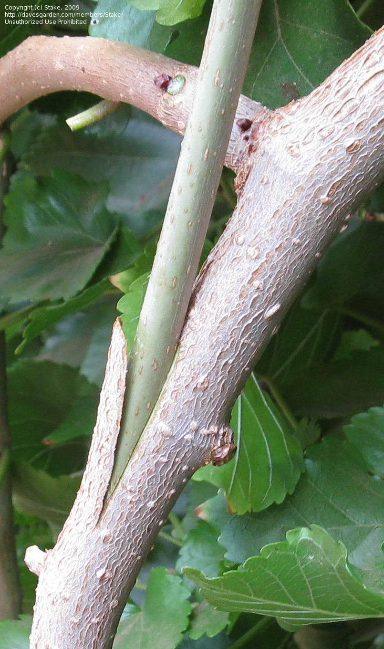
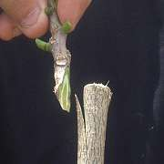

Slide 14
4. Inarching (Approach grafting)
R/S brought near to scion
Then a thin slice of bark about 20 cm above the ground is removed
Similar cut made on scion
Cambium layer of R/S and Scion exposed
These cuts brought together and tied firmly with the help of polythene strip

Slide 15
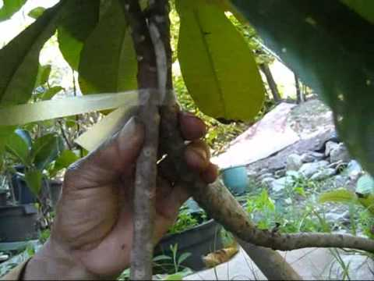
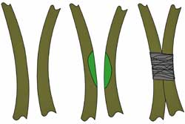

Slide 16
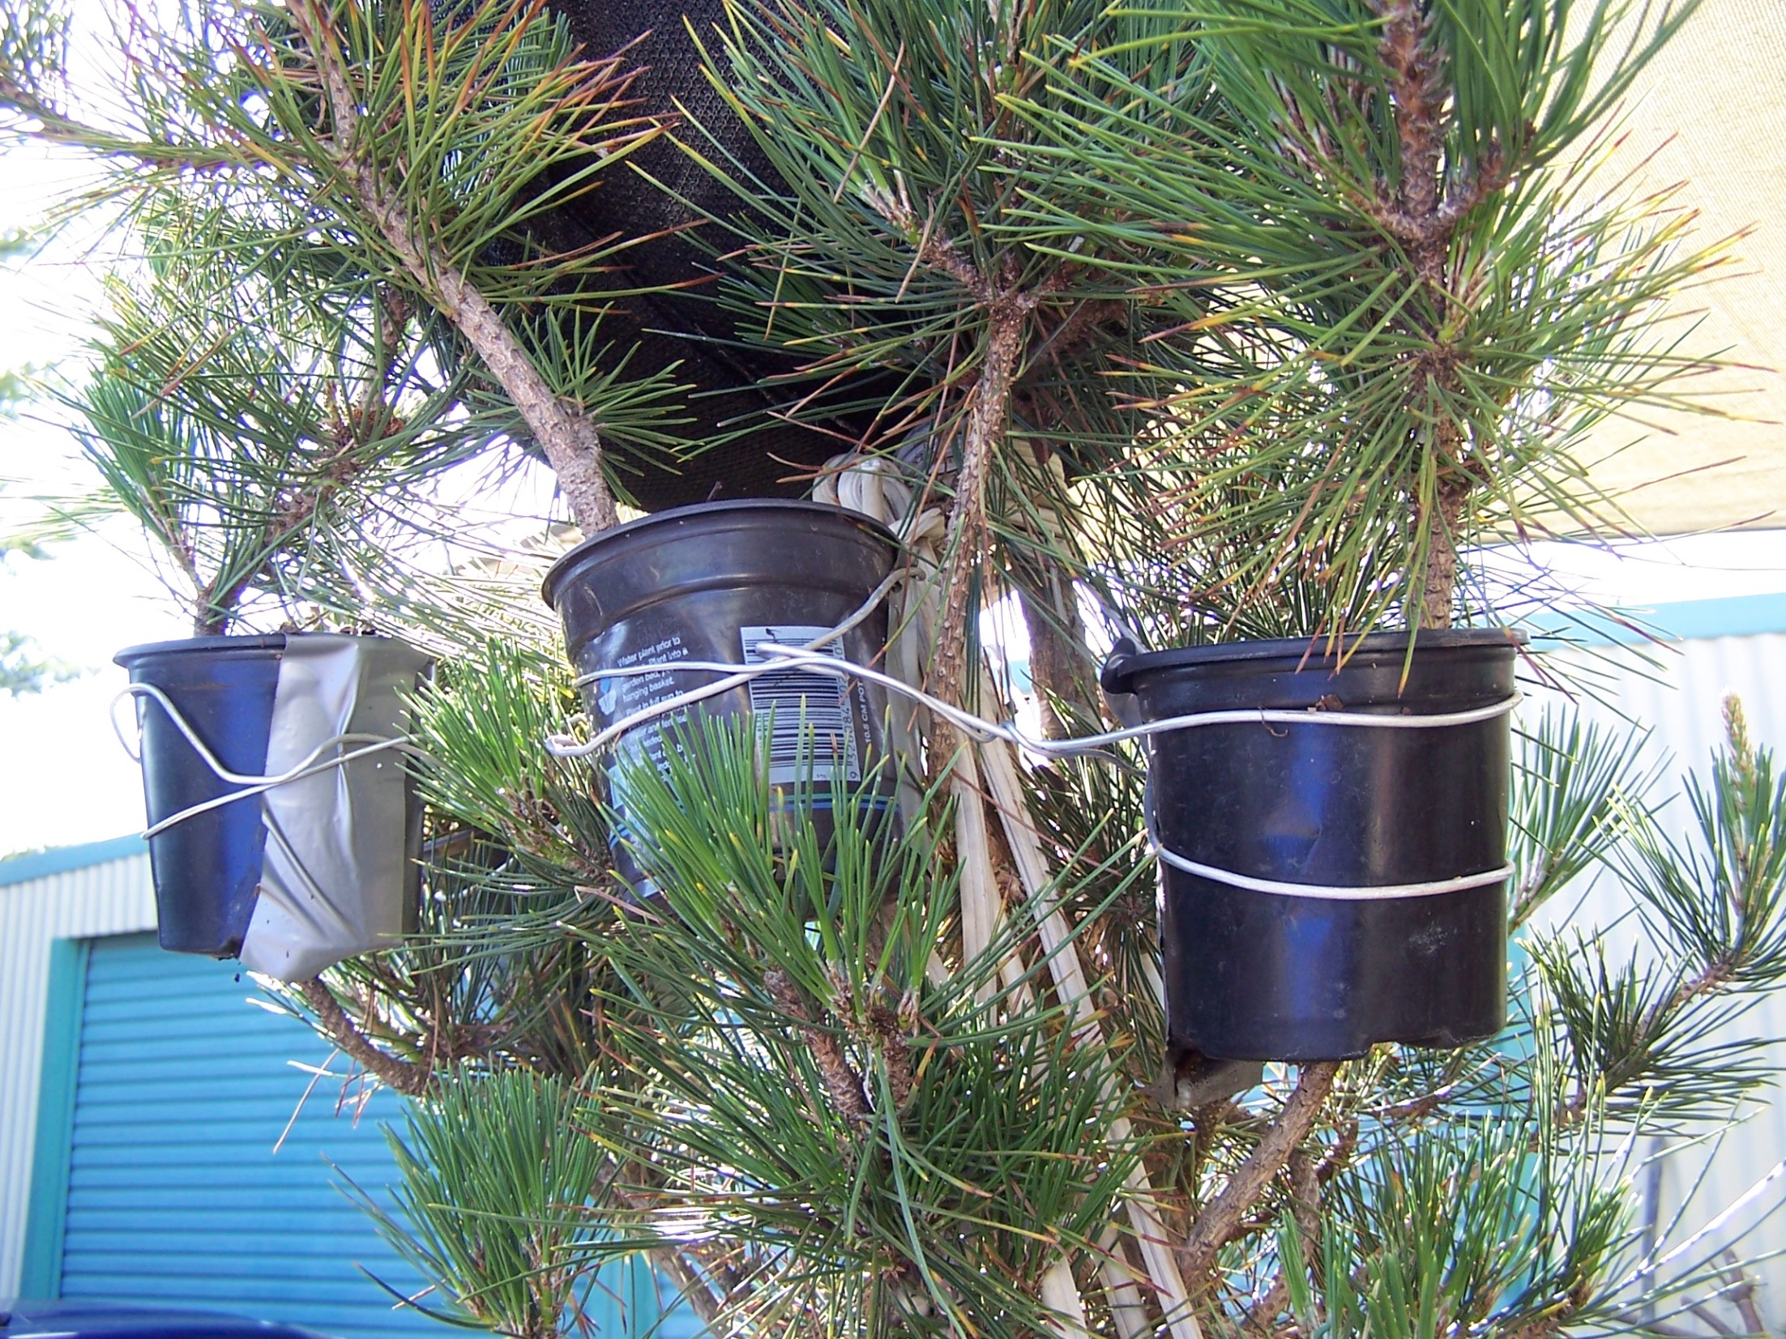

Slide 17
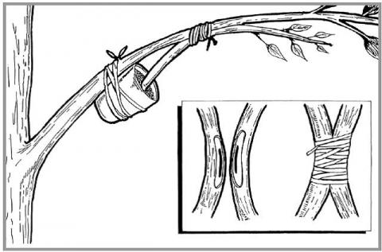

Slide 18
Old plants are usually selected as scion
Selection of scion tree is very important factor
In heavy rainfall area it should be done soon after rainy season is over

Slide 19
5. Splice or whip grafting
Very simple method
Popular method
Scion and stock must be of same diameter
One year old rootstock is used at height of 23-25cm from ground level
Same slanting cut is made on both R/S and scion
Bound with polythene tape

Slide 20
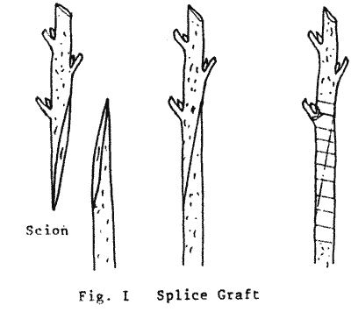

Slide 21
6. Tongue grafting
Modified form of whip grafting
Different in sense that a tongue is added to the cut surface to provide better filling and rigidity.
Shallow cut is given on both stock and scion
Interlock easily
Provide better success because three surface of cambium layers are involved in union.

Slide 22
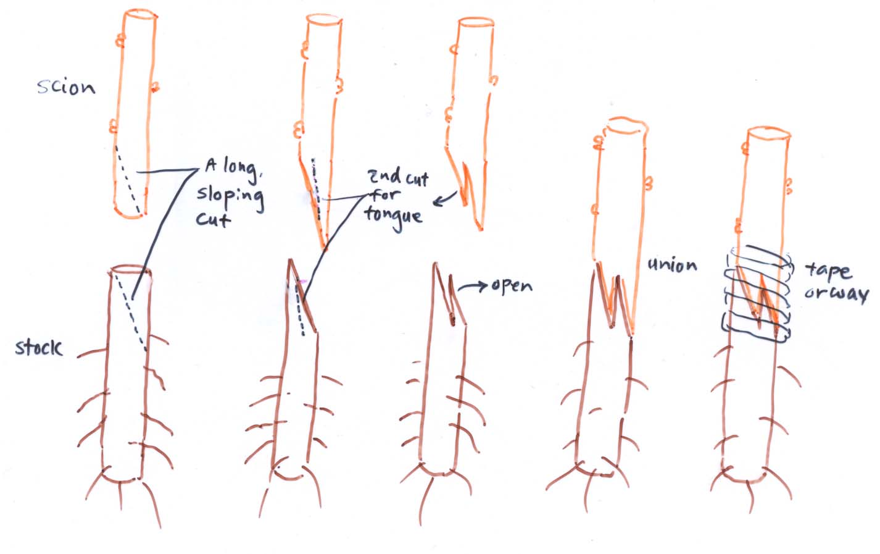
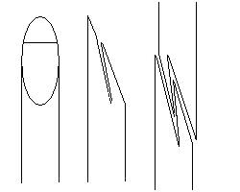

Slide 23
7. Veneer grafting
Very simple
One year old R/S used
Usually terminal or next to terminal shoots of desired scion are ideal.
Slanting cut given to scion
On R/S firstly slanting cut is given and then oblique cut at the base of first cut so that a piece of wood along with bark is removed.

Slide 24
